Slide 1
welcome

Slide 2
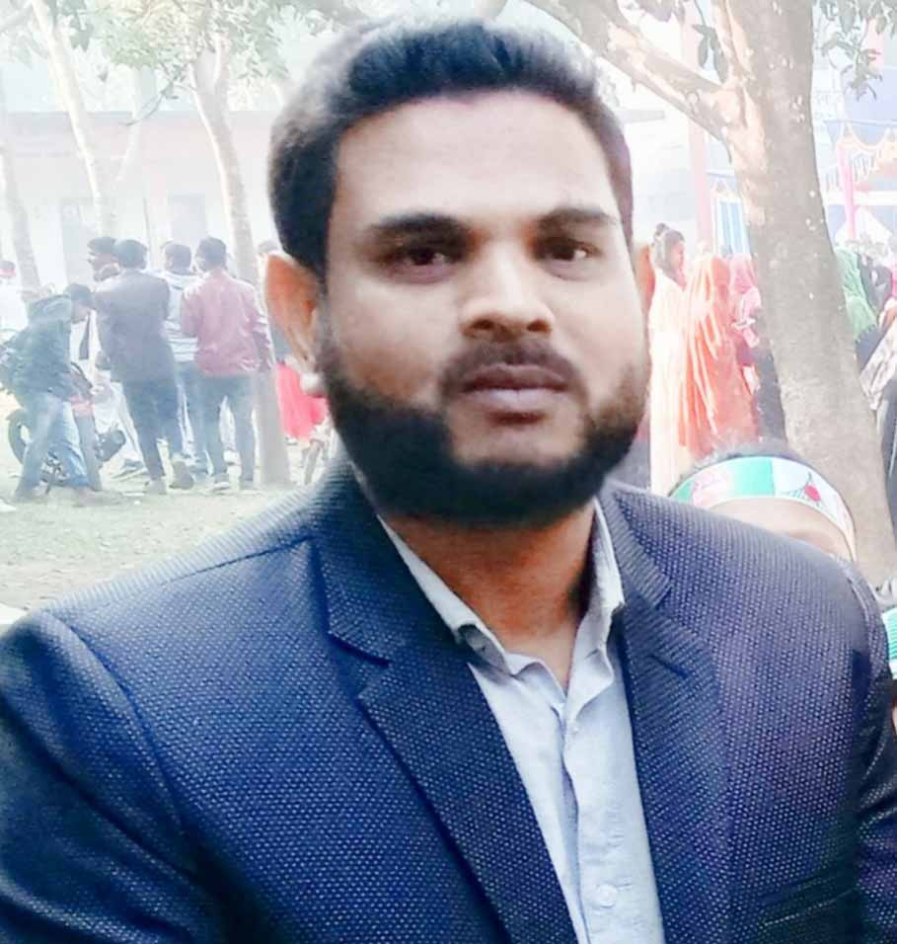
Presented By
Md.Hafizur Rahman
Assistant Teacher
Haripur Government Primary School
Haripur , Thakurgaon .
Phone: 01716437086
Email:hafizict5@gmail.com

Slide 3
Lesson Identity
Subject : English For Today
Class: Five
Date: 19-04-2022

Slide 4
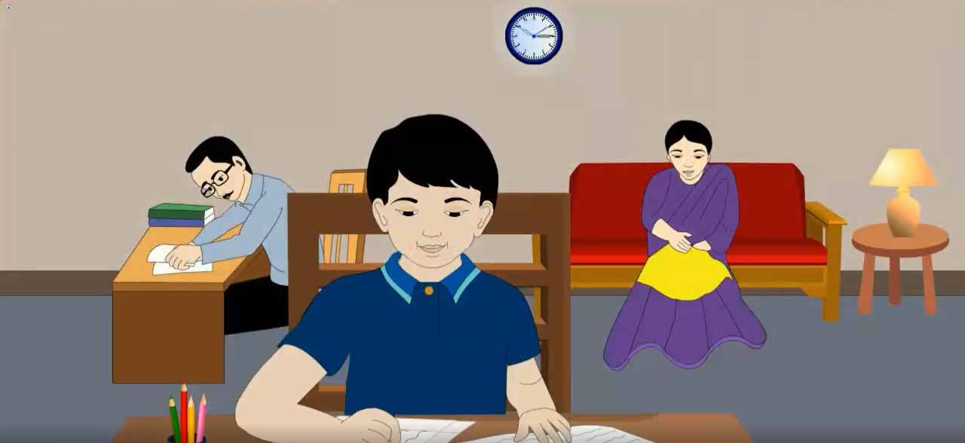
Let’s see the picture
What do you see in the picture?
Yes , A family

Slide 5
What are they doing?
They are doing different things.

Slide 6
Todays lesson
Saikat’s Family
Unit: 3
Lesson: 1-2
Page No. 10

Slide 7
Learning Outcomes
Student will be able to
Listening:
I .4.1- recognize and use intonation patterns for Yes/No and Wh questions.
I .3. I- recognize which words in a sentence are stressed
3.4. I- understand statements made by the teacher and student.
Speaking
1.1.1: Say words, phrases and sentences with proper sound and stress.
1.1.2: Say sentence with proper intonation.
3.2.1- understand questions about family and friends of students
3.1.1- ask and answer Wh questions.
Reading
1.6.1- recognize and read statements, commands, greetings, questions and answers.
I .5.1- read silently with understanding text

Slide 8
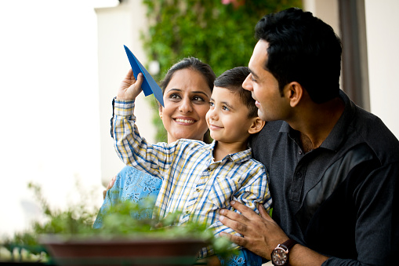
Some new word’s of the lesson.
father and mother
Parents
পিতা মাতা
She lives with her parents.

Slide 9
Some new word’s of the lesson.
pleasure
Enjoy
উপভোগ করা
Let’s enjoy the game

Slide 10
Some new word’s of the lesson.
To use a needle to pass thread through pieces of fabric
Sew
সেলাই করা
I like to sewing in my free time.

Slide 11
Some new word’s of the lesson.
In great quantities
Often
প্রায়
She often gets order from her neighbour

Slide 12
Some new word’s of the lesson.
Improve
To make better
উন্নতি করা
I want to improve my English.

Slide 13
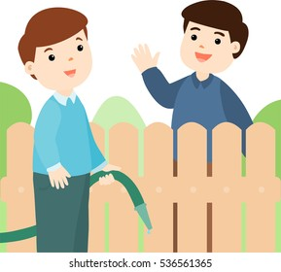
Some new word’s of the lesson.
A person who lives near another
Neighbour
প্রতিবেশি
I love my neighbor.

Slide 14
Some new word’s of the lesson.
In a special manner
Especially
বিশেষভাবে
Especially I like to play cricket

Slide 15
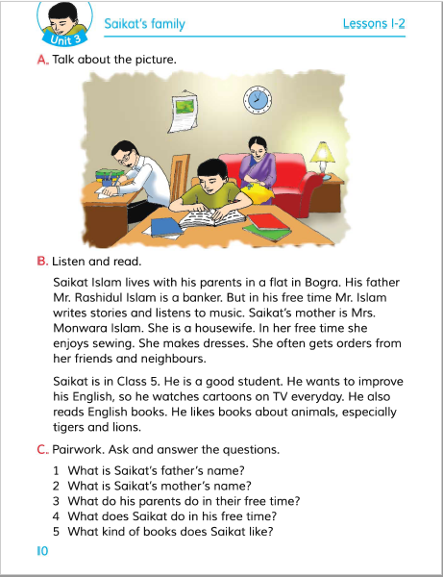
Teacher speaking loudly
Open your book and turn to page 10

Slide 16
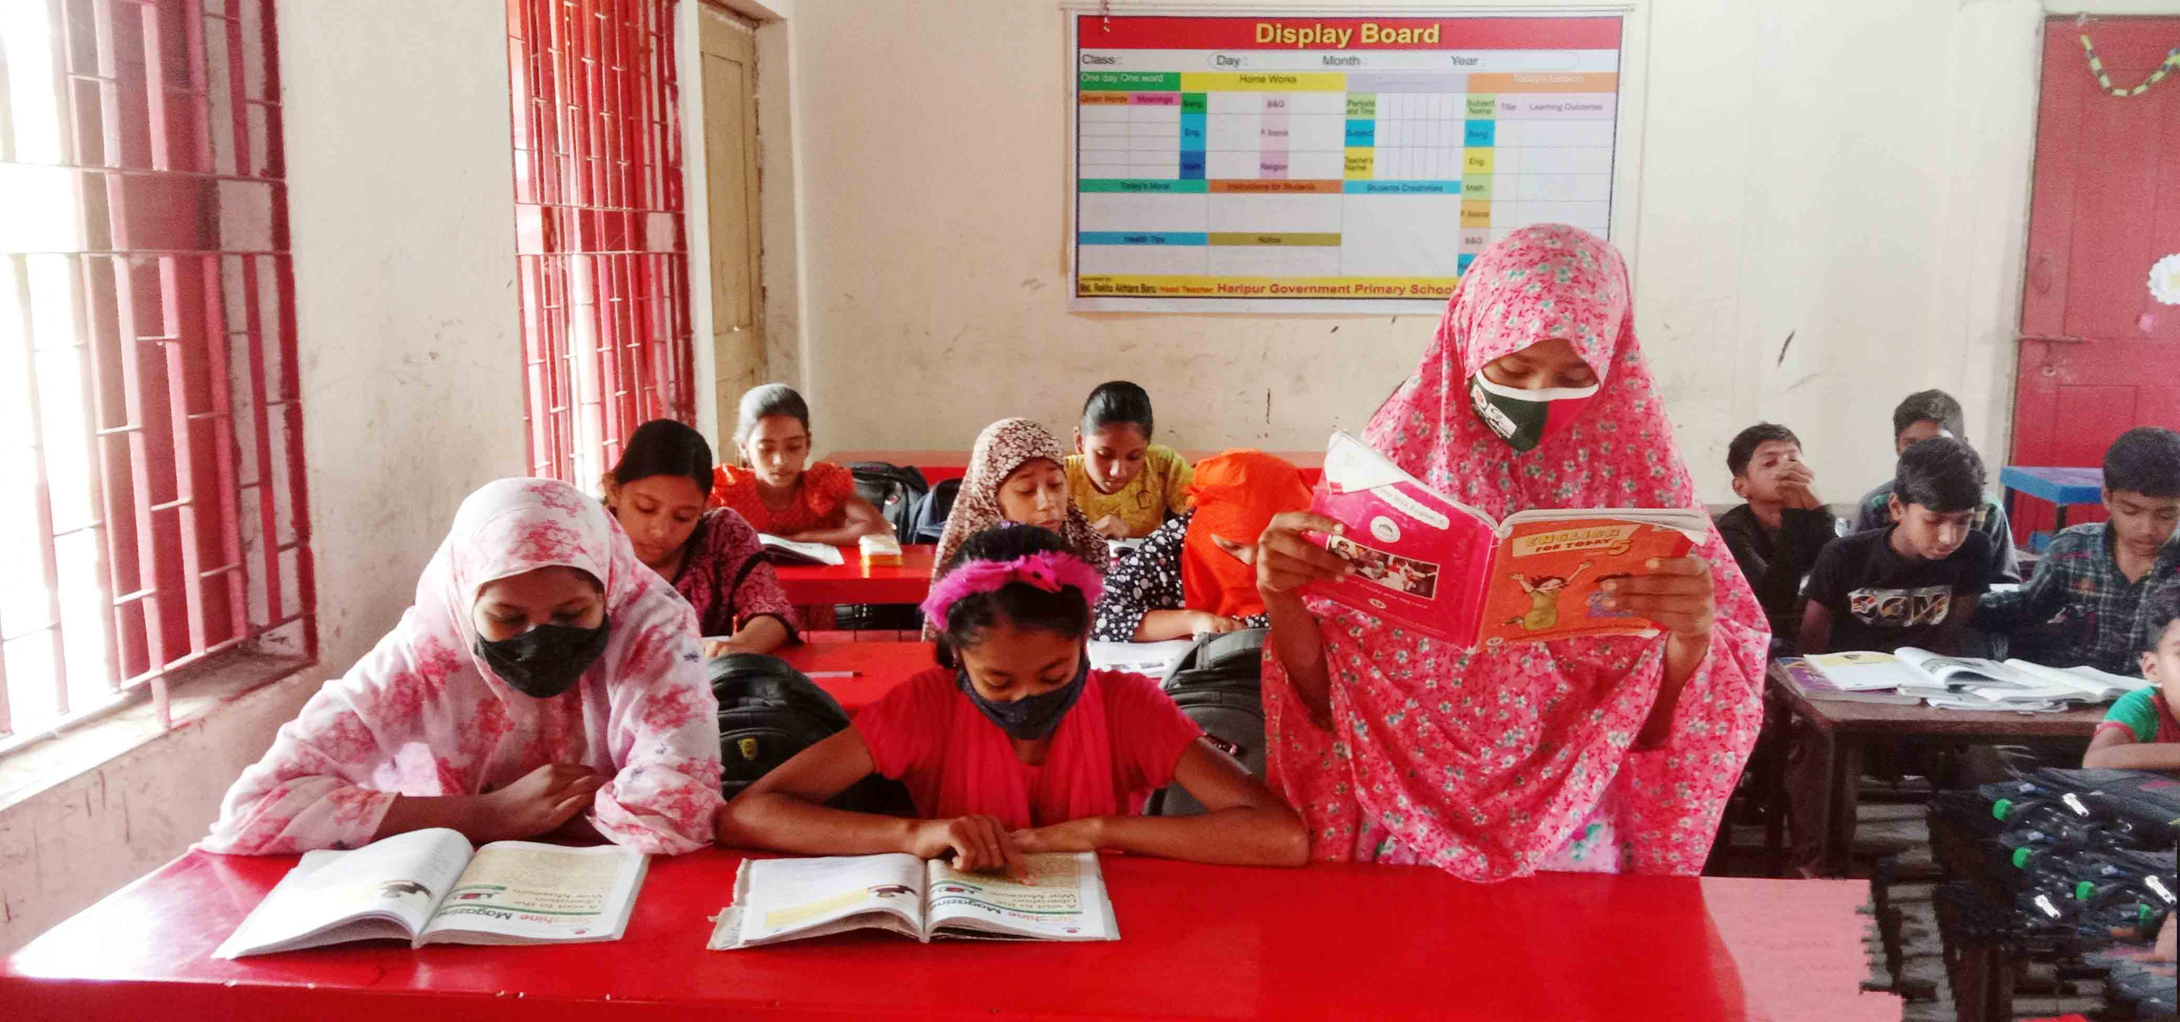
Students reading loudly

Slide 17
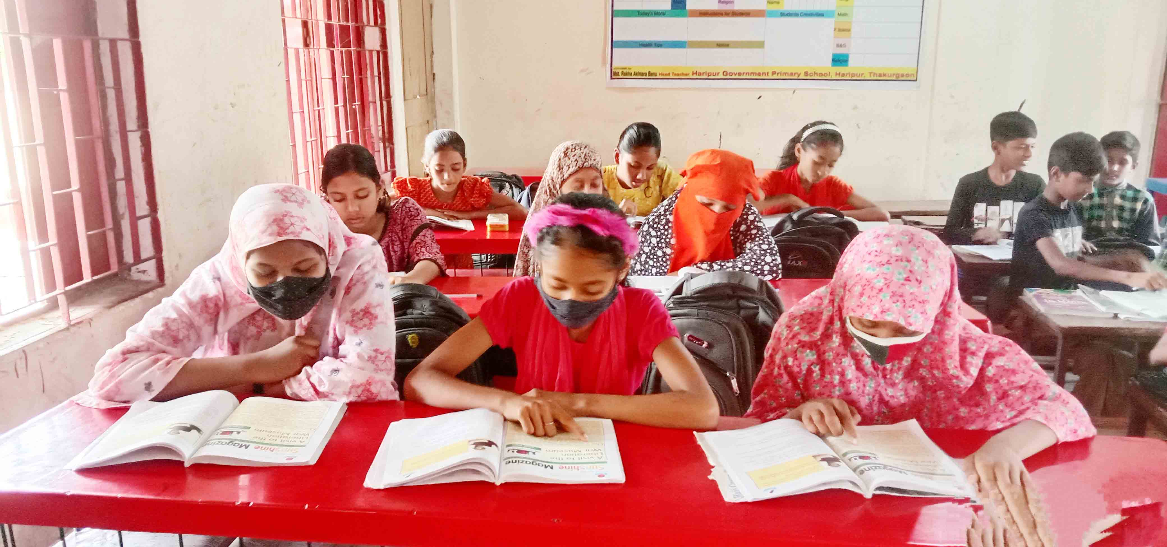
Students silent reading

Slide 18
Individual work
True or False
a) Saikat wants to improve his English.
True
False
b) Saikat lives in Dhaka .
False
c) Mrs. Monwara Islam is a teacher.
False
d) Saikat reads in class 4.
True
e) Mr.Rashidul Islam is a banker.

Slide 19
Pair work
Match the words of the column A with their meanings in column B
Column-A | Column-B
a. Enjoy | i) One’s father and mother
b. Sew | ii) pleasure
c. Neighbour | Iii) A person who lives near another
d. Often | iv) friend.
e. Parents | v) In great quantities
 | vi) To use a needle to pass thread through pieces of fabric
e
a
c
d
b

Slide 20
Individual work
Fill in the blanks.
Neighbours
English
Free time
Neighbours
English
also
Free time
parents
also
parents
a. Saikat lives with his ----------------?
b. Saikat want to improve his -----------.
c. Saikat ---------- read English books.
d. In her ----------- she enjoys sewing
e. She often gets order from her friend and ---------.

Slide 21
Individual work
Answer the following questions:
Ques:1. what is Saikat father’s name?
Ans: Saikat father name is Rashidul Islam
Ques:2.What is Saikat mother’s name?
Ans: Saikat mother’s name is Mrs . Monwara Islam
Ques:3.What kind of books does Saikat like?
Ans: Saikat likes books about animals, especially tigers and lion.

Slide 22
Group work
What does Saikat do to improving his English Speaking Skill.

Slide 23
Evaluation
a) What do Saikat parents do in their free time?
b) Where does Saikat father works?
c) What does saikat do in his free time?
D) What does siakat mother do in her free time?
e) Where does Saikat lives?

Slide 24
One day one word
Sewing
সেলাই করা
sentence making
In her free time , Mrs Monwara Islam enjoys sewing

Slide 25
Home Task
Write five sentences about “How to improve your English”

Slide 26
Good Bye
See you

