Slide 2
Identity
Mst. Lucky Akhter Parveen
Assistant teacher
Bihari Govt Primary school
Pirgachha, Rangpur
English for Today
Class: five
Unit: 3, Sounds practice 2
Lesson: 7
Time: 45 minutes

Slide 3
Learning Outcomes
Students will be able to:
Listening: 1.1.1 recognize sound differences in the context of words.
Speaking:1.1.1 say words and sentences with proper sounds and stress.

Slide 4
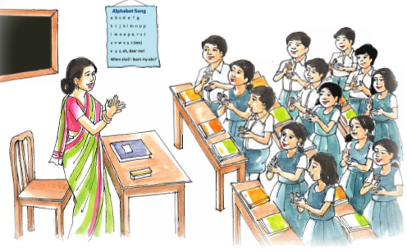
Warm up activities: Singing a song

Slide 5
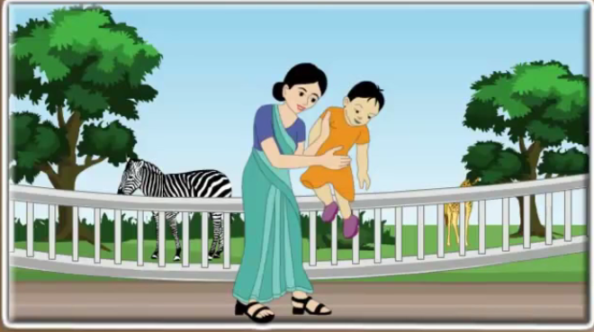
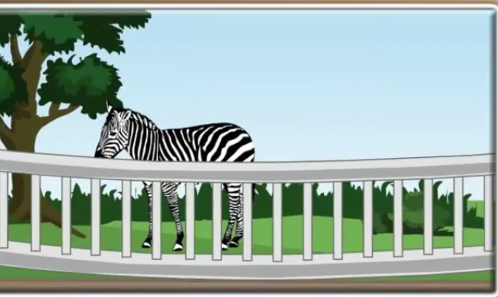
Let’s see the pictures

Slide 6
To days Lesson
Sound practice 2

Slide 7
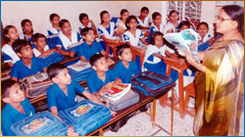
Teacher’s reading

Slide 8
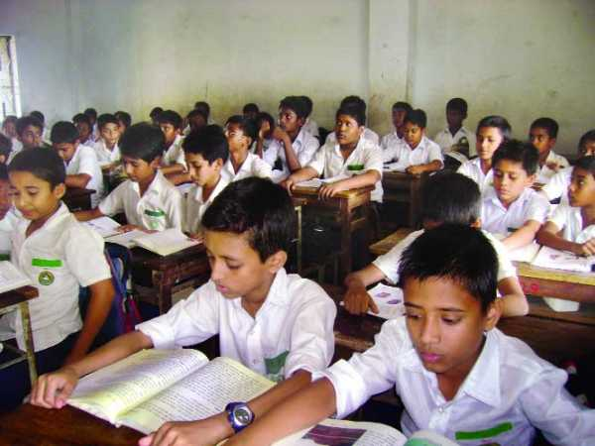
Student reading

Slide 9
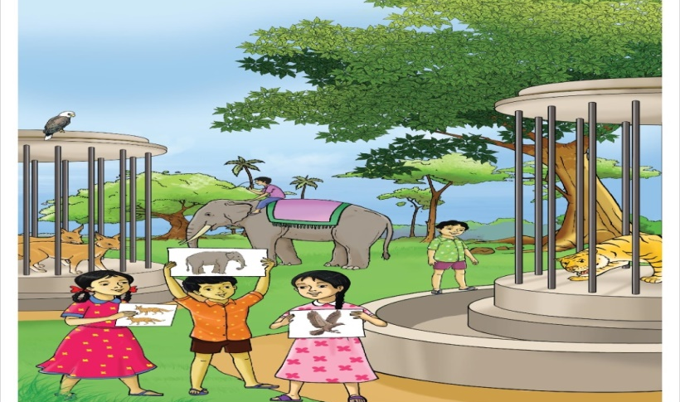
Word meaning
Treasure
accumulated wealth
a park in which living animals are kept for public exhibition
Zoo

Slide 10
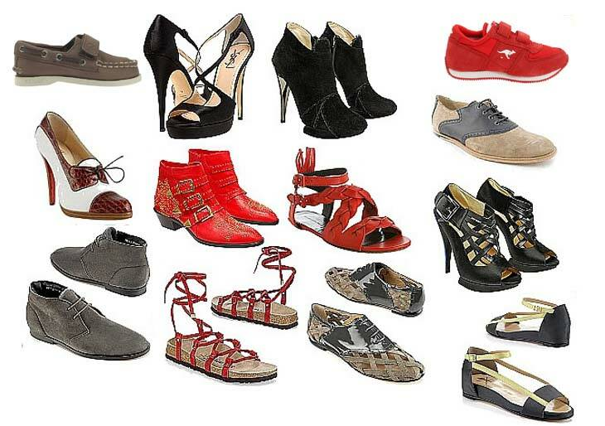
Word meaning
Shoe
an outer covering for the foot.
Measure
to weigh anything

Slide 11
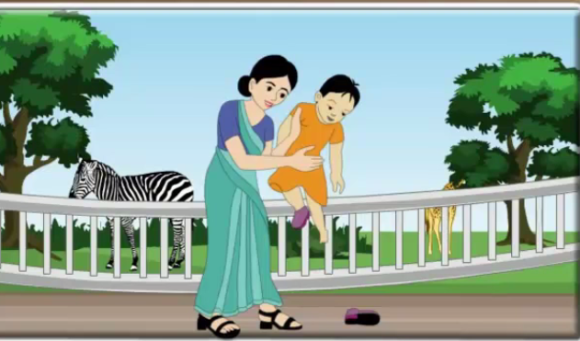
Group work.
Look, listen and say.
s, s, s is for Sue.
z, z, z, z is for zoo.
sh, sh, sh, sh is for shoe.
Sue is at the zoo, but she is got only one shoe!
Silly Sue has lost her shoe! What is she going to do?

Slide 12
Group work.
Look, listen and say.
sz, sz, sz, sz as in treasure.
sz, sz, sz, sz as in measure.
sz, sz, sz, sz as in leisure.
Measure, measure, measure.
Treasure, treasure, treasure.
Measure your treasure in your leisure.

Slide 13
Group work.
Look, listen and say.
Look, listen and say.
sharpener
zebra
ship
sun
shirt
zoo
soapcase
sandwich

Slide 14
pair work.
Choose the picture that have sound s

Slide 15
pair work.
Choose the picture that have sound sh

Slide 16
pair work.
Choose the picture that have sound z

Slide 17
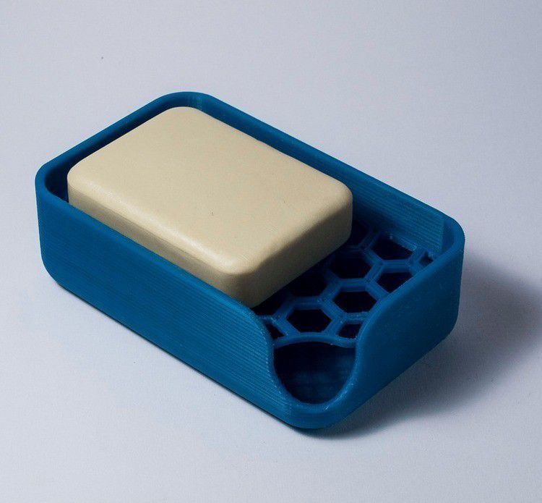
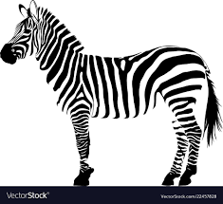
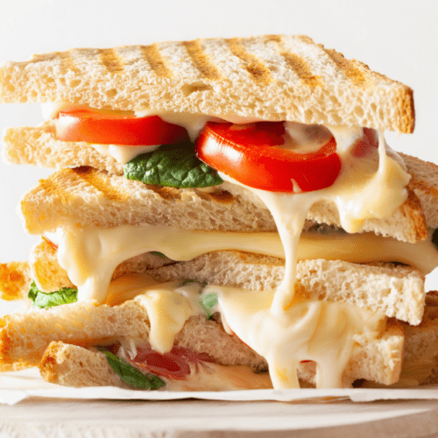
Evaluation.
Choose the picture that have sound z
Choose the picture that have sound sh
Choose the picture that have sound s

Slide 18
Thank you

