Slide 1



Welcome

Slide 2

Presented by
Md.Akter Hossain
Assistant Teacher
Bhobani Charon Roaja para Govt.Primary school.
Matiranga,Khagrachari.
Lesson Identity
Class:two
Subject: English
Lesson:4-6
Unit:one ( A)
Date: 20-04-2022

Slide 3
Learning Outcomes
By the end of the lesson the students will be able to----------------
1 .Become familiar with English sounds by listening to common English words.
2 .Repeat after the teacher simple words and phrases with proper sounds and stress
.
3.Recognize and read the alphabet both small and capital ( non –cursive).
.

Slide 4
Let,s see the Video

Slide 5

Today’s Lesson
Alphabet

Slide 6
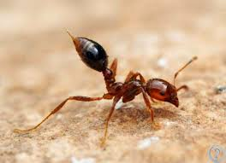

Now look at the picture.Say loudly
What is this?
What is this?
ant
bat

Slide 7


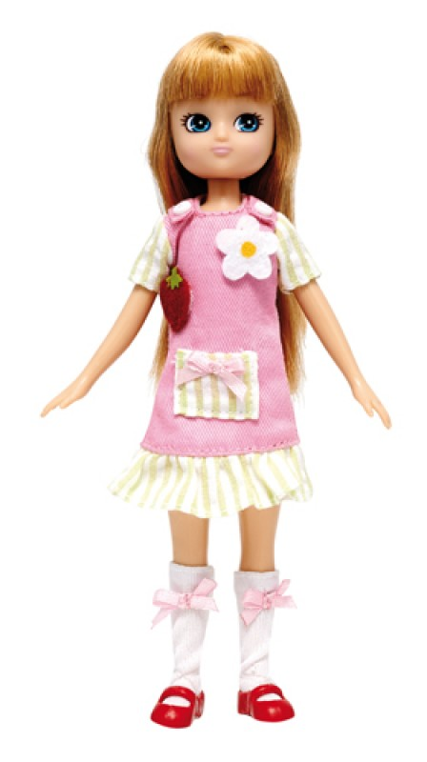
Now look at the picture.Say loudly
What is this?
What is this?
cup
doll

Slide 8

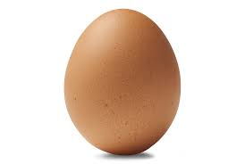
Now look at the picture.Say loudly
What is this?
egg

Slide 9
Dear students,open at page 3 of your book and look activity A.

Slide 10
What can you see?
ant
What is the letter name?
a
Aa
What is the letter sound ?

Slide 11
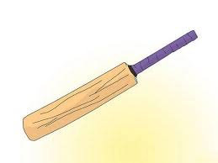

What can you see?
bat
What is the letter name?
Bb
b
What is the letter sound ?

Slide 12

What can you see?
cup
What is the letter name?
c
Cc
What is the letter sound ?

Slide 13
What can you see?
doll
What is the letter name?
d
Dd
What is the letter sound ?

Slide 14
What can you see?
egg
What is the letter name?
Ee
e
What is the letter sound ?

Slide 15
Now match the Capital letter with small letter
A d
B c
C a
D e
E b

Slide 16
Match the words with the letter
Aa
bat
Bb
doll
Cc
ant
Dd
egg
Ee
cup

Slide 17

Evaluation
What is this?
What is this?
What is this?

Slide 18
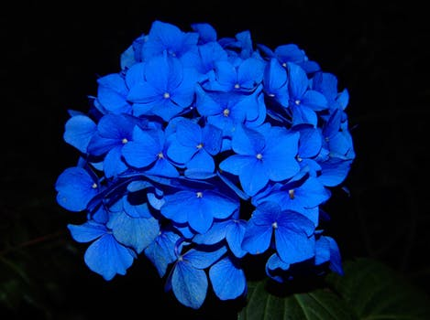
Thank you all

