Slide 1
Welcome

Slide 2
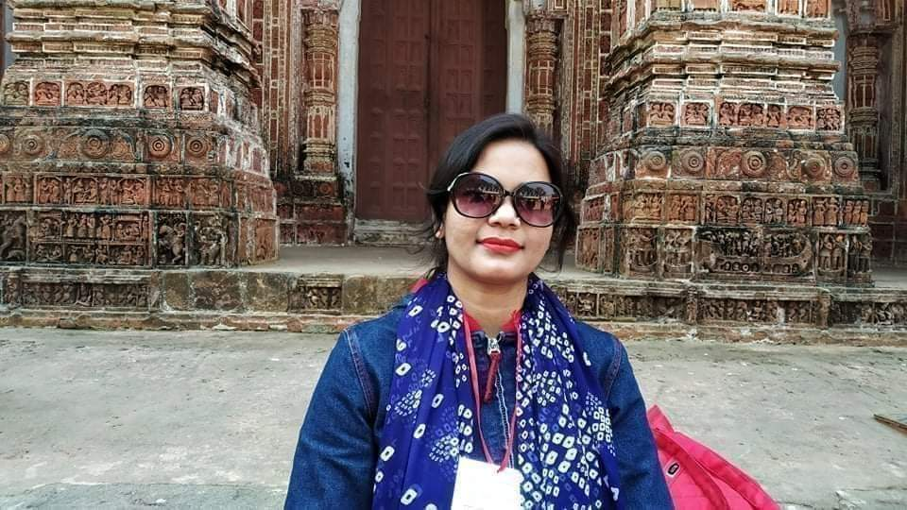
Greetings
Mahanaj Parvin
Assistant Teacher
Jhanjirapara GPS
Dinajpur Sadar
Dinajpur. mahanajparvin785@gmail.com

Slide 3
Class :2
Sub: English
Lesson: Rima and the seed
Lesson unit :On …………………a tub.s

Slide 4
Learning outcomes
Ss will be able to….
Listening:4.1.1 Enjoy the lesson and simple words and sentences.
Speaking : 4.2.1 ss will say simple words sentences.

Slide 5
Rima and The Seed
Rima

Slide 6
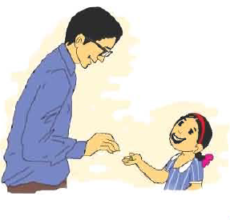
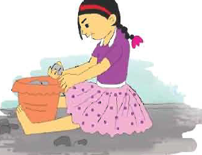
On Saturday
On Monday

Slide 7
Prensentation
On Saturday
Rimas father gives
her a seed.
On Sunday
Rima puts the
Seed in a tub.

Slide 8
Valuation
Say word meaning:
Seed Tub

Slide 9
Thank you

