Slide 1
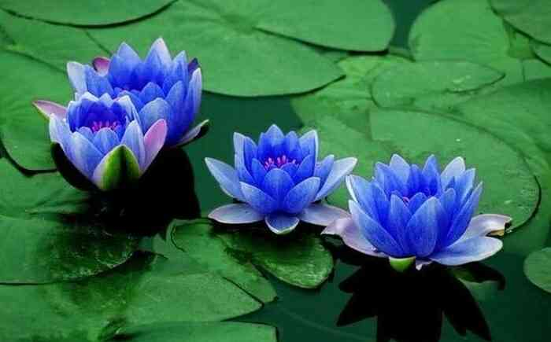
Welcome

Slide 2
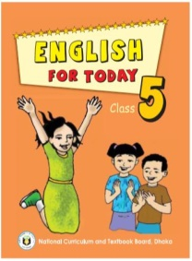
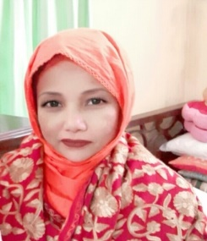
Identity
Mst. Lucky Akhter Parveen
Assistant teacher
Bihari Govt Primary school
Pirgachha, Rangpur
English for Today
Class: five
Unit: 4, Leisure time
Lesson: 1-2
Time: 45 minutes

Slide 3
Learning Outcomes
Students will be able to:
Listening-3.2.1 understand questions about family and friends of students.
Speaking 3.1.1 ask and answer Who question.
Reading 1.6.1 recognize and read statement .

Slide 4
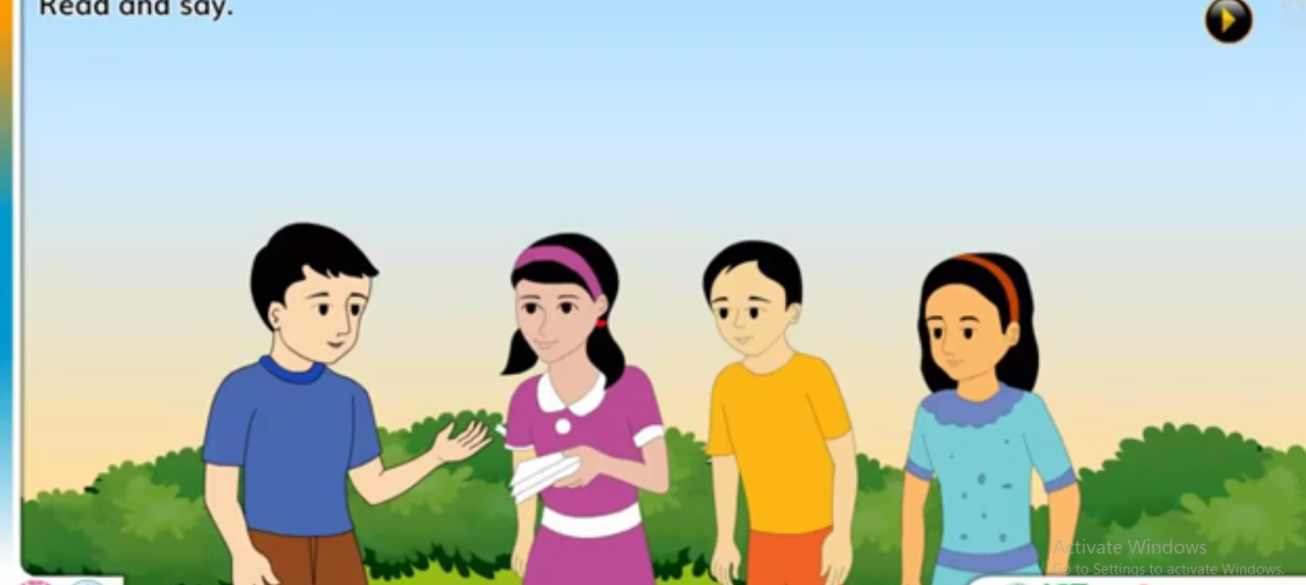
Look at the picture

Slide 5
Leisure time

Slide 6
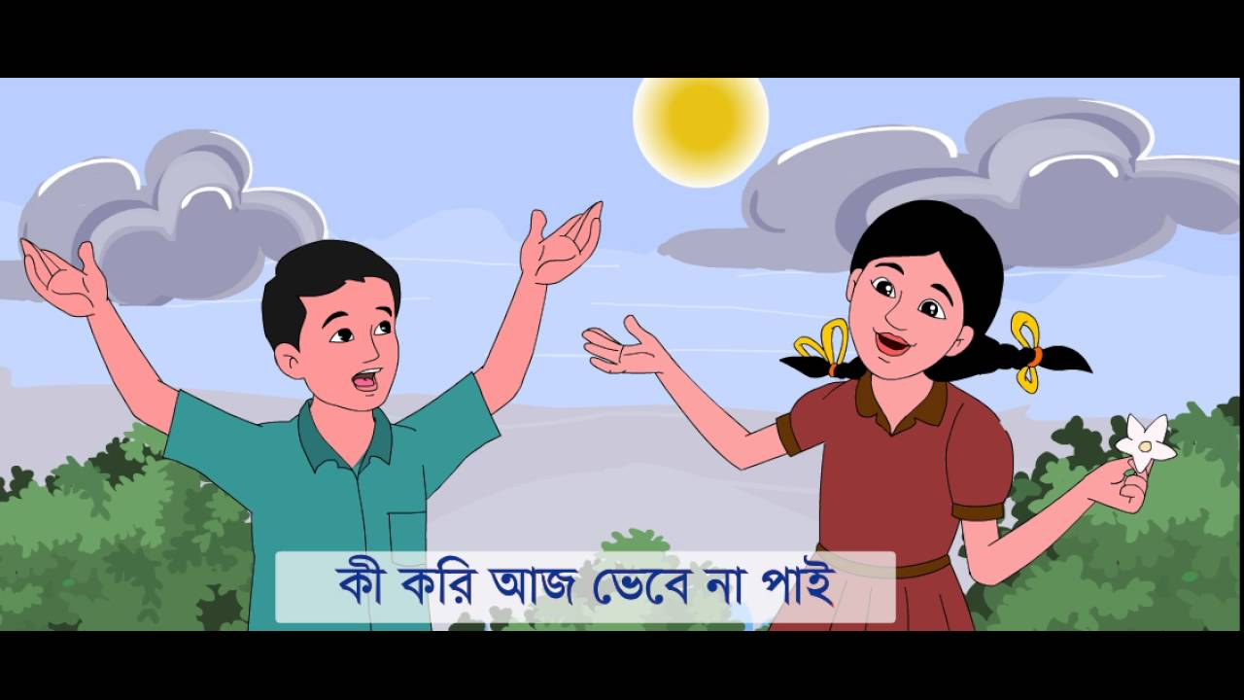
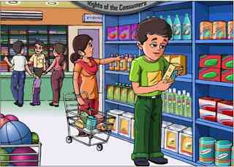
Word meaning
a state of feeling or being happy
Pleasure
to give money to pay for good
Spend

Slide 7
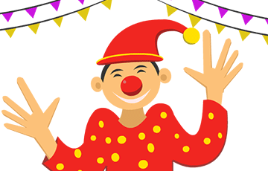
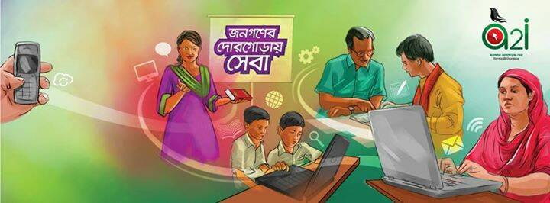
Word meaning
Fit
healthy and strong
Funny
making you laugh
to join together
Connect

Slide 8
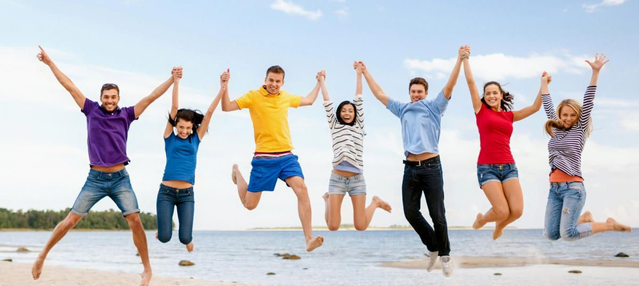
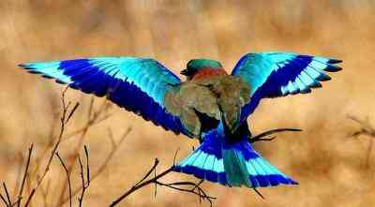
Leisure
free time
Especially
in particular

Slide 9
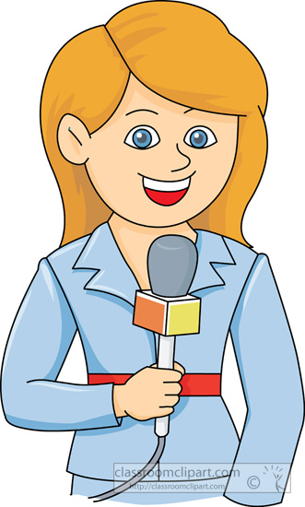
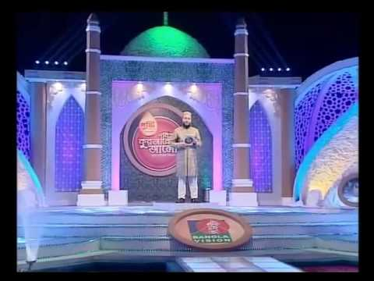
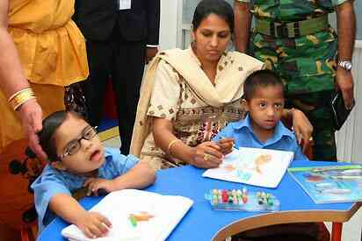
Word meaning
a person who collects and report news for newspaper
Reporter
Sure
without any dout
a thing that is difficult to deal with or to understand
Problem

Slide 10
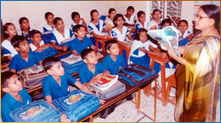
Teacher’s reading
Student reading

Slide 11
Pair work. Write ‘True’ for correct statement or ‘False’ for incorrect statement.
Sima and Tamal are reporters for the English Club Magazine.
The reporters want to know about the family of Sima and Biju.
Biju likes swimming and painting.
Sima talks the interview as a pleasure.
A reporter writes report for amusement.
False
False
True
True
False

Slide 12
Group work.
Answer the following questions.
Who are the reporters?
Who is answering the reporters questions?
What does Biju do in his leisure time?
Answer
Tamal and Nasreen are the reporters.
They are reporting for the English Club Magazine.
Biju often reads magazine in his free time.

Slide 13
Match the words with their meaning.
Pair work.
Leisure | in particular
Funny | Healthy and strong
Especially | Free time
Fit | To join together
Connect | Making you laugh

Slide 14
Evaluation
Answer the following questions.
Who are the reporters?
Which magazine are they reporting for?
What does Sima do in her leisure time?
How does Sima Take the interview?
What do you do in your leisure time?

Slide 15
Home work
Write five sentences about ‘Leisure time’.

