Slide 2
Teacher`s Information
Shohel Miah
Assistant Teacher
Kongsherkul Govt: Primary School.
Bhaluka, Mymensingh.
Email: shohelkgps@gmail.com

Slide 3
Class : Three
Sub:English
Unit 8 :Prepositions
Lesson: 1

Slide 4
Learning outcomes
Students will be able to
(a) Identify some prepositions.
Use prepositions: over, in, on,
under and between.

Slide 5
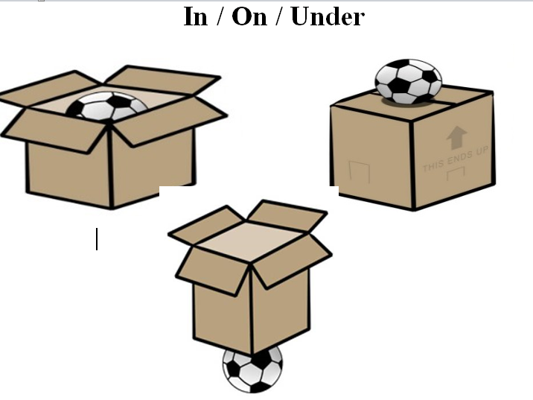

Slide 6
The lamp is on the table

Slide 7
The boy is under the tree

Slide 8
The baby is between the parents

Slide 9
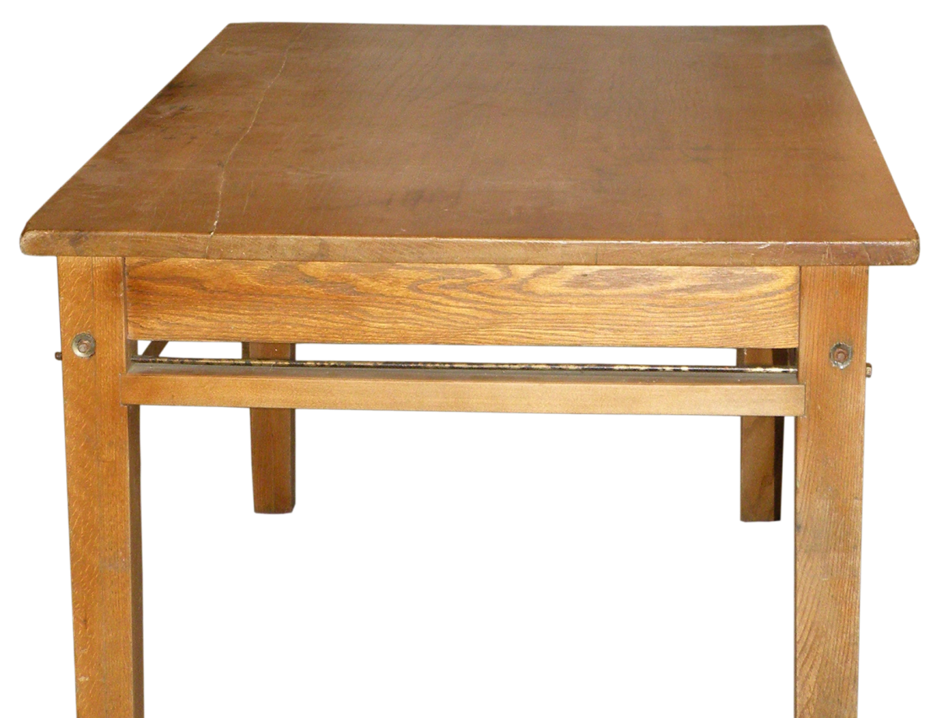
The cat is on the table

Slide 10
The ball is under the table.

Slide 11
The ball is in the box

Slide 12
on
The crow is ___ the wall.
under
The ball is --------the table.

