Slide 1
W
E
M
E
L
C
O

Slide 3
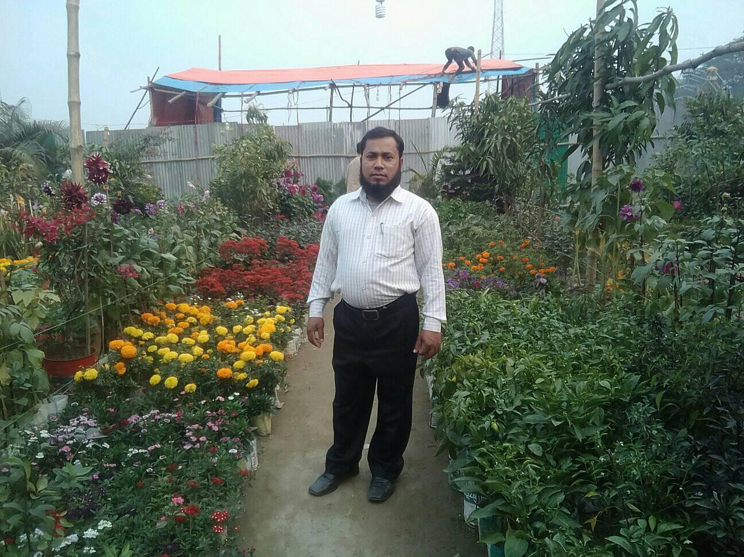
TEACHER’S IDENTITY
Shohel Miah
Assistant Teacher
Kongsherkul Govt: Primary School.
Bhaluka, Mymensingh.
Email: shohelkgps@gmail.com

Slide 4
LESSON’S IDENTITY
CLASS : FOUR
SUBJECT :ENGLISH
UNIT:14
LESSON : 1-2
(MITA’S DAY )

Slide 5
LEARNING OUTCOMES
AT THE END OF THE LESSON STUDENT WILL BE ABLE TO -
Listening:
1.3.1- Recognize the words in a sentence are stressed.
3.4.1- Understand statement made by the teacher and student
Speaking:
6.2.1- Talk about people,e object,event etc.
Say words, phrases, and sentences with proper sound and stress.
Reading:
1.7.1- Read the strory, paragraph, dialogue letter and other text.
Writing:
- 8.1.1-to make sentences using words, phrases and following phrases.
7.2.1- write the time ( hours only) and mention a.m. / p.m.

Slide 6
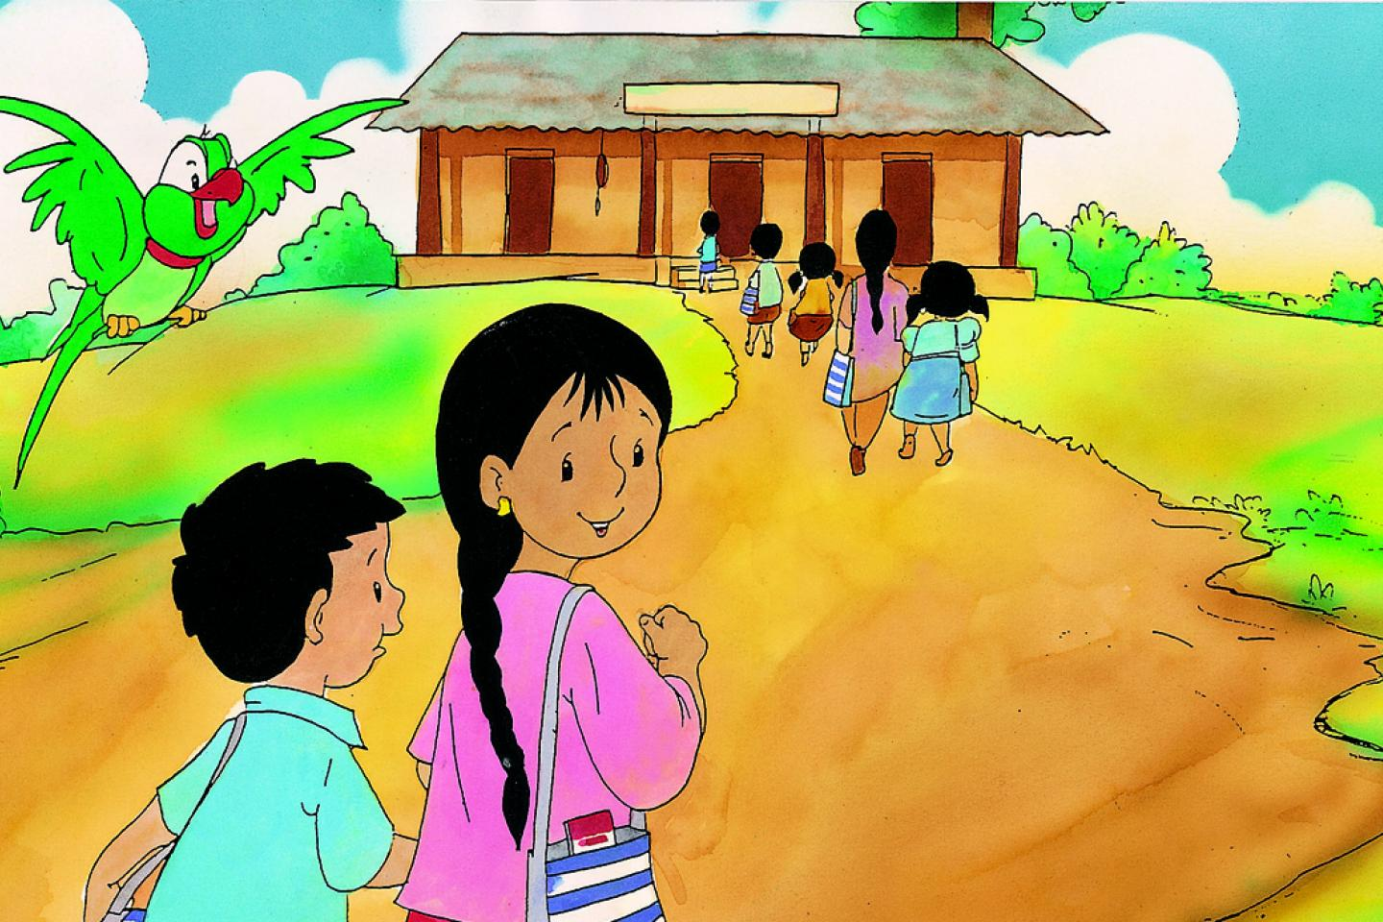
Meena is going to school.
Let’s see a picture…………..
What is the picture about?

Slide 7
Today’s lesson
Mita’s day
Unit : 14 Lesson: 1-2
Page 28

Slide 8
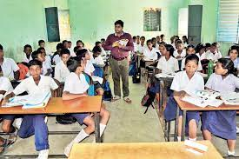
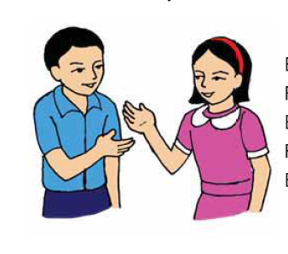
Mita is in Class four.

Slide 9
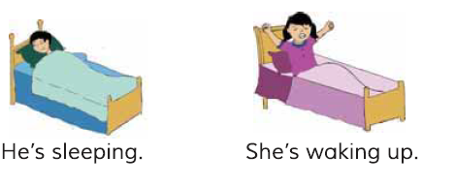
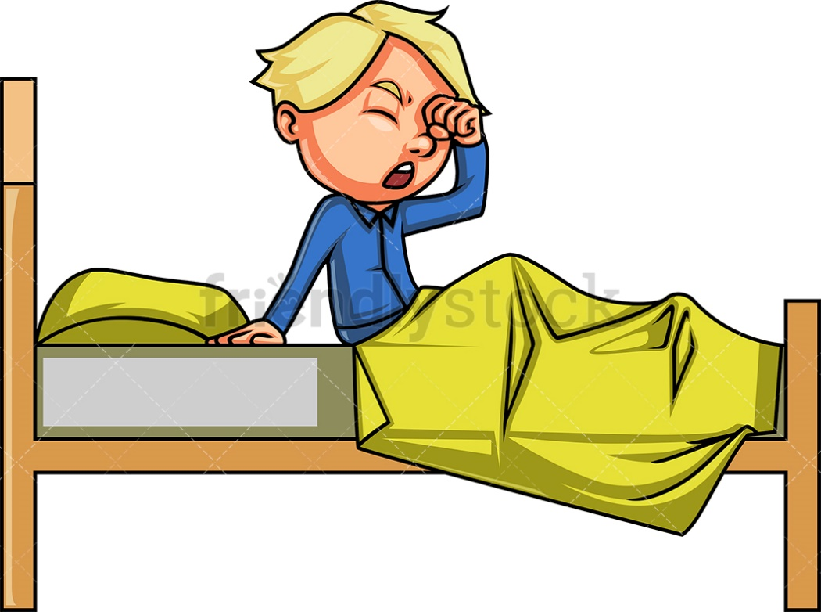
She gets up at six o’clock.

Slide 10
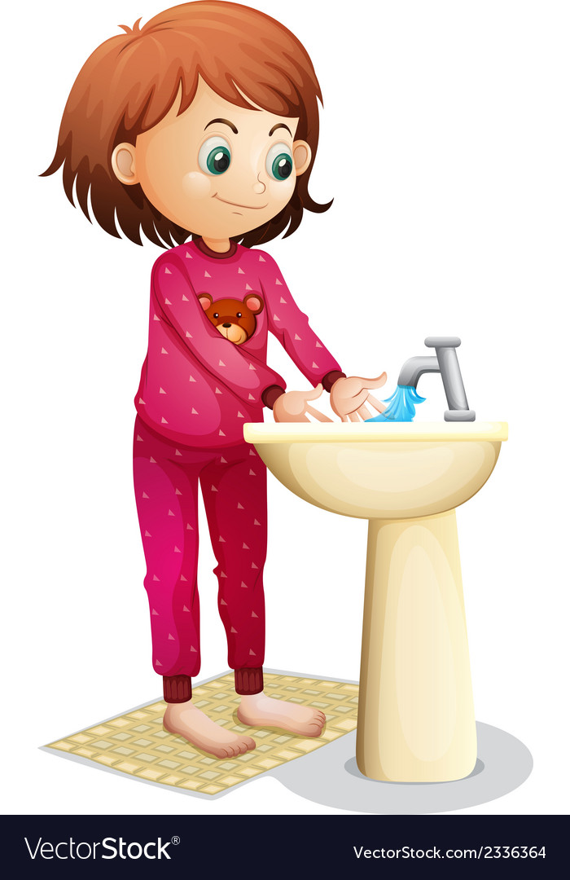
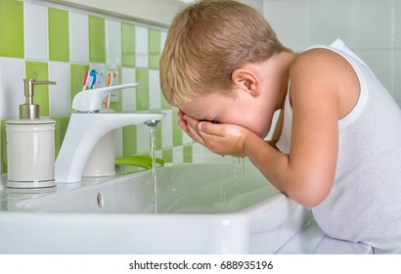
She washes her face.

Slide 11
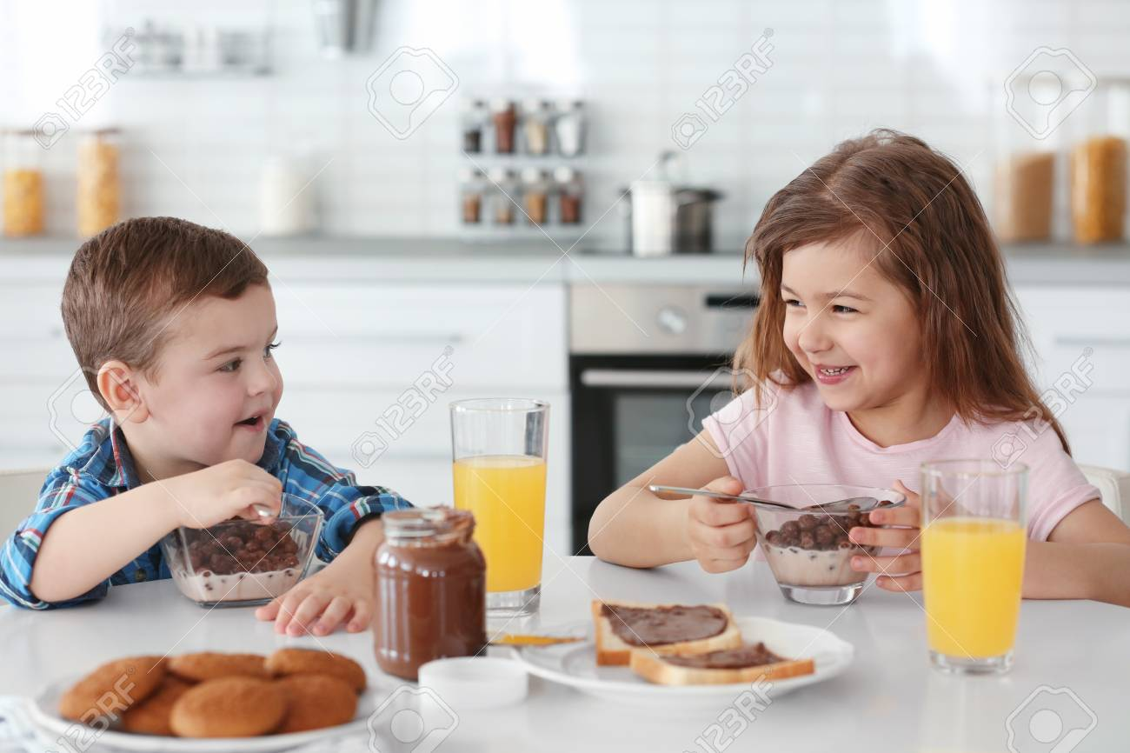
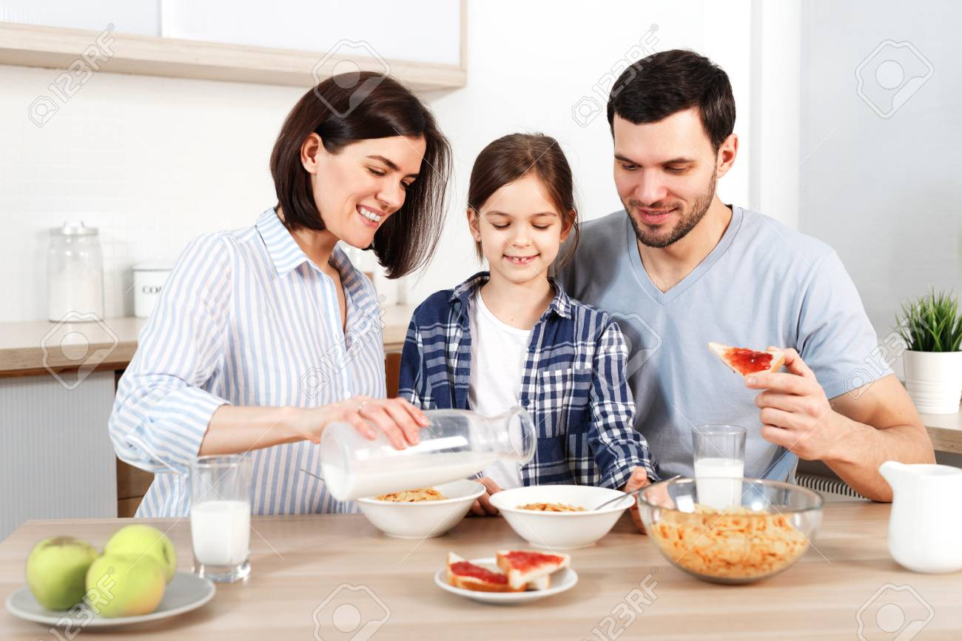
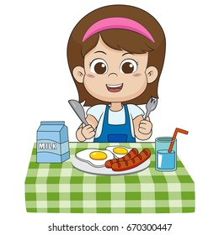
She has her breakfast at seven o’clock.

Slide 12
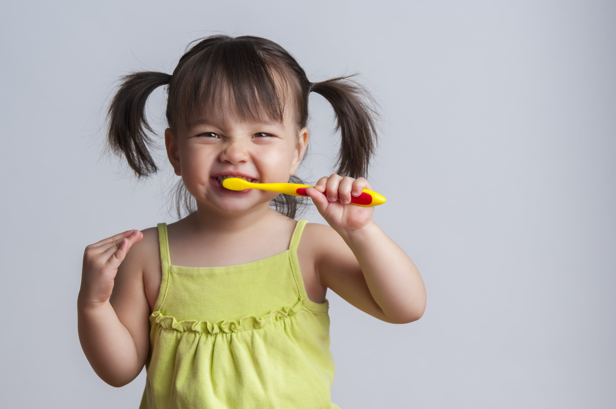
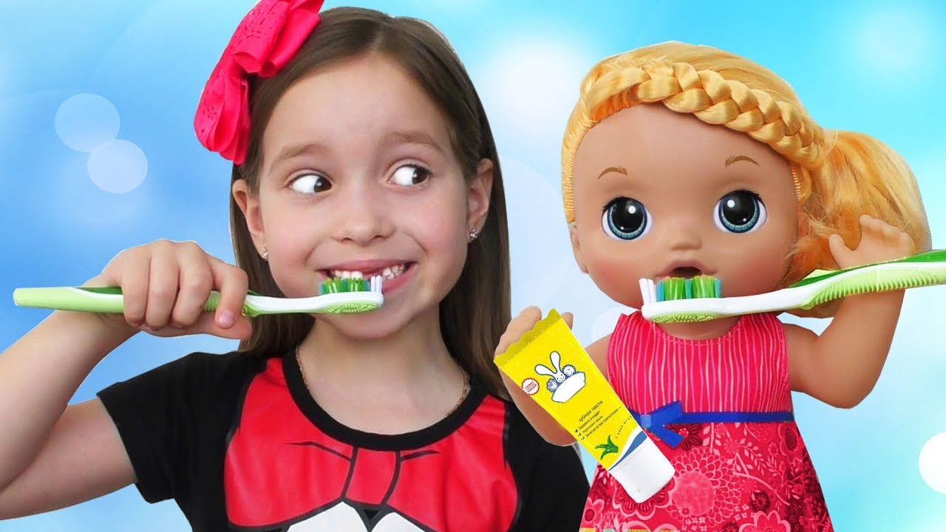
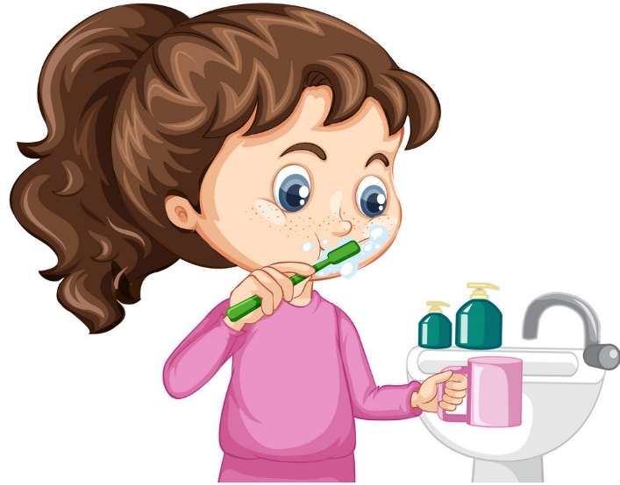
Then she brushes her teeth.

Slide 13
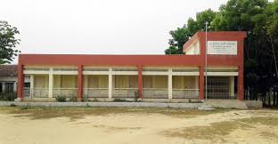
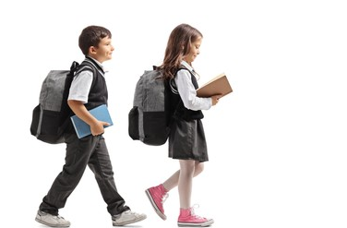
9
She goes to school at nine o’clock.

Slide 14
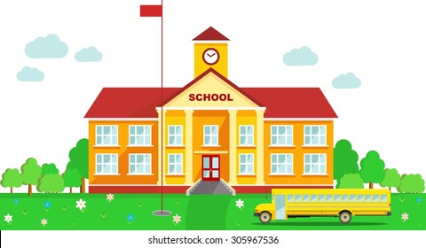
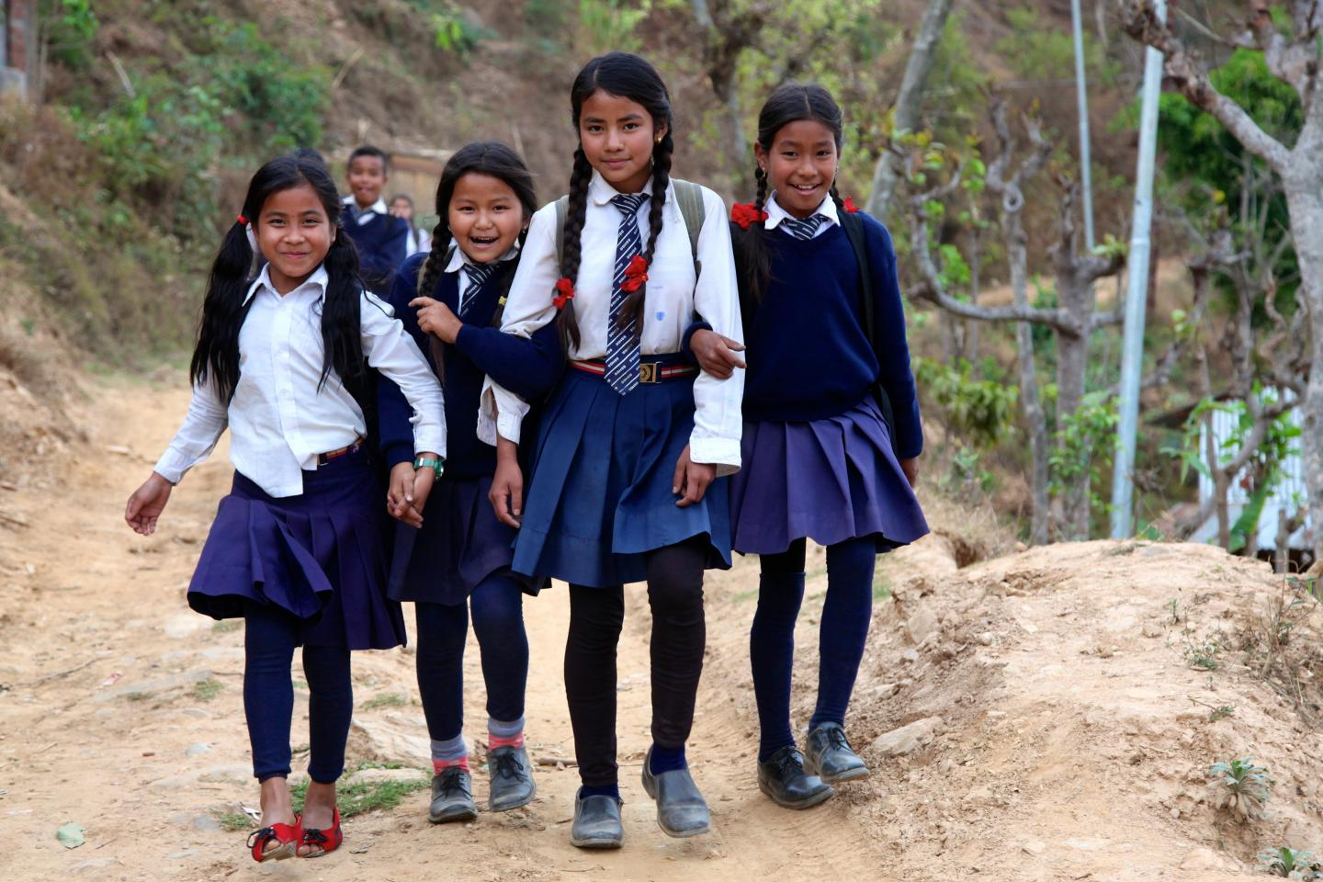
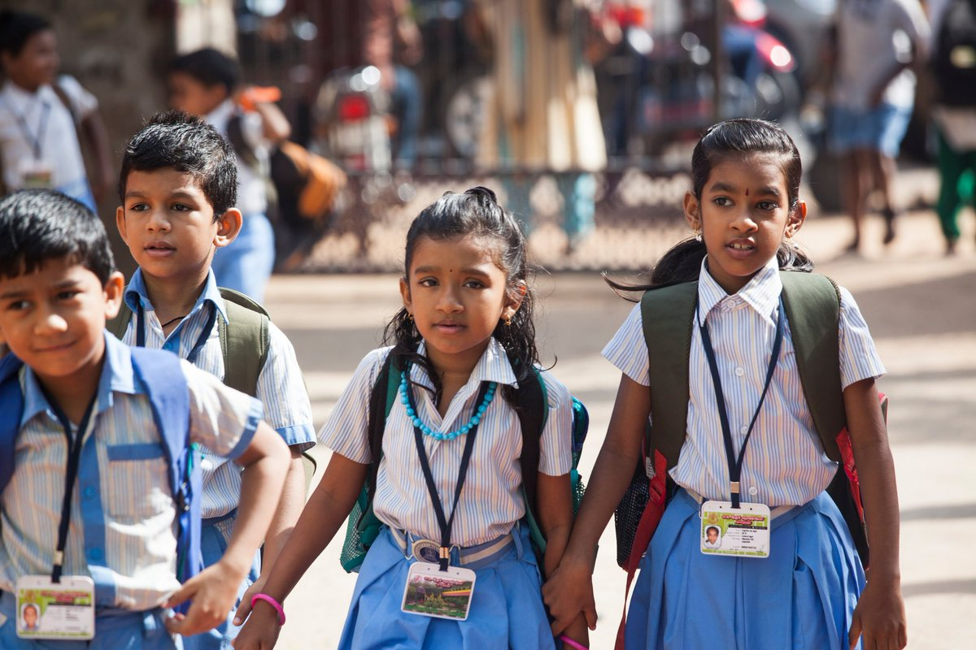
She walks to her school.

Slide 15
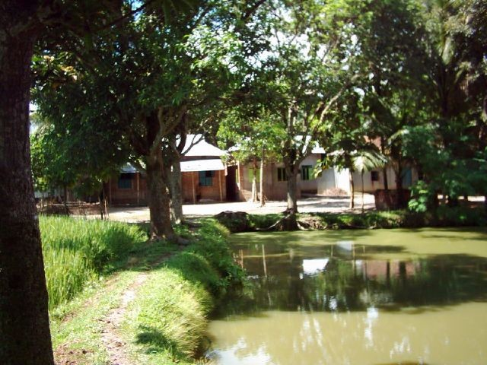
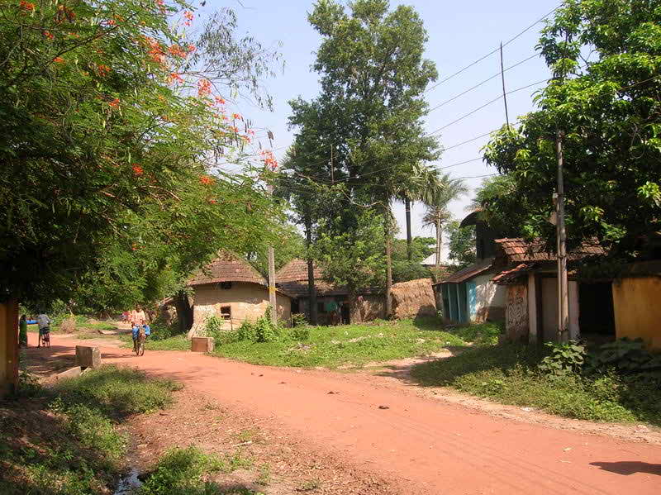
After school she visits her grand mother at three o’clock..

Slide 16
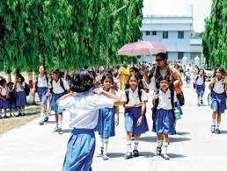
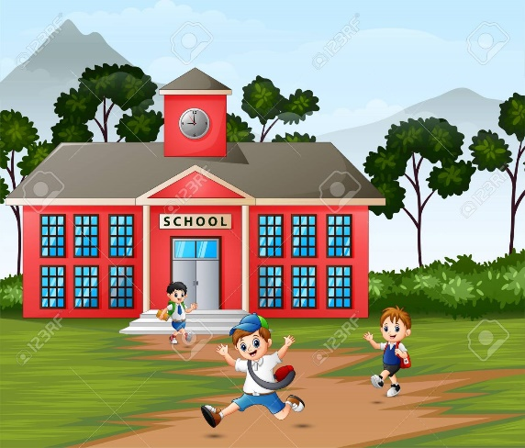
Then Mita returns home at five o’clock.

Slide 17
New words
Get up-
Wake up
(ঘুম থেকে উঠা ।)
Wash -
To clean
(ধোঁয়া ।)
Breakfast-
Take food in the morning
(সকালের নাস্তা )।
( হাঁটা)
Walk-
Go on Foot
Return-
Come back
(ফিরে আসা)

Slide 18
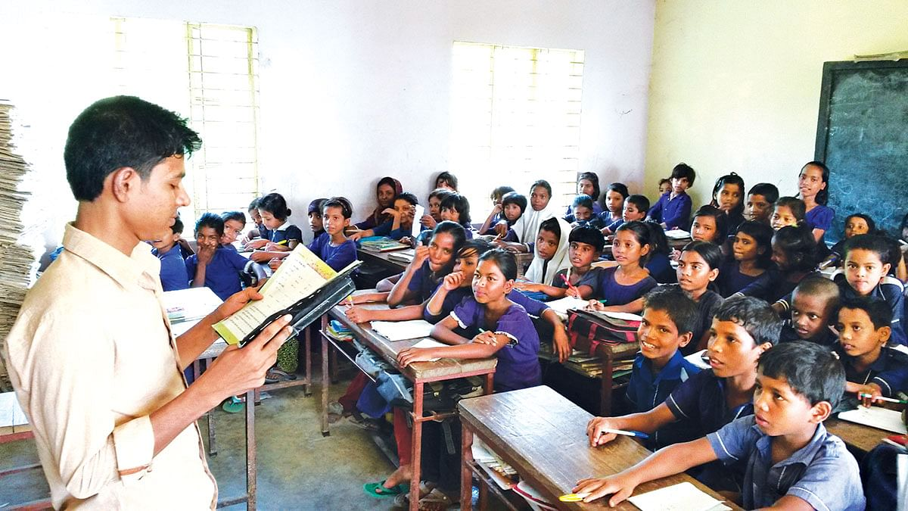
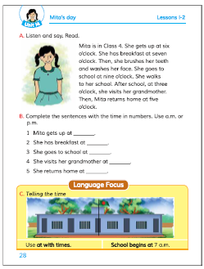
Teacher’s Loudreading.

Slide 19
Pair work
Complete the sentences with the time in number , (use a.m. /p.m. )
6 a.m.
# Mita gets up at ………………
7 a.m.
# She has breakfast at ………………
9 a.m.
# She goes to school at …………………
3 p.m.
# She visits her grand mother at …………………
5 p.m.
# She returns home at ……..............

Slide 20
Answer the short questions
* When does Mita get up?
Ans: Mita gets up at six o’clock.
* When does Mita have breakfast?
Ans: Mita has breakfast at seven o’clock.
* When does she go to school?
Ans: She goes to school at nine o’clock.
* When does she return home?
Ans: She return home at five o’clock.

Slide 21
Group work
Re-arrange the words to make sentences
a) class, in, four, is, Mita.
Ans: Mita is in class four.
b) face, washes, she, her.
Ans: She washes her face.
c) school, goes ,to, at, o’clock, she, nine.
Ans: She goes to school at nine o’clock.
d) She, grandmother, visits, at, her, three, o’clock.
Ans: She visits her grandmother at three o’clock.
e) Five, o’clock at, home, Mita, returns.
Ans: Mita returns home at five o’clock.

Slide 22
Evaluation
a) What time do you get up?
b) When do you have breakfast?
c) What time do you go to school?
d) When do you return home?
e) What time do you go to bed?

Slide 23
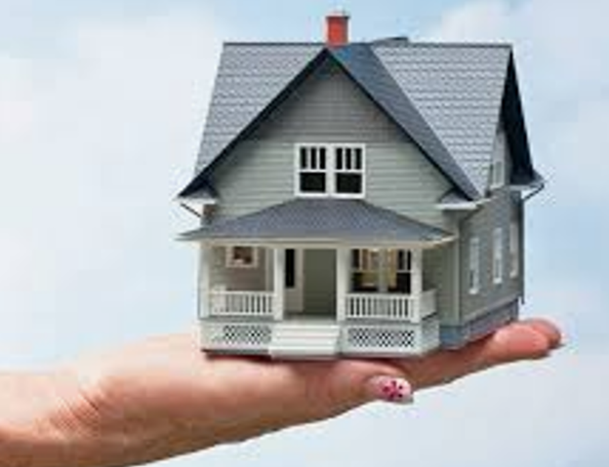
Home work
Write a short composition
about your daily activities..

