Slide 1
Welcome
Unit: 15
Lesson: 4-5
Lesson’s Title: Wh-words and Do/Does
Email: mahbubul1982at@gmail.com

Slide 2
Learning outcomes
Students will be able to :
Use Wh-words (What, Who, Where, Why, When and How)
Questions with Wh-word and do/does.

Slide 3
Question word | Do/does | I/ you/ we/ they/ he/ she/ it/
Where | do | I/ you/ we/ they | sit?
Who | do | I/ you/ we/ they | know?
How | do | I/ you/ we/ they | open this?
What | does | he/ she | study?
When | does | he/ she | get up?
Why | does | it | rain?

Slide 4
Complete the sentences with do/ does. ( in group)
What ---------- I do?
Where --------- you live?
When ---------- he go to bed?
How ------------ she do this?
Why ------------ it fly?
Who ------------ they talk?

Slide 5
Complete the sentences with the question words What, Who, Where, Why and How.
------------ old is Sagar?
------------ is Keya?
------------ does his father do?
------------ does his father work?
------------ helps his mother in the garden?
------------ is Sagar proud of his mother’s garden?

Slide 6
Complete the sentences with do/ does. ( in pair)
What are your friends’ name? Where -------- they live?
What is father’s name? What -------- he do?
When -------- we leave school today?
Who --------- you sit next to in school?
What is your mother’s name? What ----- she do?
How ------- the biscuits taste?
We are in English class now. When ----- it finish?
When -------- you get up in the morning?
What -------- you do on the weekend?
How ------- you come to school?

Slide 7
Ask & answer the questions ( in pair)
What is your father’s name? What does he do?
My father’s name is Md. Makbul Hossain. He is a farmer.
Now using What, Who, Where, Why, When and How ask and answer questions.

Slide 8
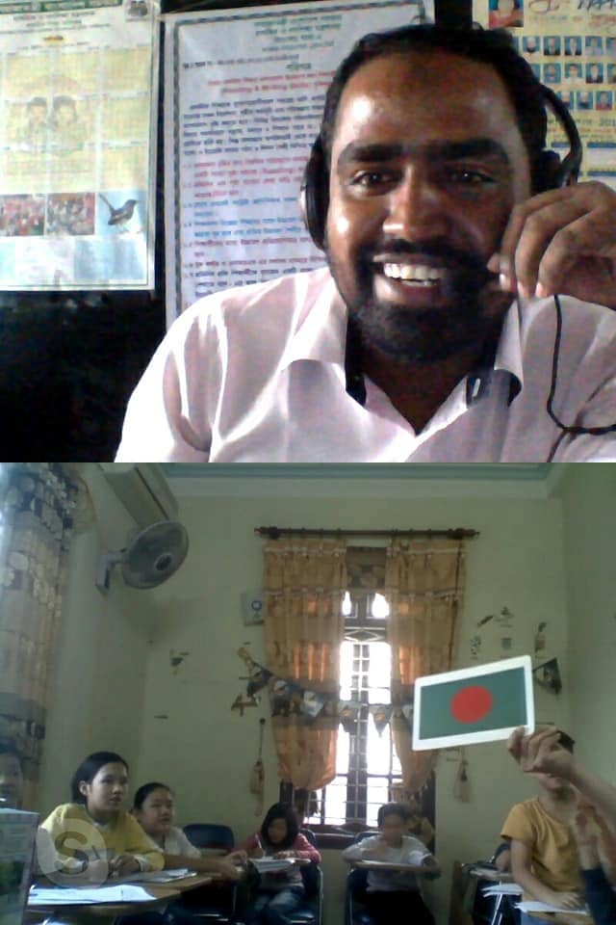
Thanks
This is Mahbubul Alam, assistant teacher, Hatirdia government primary school, Monohardi, Narsingdi. Best Teacher, Narsingdi district, Trainer (Math & English)
Contract : 01716474455
Email: mahbubul1982at@gmail.com

