Slide 1
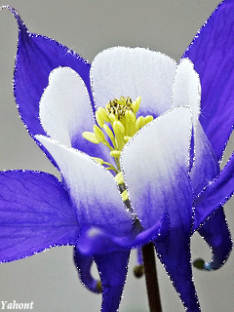
Welcome to my English Class

Slide 2
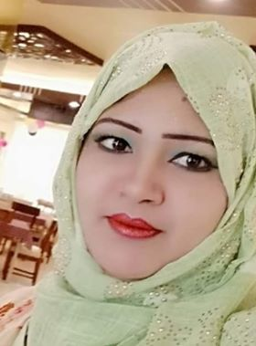
Identification
Dilruba Yesmin
Assistant Teacher
Purba bania khamar Govt.primary School
Khulna sadar,Khulna.

Slide 3
Lesson Identity
Class : Four
Unit : 5
Lesson : 1-2
(Classroom Language)

Slide 4
Student will be able to----
2.1.1- Carry out simple
Commands and instructions

Slide 5
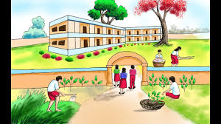
Let’s Play a Song

Slide 6
Sit down
Stand up

Slide 7
Sit down
Write your name

Slide 8
Raise your hand
Draw a circle

Slide 9
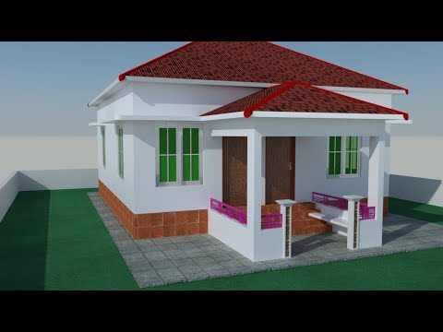
Thanks

