Slide 1
Welcome

Slide 2
MD.AMZAD HOSSAIN Assistant Teacher Uttar Gobindapur Govt. Primary School Feni Sadar,Feni.
Introduction
Subject:English
Class:Five
Lesson Unit:21-Life Is Beautiful!(But Maria……………quick learner)

Slide 3
Let’s Watch a video!

Slide 4
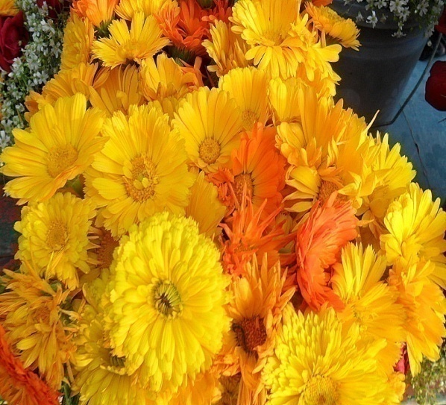
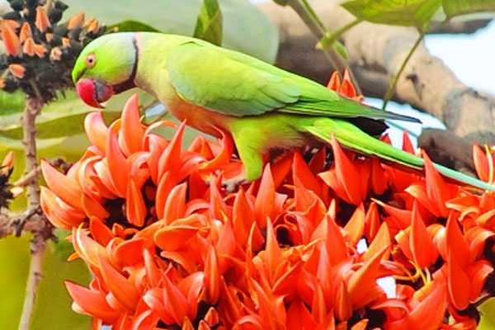
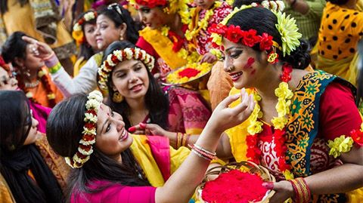
Look at the beautiful flowers!
Today’s lesson
We can see many beautiful things in our life.
beautiful
life
Life Is Beautiful!
is

Slide 5
By the end of the lesson students will be able to- 1) read the lesson with correct pronunciations. 2) write the correct answer of the questions. 3) write about “Braille”.
Learning Outcomes

Slide 6
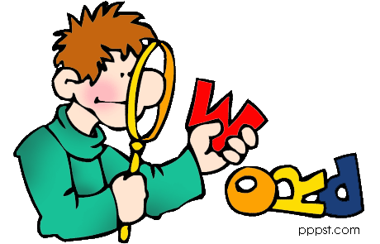
New

Slide 7
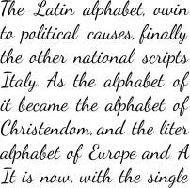
script
a piece of paper containing writing .

Slide 8
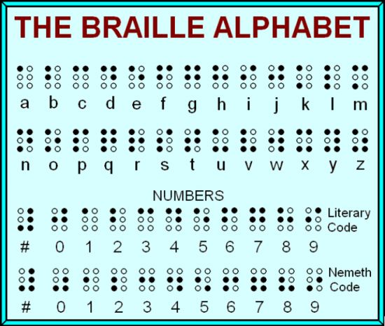
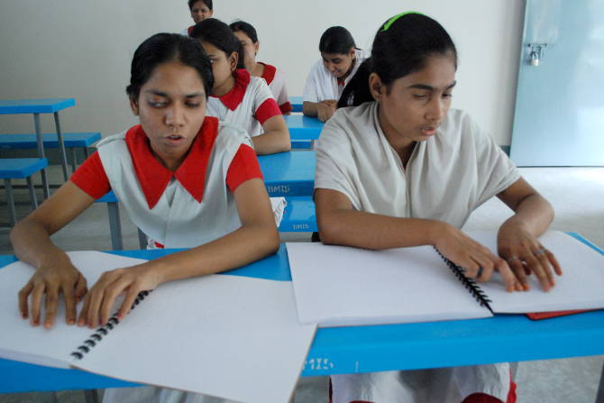
Braille
a kind of script written for visually impaired people.

Slide 9
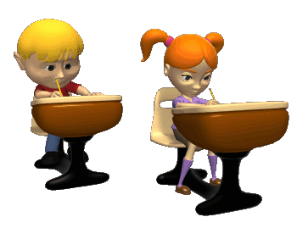
Quick learner
a student who learns anything quickly.

Slide 10
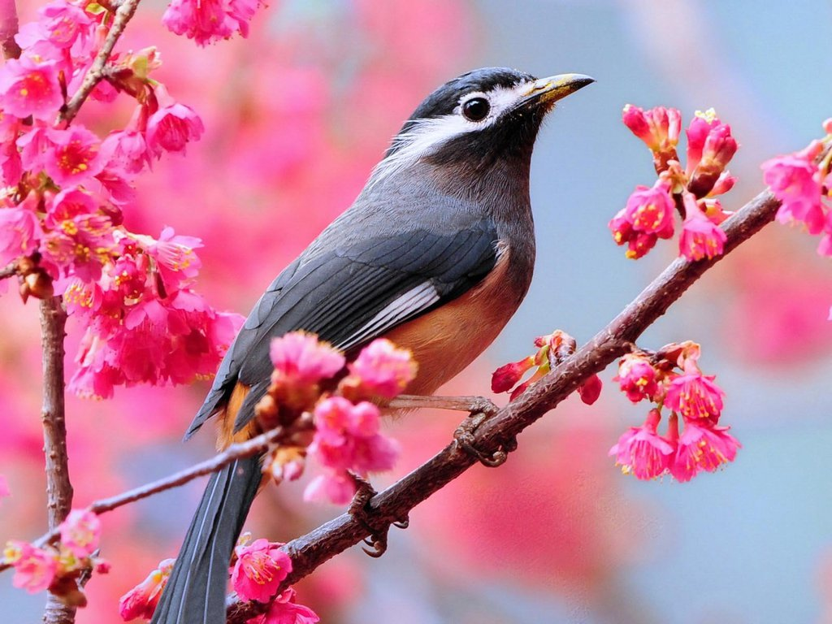
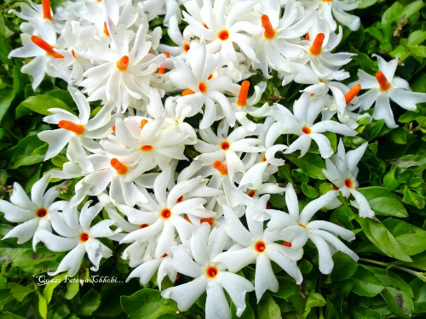
Maria can not see but hear the birds singing and smell the flowers.
She is happy.

Slide 11
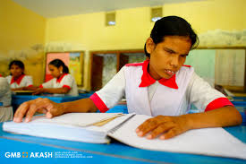
She goes to a school where she is learning to read using the braille.

Slide 12
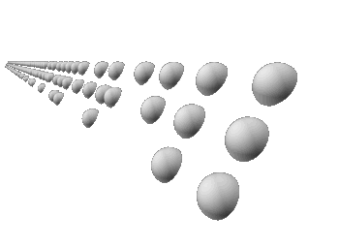
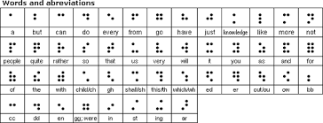
Braille is a kind of script in which words are written in a raised dots.

Slide 13
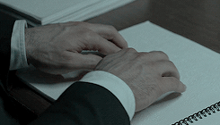
Visually impaired people read by touching it.

Slide 14
Maria is learning to read by touching the raised dots with her finger.

Slide 15
She loves to go to school.

Slide 16
She is a quick learner!
Maria’s teacher says,

Slide 17
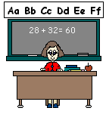
Teacher’s reading
Life Is Beautiful-page 75

Slide 18
Student’s reading

Slide 19
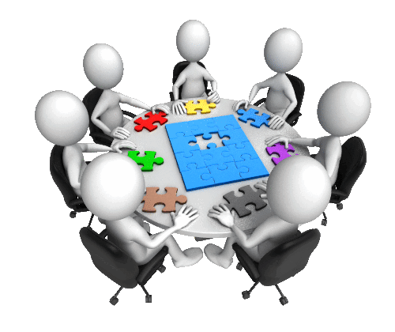
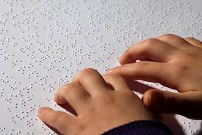
Group Work
Write five sentences about “Braille”

Slide 20
Write the correct answer:
1 Maria can not see because she was-
(a)Born blind (b) physically ill (c)disappointed (d) hopeless
2 Which organ does she use to read_________
(a) ear (b) hand (c) nose (d) eye
3 What type of student is Maria?
(a) Slow learner (b) weak learner (c) strong learner (d) quick learner
4 Who does use the “Braille”
Dumb people (c) deaf people
Physically impaired people (d) visually impaired people

Slide 21
Home
Work
How can you help a visually impaired people?
Write in five sentences

Slide 22
because she is visually impaired
Thanks!

