Slide 1
Welcome

Slide 2
Teacher’s Information
Md. Shamsul Alam
BA(Hons.)MA in English.
Assistant Teacher( English)
Nabodoy Girls High School
Shailkupa, Jhenaidah.
Phone:01917-452052,01722-922691
Email:shamsul101085@gmail.com

Slide 3
Lesson Information
Class : Nine/Ten
Subject English for Today
Unit 03
Lesson : 03
Time : 50 Minutes
Date : 18/ 12/ 2022

Slide 4
Let’s hear a song.

Slide 5
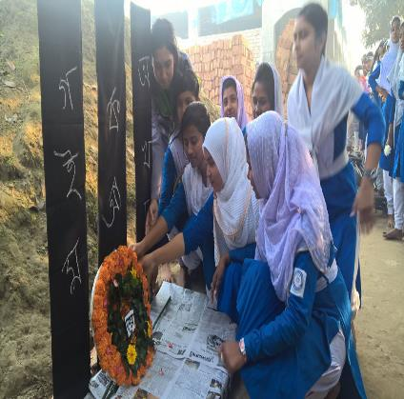
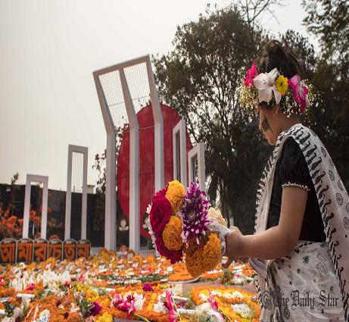
Students and teachers are going to the shahid miner to respect the martyrs who laid dawn their lives for our mother language in 1952.

Slide 6
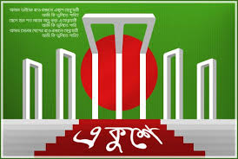
1. What’s the picture about?
➢Ans: Shaheed Minar.
2. Why was it built?
➢ Ans: For the Symbol of Shaheed who sacrifices of the
martyrs for the rightful place of Bangla.
3. Why ${21}^{st}$ February is a red letter day?
Ans: The ${21}^{st}$ February is a red letter day of
International Mother Language Day.

Slide 7
Lesson Declaration
International Mother’s Language day- 1

Slide 8
Learning Outcomes.
By end of this lesson students will able to…..
1 .tell about the language movement in 1952.
2 . Read the text
3 .understand new words.
4 .complete the chart.
5 Writing a paragraph about international mother language day.

Slide 9
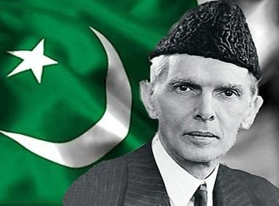
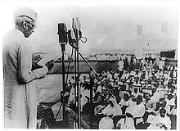
Can anybody tell me who is the person about this pictures?
Mohammad Ali Zinnah,He was Governor General Of Pakistan in 1952.

Slide 10
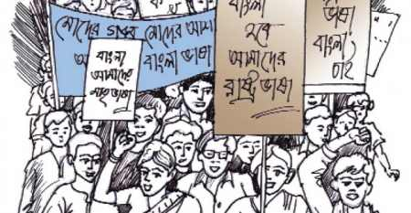
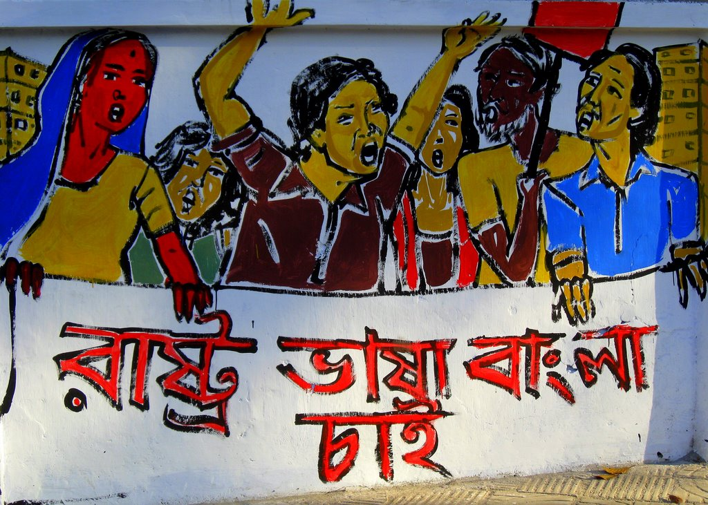
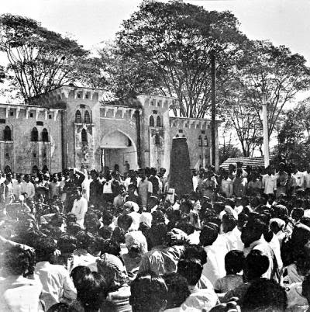
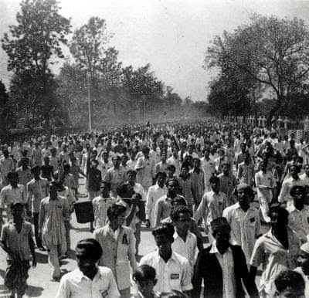
Why did the student’s of Dhaka University arrange a peaceful procession in 1952?
When Mohammad Ali Zinnah declared that Urdu would be the only state language of Pakistan, then the student’s of Dhaka University arranged a peaceful procession .

Slide 11
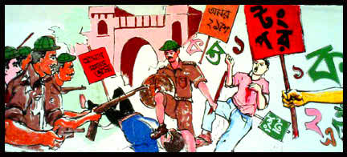
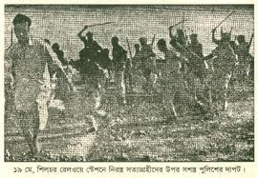
Why did the police attack on the peaceful procession?
Because, police wanted to rush the procession.

Slide 12
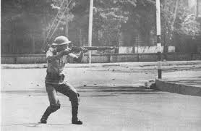
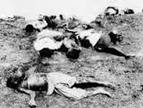
The students of Dhaka University defied the law and they brought out a peaceful protest procession on 21st february 1952, When the procession reached near the Dhaka Medical College the police opened fire on the students, Killing Salam ,Baratk, Rafiq, Safiur, and Jobber and many unknown people.

Slide 13
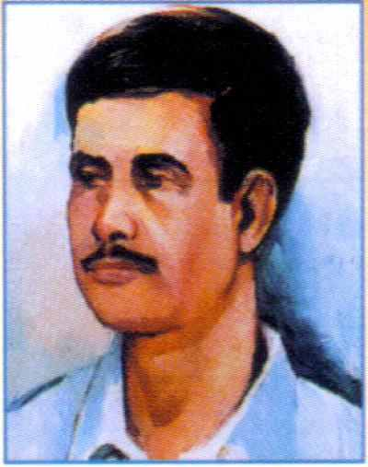
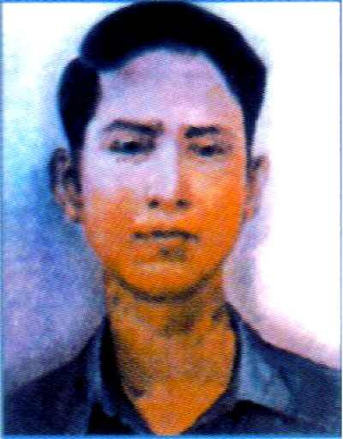
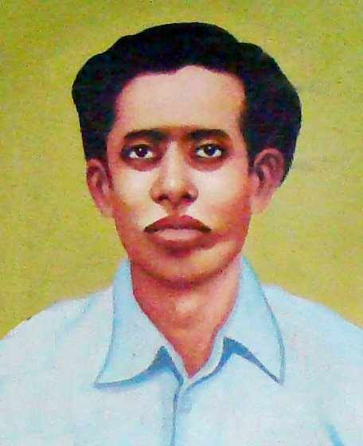
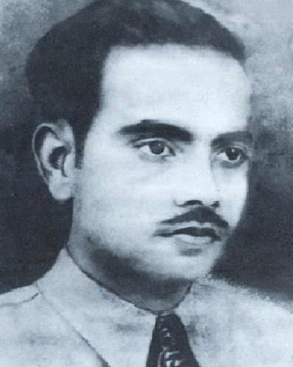
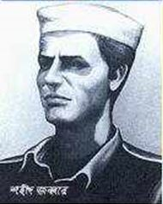
Now we will see some pictures who sacrificed their lives for our mother language in 1952
Salam
Barkath
Rafique
Shafiur
Jabber

Slide 14
EVALUATION(Individual Work)
1.What happened when Urdu was declared as the only
official language of Pakistan?
Ans: The declaration raised a storm of protest in East Pakistan. It continued non-stop. The government banned all types of public meeting.
2. Choose the best answer :
Q. The police opened fire on the students of ……… .
Dhaka Medical College ii) Dhaka University.
iii) Dhaka Dental College iv) Dhaka College.

Slide 15
Silent Reading (5min)
Unit:03
Lesson :03
International Mother’s Language Day-1

Slide 16
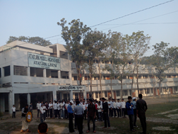
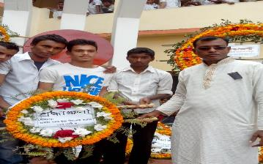
Word Meaning
1. Establish =
= Set up
2. Tribute =
= Honor.

Slide 17
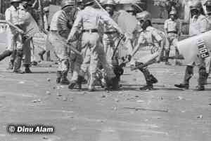
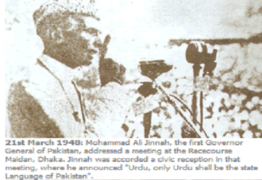
3. Defy =
= To refuse to obey.
4. Undivided =
= whole, not divided.

Slide 18
Match the words with meaning. (Pair work )
Words
Meanings
(a) Tribute
(a) to have a particular effect
(b) climax
(b) to refuse to obey
(c) outlaw
(c) to give in
(d) defy
(d) the ability to keep increasing or developing
(e) Provoke
(e) an act to show respect or admiration
(f) relent
(f) the most exciting point in time
(g) momentum
(g) to ban

Slide 19
EVALUATION(Group work)
Give the short answer on the fallowing question.
(a) What language do you speak?
(b) What did Zinnah declare in a public
meeting in 1948?
(c) Which day is known as shaheed Dibosh?
(d) Who is Mohammad Ali Zinnah?

Slide 20
Home works
❖ Write a paragraph on $′{21}^{st}$ February’ by answering the following questions.
(a) What is ${21}^{st}$ February?
(b) What do the people do on the day?
(c) How do they walk to the Shaheed Minar?
(d) What do they do for the salvation of the
martyr’s soul?
(e) How the day is observed by government
officials?

Slide 21
Thanks to all.

