Slide 1
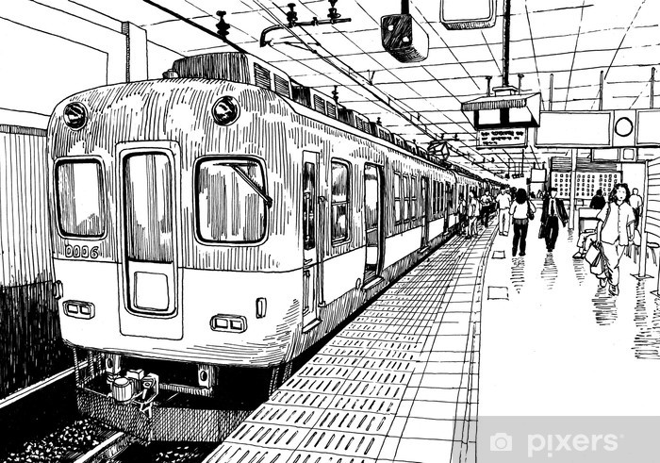
Welcome

Slide 2
Teacher’s Identity
Faridul Islam
Assistant Teacher (English)
Pakhimara Prafulla Bhowmik Secondary School
Contact: 01721913032
faridul13579@gmail.com

Slide 3
Lesson Identity
Class: Six
Subject: English Second Paper
Unit: 01- Lesson: 07
Time: 50 Minutes.
Date: March 14, 2022

Slide 4
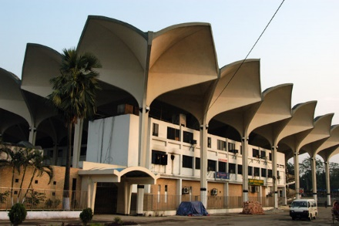
Do you know the name of this place?
Can you tell where is it situated?

Slide 5
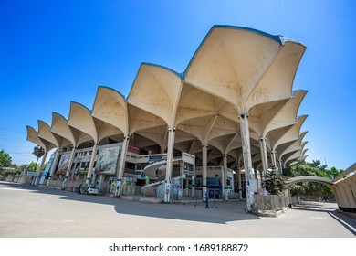
A Railway Station
Our today’s lesson …
Unit-1, Lesson-7

Slide 6
Learning outcomes
After completing this lesson you will be able to …
listen to the audio and answer the given textual question.
make an announcement.

Slide 7
Let’s go through the text.

Slide 8
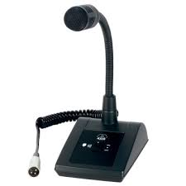
A. Listen to the audio of an announcement at a railway station.

Slide 9
Meaning of two new words
Boarding: Boarding is the entry of passengers onto a vehicle, usually in public transportation (like- rail, water or air transportation). Boarding starts with entering the vehicle and ends with the seating of each passenger and closing the doors.
Pre-boarding: Pre-boarding is a boarding call on the public announcement system for the passengers inviting them with small children or any passengers requiring special assistance, to begin boarding. In this process, passengers are asked to be ready after their boarding pass inspected before the vehicle/transport is ready to start.

Slide 10
Listening text: 3
What is the announcement for?
Where is the train going?
What platform will the Subarna Express stand at?
Where can the passengers buy their tickets?
Why should a passenger not travel by train without a ticket?
Where are the passengers asked to wait to get on the train?
What are the passengers asked to do to get to the platform?

Slide 11
Listening text answer: 3
The announcement is for the passengers of Subarna Express.
The train is going to Chittagong.
The Subarna Express will stand at platform no.1.
The passengers can buy their tickets from counter number 5 of the booking office.
Because travelling by train without a ticket is punishable offence by law.
The passengers are asked to wait on platform 1 to get on the train.
The passengers are asked to use the foot over bridge to go to the platform.

Slide 12
B. Write a similar announcement for the passengers of a luxury bus at a bus station. Give the passengers necessary instructions, including departure and arrival times, place and time for lunch break, etc. in the announcement.
Sample answer
Pre-boarding announcement: Dear passengers, welcome to RK Travels. Our trip from Dhaka to Cox’s Bazar will start at 8 tonight. We will need 11 hours to reach Cox’s Bazar. During the journey we will provide you 2 twenty minutes breaks. You will get the first break in Cumilla. The second break will be in Chattogram. We will reach Cox’s Bazar by 7 in the tomorrow morning. All the passengers are requested to get ready because you will have to board on the bus within next 30 minutes. Please, take care of your luggage and don’t leave these unattended. Take your seat according to the mentioned number in your tickets. If you need any help the bus supervisor will attend you. Have a nice journey with us. Thank you.

Slide 13
That’s all for today.

