Slide 2
Teacher’s Introduction.
Mijanur Rahman
Assistant Teacher
Gopalpur(Uttar) Gov’t Primary School.
Durgapur ,Netrakona.

Slide 3
Lesson identity
Class: Four
Subject: English
Lesson 1
Tittle: Occupation

Slide 4
Learning outcomes
By the end of the lesson student will be able to-
1.1.1 repeat after the teacher and say words, phrases and sentences with proper sounds and stress.
3.1.1 ask and answer simple WH question.
6.2.1 talk about people, objects,event etc.
1.4.1 read word, phrases and sentences in the text.
1.6.1 answer to the questions.

Slide 5
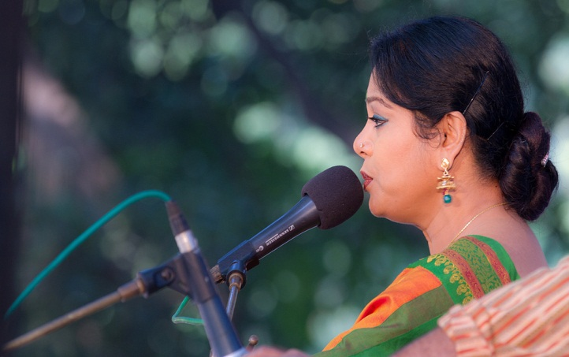
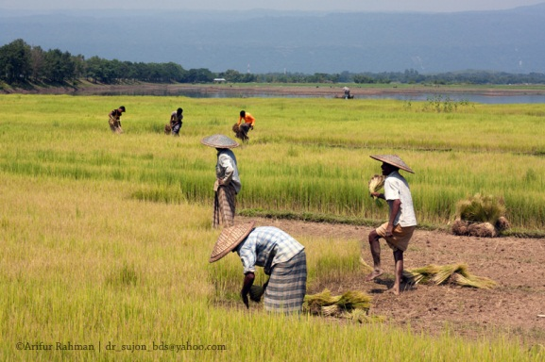
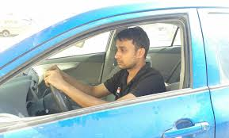
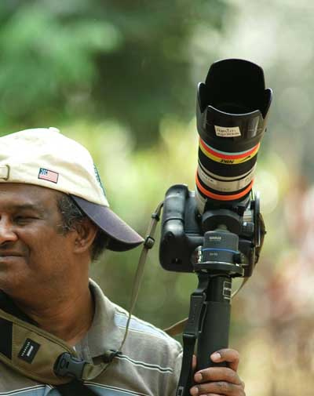
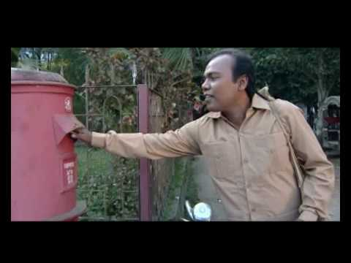

Slide 6
Today’s Lesson.
Occupations

Slide 7
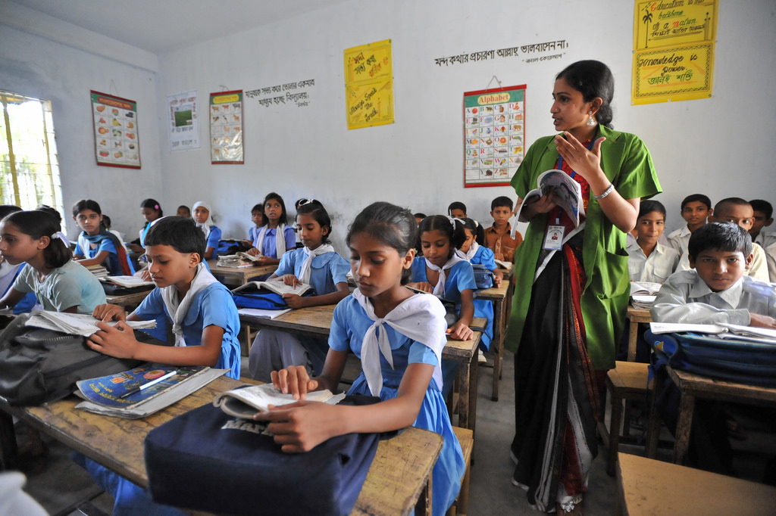
Open your book page at-78

Slide 8
farmer
photographer
singer
postman
doctor
driver

Slide 9
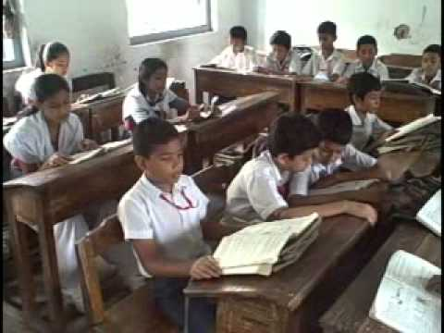
Text the read

Slide 10
Who is farmer?
He/She grows food.
Who is doctor?
He/She helps sick people.
Who is postman?
He brings letter to people.
Who is photographer?
He/she takes photos.

Slide 11
Group work
Group-1
Answer to the questions
1.Who grows food?
2. Who helps sick people?
Group-2
1.Who takes photos?
2.Who sings songs?
Help the teacher in text.
Group-3

Slide 12
Task
What do you want to be when you will grow up?
I want to be a [Doctor/singer/photographer/postman------]

Slide 13
Thanks everybody
See you again.

