Slide 2
Teachers Identity
MD.Ershadul Haque
Assistant teacher
Bhalukapara St. Teresa’s High School.
Class : Six
Subject: English 2nd paper
Topic: Sentence

Slide 3
Learning outcomes
By the end of the lesson students will be able to -
1.say what is sentence?
2 . Kind of sentences.

Slide 4
I was a student of class six in this school.
Now I am a doctor.

Slide 5
Todays topic
is
‘’Sentence’’

Slide 6
Sentence : A sentence is a combenation of words with a subject and predicate and expresses a complete thought or ideas.
Kinds of sentences.
1 . Assertive Sentence: A sentence that states something is an assertive sentence.
Rina is a girl.
2.Interrogative sentence:
A sentence that ask a question is an Interrogative sentence.
Are you well ?
3.Imperativesentence: A sentence that expresses an order,request or a prayer is an Imperative sentence.
Do this.
4.Optative sentence: A sentence that expresses wish is called an Optative Sentence.
May you be happy.
5.Exclamatory Sentence: The sentence which indicates an emotion or strong felling is called an exclamatory sentence.
Hurrah! We have won the match .

Slide 7
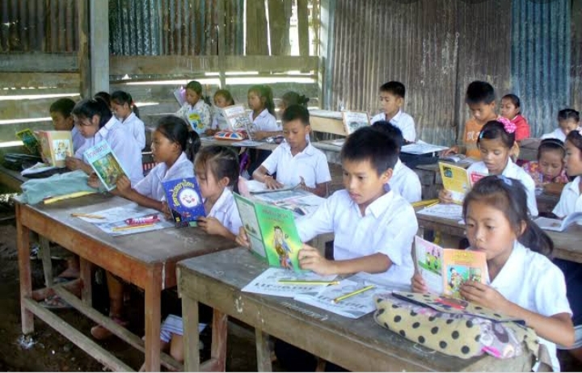
Make a assertive sentence in your own idea.

Slide 8
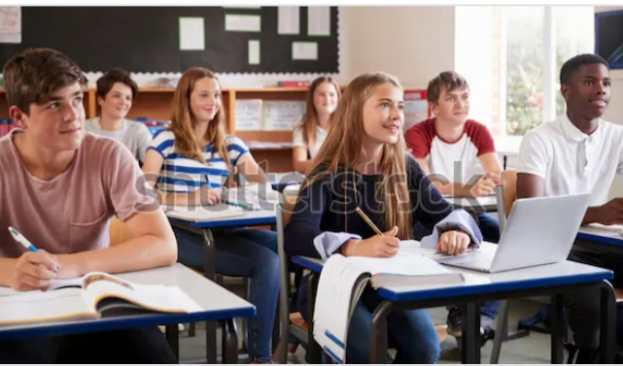
Make a meaningful sentence from these following words.
Sun, the ,rises, east, in ,the ,

Slide 9
Say what kinds of sentences are the following :-
Allah is merciful .
Alas ! I am done for.
Who are you?
May Allah help you.
Obey your teachers.

Slide 10
Five meaningful sentences make your own idea.

