Slide 1

Welcome

Slide 2
Identity
Teacher’s Identity
Abdur Rahaman
Head Teacher
Otarhat Govt Primary School
Kabirhat, Noakhali
  Lesson Identity
  Class: Three
  Sub: English
  Unit: 3
  Lesson: 4-6
  Part of the Lesson: Alphabet

Slide 3
Create Safety Environment
Let’s watch this video

Slide 4
Today’s Lesson
Alphabet
(Kk-Oo)

Slide 5
Learning outcomes
At the end of the lesson students will be able to-
1.1.1 become familiar with English sounds by listening to common English words.
1.1.1 repeat after the teacher simple words and phrases with proper sounds and stress.
1.1.2 say simple words and phrases with proper sounds and stress.
1.2.1recognize and read the alphabet both small and capital (non-cursive).
1.3.1 recognize and read the name of objects having the same initial and final sounds.

Slide 6

Look, listen and say.
W.C.W
K k
Kite

Slide 7
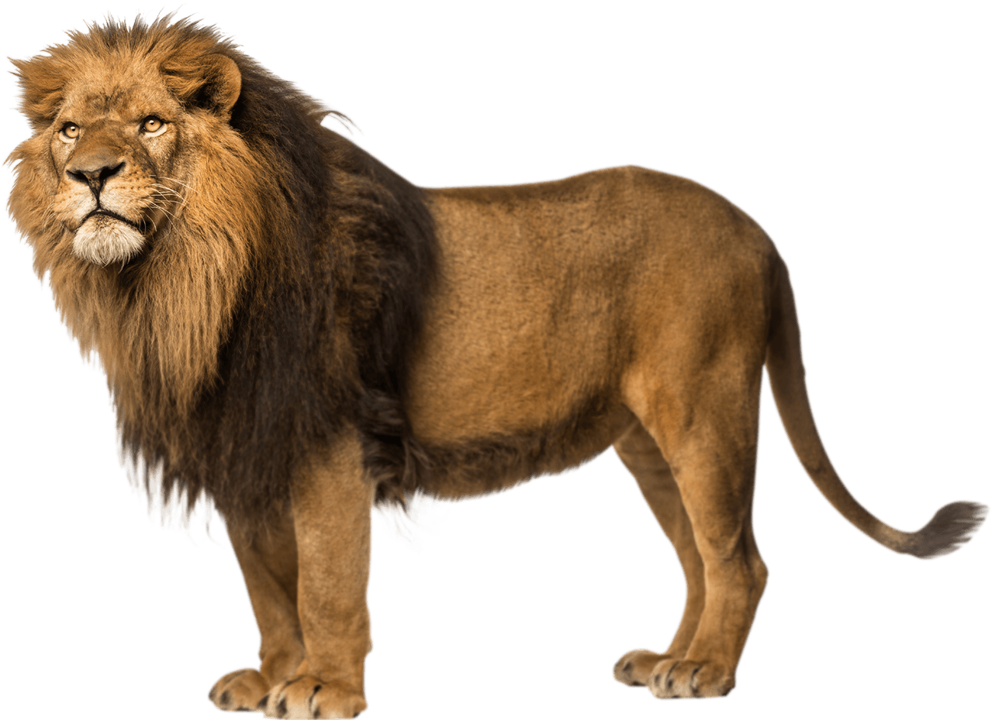
Look, listen and say.
W.C.W
L l
Lion

Slide 8

Look, listen and say.
W.C.W
Mm
Mango

Slide 9
Look, listen and say.
W.C.W
N n
Net

Slide 10
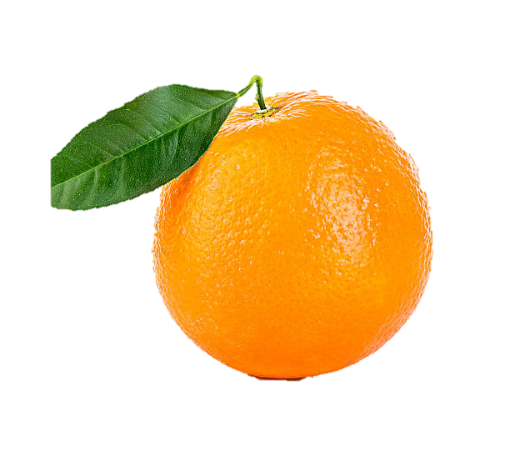
Look, listen and say.
W.C.W
Oo
Orange

Slide 11
Say, trace and write.
WCW
kite
lion
mango
net
orange

Slide 12
I.W
Write words
K=
k=
L=
l=

Slide 13
Write words
I.W
M=
m=
N=
n=

Slide 14
I.W
Write words
O=
o=
O=
o=

Slide 15
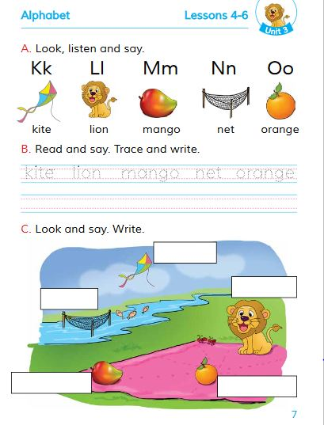
Open your EFT Book
WCW
Page No. 7

Slide 16
Match with pictures:
P.W
lion
mango
kite
net
orange

Slide 17
Write the missing letter.
I.W.
ango
ion
M
ite
L
K
range
et
O
N

Slide 18
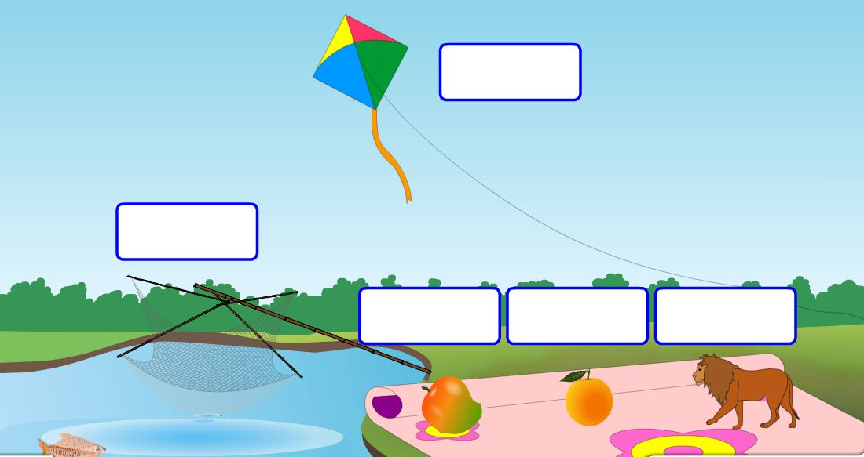
Filling the box.
Group work
Kite
Net
Mango
Ornage
Lion

Slide 19

Home work
I.W.
Write 2 words with the every letters by the help of elder.

Slide 20
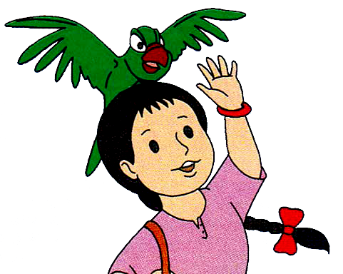
B
Bye,bye.

