Slide 3
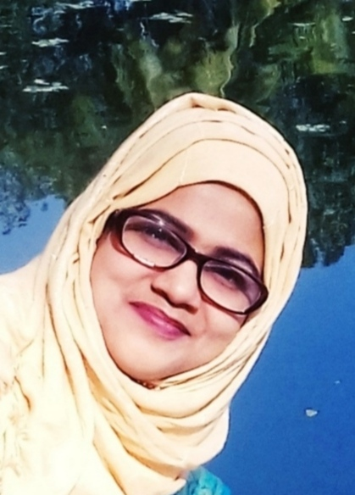
Teacher’s Identity
Sabiha Parvin
Assistant Teacher
Bagbary Chowbaria GPS
Tangail Sadar, Tangail

Slide 4
Subject’s Identity
Subject: English
Class: two

Slide 7
Creating safety environment: By Greeting song

Slide 8
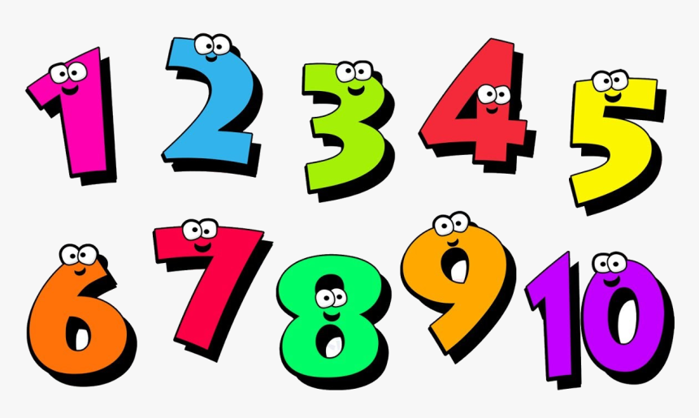
Numbers
What do you see?

Slide 9
Unit 6 , Lesson:1-3(B)
Numbers
We will read today.

Slide 10
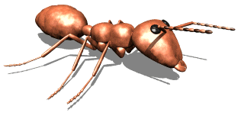
How many ants here?
Count with me.
8
Eight

Slide 11
How many balloons here?
Count with me.
9
Nine

Slide 12
How many balls here?
Count with me.
10
Ten

Slide 13
Say and Look at the tracing.
8
9
10
Eight
Nine
Ten

Slide 14
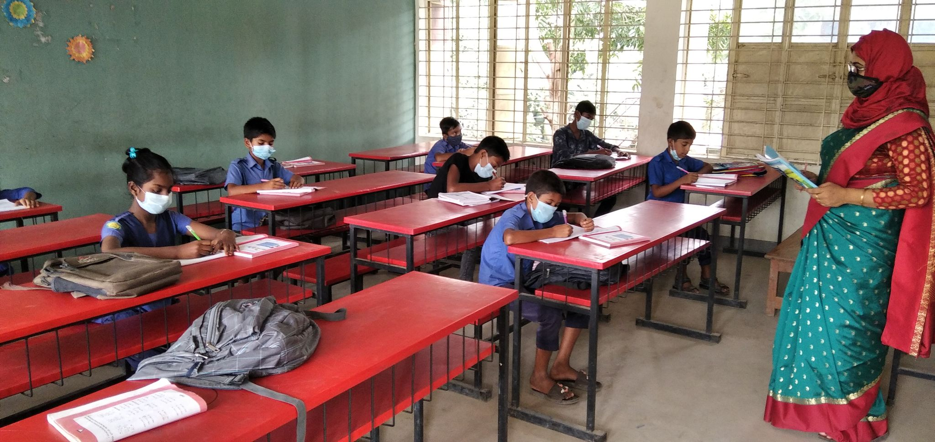
8 - Eight
Say after me.
9 - Nine
10- Ten

Slide 15
Open at page 12.

Slide 16
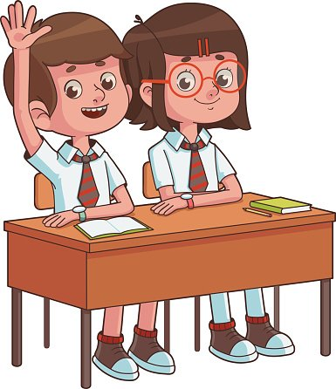
Pair work.
Write 8, 9, 10 and spell these.

Slide 17
Evalution.
Individual work.
Come in front of the board and write 8,9,10.

Slide 19
It’s time to say …….

