Slide 1
WELCOME
TO
ENGLISH 1ST PAPER CLASS
CLASS-VIII

Slide 2
PREPARED AND PRESENTED BY:
Mst. Kohinoor Akter Banu
Assistant Head Master
Alampur Secondary Girls School
Kushtia Sadar Kushtia
Mobile no- 01716494605

Slide 3
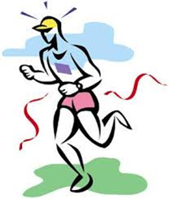
TODDAY’S TOPIC
Physical exercise
Unit-3
Lesson-6

Slide 4
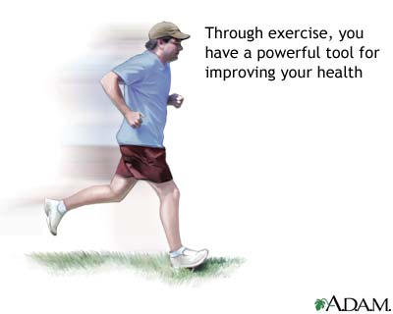
LEARNING OUTCOMES
By the end of the lesson the learners will be
able to…
ask and answer questions
explain the text
write the usefulness & importance of physical exercise

Slide 5
Work in pair-pre text reading activity
Look at the picture and talk about it with your partner. After that, answer the following questions.
1.Who can you see
in the picture?
2.What is he doing ?
3.Can you tell me
what it is called?
Notes:
After eliciting the answer the teacher can asked 1-2 students to say 5 sentences on the picture.

Slide 6
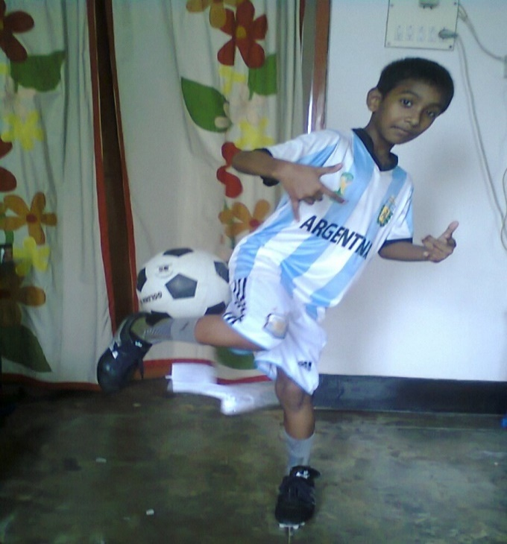
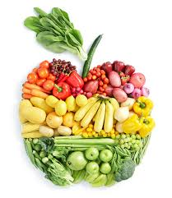
Physical(aDj)
Of the body or pertaining /
relating to the body
The Mind-Body Connection
As they eat healthy foods and take exercise regularly, they have physical fitness to do any work.

Slide 7
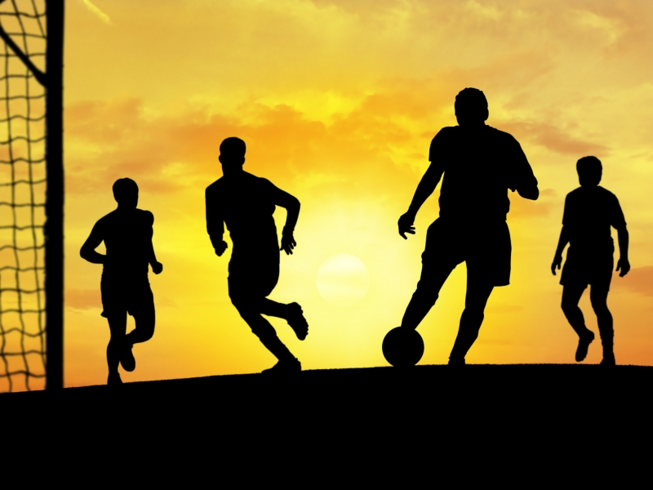
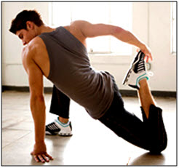
PHYSICAL EXERCISE
Physical exercise is any bodily activity that enhances or maintains physical fitness and overall health and wellness.

Slide 8
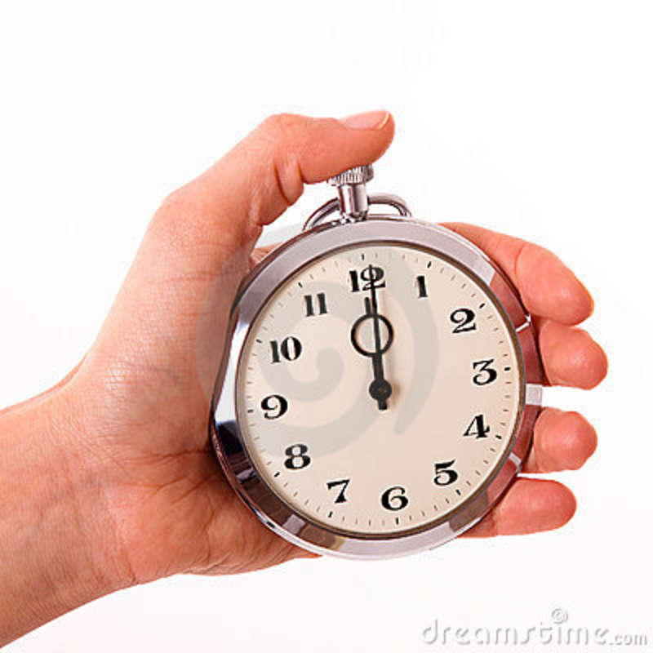
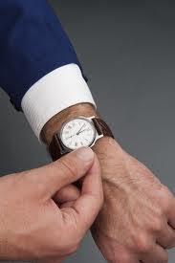
PUNCTUALITY
orderliness, being on time
We should have the knowledge about punctuality
so that in all the time we can be on time.
noun

Slide 9
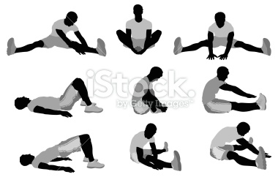
STRECH
distend
widen,
to lengthen
to lengthen, widen, or distend shape.
Notes:
The teacher can ask the students to prono

Slide 10
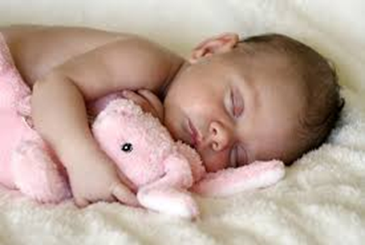
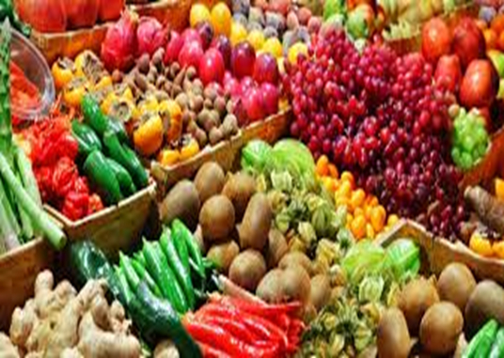
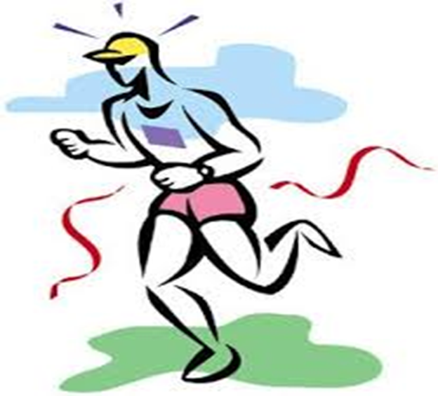
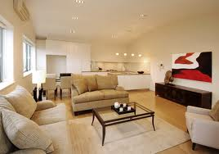
PROPER REST AND SLEEP
Being/keeping
Regular physical exercise

Slide 11
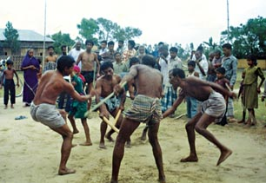
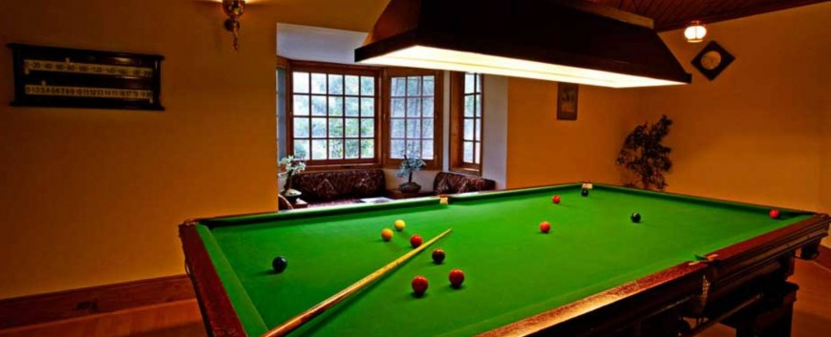
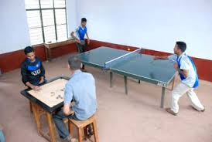
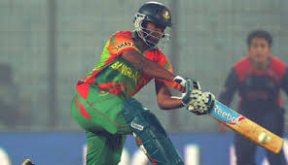
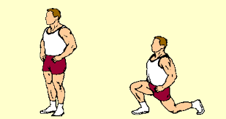
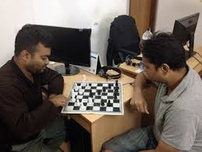
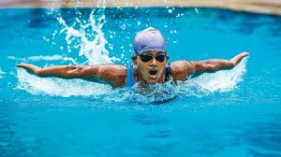
Different types of physical exercise:
Showing pictures I will explain the activity.
Outdoor games
Indoor games
Free hand exercise

Slide 12
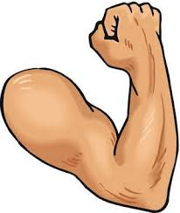
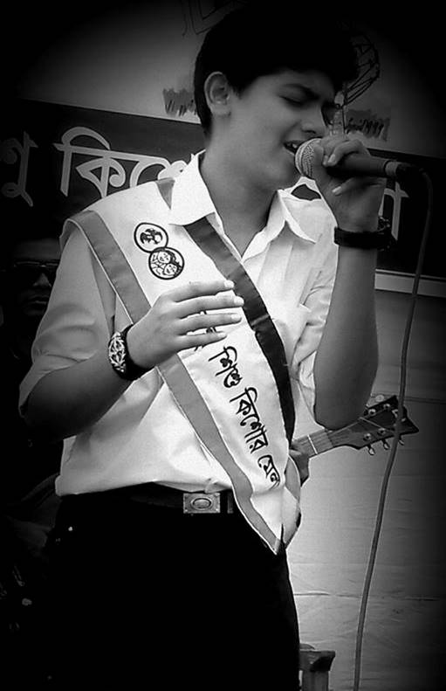
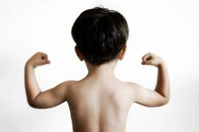
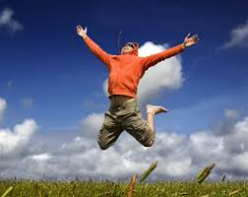
Why do we need physical exercise ?
to be
strong
to be cheerful

Slide 13
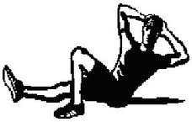
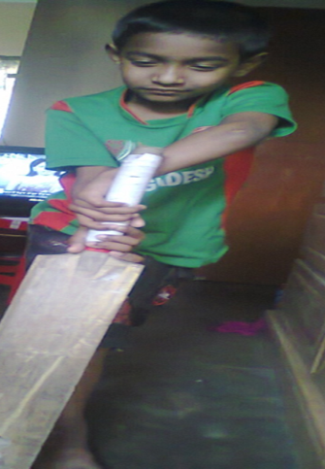
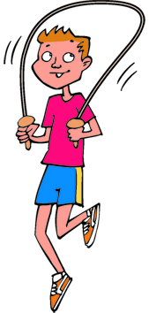
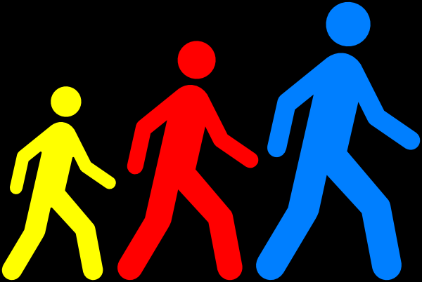
C. A list of indoor and outdoor exercises, Now go to board and write which ones are indoor and outdoor games
1.Playing sports
2.Swimming
3.Skipping
4.Jogging
5.walking
6.stretching

Slide 14
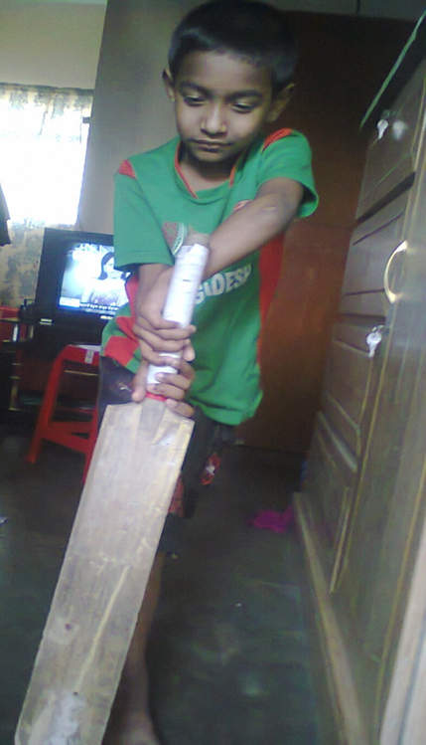
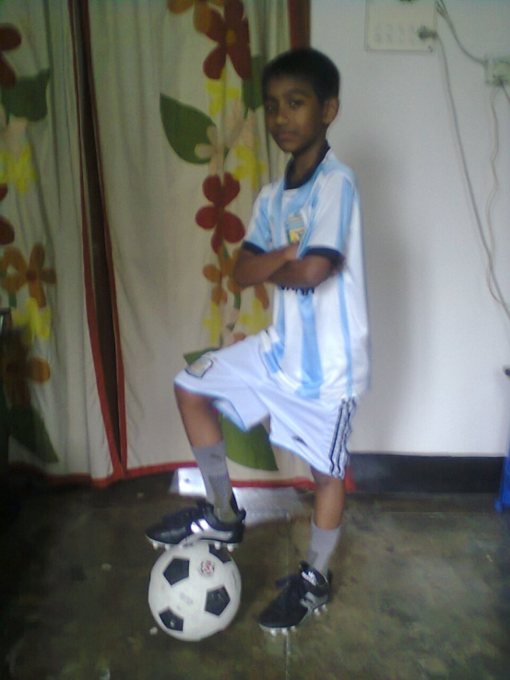
HOME WORK
What’s your favourite sport? Do you take
part in it? If so , where do you play it and
who with? Now write a paragraph on it
answering the above questions?

Slide 15
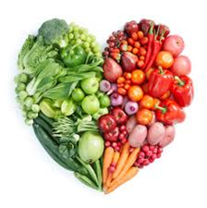
TAKE EXERCISE, PROPER REST AND SLEEP,
EAT GOOD FOOD
&
REMAIN HEALTHY.
THANK YOU A LOT

Slide 16
Acknowledgement
MoE, DSHE, NCTB & A2I respective officials
And the editors panel:
Mr. Ranjit Poddar, Associate Prof, TTC, Dhaka,
Mr. Md. Jahangir Hasan, Asst. Prof, TTC, Rangpur,
Urmila Khaled Asst. Prof, TTC, Dhaka.
Their direction, valuable suggestions and intensive supervision have enriched the model contents.

