Slide 1
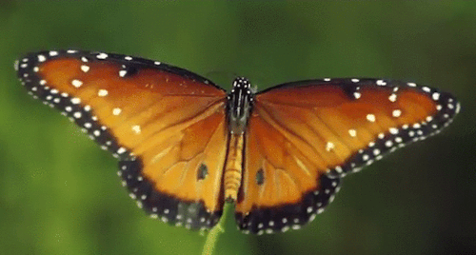
Wellcome

Slide 2
Identification
Teacher’s Identification
ABDUR RAHAMAN
Head Teacher
Otarhat Govt. Primary School
Kabirhat,Noakhali
Lesson Identification
Class : Three
Sub: English
Lesson: 4 – 6
Unit: 23
Page No. 47
Time: 45 minutes

Slide 3
Let’s we sing a song.
We shall overcome
We shall overcome
We shall overcome someday
Oh deep in my heart, I do believe,
………………………………..

Slide 4
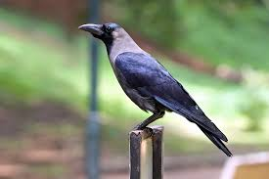
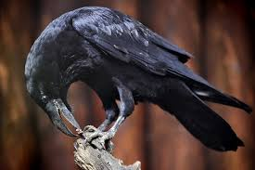
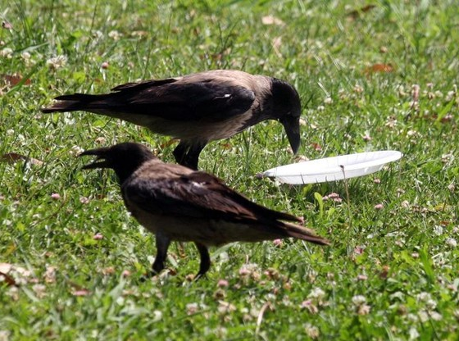
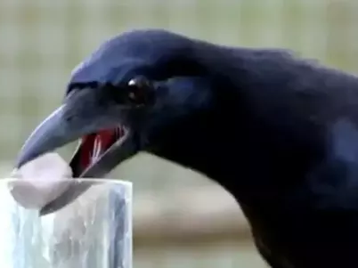
What do you see in the picture?

Slide 5
Welcome everyone in today's lesson
What do they do?

Slide 6
Learning outcomes:
Students will be able to
Listening: 1.1.1- recognize English sound difference in the context of words.
Speaking: 1.1.1- repeat words, phrases and sentences after the
teacher with proper sounds and stress.
1.1.2- say words, phrases and sentences with proper
sounds and stress.
Reading: 1.5.1- read simple sentences with proper
pronunciation and stress.
5.1.3- read text

Slide 7
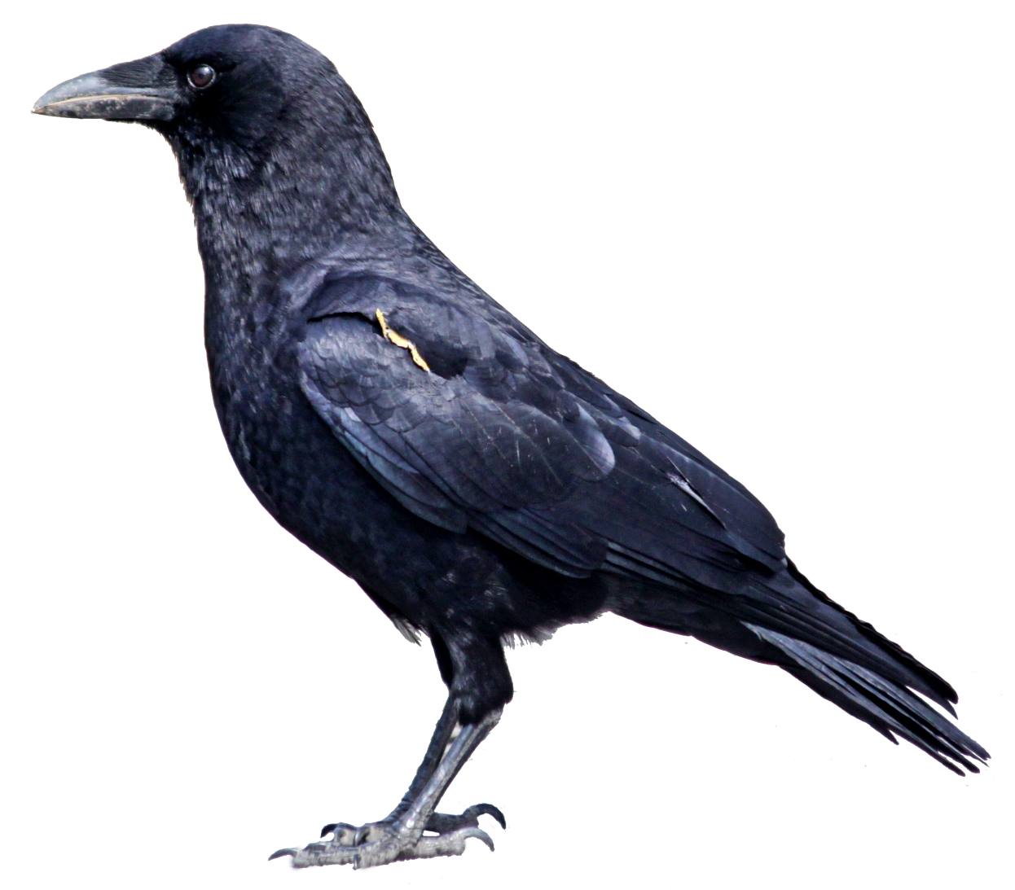
Look at the picture and say.
I’m a crow.

Slide 8
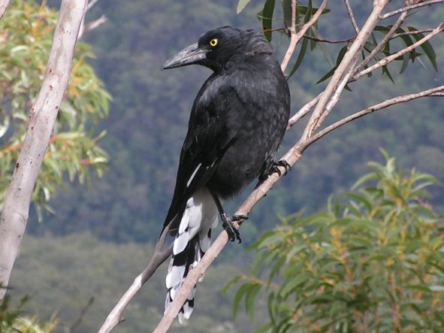
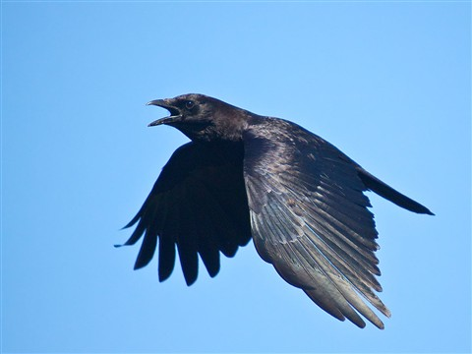
Look at the picture and say.
I live in a tree.
I get up early in the morning.

Slide 9
Look at the picture and say.
I’ m active all day.

Slide 10
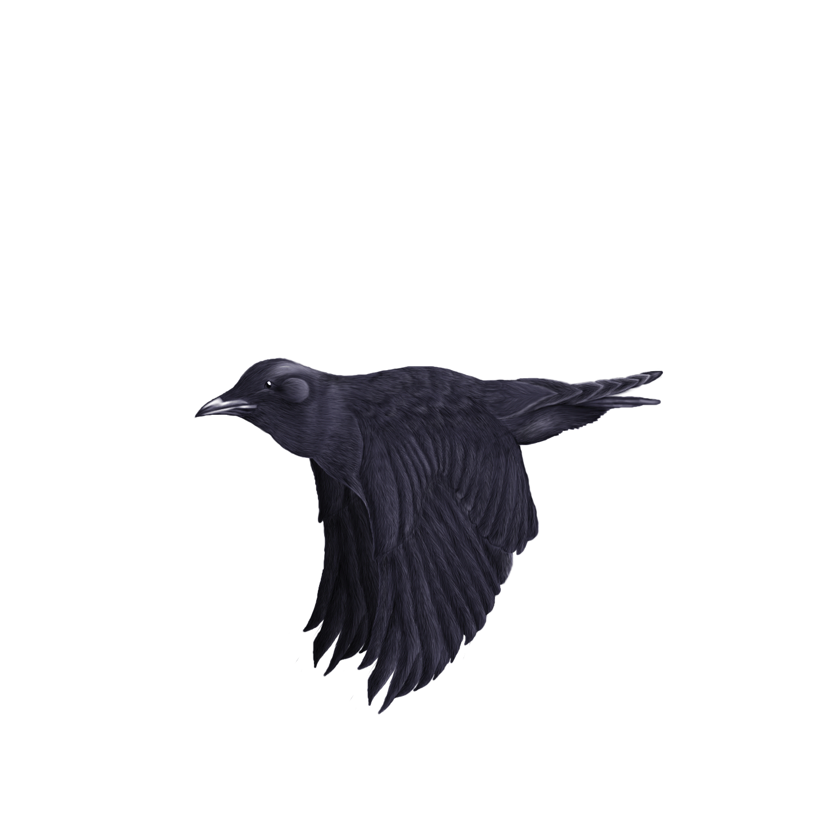
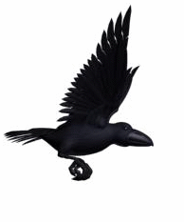
Look at the picture and say.
I fly in the sky.
and look for food.

Slide 11
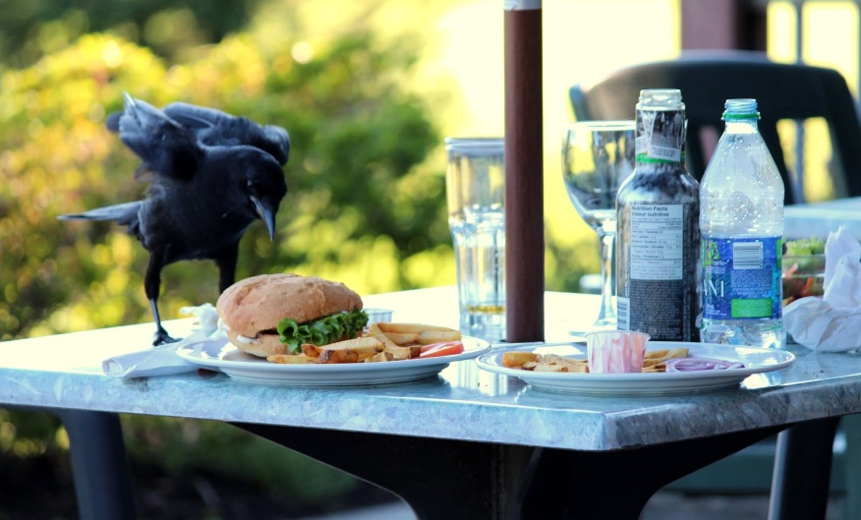
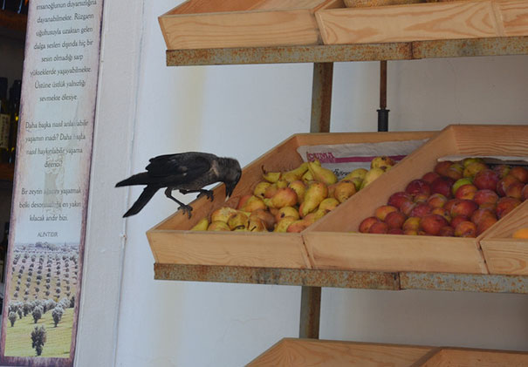
Look at the picture and say.
Sometimes I take food from people.
I’m very quick.

Slide 12
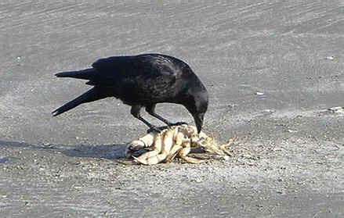
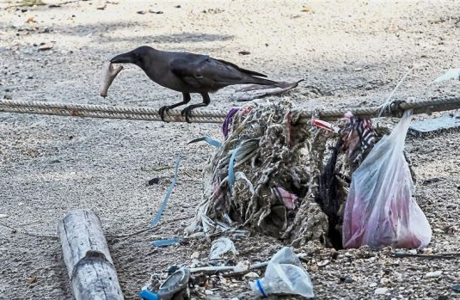
Look at the picture and say.
Sometimes I eat dirty things.

Slide 13
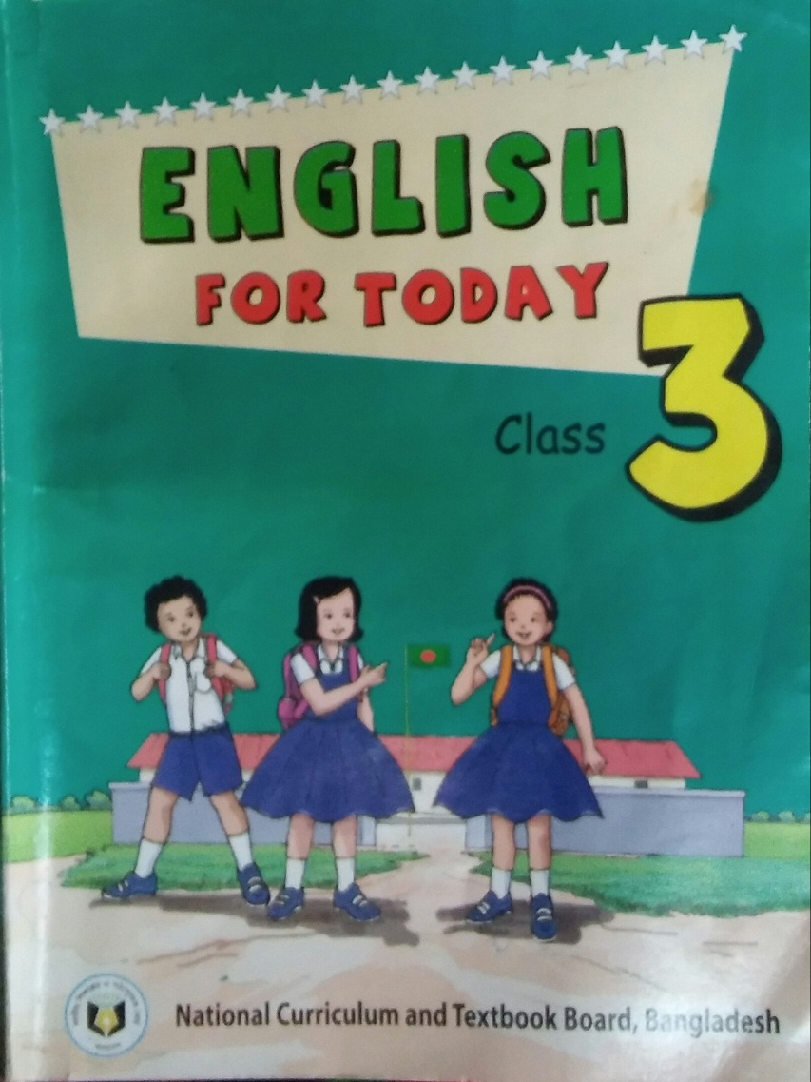
Open your book at page 47.

Slide 14
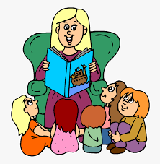
Teacher’s reading Loudly

Slide 15
Everybody listen and say after me.
I’m a crow.
I live in a tree.
I get up early in the morning.
I’ m active all day.
I fly in the sky and look for food.
Sometimes I take food from people.
I’m very quick.
Sometimes I eat dirty things.

Slide 16
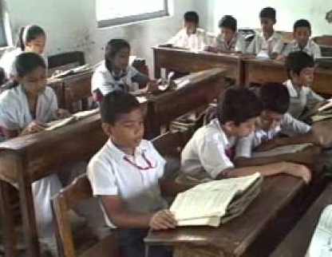
Student’s reading silently

Slide 17
Let us find out new words
Active
Live
Fly
Quick
Dirty

Slide 18
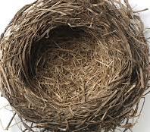
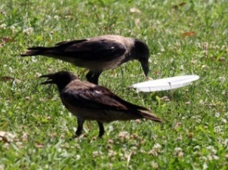
Word , similar word and make sentences
The crow lives in a nest.
Live
Nest
Active
The crow is active all day.
Working
Dirty
The crow eats dirty things.
Unclean

Slide 19
Let’s work in group
B. Read again. Say true or False.
1. The crow lives in a tree.
Answer: True
2. The crow is lazy.
Answer: False
3. The crow is slow.
Answer: False
4. The crow doesn’t eat dirty things.
Answer: False
5. The crow takes food from people.
Answer: True

Slide 20
Let’s work in pair
A. Read the text again and again
I’m a crow. I live in a tree. I get up early in the morning. I’m active all day. I fly in the sky and look for food. Sometimes I take food from people. I’m very quick. Sometimes I eat dirty things.

Slide 21
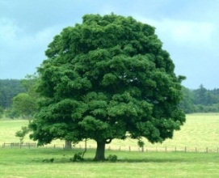
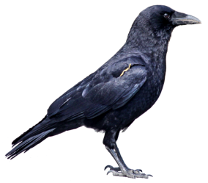
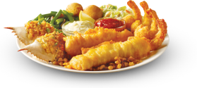
Individual work
See the pictures and say about these
Sky
Tree
Crow
People
Food

Slide 22
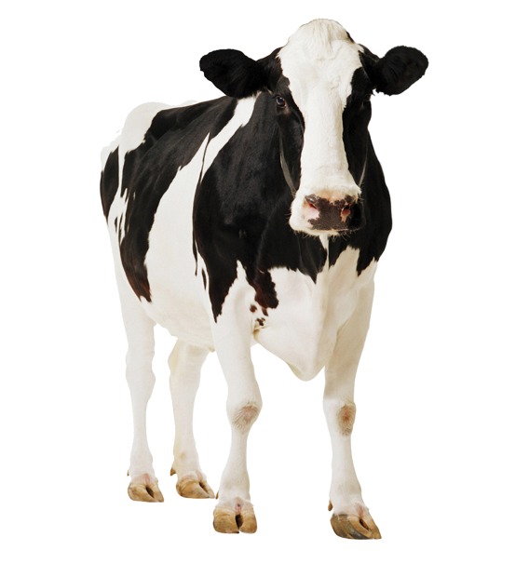
Checking learning
I’m a cow / goat.
I live in a stream/ shed.
cow
shed
I get up early / late.
I am a slow / quick animal.
early
slow

Slide 23
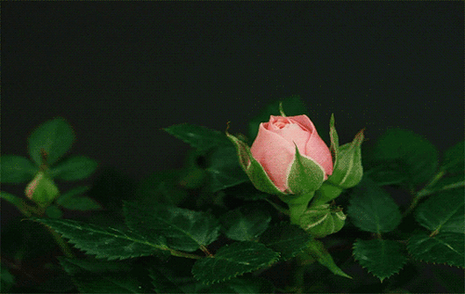
Good bye

