Slide 2
Welcome

Slide 3
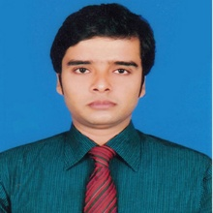
Presentation by
Md. Jubayer Hossain Jewel
Asst. Teacher
Ekannobigha Govt. Primary School
Singra , Natore.
Mobile: 01711943857
Email: jubayer.jewel@gmail.com

Slide 4
Lesson’s identy
Class: Four
Subject : English
Unit: 2 : Lesson: 1-2
Lesson Title:Greetings Today,sLesson:Look,
Listen and say.

Slide 5
Learning Outcomes
2.1.1:Carry Out Simple Commonds
And Instructions.
2.2.1:Carry Out a Set Of Commonds
And Instructions.

Slide 6
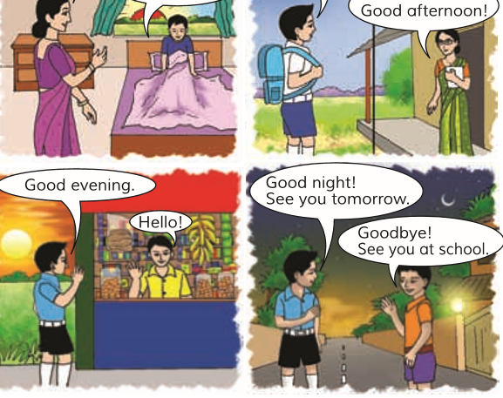
Let,s see some Pic
Look at Picture?What can u see in the picture? What About the Picture Is?

Slide 7
Declear Lesson
Greetings each others

Slide 8
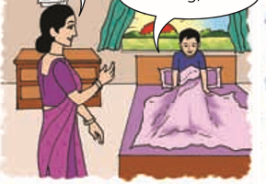
Good morning = শুভ সকাল

Slide 9
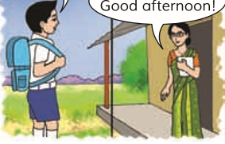
Good afternoon= শুভ বিকাল

Slide 10
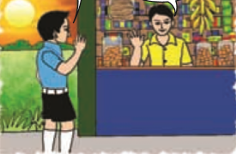
Good evening= শুভ সন্ধ্যা

Slide 11
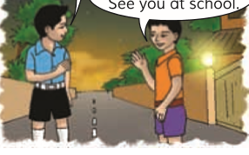
Good Night
= শুভ রাত্রি

Slide 12
Thank you, that’s all for today
See you tomorrow.

