Slide 1

Welcome to all
Notes:
Mohammad Ayub Ali- Senior teacher- R M Hat K High School- Motigonj- Sonagazi- Feni.

Slide 2
Let’s discuss transform of sentence today
Affirmative to negative
Her parents liked her very much.
Answer- Her parents did not dislike her at all.
b) Everybody must take care of his health all the time.
Answer- Everybody cannot but take care of his health all the time.
c) We all should avoid the killers of mankind.
Answer- We all cannot but avoid the killers of mankind.
Notes:
Mohammad Ayub Ali- Senior teacher- R M Hat K High School- Motigonj- Sonagazi- Feni.

Slide 3
d) As soon as their real identity gets revealed, people leave them.
Answer- As soon as their real identity gets revealed, people do not stay with them.
e) The electricity lights both the streets and the houses.
Answer- The electricity lights not only the streets but also the houses.
f) He was very kind to the poor.
Answer- He was not unkind to the poor at all.
g) We must create social movement about reading books.
Answer- We cannot but create social movement about reading books.
Notes:
Mohammad Ayub Ali- Senior teacher- R M Hat K High School- Motigonj- Sonagazi- Feni.

Slide 4
h) We must try our best to improve its present position.
Answer- We cannot but try our best to improve its present position.
All men must die.
Answer- All men cannot but die.
j) Everybody avoids a corrupted man.
Answer- Everybody cannot but avoids a corrupted man.
k) Its functions are smooth and rapid.
Answer- Its functions are not only smooth but also rapid.
Notes:
Mohammad Ayub Ali- Senior teacher- R M Hat K High School- Motigonj- Sonagazi- Feni.

Slide 5
Let’s discuss Negative to Affirmative Sentence.
a) So, everybody cannot but be concious of his health.
Answer- So, everybody must be concious of his health.
b) He did not marry.
Answer- He was unmarried.
Or- He was bachelor.
c) Books give us not only knowledge but also pleasure.
Answer- Books give us both knowledge and pleasure.
Notes:
Mohammad Ayub Ali- Senior teacher- R M Hat K High School- Motigonj- Sonagazi- Feni.

Slide 6
d) Nobody is absolutely happy on the earth.
Answer- Everybody is not unhappy to some extent on the earth.
e) A patriot fears none but the creator.
Answer- A patriot fears only the creator.
f) There is no student but without smart phone.
Answer- Every student has smart phone.
g) It is not an easy thing.
Answer- It is an uneasy thing.
h) Nothing but books can remove the darkness of ignorance.
Answer- Only books can remove the darkness of ignorance.
Notes:
Mohammad Ayub Ali- Senior teacher- R M Hat K High School- Motigonj- Sonagazi- Feni.

Slide 7
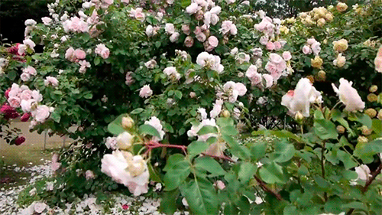
Good Bye My Dear Learners
Notes:
Mohammad Ayub Ali- Senior teacher- R M Hat K High School- Motigonj- Sonagazi- Feni.

