Slide 1
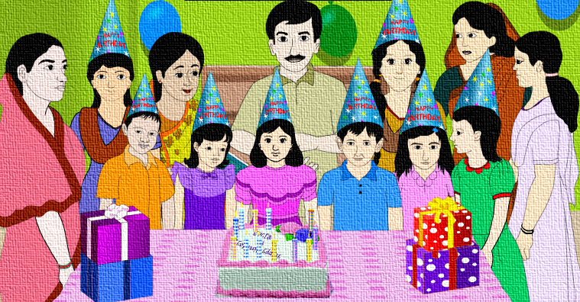

Slide 2
Welcome

Slide 3
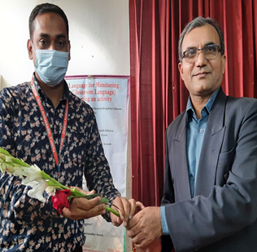
Md. Jashim Uddin
Assistant Teacher
Narayanpur Govt. Primary School
Chauddagram, Cumilla.
jashimuddinmasum@gmail.com
Class: Five
Sub: English
Unit: 15
Lesson: 1( A )
Time: 45 Mins

Slide 4
What do you see in the video?

Slide 5
Today we will read
Unit-15, Lesson-1 (A)
A person’s.......... and family.
Page -58

Slide 6
Learning outcomes
By the end of the lesson students will be able to…
3.4.1- understand statement made by the teacher
and students.
1.1.1- say words, phrases and sentences with proper
sound and stress.
5.1.1- read silently with understanding paragraph.

Slide 7
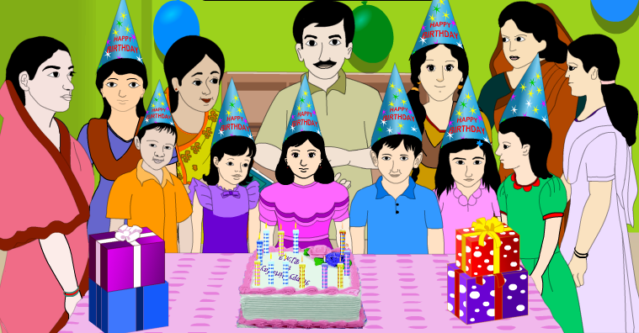
Let’s see the picture and think about it.
What is happening in the picture?
What can you see in the picture?

Slide 8
Let’s see the picture and think about it.
Who are there in the picture?
What is written top of the picture?

Slide 9
Now let’s see the picture and think about it.
What do these packets look like?
What do we do with these packets?
When do we present these to others?

Slide 10
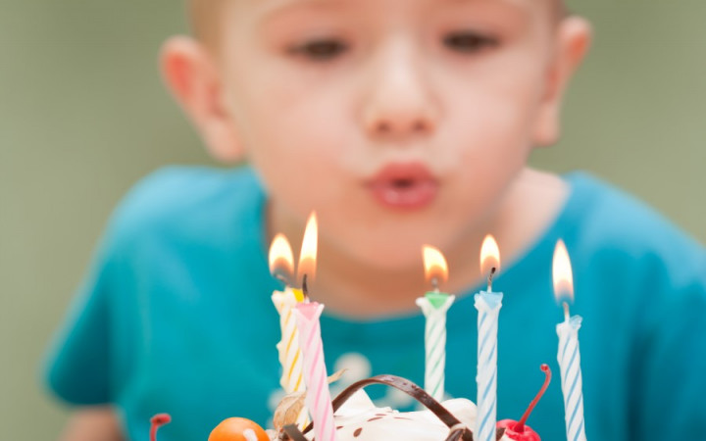
Blow out
Be extinguished by an air current.

Slide 11
Candle
A block of wax with a central wick which lit to produce light.

Slide 12
Celebrate
Acknowledge with a social gathering or enjoyable activity.

Slide 13
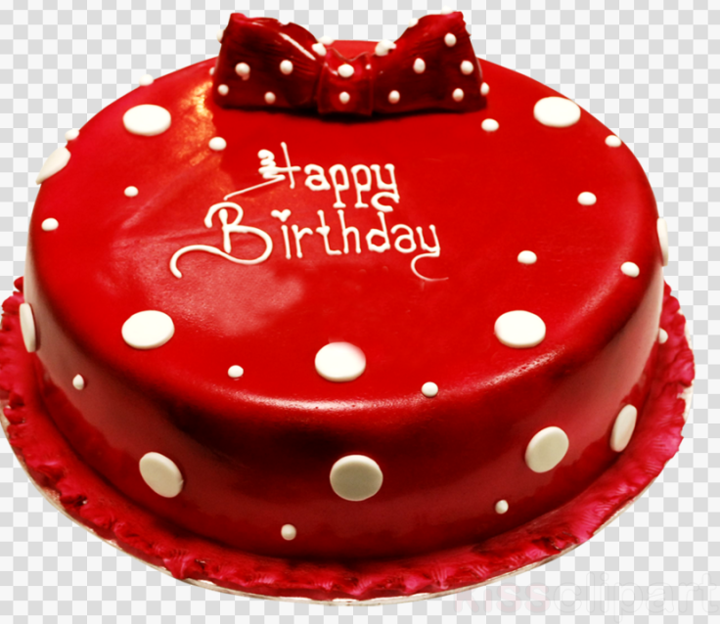
Cake
A type of soft sweet food made from mixture of flour, sugar, eggs etc.

Slide 14
Gift
A thing given willingly to someone without payment.

Slide 15
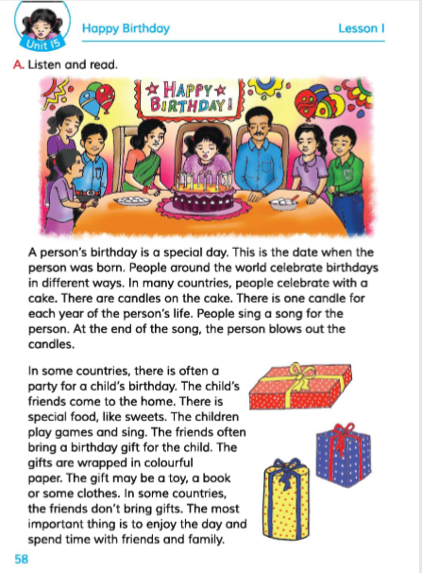
Teacher’s reading

Slide 16
Individual Work
Answer the questions
1.What is birthday ?
Ans : A birthday is a day when a person is born.
2.What is the most important thing on birthday?
Ans : The most important thing on a birthday is to enjoy the day and spend time with friends and family.
3.Who bring gifts for a child on its birthday?
Ans : A child’s friends bring gifts on its birthday.

Slide 17
Student’s reading

Slide 18
Pair Work
Match the words of the column A with their meanings in column B
Column-A | Column-B
a) Blow out | i) to make musical sounds with the voice.
b) Different | ii) to cover something completely.
c) Bring | Iii) to be extinguished by an air.
d) Wrap | iv) perceive with eyes.
e) Sing | v) without any doubt.
 | vi) not the same.
 | vii) to take something to a place.

Slide 19
Evaluation
Fill in the blanks.
born
special
placed
eat
candles
special
a. A birthday is a ----------- day to a person.
b. We ----------- special foods on birthday party.
c. We light ----------- on the birthday cake.
d. Candles are ------------ on the birthday cake.
e.This is the day when someone was------------ .
eat
candles
placed
born

Slide 20
Home work
Write five sentences about “Your birthday party”

