Slide 2
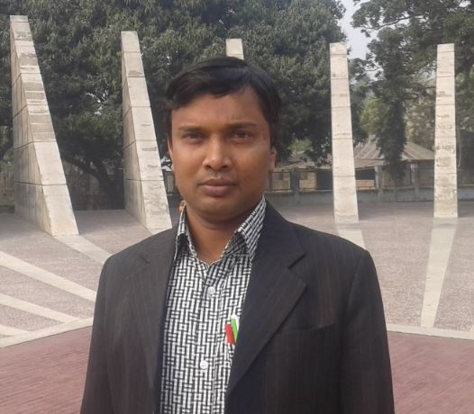
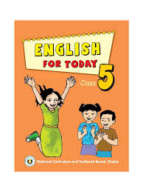
Identity
Md. Faruq Hossain
Assistant teacher
Anandabash Govt. primary school.
Mujibnagar, Meherpur.
Mobile no- 01717406029
E-mail- faruqbd01@gmail.com

Slide 3
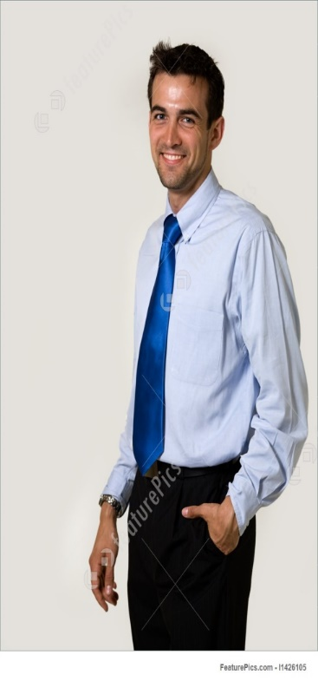
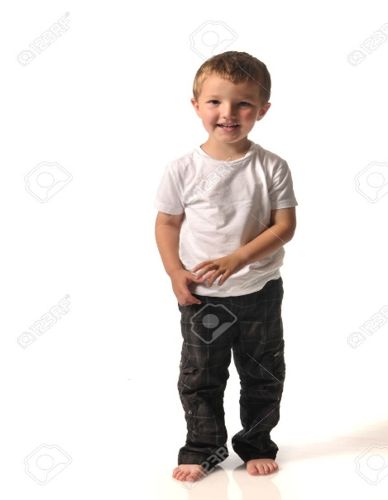
Think about the picture
Saikat
Saikat`s family

Slide 4
Today`s lesson
Saikats family
Seen Passage

Slide 5
Learning Outcome
3.2.1. To understand questions about family and friend. 3.1.1. To ask and answer Wh. questions. 1.5.1.To read sentences in proper pronunciation stress and intonation. 10.2.1. To write short and simple paragraph about daily routine.

Slide 6
Seen Passage
Question No- 1,2,3 & 4
1. Match given words with meanings/Fill in the blanks ------------05
2. Write true for correct and False for incorrect statement ----- 06
3. Answer short question --------------------------------------------------------------12
4. Short Composition---------------------------------------------------------------------10
Total = 33

Slide 7
Read the text and answer the questions 1,2,3 and 4.
Saikat Islam lives with his parents in a flat in Bogura. His father Mr. Rashidul Islam is a banker. But in his free time Mr Islam writes stories and listens to music. Saikat`s mother is Mrs Monwara Islam. She is a housewife. In her free time she enjoys sewing. She makes dresses. She often gets orders from her friends and neighbours. Saikat is in class 5. He is a good student. He wants to improve his English, so he watches cartoons on TV everyday. He also reads English books. He likes books about animals, especially tigers and lions.

Slide 8
Some word meanings
Live
Parents
Flat
Banker
Free
Story
Listen
Music
Housewife
Enjoy
বাস করা
Order
Neighbour
Improve
Watch
Cartoon
Animal
Especially
Dresses
Sewing
আদেশ
পিতামাতা
প্রতিবেশী
অট্টলিকাদির স্বয়ংসম্পূর্ণ তল
উন্নতি করা
ব্যাংক কর্মকর্তা
পর্যবেক্ষণ করা
অবসর/ মুক্ত
গল্প
ব্যাঙ্গচিত্র
শোনা
প্রাণী
সংগীত
বিশেষভাবে
গৃহিনী
পোশাক
উপভোগ করা
সেলাই

Slide 9
1. Match the words in column A with their meanings in column B. Two extra meanings are given in column B. 1×5=5
Column A
Column B
a) Flat
1) a women who looks after her family
b) Banker
2) someone who lives in house
c) Neighbour
3) to make better
d) Housewife
4) a person who lives near someone`s house
e) Improve
5) a set of rooms for living
6) father and mother
7) a person who works in a bank

Slide 10
Answer to the question no.-1
a) Flat- a set of rooms for living
b) Banker- a person who works in a bank
c) Neighbour- a person who lives near someone`s house
d) Housewife- a women who looks after her family
e) Improve- to make better

Slide 11
Answer to the question no.-1
a)+5
b)+7
c)+4
d)+1
e)+3

Slide 12
2. Write “True” for correct statement and “False” for incorrect statement: 1×6=6
Saikat reads in Class five.
Mr. Rashidul Islam lives in Bogura.
Mrs. Monwara Islam watches cartoons on TV.
There are three members in Saikat`s family.
Mr Rashidul Islam reads stories in his free time.
Saikat likes books about fruits.
True
True
False
True
False
False

Slide 13
Answer to the question no.- 2
a) True
b) True
c) False
d) True
e) False
f) False

Slide 14
3. Answer the following questions.
a) What is Mrs Monwara Islam? 1
Ans: Mrs Monowara Islam is a housewife.
b) What does Saikat`s father do in his free time? 2
Ans: In his free time, Saikat`s fatherwrites stories. He also listens to music.
c) What does Saikat`s mother do in her free time? 2
Ans: In her free time Saikat,s mother enjoy`s sewing. She makes dresses.
d) How can Saikat improve English? 2
Ans: Saikat can improve English by watching cartoons in English, reading English books everyday.
e) What kind of books does Saikat like? 2
Ans: Saikat likes books about animals, especially tigers and lions.
f) Write three sentences about Saikat`s family. 3
Ans: Saikat`s family consists of three members. They live in a flat in Bogura. Saikat`s family is a happy family.

Slide 15
Answer to the question no.- 3
a)
b) In his free time, Saikat`s fatherwrites stories. He also listens to music.
c) In her free time Saikat,s mother enjoy`s sewing. She makes dresses.
d) Saikat can improve English by watching cartoons in English, reading English books everyday.
e) Saikat likes books about animals, especially tigers and lions.
f) Saikat`s family consists of three members. They live in a flat in Bogura. Saikat`s family is a happy family.
Mrs Monowara Islam is a housewife.

Slide 16
Homework
4. Write a short composition about “Your family”. 10
( Write at least five sentences about the topics. Remember to use capital letters, punctuation, correct spelling and sentence structure.)

Slide 17
Answer to the question no- 4
My family

