Slide 1


Slide 2
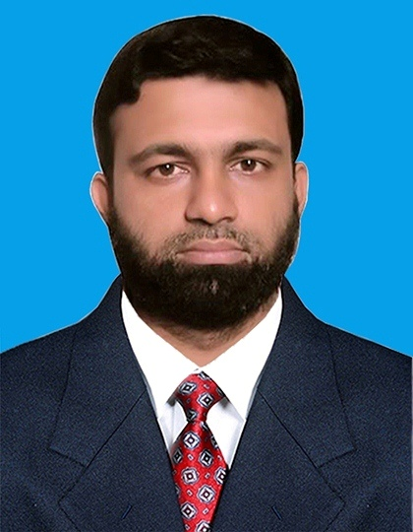
Introduction
Md. Younus Patwary
Asst. Teacher (ICT)
West Larua Karamatia Girls Dakhil Madrasah
Faridganj, Chandpur.

Slide 3

Class: Nine
Sub: English 1st Paper
Unit: 01
Lesson: 01
Time: 50 minutes

Slide 4

A group of people who are related to each other........
It‘s Called family !

Slide 5
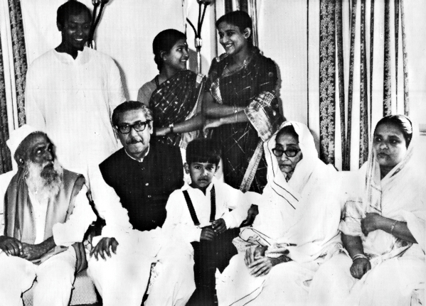
Today’s Lesson
Bangabandhu’s Family in 1971

Slide 6
Learning Outcomes:
After completing the lesson students will be able to-
Read and Understand texts.
Use new vocabulary in the text.
Narrate incidents and events in a logical sequence.
Participate in conversation, discussions and debates.
Tell stories.

Slide 7
vocabulary
Apprehend
Ready to accept offer
Indiscriminately
In a random manner
Tell or order someone to do something especially in a formal or official way.
Instructed
Providing encouragement or emotional help.
Supportive

Slide 8
vocabulary
Ignorant
Lacking knowledge or awareness in general
A feeling of worry, nervousness or unease about something with an uncertain outcome
Anxiety
Go somewhere with as a companion or escort.
Accompanied
Give a different appearance in order to conceal one’s identity.
Disguise

Slide 9
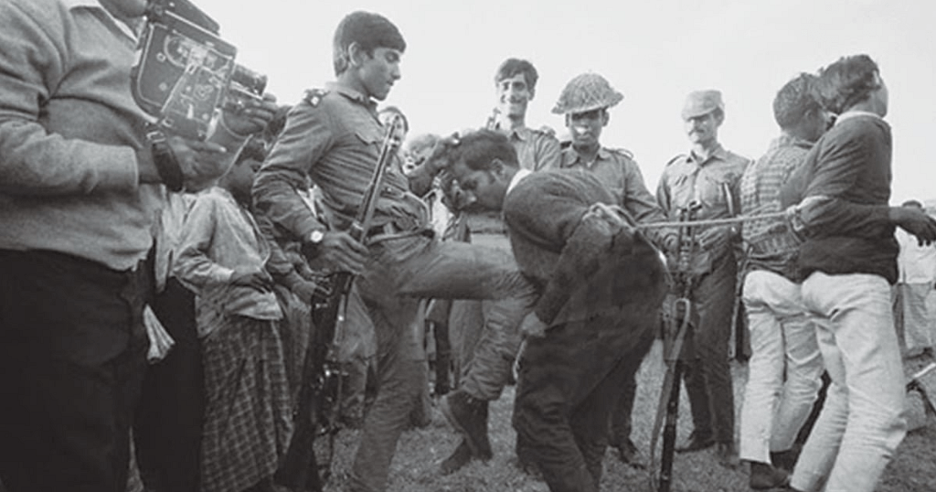
It was the night of 25 March,1971………..

Slide 10
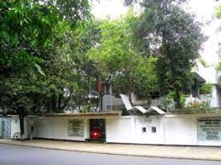
There was a full of quietness at Dhanmondi Road No. 32

Slide 11
INDIVIDUAL WORK
Silent Reading
It was the night of March, 1971. There was a full of quietness at Bangabandhu’s home at Dhanmondi Road No. 32 throughout the day.
Bangabandhu Sheikh Mujibur Rahman and his family members could apprehend that something tragic was going to happen. Gunshots were heard around the city. Bangabandhu’s eldest son Sheikh Kamal was out of home for forming barricades against the Pakistan Army who had been killing people indiscriminately that night. Bangabandhu decided to send the girls of the family to a safer place for the night and he gave their responsibility to his son in law Mr. Wazed Miah. Bangabandhu’s daughter Sheikh Hasina, who was expecting a baby soon along with her sister Sheikh Rehana and her cousin Farida were sent to a house at Road no. 15, Dhanmondi for that night. Bangabandhu’s wife Begum Fazilatunnesa Mujib, stayed with him.
Just before midnight, Bangabandhu sent the declaration of Independence to Mr. Zohur Ahmed Chowdhury at Chittagong via wireless.
At the darkest part of that night, the Pakistan Army surrounded his home and started firing at random. The situation agitated Bangabandhu much and he asked them to stop. But, soon he was instructed to get ready to go with them. Begum Mujib packed his necessary belongings. After Bangabandhu left, she was at a loss what to do and where to go with her children. However, being a supportive wife of the great leader all through her life, she soon pulled up her mental strength. But, her anxiety continued till the end of the war.
The next day Begum Mujib had to leave House No. 32 with her children and other members of her home. During the next couple of months, they moved from one shelter to another in search of a safer place. During their stay in house places, some people came forward to helping them while some refused to give them shelter for fear of their own safety. When their provision ran short, Sheikh Kamal, who had already joined the Liberation War, came to them in disguise and delivered some money. Some very close people also supported the family with money and food stuff.

Slide 12
PAIR WORK
Answer the following questions. First discuss then write the answers.
Why was the family anxious on the 25th March night in 1971 ?
Where did Bangabandhu send the girls on that night ?
How would the family communicate with people or freedom fighters while they were under house arrest ?
How did the Pakistan Army scare Sheikh Jamal? How did Sheikh Jamal manage to flee from captivity?
How do you explain Bangabandhu’s family’s contribution to Liberation War?

Slide 13
Check Your Answers
1
The family was anxious on the 25th March night in 1971 because something tragic was going to happen.
Bangabandhu decided to send the girls of the family to a safer place for the night and he gave their responsibility to his son in law Mr. Wazed Miah.
2
People would come to their home with valuable information in disguise of vendors also some would throw pieces of waste paper with important information written on them. This way the family would communicate with other people or freedom fighter while they were under house arrest
3
The Pakistan Army often used to threaten Sheikh Jamal that they would hang him upside down. So he find an opportunity and fled from the hospital and joined the freedom fighters.
4

Slide 14
EVALUATION
What was that night?
Who is Mr. Wazed Miah?
Who declaration of Independence?
When was born Sajeeb Wazed Joy ?
Which Hospital was admitted Bangabandhu?

Slide 15
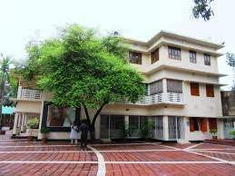
Home work
Write down the suffering of Bangabandhu’s family during Liberation War in your own words​.

Slide 16



