Slide 1
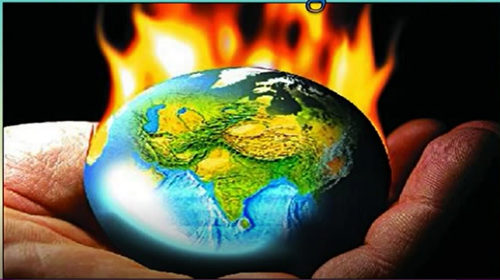

Slide 2
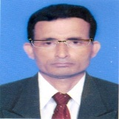
Identity
Manik Chandra Majumder
Senior Teacher
Gazirhat High School
Senbag, Noakhali.
Mobile No: 01717155169
Email: manikmajumder01@gmail.com
Class : Eight-Ten
Subject : English 2nd paper
Time : 50 Minutes
Date : 00/00/2021

Slide 3
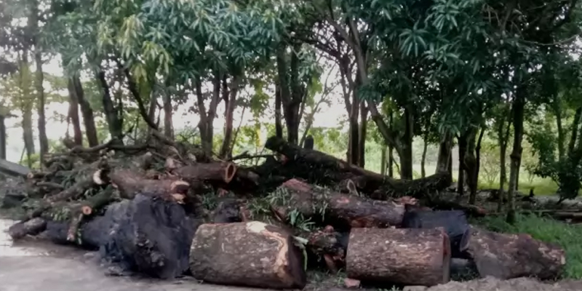
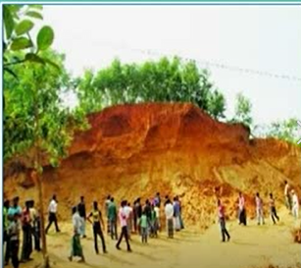
Look at the Pictures and Talk about them.
Cutting down trees and destroying hills and forests.

Slide 4
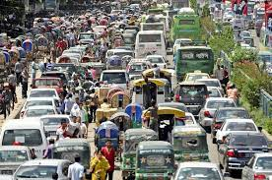
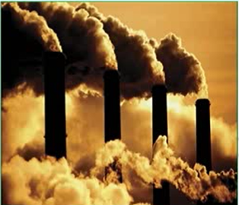
Increasing vehicles, usages of fossil fuels creating huge amount of smoke.

Slide 5
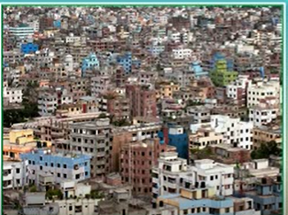
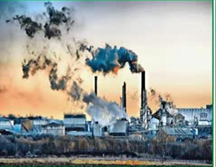
Unplanned urbanization and industrialization

Slide 6
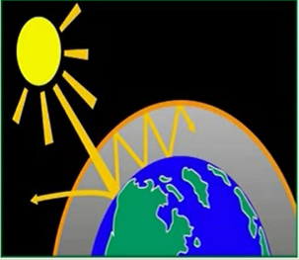
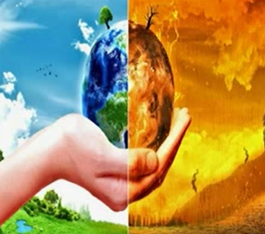
Look at the Pictures and Talk about them.
The earth is getting warmer day by day.

Slide 7
Discuss the questions in pairs.
1 Can man influence the climate? If the answer is yes,
explain how?
2 Which human activities are responsible for increasing
carbon dioxide in the atmosphere?
3 How can trees help save our environment?

Slide 8
Our today’s lesson is….
Unit : Five
Lesson : 3
Page No : 65

Slide 9
Learning Outcomes
By the end of the lesson the learners will be able to...
❖ ask and answer questions,
❖ match words with their meanings,
❖ talk about how human activities influence on climate,
❖ discuss about the impacts of climate change on men,
❖ Write letters to newspapers highlighting certain
problems.

Slide 10
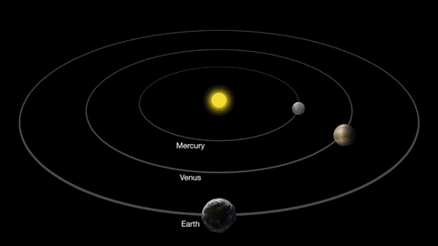
Vocabulary and sentence making
Word : Orbit (N)
Meaning :A circular path, Compass, Move around a center.
Sentence : The earth makes an orbit around the sun.

Slide 11
Word : Atmosphere (N)
Meaning :Airspace, Troposphere, Mixture of gases around the earth.
Sentence : The huge amount of green house gases affect on atmosphere.

Slide 12
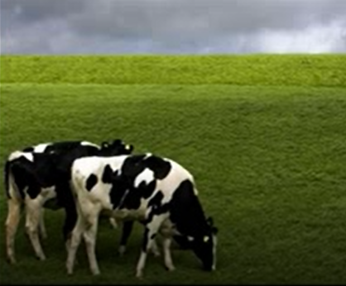
Word : Pastures (N)
Meaning : Grazing land, A field covered with grass.
Sentence : There are many pastures in Australia.

Slide 13
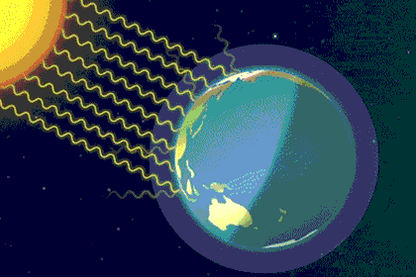
Word : Radiation (N)
Meaning :Emission, Polarization.
Sentence : Man cannot change the radiation of the sun.

Slide 14
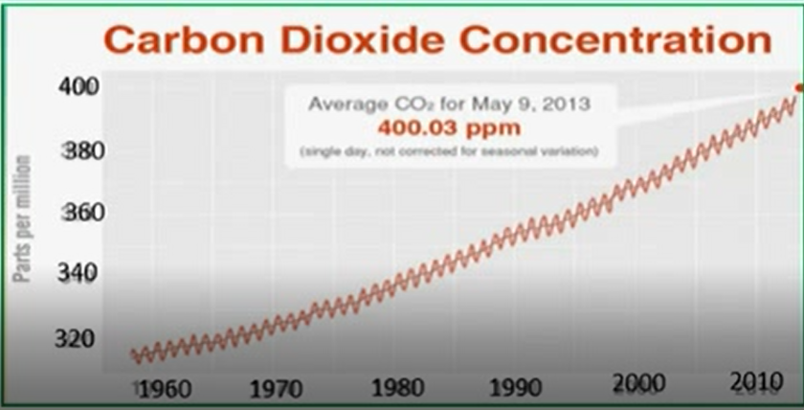
Word : Concentration (N)
Meaning : Mass, Condensation
Sentence : The graph shows the carbon dioxide concentration in the atmosphere in different decades.

Slide 15
Some more vocabulary
Fossil fuel
Crude oil, natural gas
Combustion
Burning, Firing
Crude oil
Unrefine oil
Obtain
Achieve, accomplish
Absorb
Take in, Consume

Slide 17
Now read the text below and find answers to the above questions.
Humans can neither change the sun's radiation nor the earth's orbit around the sun.

Slide 18
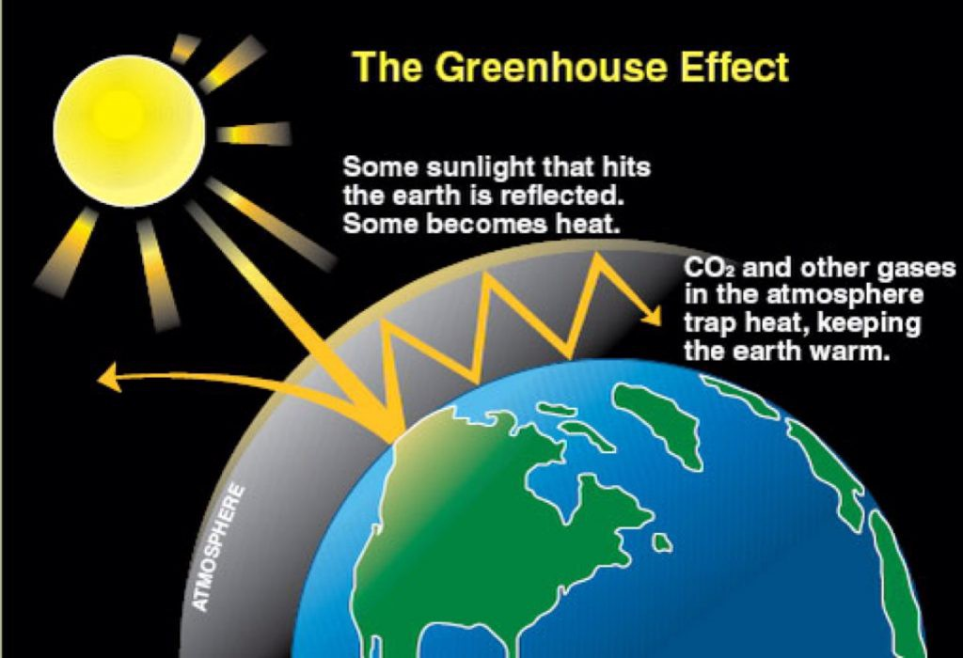
But they can control the increase in the amount of greenhouse gases and its effect on the atmosphere. Only during the last hundred years the carbon dioxide concentration has been raised alarmingly in the atmosphere and we humans can be held responsible for this.

Slide 19
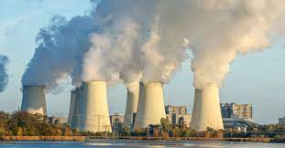
The main cause of the increase in carbon dioxide level in the atmosphere is the burning of fossil fuels. Since the end of the 19th century, industrial activities increased rapidly giving rise to many factories. These factories required energy, which was produced through the combustion of coal.

Slide 20
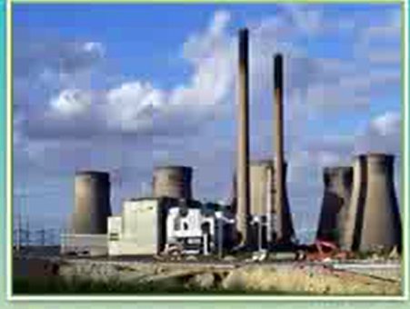
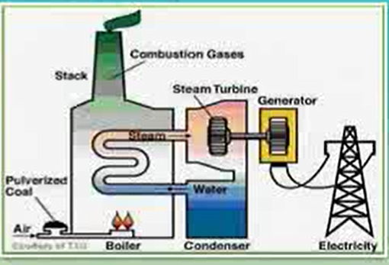
Besides coal, other sources of energy such as mineral oil and natural gas were also burned to heat our houses, run cars and airplanes or to produce electricity. Nowadays, about 85 million barrels of crude oil are burned daily. Every time a fossil raw material is burned, it releases carbon dioxide into the air.

Slide 21
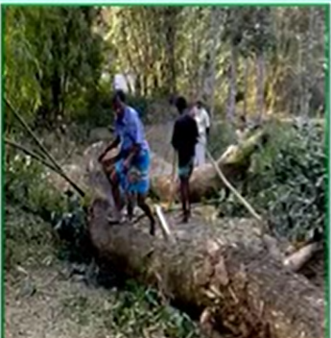
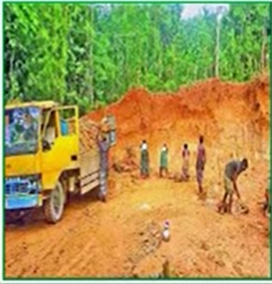
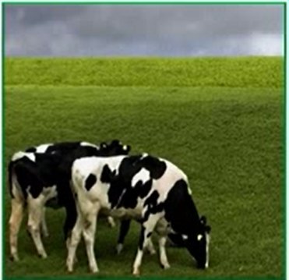
Therefore, it is clear that more and more greenhouse gases like carbon dioxide are being generated worldwide by humans. Moreover, we are also strengthening the greenhouse effect by deforestation, which means cutting down trees.

Slide 22
Every year enormous areas of forests are destroyed by people to obtain wood and to clear regions for mining and to create pasture. This loss of the forest causes dual problems. Trees that are burned up release large volumes of carbon dioxide gas into the air.

Slide 23
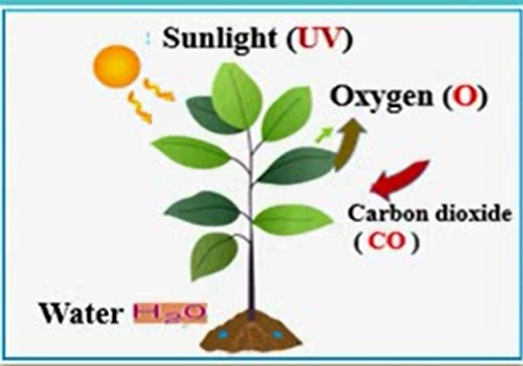
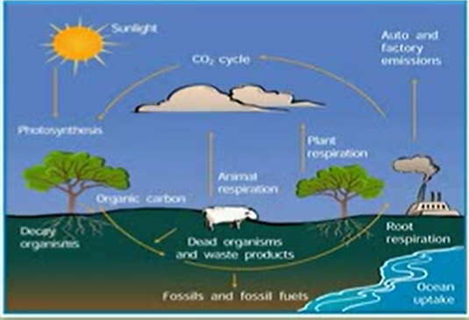
On the other hand, as forests absorb a lot of carbon dioxide from the air and deliver oxygen instead, we also destroy an important storehouse of carbon dioxide when we clear forests.

Slide 24
C Match the meanings in column B and the words/phrases in column A.
Column A | Column B
1 Sun's radiation | a. energy that is transmitted from the sun in the form of rays or waves or particles
2 Fossil fuels | b. the process used by plants to convert light energy captured from the sun to chemical energy
3 Combustion of coals | c. a basic material or substance used in the production or manufacturing of goods
4 Crude oil | d. non-renewable sources of energy that come from the remains of plants and animals
5 Raw materials | e. intentional destructions or removal of trees and other vegetations for agricultural, commercial, housing or firewood use
6 Deforestation | f. a naturally occurring, unrefined petroleum product that can be refined to produce usable products such as diesel, gasoline, heating oil, jet fuel, kerosene, etc.
7 Photosynthesis | g. burning of coal usually in industrial plants.
1-a
2-d
3-g
4-f
5-c
6-e
7-b

Slide 25
Choose the correct answer from the following alternatives.
Q : a) The greenhouse effect is accelerated by----
ii. deforestation
Ans :
i. increasing forest
ii. deforestation
Ans :
iii. afforestation
iv. melting ice
Q : b) Trees absorb------------------
Ans :
Ans :
i. oxygen
ii. carbon dioxide
ii. carbon dioxide
iii. Sun's rays
iv.dust in the air
Ans:

Slide 26
Q : C) Greenhouse gases have-------- effects on the environment.
Ans :
i. pleasant
ii dangerous
Ans :
ii dangerous
iii. smooth
iv. positive
Q : d) Due to industrial revolution---------- have increased to a great extent .
Ans :
i. Unemployment problem
ii. afforestation
iii. habitations
iv. factories
iv. factories
Ans :

Slide 27
Q : e) What does deforestation mean?
Ans :
i. Planting trees
ii. increasing forest land
Ans :
iii. Destroying forest
iii. Destroying forest
iv. Enhancement
Q : f) Energy required by factories was produced through the consumption of ……………….
ii. coal
i. plants
ii. coal
iii. straw
iv. sunlight
Ans :
Ans :
Q :g) Coal is one of the fuels used for----------- energy .
i. compacting
ii. lessening
iii. generating
Ans :
iii. generating
iv. reducing
Ans :

Slide 28
Answer the following questions:
b)Which human activities are responsible for increasing carbon dioxide in the atmosphere?
Can man influence the climate? If your answer is yes, explain how?
c) How can trees help save our environment?
d)Which changes according to the passage are beyond our means?
e) How can the world be greener?
Answer-b) A large number of human activities are responsible for increasing carbon dioxide in the atmosphere. Of all these, cutting down trees, destroying hills and forest, unplanned urbanization, industrialization, excessive use of chemical, burning fossil fuels increasing number of vehicles and greenhouse effects are the major causes for increasing carbon dioxide in the atmosphere.
Answer-a) Yes, man can influence climate. We know air, water, soil are the most important element of our environment. But we are continuously polluting these elements. Moreover we are cutting down trees, destroying hills and forest, Above all unplanned urbanization, industrialization, excessive use of chemical, burning fossil fuels and greenhouse effects the earth is getting warmer and influence on climate.
Answer-e) If we can minimize the use of fossil fuels, stop cutting down trees, stop destroying hills and forest and taking afforestation programme, the world can be greener.
Answer-d) According to the passage , changing the sun radiation and changing the earth's orbit around the sun are beyond our means.
Answer-c) Trees provide us life saving oxygen and take up harmful carbon dioxide . They also prevent ultraviolet rays of sun and global warming. Thus trees maintain ecological balance and make the earth suitable for living.

Slide 29
Read the following text and fill in each gap with a suitable word based on the information of the text.
Though man cannot control the sun's radiation, he can control the increase in the amount of greenhouse gases. There has been a tremendous increase of carbon dioxide gas in the atmosphere during the last hundred years human beings are responsible for this. The main cause of the increase in carbon dioxide level in the atmosphere is the burning of fossil fuels. With the progress of time, industrialization and urbanization activities have been increased rapidly and causing more emission of carbon dioxide. Moreover we are cutting down trees, destroying hills and forest and consequently losing the factories of oxygen. Above all, excessive use of chemical, burning fossil fuels and greenhouse , effects the earth is getting warmer and influence on climate.

Slide 30
Summary: Ours is an age of industrialization. So we have been running a)---------- settlements for long since and for which we have to b)---------- mineral oil and coal. Fossil fuels, after being burnt c)---------- CFC and other health hazardous gases. The ultimate result of this d)------------- act leads us to destruction. Let us e) -------- our globe for our own sake.
a) industrial
b) use
c) produces
d) unwise/ unconscious
e) save

Slide 31
Read the statements below and say if they are true/false. If false, give the correct information. (Evaluation)
Statement-1. Fossil fuels are burned at an alarming rate due to
industrialization.
Statement 2. Coal is the only fuel used for generating energy.
Statement 3. At present, nearly 85 million barrels of crude oil are used
weekly.
Statement 4. Deforestation is caused by nature.
Statement 5. Forests help consume carbon dioxide gases from the air.
True
False, Cor. Ans-Besides Coal, mineral oil and natural gas are used for generating energy.
False, Cor. Ans- At present, nearly 85 million barrels of crude oi are used daily.
False, Cor. Ans-Deforestation is caused by people.
True

Slide 32
Home Work
Write a letter to the Editor of a newspaper expressing your concern about growing deforestation in your area.

Slide 33
STAY HOME, STAY SAFE.

