Slide 1
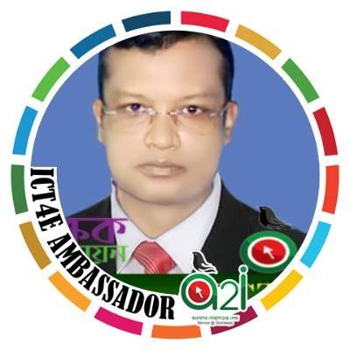
01
03
02
Welcome to my
Class
Multimedia
Md. Lutfor Rahman

Slide 2
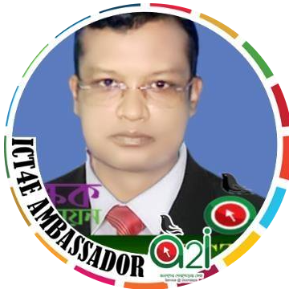
Teacher`s Identity
Lutfor Rahman (M,A, M-Ed)
Assistant Teacher,
SB Trainer English, Arts and Crafts and BGS.
Selected Master Trainer in English TMTE Project British Council and DPE.
ICT4E District Ambassador, Dinajpur
Kundarampur, Government Primary school School,
Ghoraghat, Dinajpur.
E-mail: mlutfor81@gmail.com

Slide 3
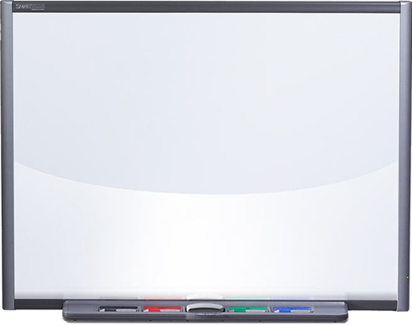
Dear students, think and try to say about the video
Yes, you are correct. The video is about Cyclone Aila. Thank you all. Today`s lesson is…
Click the play icon

Slide 4
Dear students, think and try to say about the video
Yes, you are correct. The video is about a trip. Thank you all. Today`s lesson is…

Slide 5
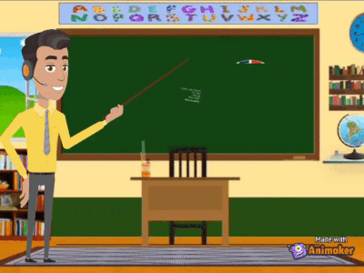
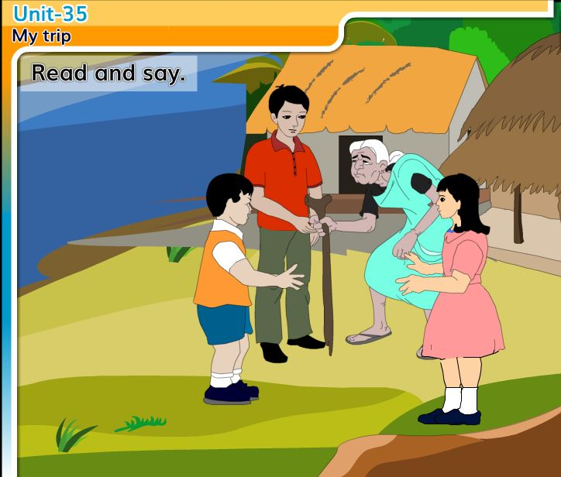
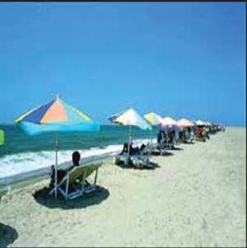

Slide 6
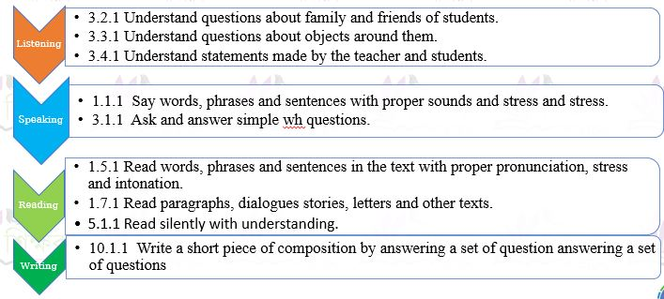
Learning Outcomes
Listening
3.2.1 Understand questions about family and friends of students.
Speaking
1.1.1 Say words, phrases and sentences with proper sounds and stress and stress.
Reading
1.5.1 Read words, phrases and sentences in the text with proper pronunciation, stress and intonation.
Writing
10.1.1 Write a short piece of composition by answering a set of question answering a set of questions
3.3.1 Understand questions about objects around them.
3.4.1 Understand statements made by the teacher and students.
3.1.1 Ask and answer simple wh questions.
1.7.1 Read paragraphs, dialogues stories, letters and other texts.
5.1.1 Read silently with understanding.

Slide 7
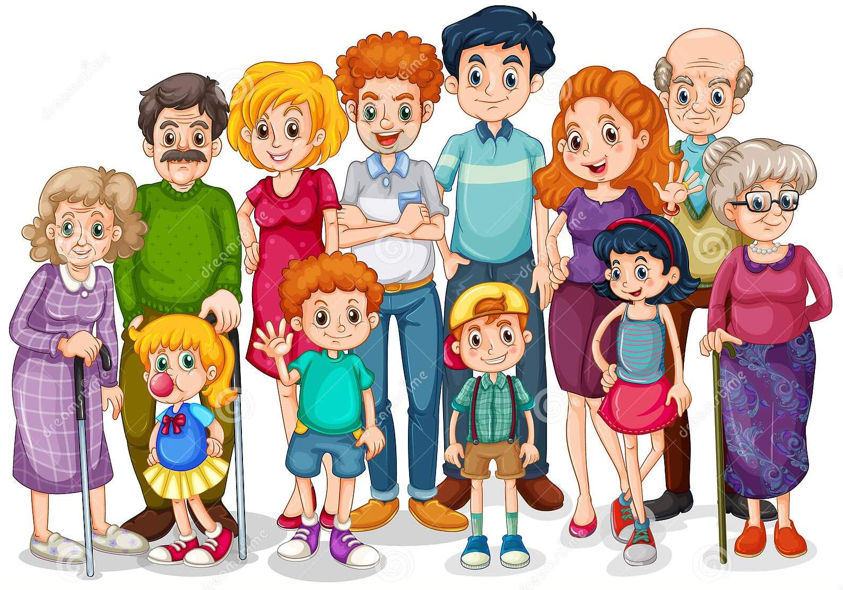
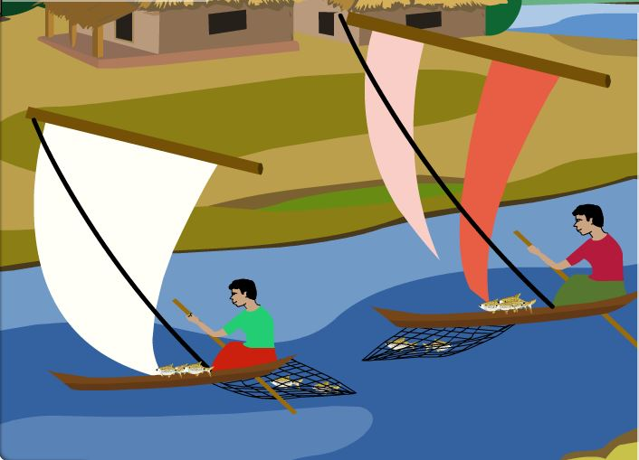
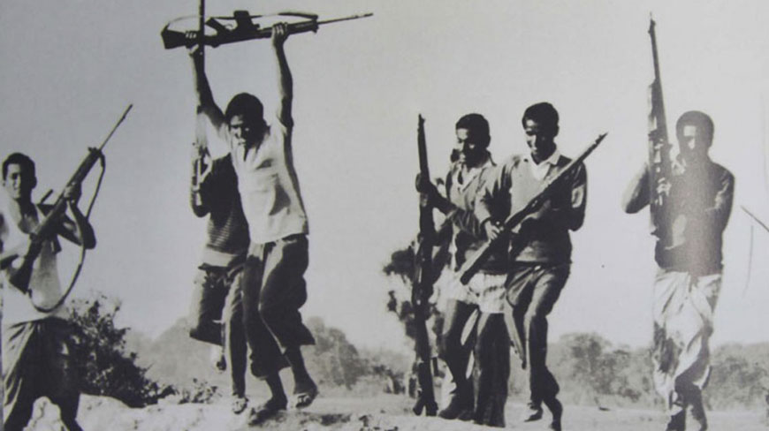
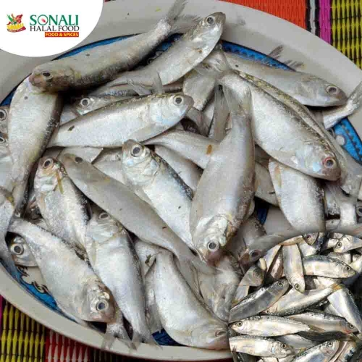
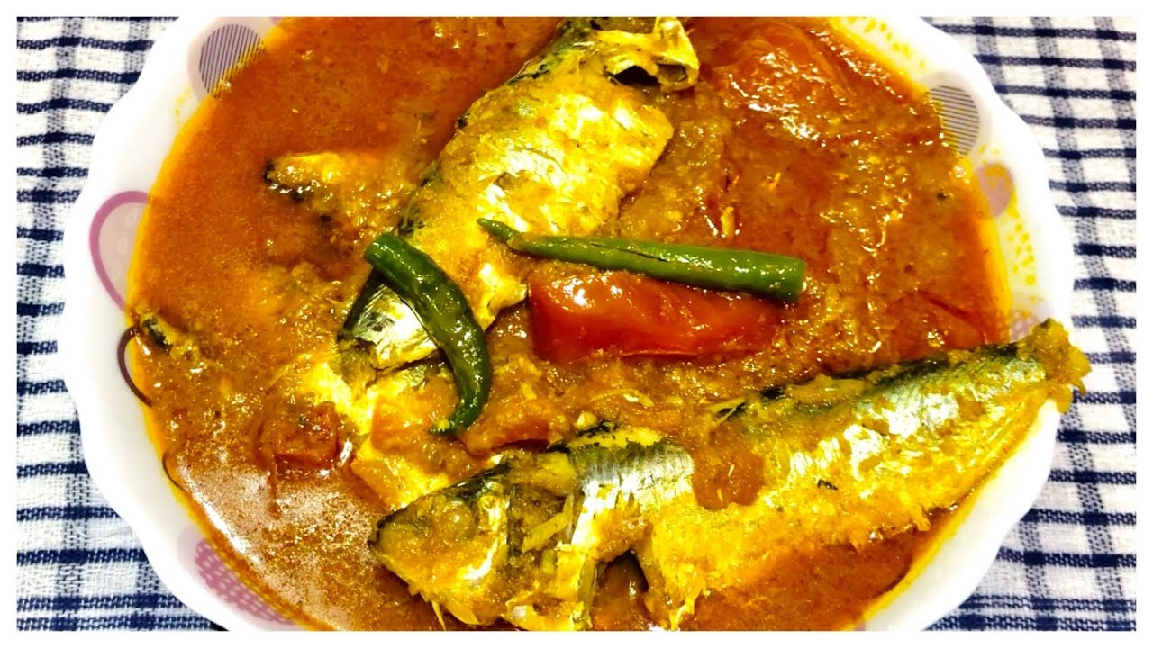
Relatives
Kin
My relative still live there.
Fisherman
Who catches fish
My grandfather was a fisherman.
History
Important event
Our grandmother told us the history of Bangladesh.
Favourite
Dear
My favourite fish is Chapila.
Delicious
Pleasing taste
Chapila fish is delicious.

Slide 8
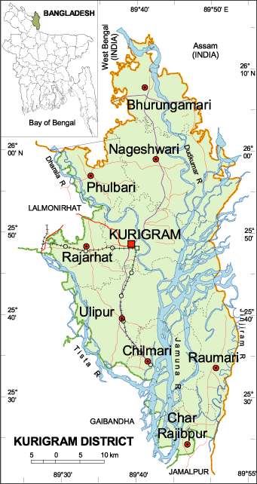
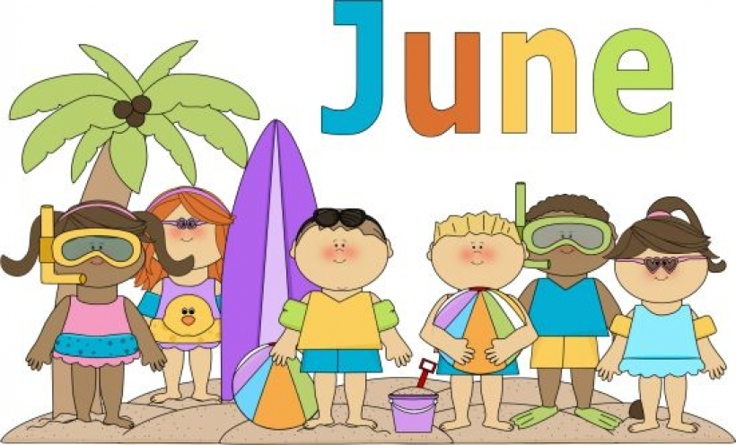
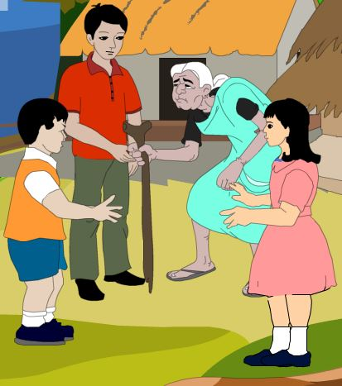
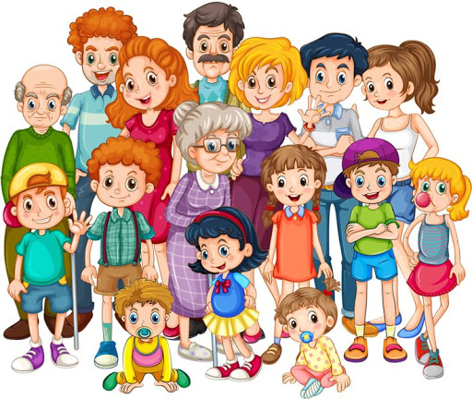
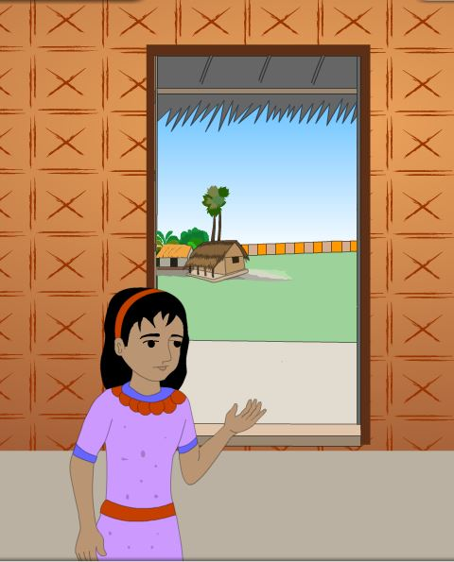
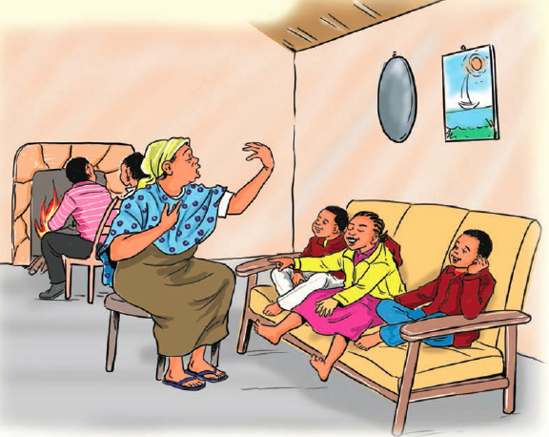
Think about the picture
When my sister and I visited Chilmari in June, we had so much fun!
My grandmother and many of my relatives still live there.
I am Alvi. I live in Dhaka, but my family is from Chilmary in Kurigram.

Slide 9
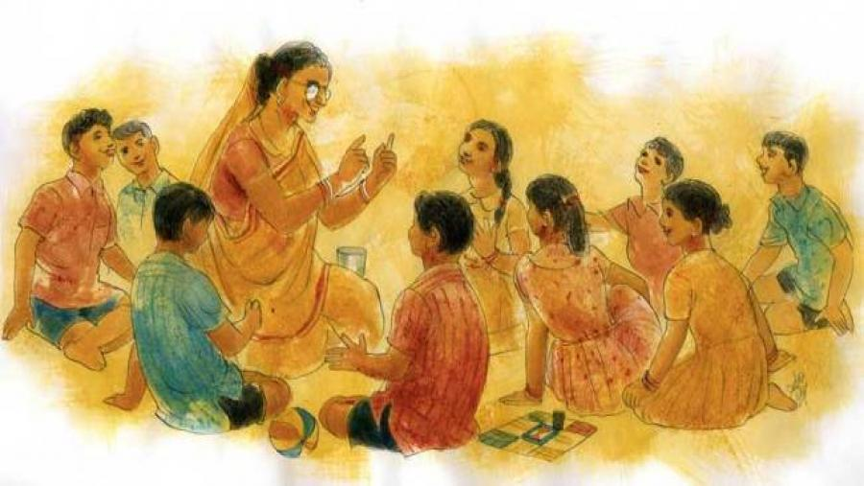
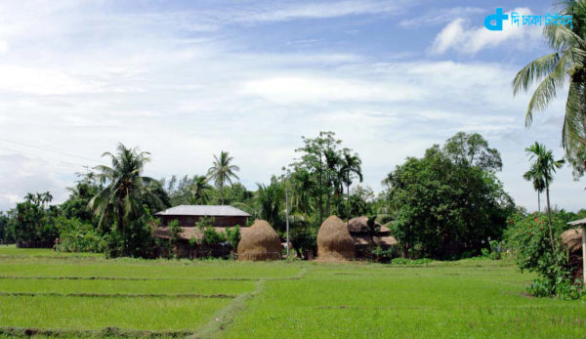
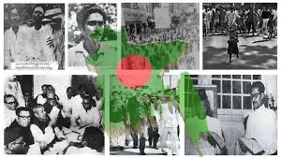
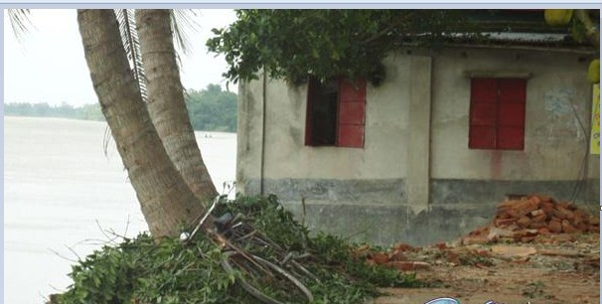
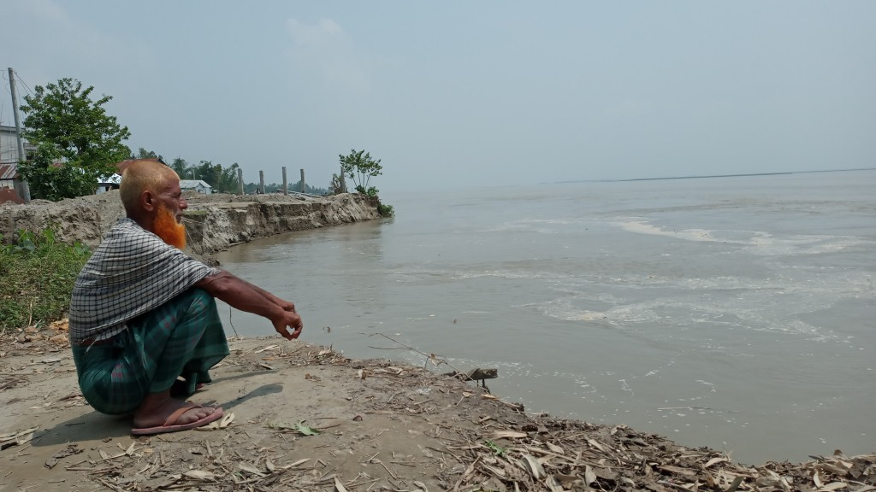
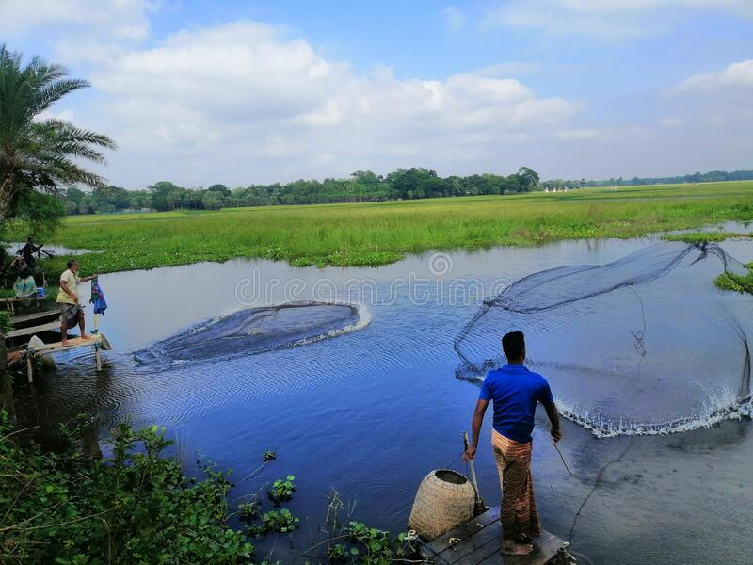
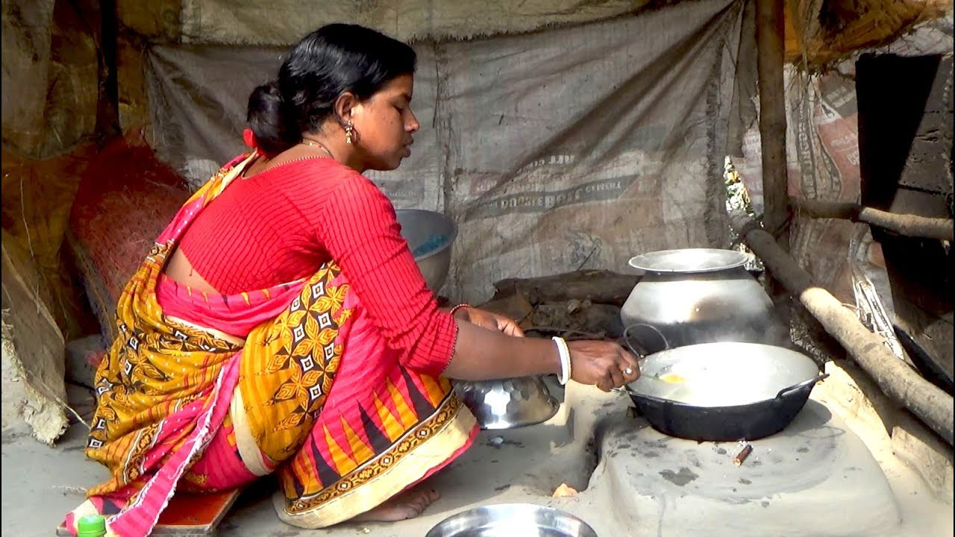
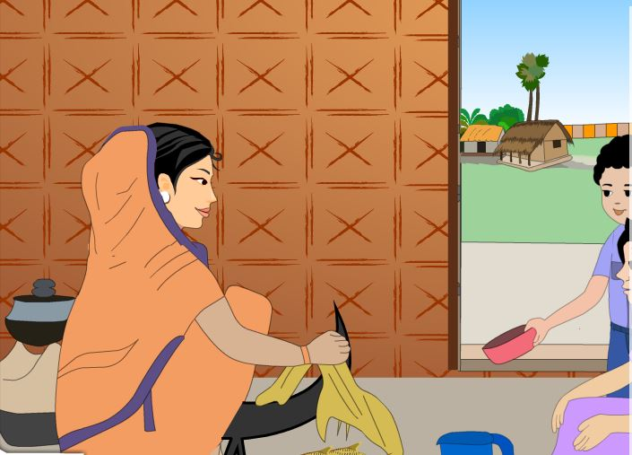
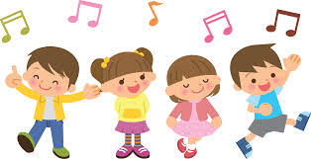
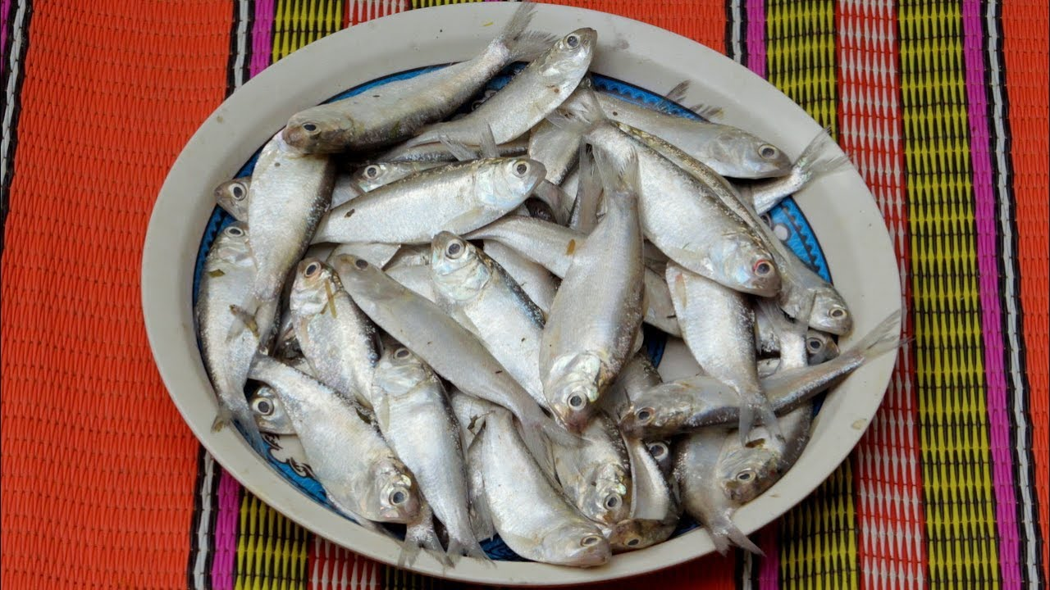
Think about the picture
It was a very special trip. We talked with our relatives and learned about our family and our country. We also sang songs together.
Their house is near the Jamuna river. My uncle is a fisherman. My grandfather was a fisherman, but he died about 10 years ago. I didn't know him.
My uncle caught a lot of fish. My favourite fish is “Chapila”.It’s a thin, white fish. It’s delicious!
We helped our grandmother make the fish every night. We also made rice and vegetables.
Our grandmother told us stories about our family and about the history of Bangladesh.

Slide 10
Teacher`s Reading
Dear students,
open your book at page 70. Say after me.

Slide 11
My name is Kusum/I am Alvi. I live in Dhaka, but my family is from Chilmary in Kurigram. My grandmother and many of my relatives still live there. Last June, I went to visit my grandmother, my uncle and cousins in Chilmari. Their house is near the Jamuna River. My uncle is a fisherman. My grandfather was a fisherman but he died about 10 years ago. I didn`t know him. When my sister and I visited Chilmari in June, we had so much fun! Our grandmother told us stories about our family and about the history of Bangladesh. My uncle caught a lot of fish. My favourite fish is “Chapila”.It’s a thin, white fish. It’s delicious! We helped our grandmother make the fish every night. We also made rice and vegetables. It was a very special trip. We talked with our relatives and learned about our family and our country. We also sang songs together.
Click the play icon

Slide 12
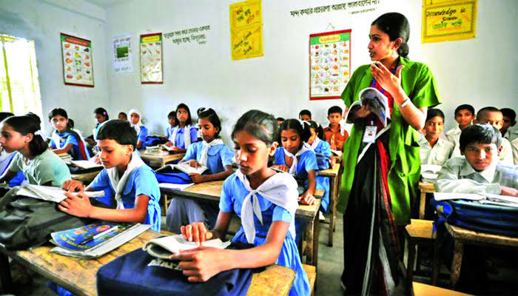
Student`s Silent Reading
Dear students, read the text silently.
Open your English book at page number 70. Read and point out with your finger.

Slide 13
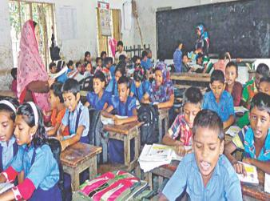
Student's Loud Reading
Dear students read the text loudly.

Slide 14
Group Work
Write a short composition about “ Alvi`s trip” by answering the following questions.
1.Where does Alvi live?
2.Where did Alvi go?
3. What did he see there?
4.Who did he go with?
5. What did he do there?
6. What was special about his trip?

Slide 15
Inaduvidual Work
Write ‘True’ for correct statement or ‘False’ for incorrect statement.
Alvi`s house near the Padma river.
Alvi speaks about her trip.
Alvi`s uncle is fisherman.
Alvi`s uncle caught a lot of bird.
Alvi`s favourite fish is Chapila.
False
True
True
False
True

Slide 16
Pair work:
Match the words in column A with their meanings in column B
Column A | Column B
a) Delicious | 1. Dear.
b) Favourite | 2. Recall.
c) History | 3. Who catches fish.
d) Fisherman | 4. Kin.
e) Relative | 5. Hear .
 | 6. Important event.
 | 7. Pleasing taste.

Slide 17
Assessment
Answer the questions.
1. Ans. Alvi lives in Dhaka.
1. Where does Alvi live?
2. Ans. Alvi went to Chilmari in Kurigram.
6. Ans. It was a very special trip because they talked with their relatives and learned about their family and their country.
3. Ans. He saw there his grandfather, his uncle and cousins.
2. Where did Alvi go?
4. Ans. He went there with his sister.
5.Ans.He had so much fun! They listened story and they sang songs together.
3. Who did he see there?
4. Who did he go with?
5. What did he do there?
6. What was special about this trip?

Slide 18
Make a list of things that Alvi see in Chilmari.

Slide 19
Thank You

