Slide 1
Welcome

Slide 2
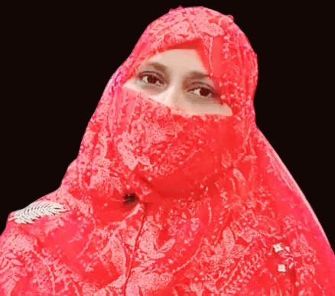
Mafuza Akter
Senior Lecturer of English
Kushtia City College, Kushtia
HSC English Second Paper
Grammatical Items
Class: XI-XII

Slide 3
Read the passage at first
Saima lives Banani Dhaka. He goes
school rickshaw. Sometimes she goes
school foot. She starts from home 7 a.m. early the morning . There was a heavy rain yesterday and the roads went water. So she was absent school yesterday.
at
in
to
By
to
on
at
on
under
from
This bold words -
at, in ,to, on, by , from, under are prepositions.

Slide 4
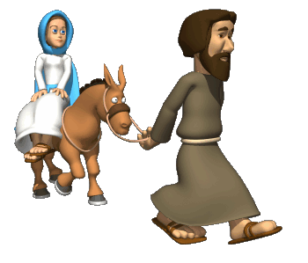
Look at the picture
The girl is the horse.
on
in front of
Her father is the horse .
The kids are their parents.
between

Slide 5
Our today’s lesson is
IN
Into
ON
to
onto

Slide 6
Learning Outcomes
At the end of the Lesson ,Ss will be able to-
Define the different types of Preposition
Can explain the different types of Preposition
Can fill the gaps .

Slide 7
Different Types of Prepositions
Appropriate Preposition
Situational Prepositions
Prepositional Phrase
Preposition in Group Verb
Preposition of Passive Voice

Slide 8
1. Appropriate Prepositions
Appologize for: Shahed apologized for his mistake
Solution to: Here is the solution to that problem.
Aware of: Everybody is now aware of dowry system.
Consist in : True happiness consists in satisfaction.
Comply with : I couldnot comply with her request.

Slide 9
Situational Prepositions
The mobile is on the table.
Mila will meet him at 5.30 pm.
I had to take my breakfast by 8 o’clock
Bangladesh achieved independence in 1971.
She cannot do it without your help.

Slide 10
3. Prepositional Phrase
In lieu of : Shila has taken Biology in lieu of Math
On the Contrary : On the contrary , Rina insulted him.
In brief: He described the whole story in brief.
By birth: Laila is a Bangladeshi by birth .
At any cost : She will purchase the mobile at any cost.

Slide 11
4. Preposition in Group Verb
Look after ( take care of ) : He looks after his mother
Look down upon ( Consider inferior): You should not look down upon the poor.
Look for ( find) : She was looking for a red dress for the party.
Look forward to ( excited/eager): I’m looking forward to the Christmas break.
Look into( investigate) : We are going to look into the matter.

Slide 12
5. Preposition in Passive Voice :
Nabila was taught by her elder brother
She is known to me.
Malaria is carried by mosquitos.
How was your lost watch come by you?
The snake was beaten with a stick.

Slide 13
Homework
What is Preposition in Passive voice?

Slide 14
That’s All For Today

