Slide 1


W
E
L
C
O
M
E

Slide 2




Teacher’s Identity
ASMA KHANOM
ASSISTANT TEACHER
KALACHANDPUR GPS SADAR,NOAKHALI

Slide 3

LEsSON IDENTITY
Class: Four
Subject: English
Unit:10
Lesson:1-2
Who’s first?

Slide 4
Learning outcomes:
4.1.1
By the end of the lesson students will be able to……
Listening
1.1.1. recognize sound differences in the contest of words.
3.4.1. understand statements made by teacher & students.
Speaking
1.1.1 repeat after the teacher and say words phrases and sentence with proper sounds streets & intonations.
Reading
1.4.1 read words phrass and sentence in the text.
1.7.1.. recognize & read ordinal numbers up to 10th.

Slide 5

Let’s sing a good morning
Song ”

Slide 6
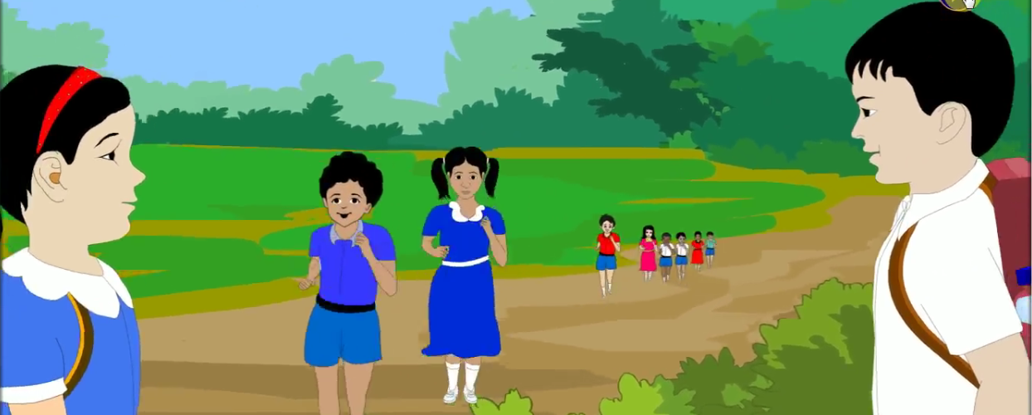
Look at the picture
How many people are there in the Race?
There are eight people in the race.
Who is the first?

Slide 7
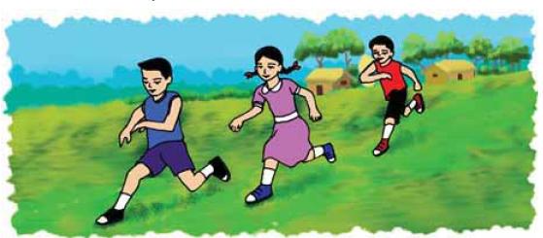
Today’s Lesson
Who’s first?

Slide 8
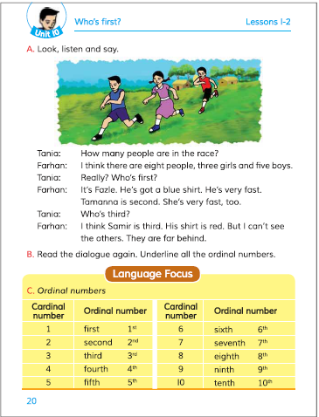
Open your EFT Book at page no. 20

Slide 9
Look,listen and say

Slide 10
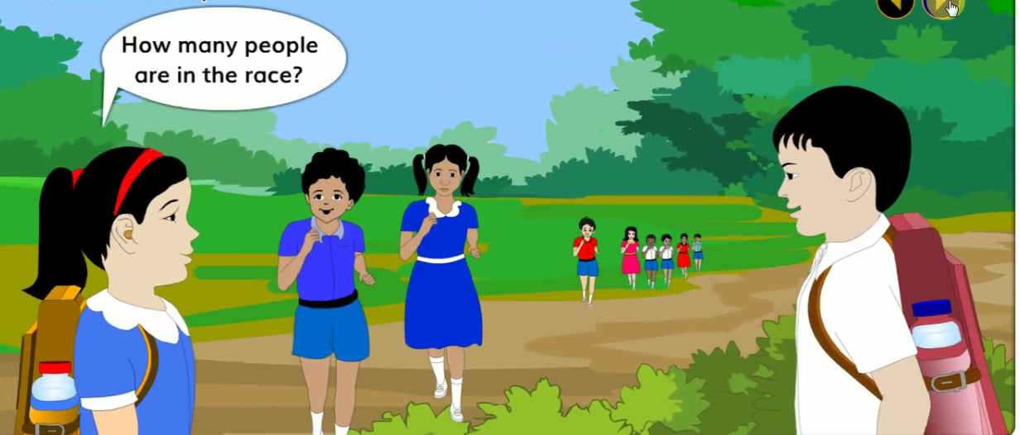
Look,listen and say

Slide 11
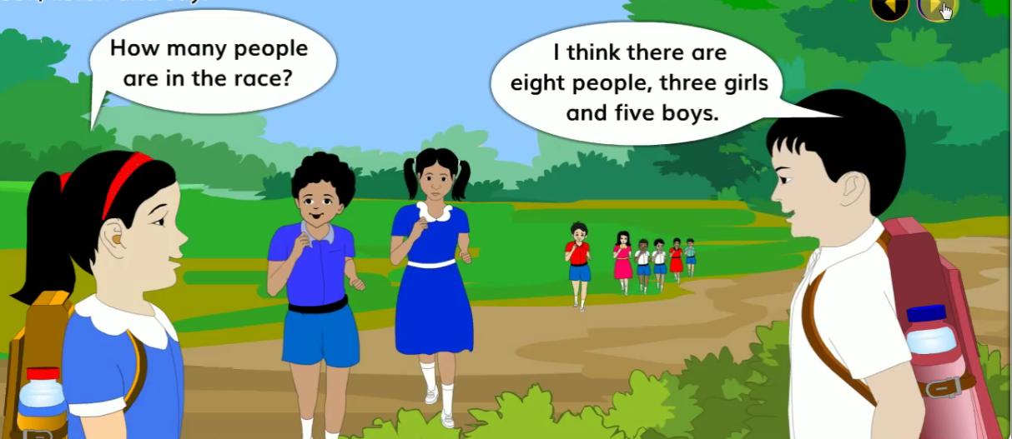
Look,listen and say

Slide 12
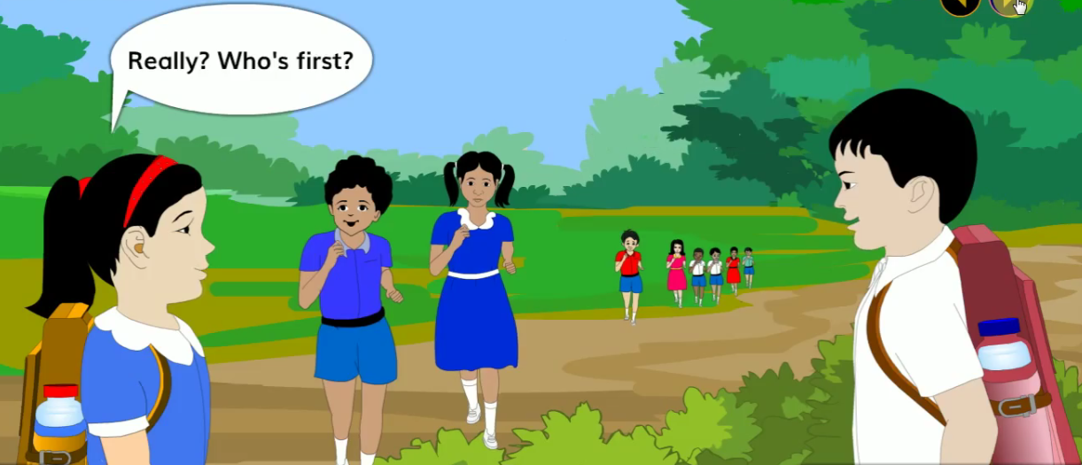
Look,listen and say

Slide 13
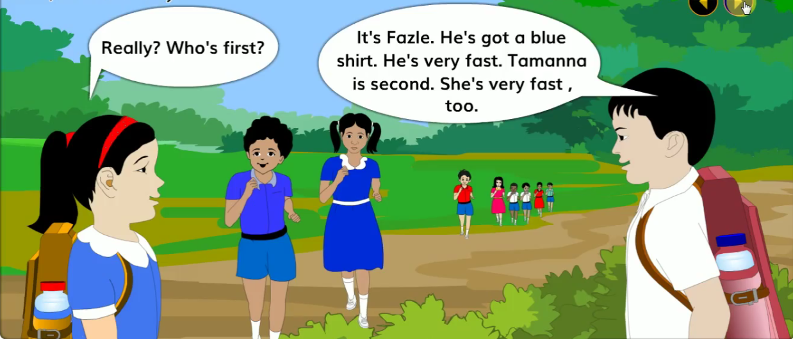
Look,listen and say

Slide 14
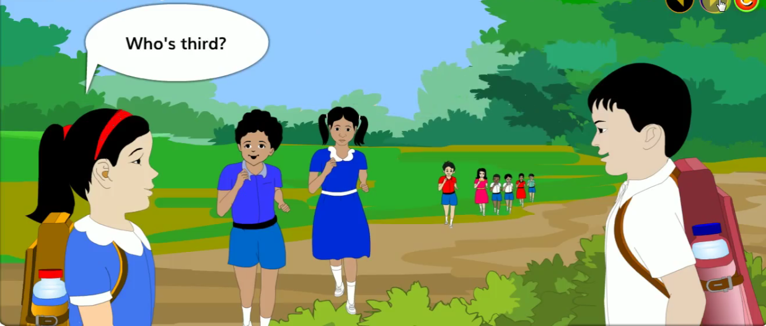
Look,listen and say

Slide 15
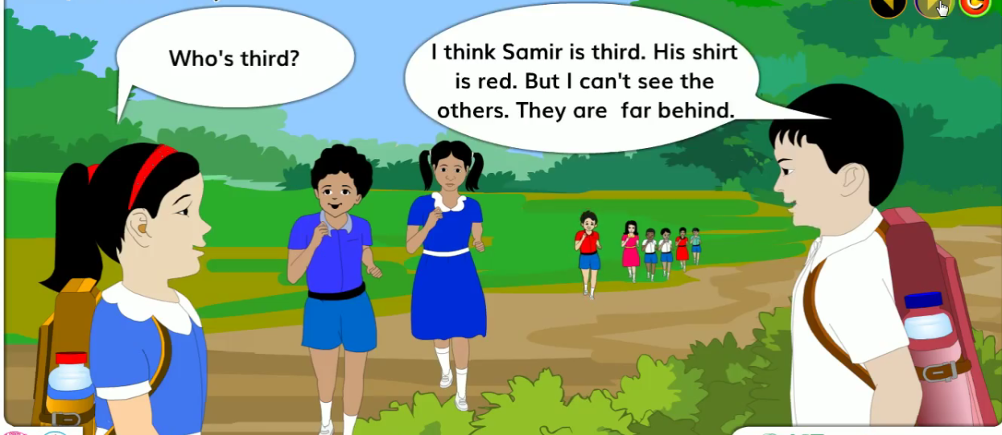
Look,listen and say

Slide 16
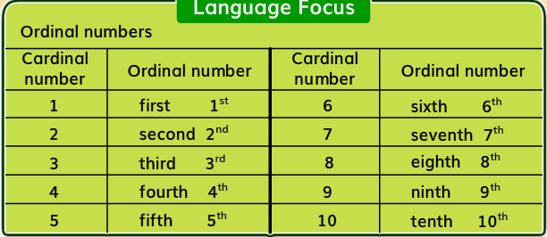
Ordinal numbers

Slide 17

Group work
Group A : Write Ordinal numbers 1st to 10th.
Group B :How many people are there in the race?
Group C : Who is first in the race?

Slide 18
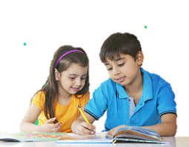
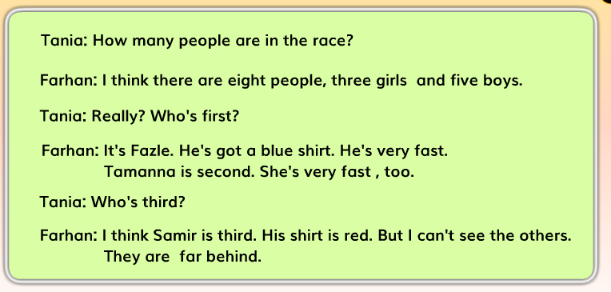
Pair work
Read the dialogue again.underline all the ordinal numbers.

Slide 19

Match cardinal number with ordinal number
Cardinal
Ordinal
IW
1
Third
7
Ninnth
4
Seventh
9
Fourth
3
First

Slide 20
One day ond word
behind
পিছনে
Behind
The girl is behind of the boy.

Slide 21
Evaluation
Answer to the Questions
1. Who is first in the race?
1. Fazle is first in the race.
2. Who is second ?
2. Tamanna is second.
3. Who is very fast ?
3. Fazle is very fast.
4.Who is third?
4.Samir is third.

Slide 22

Home Work
Home Work
Make a chart of ordinal numbers 1st to 10th.

Slide 23


