Slide 1
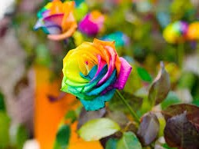
Welcome

Slide 2
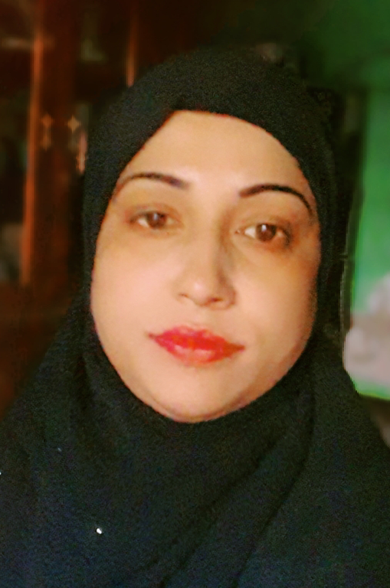
Teacher's identity
Chaina akter
Assistant teacher
Ishwardi Govt. Primary School
Bhanga, Faridpur.

Slide 3
Introducing Lesson
Class: Four
Subject: English
Time: 40 minute
Page: 30
Part of lesson: A. Look, listen and say. Read.

Slide 4
Learning outcomes
Students will able to
Listening :
1.1.1 recognize sound differences in the context of words.
1.2.1 recognize which syllable in a word is stressed.
1.3.1 recognize which words in a sentences stressed.
Speaking :
1.1.1 repeat after the teacher and say word phrases and sentences with proper sounds, stress and intonation.
6.2.1 talk about people, objects, events etc.
Reading :
1.5.1 read words, phrases and sentences in the text with proper pronunciation, stand intonation.

Slide 5
1 Minute
What did you watch about?
Family

Slide 6
1 Minute
Today lesson
Sagar and His Family

Slide 7
Presentation
Sagar and His Family
Sagar
Father
Keya
Grandmother
Mother
Grandfather

Slide 8
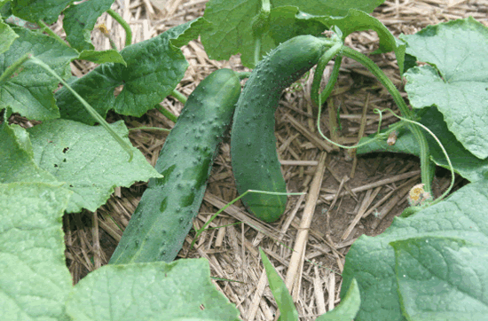
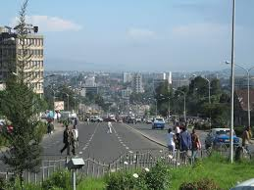
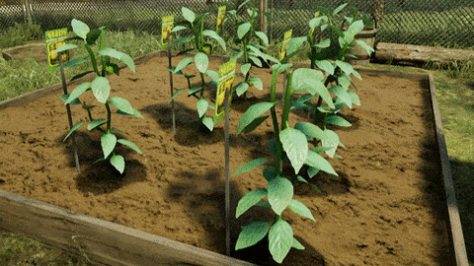
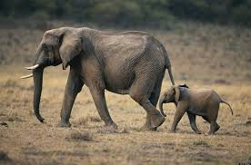
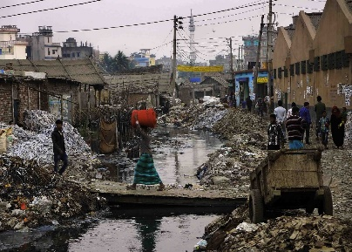
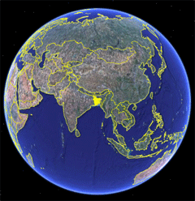
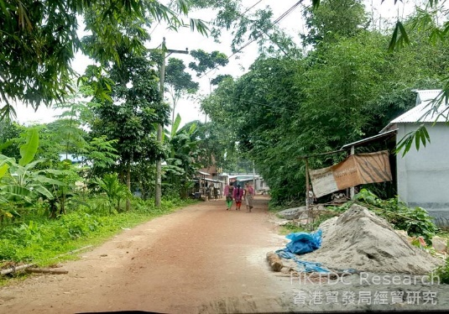
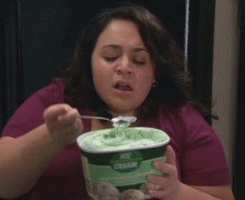
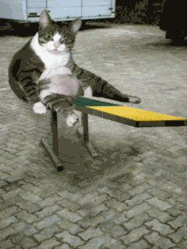
New word
√
Cucumber
Best
Grow
Little
Only
Proud
Delicious
Wonderful
World
Neighbourhood

Slide 9
6 minutes
true
false
Write the answer to true or false .
Sagar is a teacher.
Sagar mother is a housewife .
Sagar sister name is Mita .
His sister is only three years old .
Sagar father is a teacher .

Slide 10
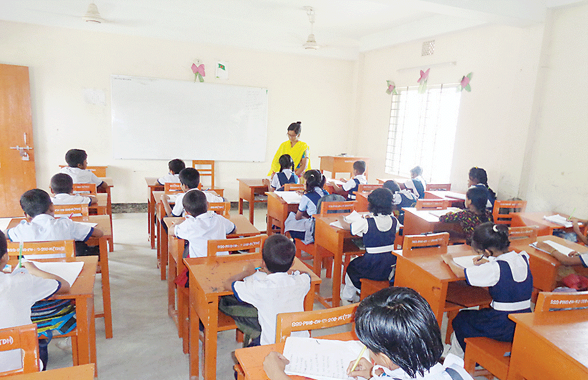
5 minutes
Teachers reading
Hi ! I'm Sagar. I'm in class 4. I'm nine years old.
I have a little sister. Her name is Keya. She's only three years old.
My father is a doctor and
My mother is a housewife.
My grandfather was a school teacher, but he doesn’t work now. My grandfather helps me with my homework. He is very smart!
My grandmother works at home. She makes the best ' Pithas ' in
the world! She helps my mother with the garden.
My mother has a wonderful garden. I am very proud of it. She grows the best tomatoes and cucumbers in the neighbourhood. They are delicious!

Slide 11
Listen to me
1. Who has a wonderful garden?
Ans: Sagar's mother has a wonderful garden.
2. How old is Sagar?
Ans: Sagar is nine years old.
3. What does grandmother make?
Ans: Grandmother makes Pithas.
4. What does Sagar's father do?
Ans: Sagar's father is a doctor.

Slide 12
Task & checking learning
10 minutes
Questions
How many members in your family?
What does Sagar do?
Who was a teacher?
How old is Keya?
Who are in your family?

Slide 13
Home work
Write five sentences about your family

Slide 14
Thank you all

