Slide 1
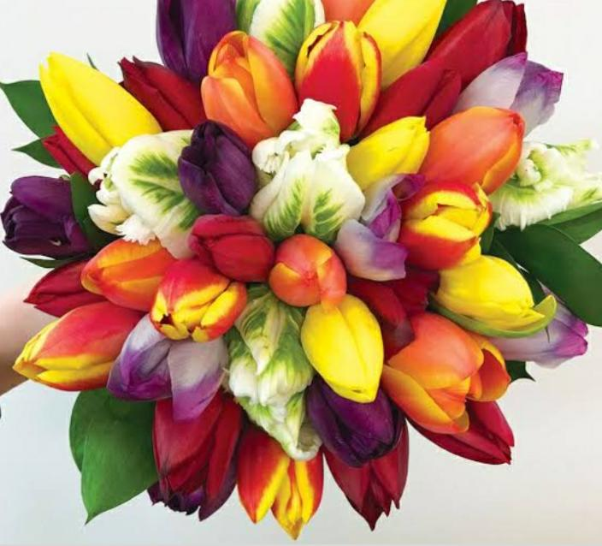
Welcome

Slide 2
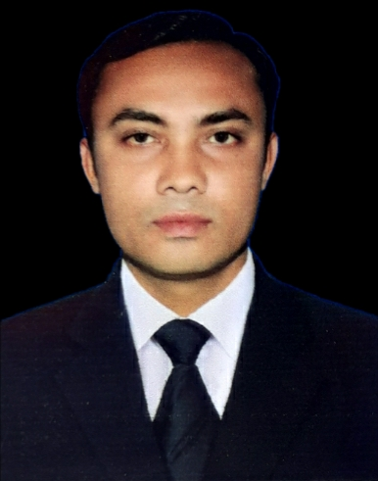
INTRODUCTION
SUBJECT: English 2nd Paper
CLASS: Six
Topic: The use of Punctuation
MD.ERSHADUL HAQUE Assistant Teacher Bhalukapara St Teresa’s High School

Slide 3
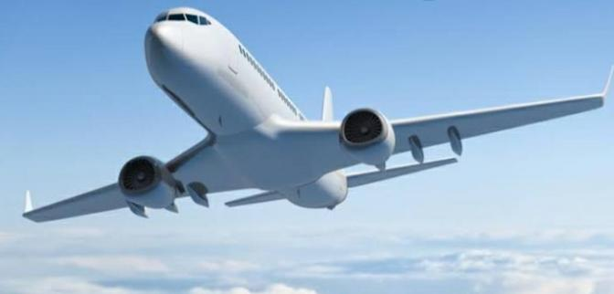
What do you see in the picture?
A plane
How will you feel if you have a plane journey
?
!
.
Wow It will be great
What do we call the red marks in the sentences?
Punctuation Marks
/storage/emulated/0/Download/file_43166_1591265878.pptx

Slide 4
Todays Topic
The Use of Punctuation

Slide 5
Learning Outcomes
By the end of the lesson the students will be able to-
use punctuation marks correctly in the sentences and in the passage.

Slide 6
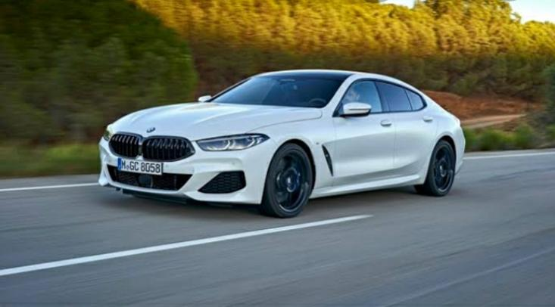
What do you see in the picture?
A car
I like this car
.
Can you tell what is wrong with the sentence?
1. At the end of the sentence, there will be full stop(.).

Slide 7
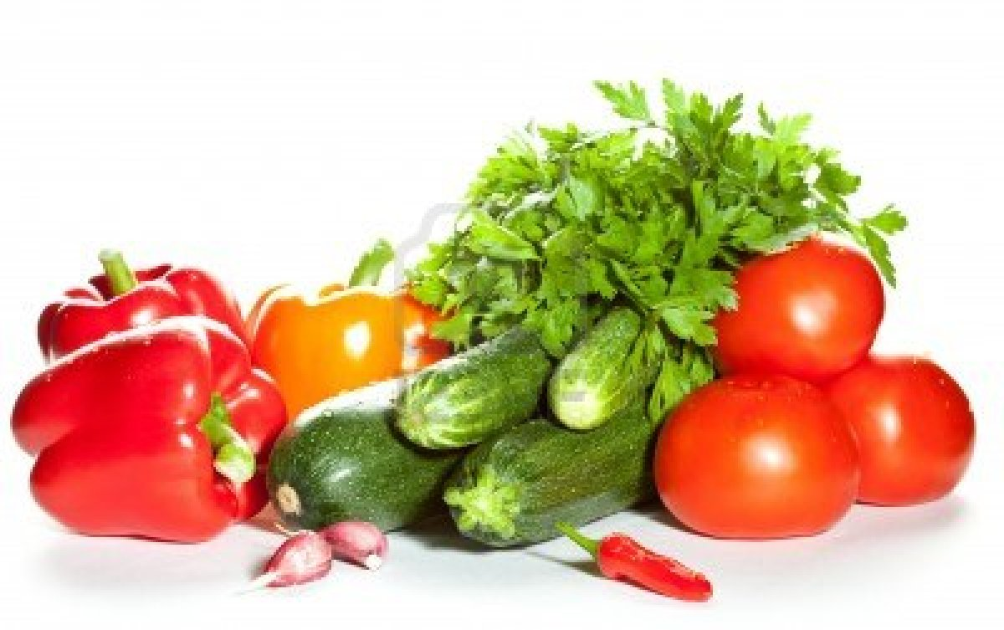
,
Here are some vegetables. They are capsicum cucumber tomato onion chili and mint.
,
,
,
Can you tell what is wrong with the sentence?
2.If there are more than two same parts of speech, there will be comma(,) after each but last two.

Slide 8
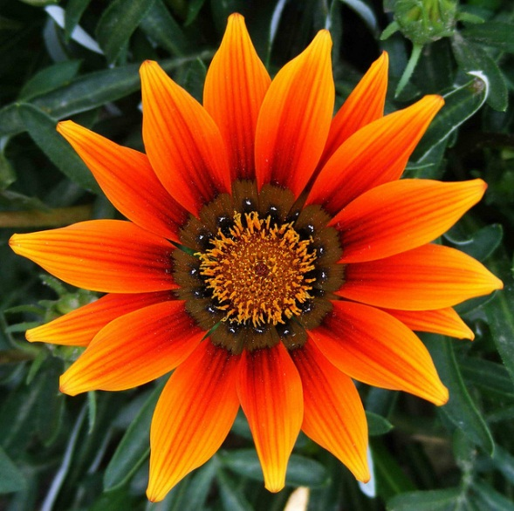
?
What is the name of the flower
Can you tell what is wrong with the sentence?
Sunflower
3.After the interrogative sentence there will be question mark(?).

Slide 9
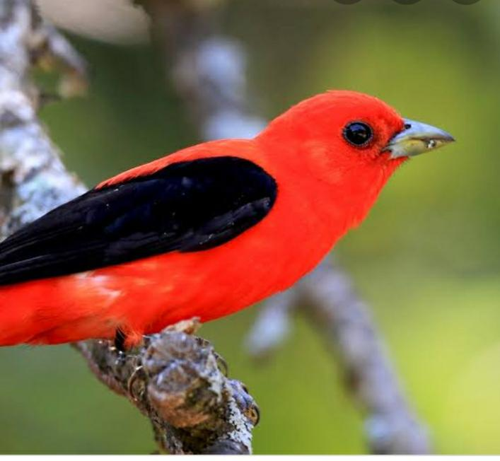
Wow The bird is very beautiful.
!
Can you tell what is wrong with the sentence?
4.After the interjection words such as- Hurrah,Oh, Alas, Wow etc. there will be exclamatory mark(!).

Slide 10
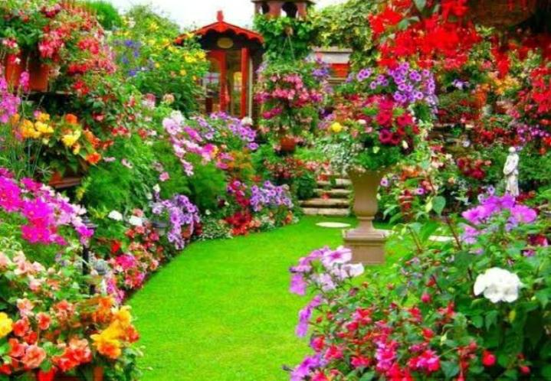
How beautiful the garden is
!
Can you tell what is wrong with the sentence?
5.At the end of the exclamatory sentence, there will be exclamatory mark(!).

Slide 11
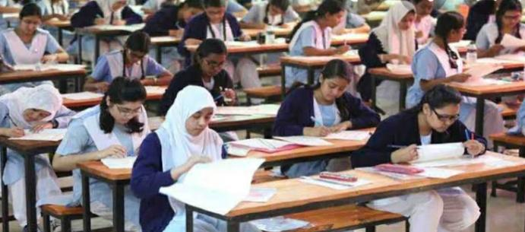
The teacher said to the students, May you pass in the examination .
“
”
Can you tell what is wrong with the sentence?
6. Direct speech will be in Inverted
comma(“ ”).

Slide 12
Take the punctuation marks from the box and say which punctuation marks will be suitable for which sentences.
!
1. Where are you going
2. Hurrah We have won the game.
“
”
3. I love my mother very much
?
4. I usually take bread jelly banana and apple as my breakfast.
.
,
,
5. My sister says, I like sunrise .

Slide 13
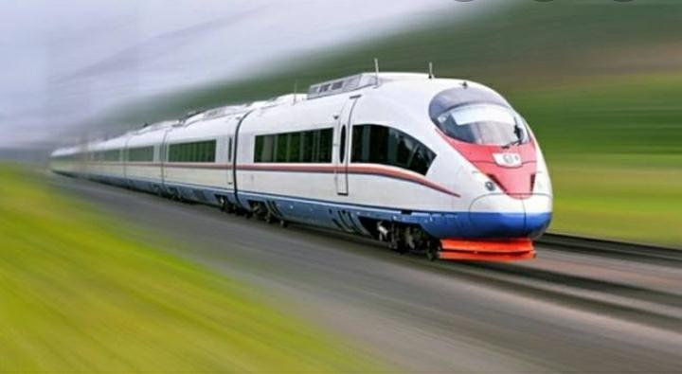
Read the following passage and re-write the following passage with the correct punctuation marks.
!
!
Oh What a great journey it was I went on my first train journey I travelled with my father mother and brother Dhaka to Khulna Do you like travelling my father asked me in the train.
.
,
.
“
?
”

Slide 14
my son he said a great treasure lies hidden in the fields i am about to leave you where is it hidden said the son you must dig the soil for it said the old man

