Slide 1
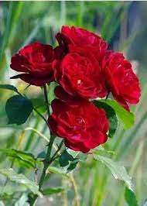
WELCOME

Slide 2
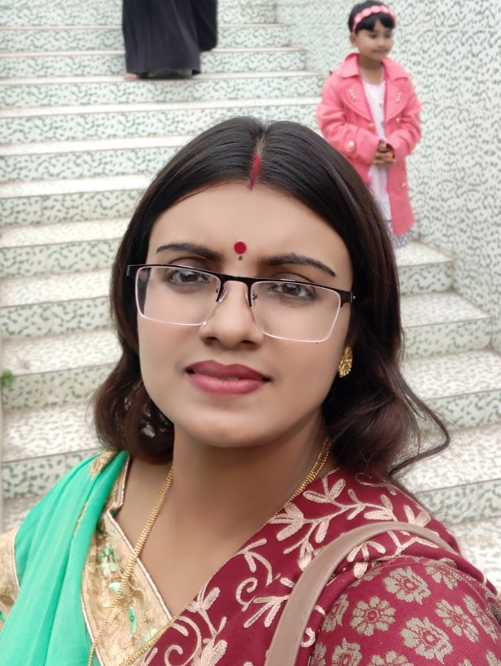
Identity
Aloka Rani Sarkar,
Assistant Teacher,
Balarampur Govt primary School,
Kotchandpur Jhenidah.
Subject: English ,
Class: 3,
Unit: 23, What do they do.
Lesson:4-6

Slide 3
Learning Outcomes
Learning outcomes: Students will be able to-
Listening:
1.1.1 recognize English sound differences in the context of words.
Speaking :
1.1.1 repeat words, phrases and sentences after the teacher with proper sounds and stress.
1.1.2 say word , phrases and sentences with proper sounds and stress.
Reading :
1.5.1 read simple sentences with proper pronunciation and stress.
5.1.3 read the text.

Slide 4
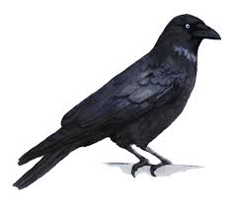
What do you see in the picture ?
Crow

Slide 5
Todays Lesson:
What do they do?

Slide 6
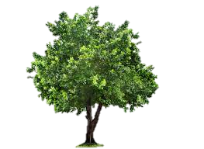
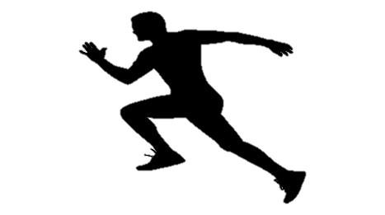
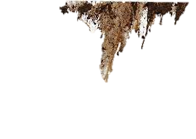
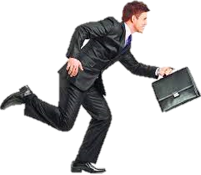
Vocabulary
Crow
One kind of black bird
Tree
Plant
Active
Energetic
Dirty
Unclean
Quick
Fast

Slide 7
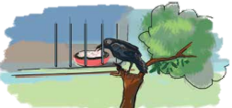
Teachers Reading
What do they do?
Read
I am a crow. I live in a tree. I get up early in the morning. I’m active all day. I fly in the sky and look for food. Sometimes I take food from people. I’m very quick. Sometimes I eat dirty things.

Slide 8
Teachers and Students chorusly reading
What do they do?
Read
I am a crow. I live in a tree. I get up early in the morning. I’m active all day. I fly in the sky and look for food. Sometimes I take food from people. I’m very quick. Sometimes I eat dirty things.

Slide 9
Students Reading
What do they do?
Read
I am a crow. I live in a tree. I get up early in the morning. I’m active all day. I fly in the sky and look for food. Sometimes I take food from people. I’m very quick. Sometimes I eat dirty things.

Slide 10
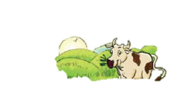
Pair work
Look at the picture. Circle the answer.
I’m a cow/goat.
I live in a stream/shed.
I get up early/late.
I am a slow/quick animal.

Slide 11
Group work
Make sentences with following words.
Group -A
Group -B
Quick
Sky
Fly
Get up
Look for
Active
Dirty
Food

Slide 12
Check the Answers.
Quick
Do the work quick.
Sky
Crow flies in the sky.
Get up
I get up early in the morning.
Fly
A crow flies in the sky.
Look for
He looks for a pen.
Food
We eat food.
Active
Our teachers are active.
Dirty
Crow is a dirty bird.

Slide 13
Evaluation
Write T for true and F for false beside the sentence.
1. The crow lives in a tree.
T
2.The crow gets up late in the morning.
F
3. The crow is lazy.
F
4.The crow takes food from people .
T
5. The crow is slow .
F
6. The crow doesn’t eat dirty things .
F

Slide 14
Home work
#Write five sentences about crow.

Slide 15
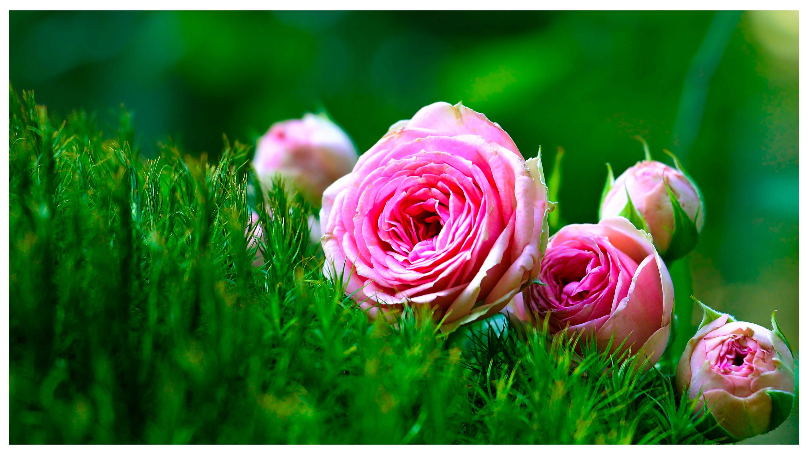
Thank you

