Slide 1


GOOD MORNING DEAR

Slide 2
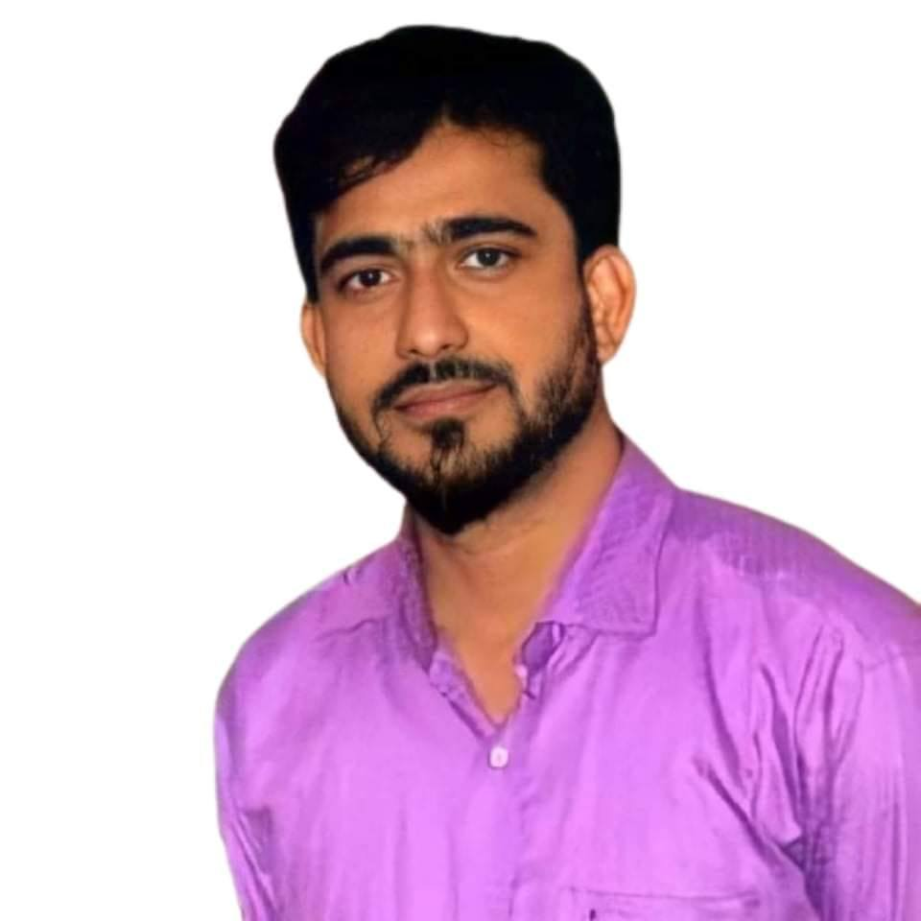
Teacher’s Identity:
Md. Ariful Islam
Lecturer in English
Shayestaganj Kamil Madrasah
Shayestaganj, Habiganj
arif046980@gmail.com

Slide 3
Lesson’s Identity
Subject: English
Class: Two
Unit: 3
Lesson: 4-6
Alphabet

Slide 4
Learning Outcomes:
By the end of the lesson students will be able to
Listening:1.1.1-become familiar with English sounds by listening to common English words.
Speaking: 1.1.2-say simple words and phrases with proper sounds and stress.
Reading: 1.2.1-recognize and read the alphabet both small and capital
(non-cursive)

Slide 5

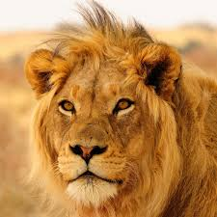
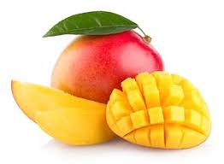
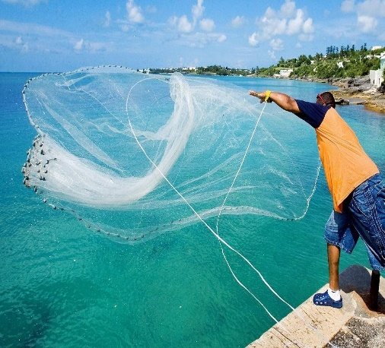
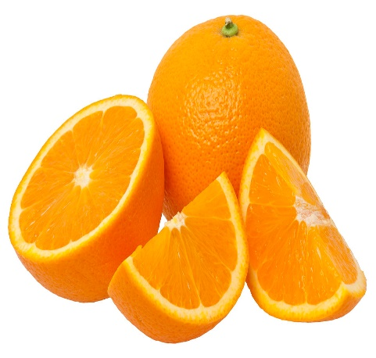
Let’s see some pictures
Kite
Lion
Mango
Net
Orange

Slide 6
Kite
Lion
Mango
Net
Orange
K
L
M
N
O

Slide 7

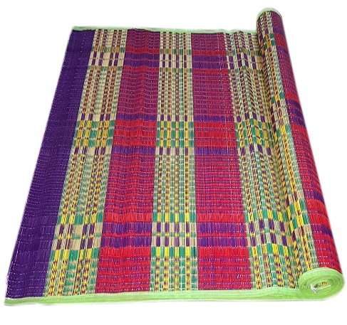
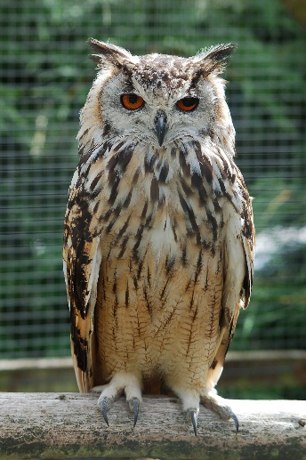
z
Lets match the word with picture
Lamp
Mat
Kettle
Nest
Owl

Slide 8
LetLet’s match the letter with words
Orange
L
Net
K
Mango
N
M
Lion
O
Kite

Slide 9
Group Work
.....ango
......ite
.....ion
.....range
.....et
M
K
N
L
O

Slide 10
Home Work
K,L,M,N,O দিয়ে আরও কিছু word শিখে আসবে।

Slide 11

Thank You Dear

