Slide 1
W
E
L
C
O
M
E

Slide 2
Teacher Identity
Lesson Identity
Muhammad Rehan Uddin
Assistant Teacher
Pakshail Ideal High School
Barlekha, Moulvibazar
Email: mdrehanuddin17@gmail.com
ICT4E District Ambassador, Moulvibazar
Subject: English 1st paper
Class: Eight
Unit: 6, Lesson: 9
Time: 50 Minute

Slide 3
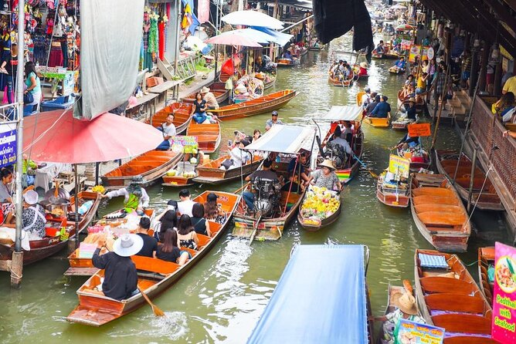
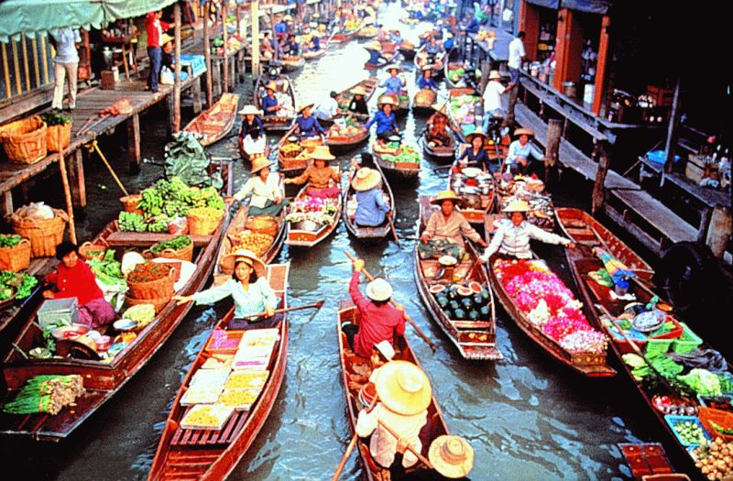
Let’s see some pictures……….
Look properly these picture and guess.

Slide 4
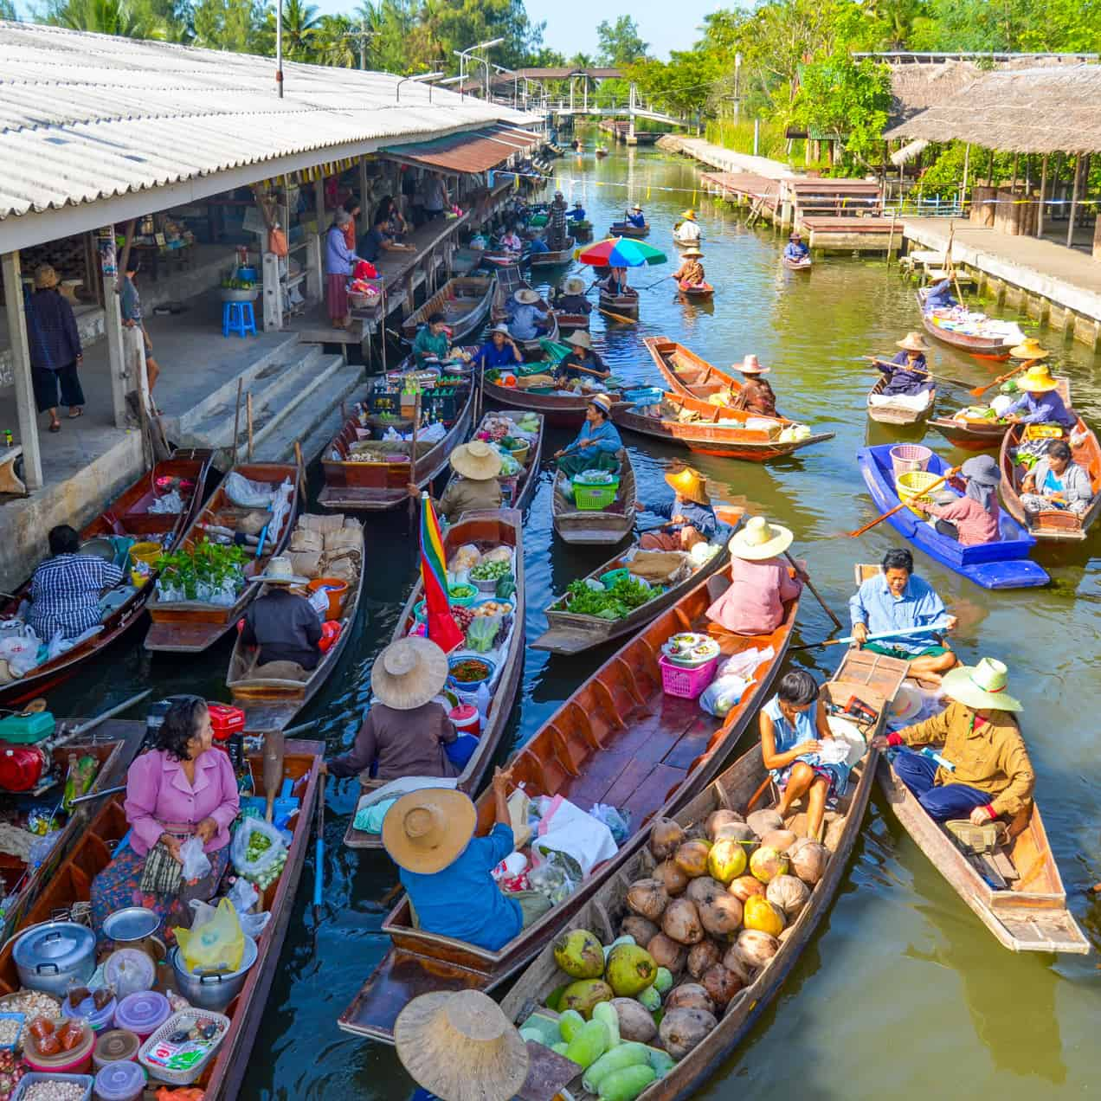
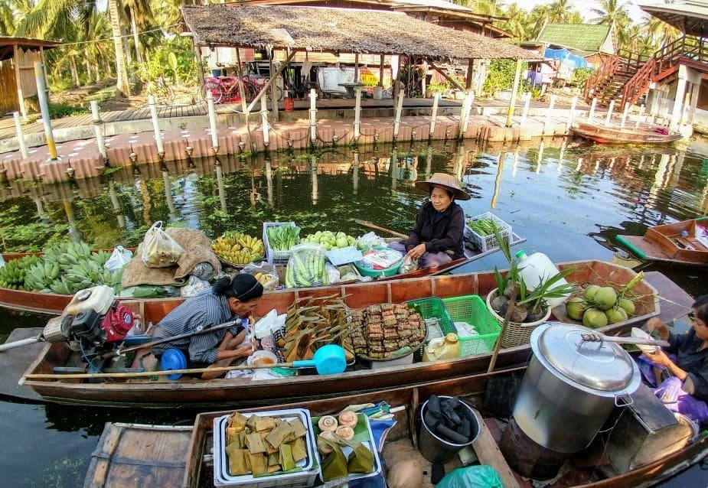
Can you guess what those could be?
Where do you think this place is?

Slide 5
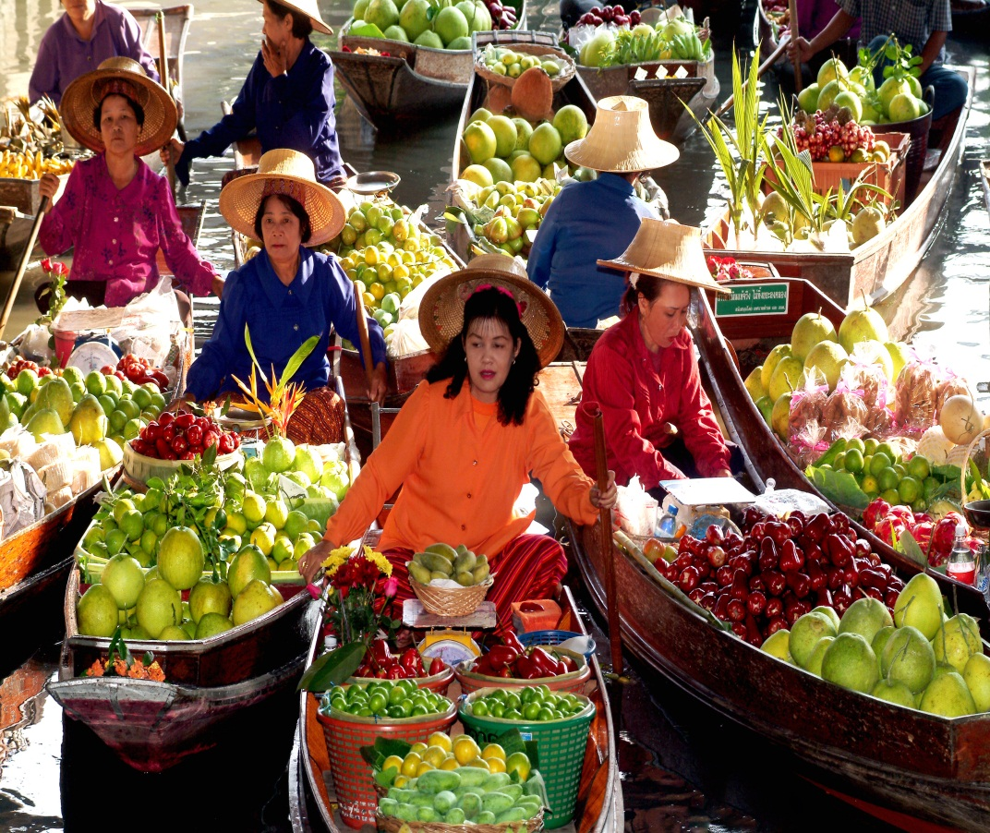
So,Today’s our Lesson is…..
The Tha Kha Floating Market

Slide 6
Learning Outcomes
After studied this lesson the student
will be able to…….
Read and understand the text.
Ask and answer questions.
Identify true or false.
Write a short description about the text.

Slide 7
Let’s discuss about some Vocabulary

Slide 8
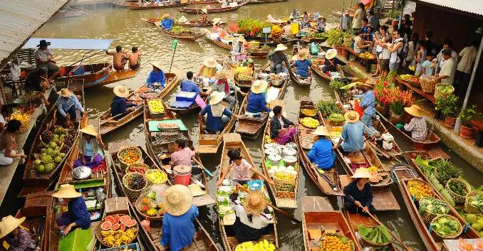
Laden
loaded
The market is very loaden with boats, sellers and buyers.

Slide 9
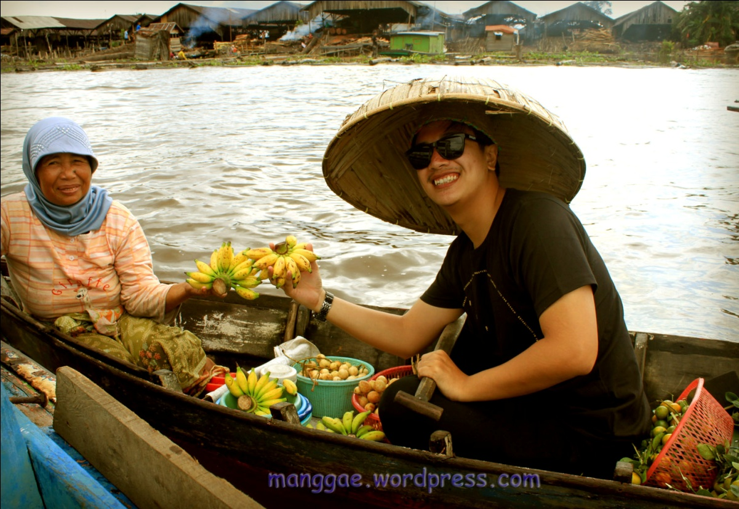
Chit-chat
idle talk
A seller and a buyer chit-chat.

Slide 10
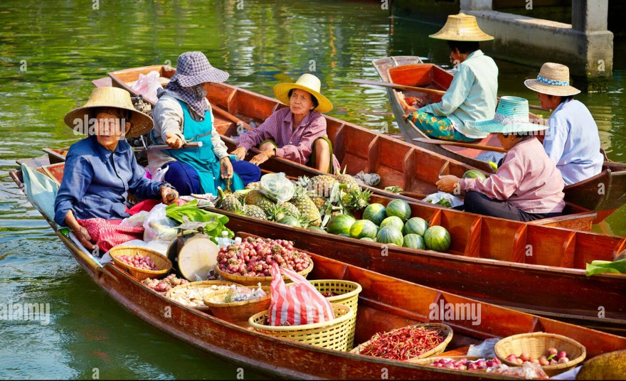
Natives
Aboriginals
Really, The sellers are natives.

Slide 11
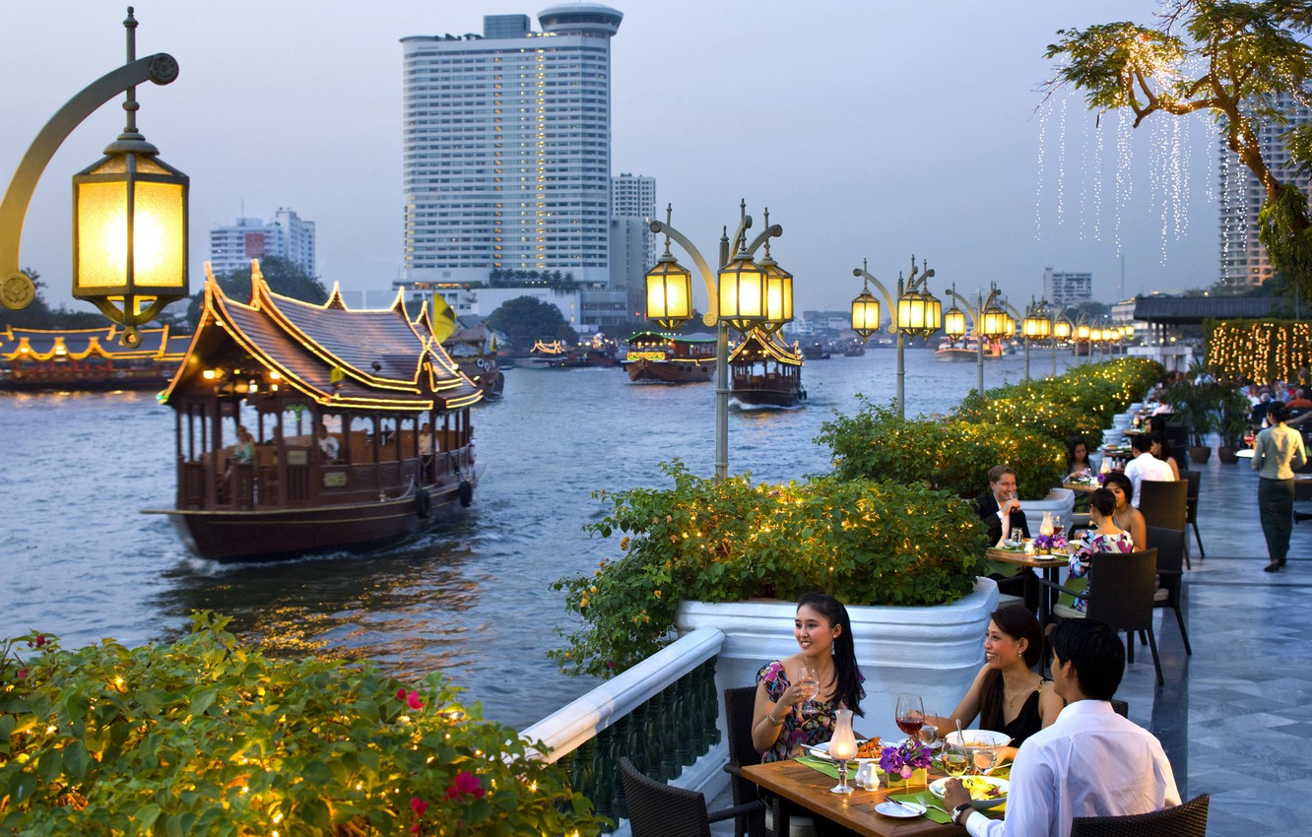
City
Town
Bangkok is a large noisy city

Slide 12
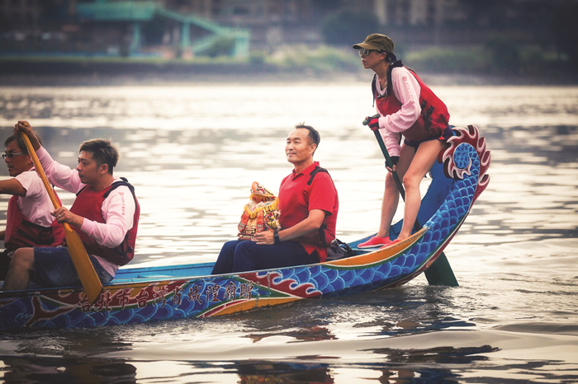
Travel
Visit
They always travel by boat

Slide 13
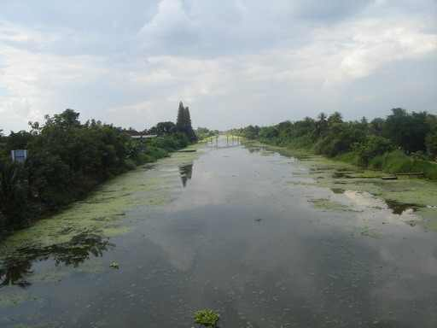
Klongs
Canal
There are many Klongs in Bangkok

Slide 14
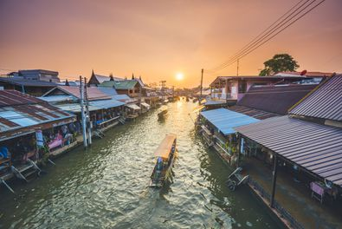
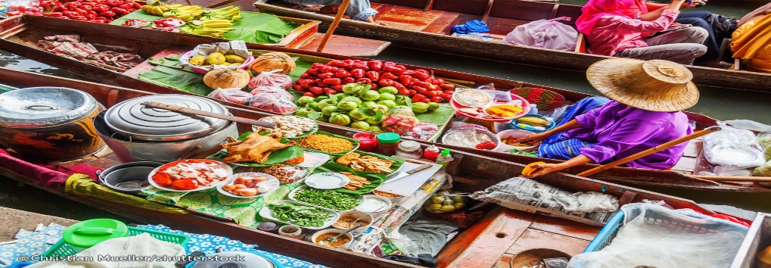
Let’s see some more vocabulary
Traditional
Conventional
Phase
Period
Originally
Primitive

Slide 15
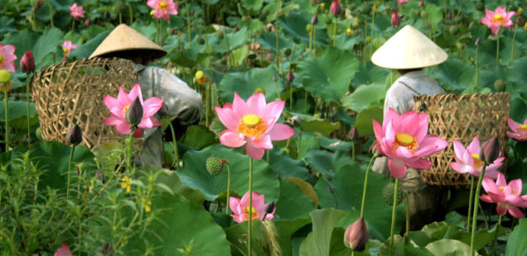
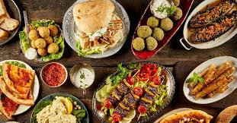
Lotus
One kind of watery flower
pleasing, especially to
the taste
Delicious

Slide 16
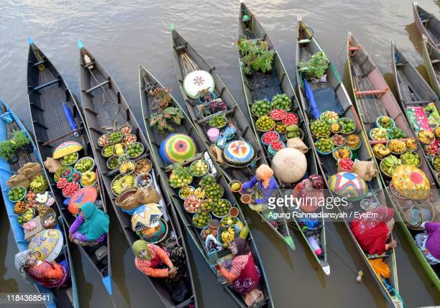
Floating
An object or substance which
floats on water.
An exercise performed with
a pulling motion.
Row

Slide 17
Let’s enjoy the text

Slide 18
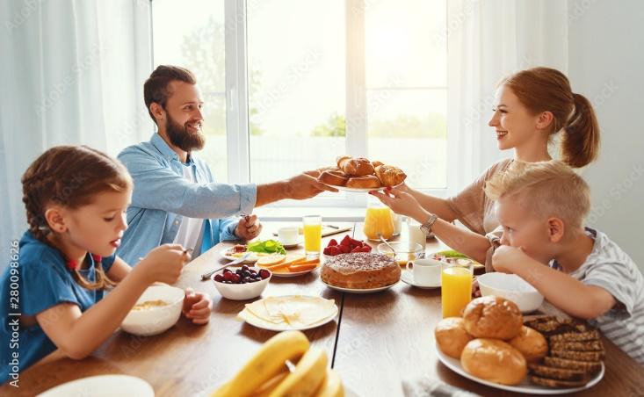
It was Sunday. Mita, Zara, Jhuma Islam and Mazharul Islam woke up very early. They quickly got ready and started for Tha Kha floating market. They planned to have breakfast at the market.

Slide 19
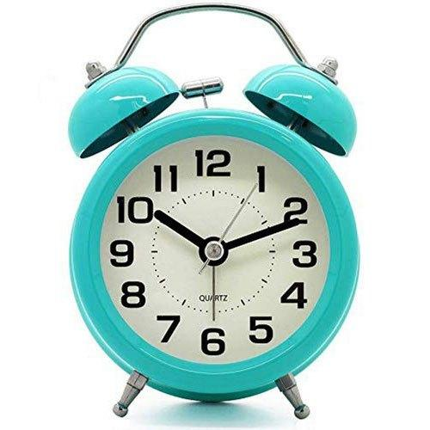
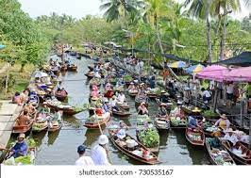
They reached the market place sharp at 7. The canals were surrounded with coconut palm trees. They hired a boat. The boatman started to row slowly taking them to the centre of the market.

Slide 20
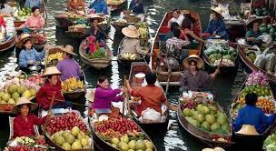
There were boats everywhere. The sellers were mainly elderly Thai women. Their small boats were laden with bundles of lotus flowers, farm-fresh coconuts, fruits, vegetables, local food, and delicious sweets.

Slide 21
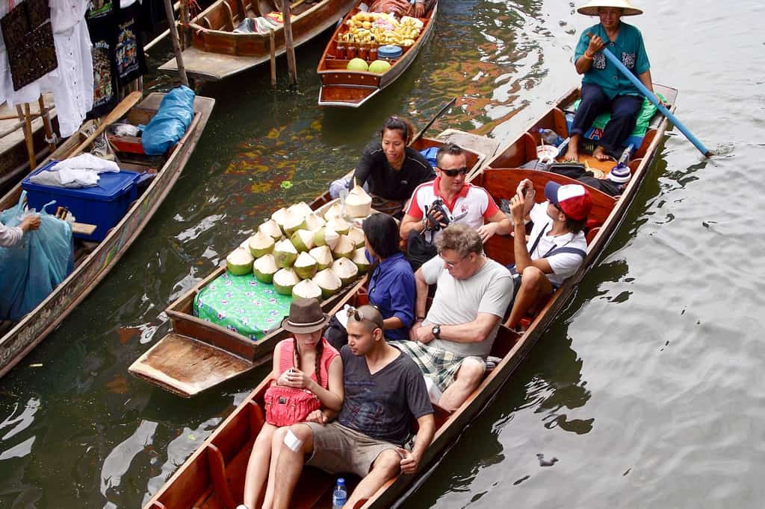
The sellers and buyers rowed their boats slowly. The sellers displayed their goods for sale and the buyers chose their pick. They could have a little chit-chat as buying and selling was going on.

Slide 22
Pair Work
Answer the following questions.
1. What kind of market was it?
2. Why did the boatman row slowly?
3. Who were selling goods? How were they selling goods
4. What were they selling?
5. What was the atmosphere at the market?

Slide 23
Answer sheet
It was a floating market.
The boatman rowed slowly to take the people to
the center of the market.
3. Mainly, Thai elderly women were selling goods.
They were selling goods with their small boats.
4. They were selling bundles of lotus flowers, farm fresh coconuts,
fruits, vegetables, local food and delicious sweets.
5. As buying and selling was going on among different people,
we can say that it was a noisy atmosphere at the market.

Slide 24
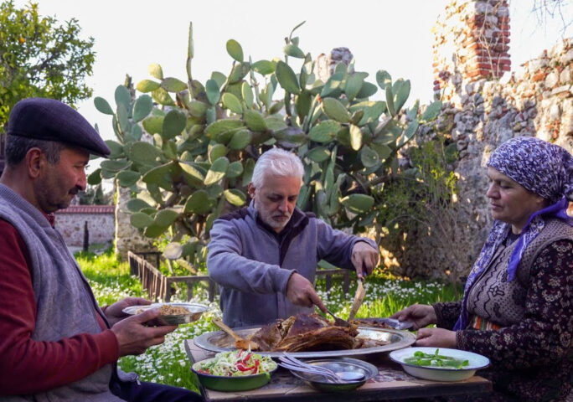
The Tha Kha floating market is more traditional with a
few tourist visiting than Other floating market. Originally,
the Tha Kha floating market used to sits only six or seven
days a month depending on the phase of the moon.
Nowadays the Trade takes place on Friday, Saturday,
and Sunday too.

Slide 25
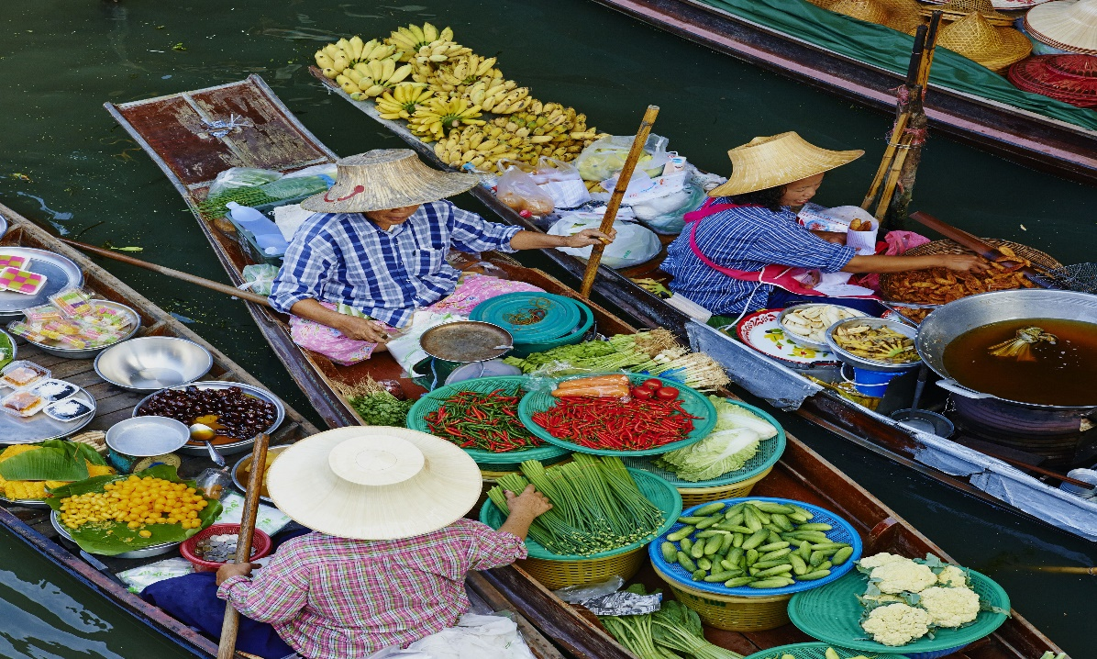
The main buyers here are the Tha Kha natives. People seem
to know each other very well. Everyone was seen Smiling
and calling each other by name. The locals did not notice
Mita and others much. They were all busy Buying and selling.

Slide 26
Group Work
Read the following statements are true or
false if false give the correct information.
The tha kha floating market is a tourist place.
It sits only six or seven days a month.
The buyers and sellers are the local people living near Tha Kha river.
4. They all knew each other.
5. The main buyers here are not the Tha Kha natives.

Slide 27
Answer sheet
Match the following answer with the statements.
Answer: True.
Answer: False- It used to sit only six or seven days a month.
Answer: True.
Answer: True.
Answer: False- The main buyers here are the Tha Kha natives.

Slide 28
Evaluation
Why did Mita, Zara, Juma Islam and Mazharul Islam
woke up very early?
When They reached the market place?
Who are mainly sellers on this market?
How many day’s do the Tha Kha floating market sits on?
Who are the main buyers on this market?

Slide 29
Home Work
Write a paragraph about ‘The Tha Kha Floating Market’

Slide 30
Thank You All

