Slide 1
WELCOME

Slide 2
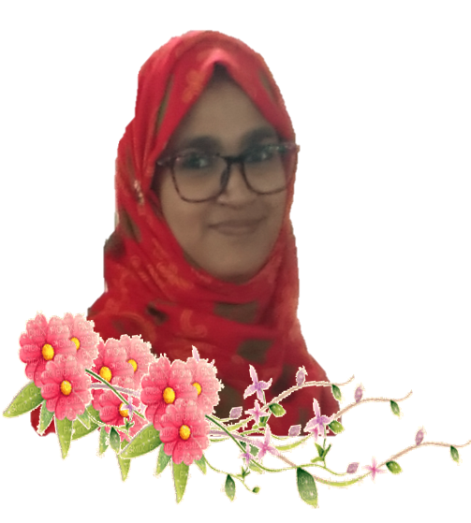
PRESENTED BY
LESSON
Umme Sarmin
Assistant teacher
Chardicree Govt Primary School
Muladi, Barishal.
Class : Two
Sub: English For Today
Unit : 16
Lesson : 4

Slide 3
Learning Outcomes
Listening:
1.1.1 become familiar with English sounds by listening to common English words.
Speaking:
1.1.1 repeat after the teacher simple words and phrases with proper sounds and stress.
1.1.2 say simple words and phrases with proper sounds and stress.
By the end of the lesson students will be able to-

Slide 4
Let’s enjoy a song

Slide 5
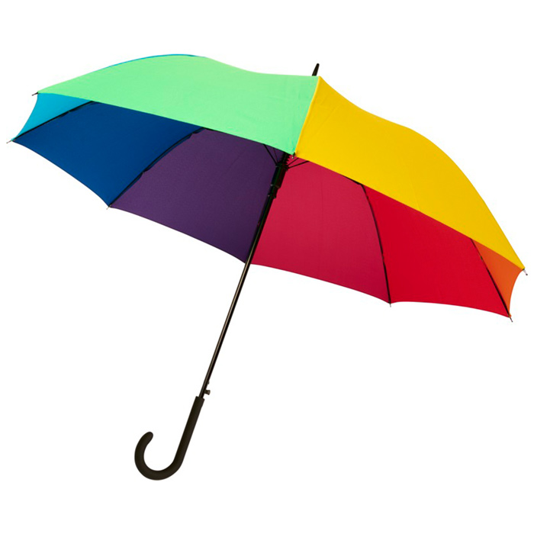
Look at the picture
How’s the Umbrella?
What’s this?
Colourful
Umbrella

Slide 6
Our Today’s Lesson
Colours

Slide 7
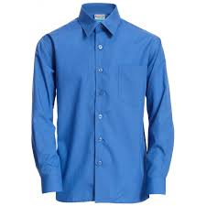
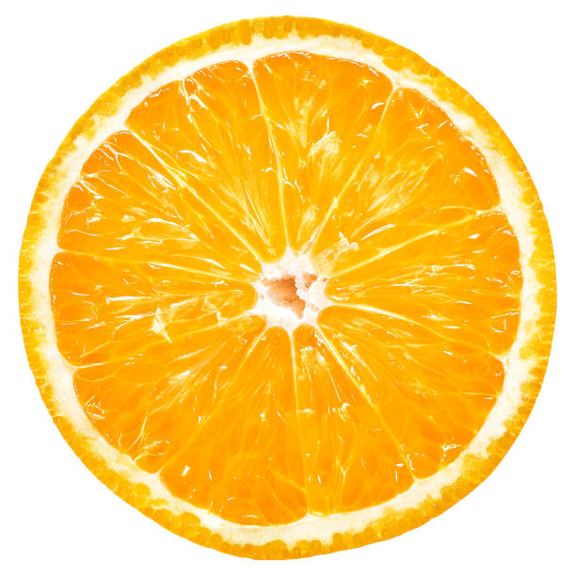
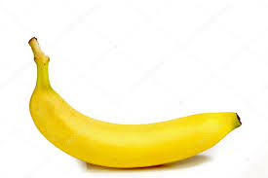
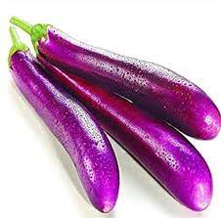
Look
Leaf
Green
Rose
Red
Shirt
Blue
Orange
Butterfly
Orange
Indigo
Banana
Eggplant
Yellow
Violet

Slide 8
Look
Listen and say
Red
Orange
Yellow
Green
Blue
Indigo
Violet

Slide 9
Say the colour of the card in pair

Slide 10
Listen and say
Look and say
red
Red
Orange
orange
yellow
Yellow
Green
green
Blue
blue
Indigo
indigo
Violet
violet

Slide 11
Game
Anyone who can will get -
Find seven colors from the class and keep them in mind. I will tell someone the name of a colour and he/she will show me the object of that colour .
Anyone who can’t will get -

Slide 12
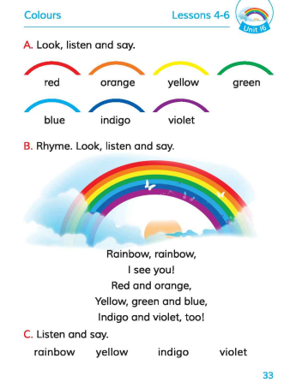
Open your book
Page no
33

Slide 13
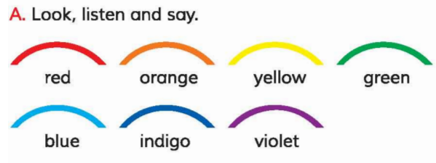
Connection to textbook

Slide 14
2
1
3
Name the 7 colours
Task
7
4
6
5

Slide 15
Practice the name of the colour of different things in your home
Homework

Slide 16
Thank you
Bye bye

