Slide 1
Welcome

Slide 2
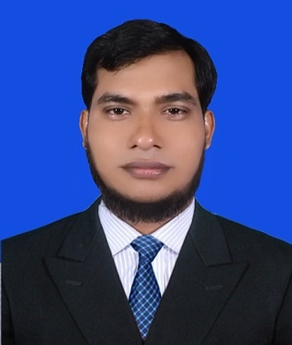
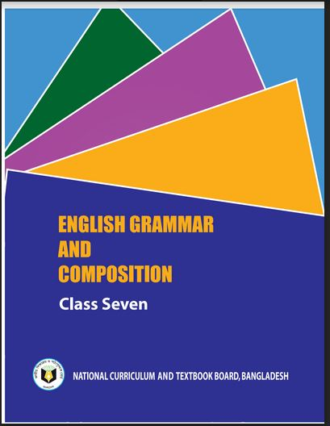
Identity
Class : Seven.
Lesson-13
Time- 50 Minutes
Date-20/03/2020
Md. Shariful Islam
M.A, B.ED.
Asst. Teacher
Balakhal Chandraban Girls’ High School
Hajigonj, Chandpur.
Mobile no- 01736337531
E-mail-saharatanha@gmail.com

Slide 3
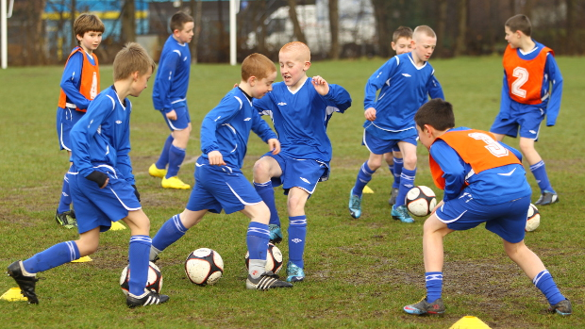
Look at the pictures and the sentences.
Q:- What are the children doing in the field?
A:-The Childrens are playing football on the field.
Notes:
Showing the picture teacher can ask the question to the whole class.

Slide 4
How do the flowers look?
The flowers look beautiful.

Slide 5
What is the parts of speech of the words in the circles?
1.The Childrens are playing football on the field.
2.The flowers look beautiful.
Verb

Slide 6
Today’s topic
Right forms of verbs

Slide 7
Learning outcomes
After completing the lesson students will be
able to –
write the sentences using right forms of verbs.
fill the gaps with right forms of verbs (with clues).

Slide 8
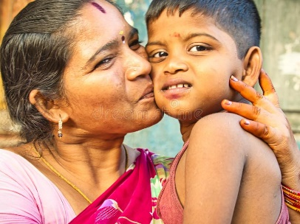
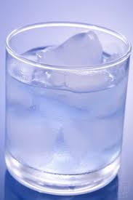
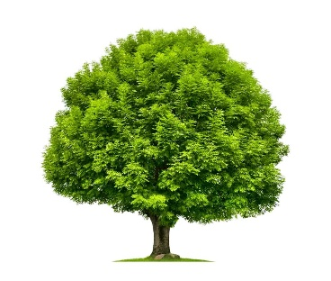
Look at the pictures and the sentences.
Mother loves her child
Ice floats on water.
Trees give us oxygen.
If the sentence is Universal truth, it will be Present Simple Tense.
Do the sentences express universal truth?
Can you tell why the sentences are present simple?
Which tense is expressed by the sentences?
Present simple tense

Slide 9
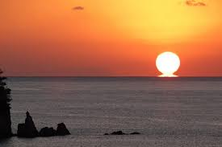
Give answers using right forms of verbs.
The sun _____ (rise) in the east. It ____ (give) us light. It _____ (be) the most important source of energy for life on Earth. The sun _____ (set) in the west.
rises
gives
is
sets

Slide 10
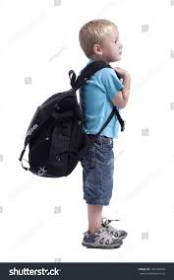
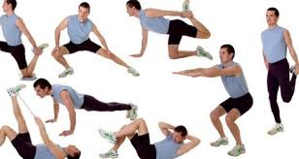
Look at the pictures and the sentences.
He goes to school every day
They exercise regularly
If in the sentence there is everyday/always/regularly/
occasionally/usually/often/sometimes/generally , the sentence will be Present Simple Tense.
Can you tell why the sentences are present simple?
Present simple tense
Which tense is expressed by the sentences?

Slide 11
Give answers using right forms of verbs.
goes
1. The boy ____ (go) to school regularly.
studies
2. He ____ (study) attentively everyday.
3. He always ____ (speak) the truth.
speaks
4. He and his parents often ____ (visit) their relatives.
visit

Slide 12
Look at the pictures and the sentences.
They are playing Football now.
He is watching the Television at this moment.
If in the sentence there is now/at this moment/at this time , the sentence will be Present Continuous tense.
Can you tell why the sentences are present continuous tense?
Which tense is expressed by the sentences?
Present continuous tense

Slide 13
Give answers using right forms of verbs.
The wheel --- (move) on the line at this moment
is moving
We ------ (do) housework now
are doing

Slide 14
Look at the pictures and the sentences.
I have met him recently.
She has taken his lunch just now.
If in the sentence there is recently/already/just/just now/lately , the sentence will be Present Perfect tense.
Can you tell why the sentences are present perfect tense?
Present Perfect Tense
Which tense is expressed by the sentences?

Slide 15
Give answers using right forms of verbs.
1. They already (come) home.
Ans: They have already come home.
2. The train just (reach) the station..
Ans The train has just reached the station.
3. Arif lately (get) student visa or USA.
Ans: Arif has lately got student visa for USA.

Slide 16
Look at the pictures and the sentences.
It has been raining for two hours
He has been doing the work since morning
If in the sentence there is for/since+ time the sentence will be Present Perfect Continuous Tense.
Can you tell why the sentences are present perfect continuous tense?
Present Perfect Continuous Tense
Which tense is expressed by the sentences?

Slide 17
Give answers using right forms of verbs.
1. The boy (play) football since morning.
Ans: The boy has been playing football since morning.
2. They (read) a book for an hour.
Ans. They have been reading a book for an hour.

Slide 18
Home work
1.The boy (go) to school regularly.
2. The earth (move) round the sun.
3. Now the students are (sing) the national anthem.
4. He has already (reach) home.
5. He(join) there recently.

Slide 19
Thank you

