Slide 1
my
dear
students

Slide 2
Introduction
Md. Sultan-ul Arefin
Assistant Teacher
Gurudaspur Model Govt. Primary School
Gurudaspur, Natore.
Class : Five
Subject : English
Unit : 6
Lesson Title : Eat healthy
Lesson : 3 (Activity-F.)

Slide 3
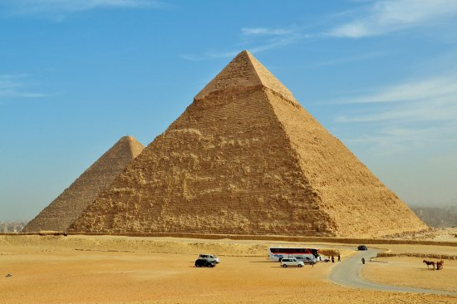
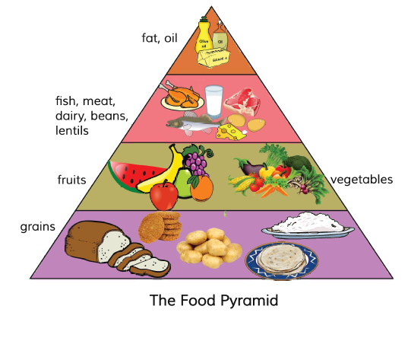
Picture-1
Picture-2
What do you see in picture-2?
It’s the pyramid of Egypt.
What do you see in picture-1?
Very fine. We can call it food pyramid.
It’s also like the pyramid of Egypt.

Slide 4
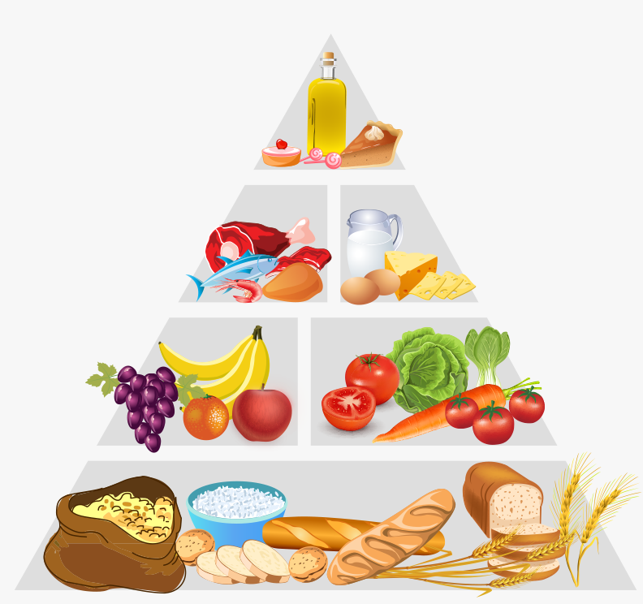
Lesson Declaration
Well, To day we are going to read-
Eat healthy
(On the next…… good choices.)
- Activity F. Listen and read

Slide 5
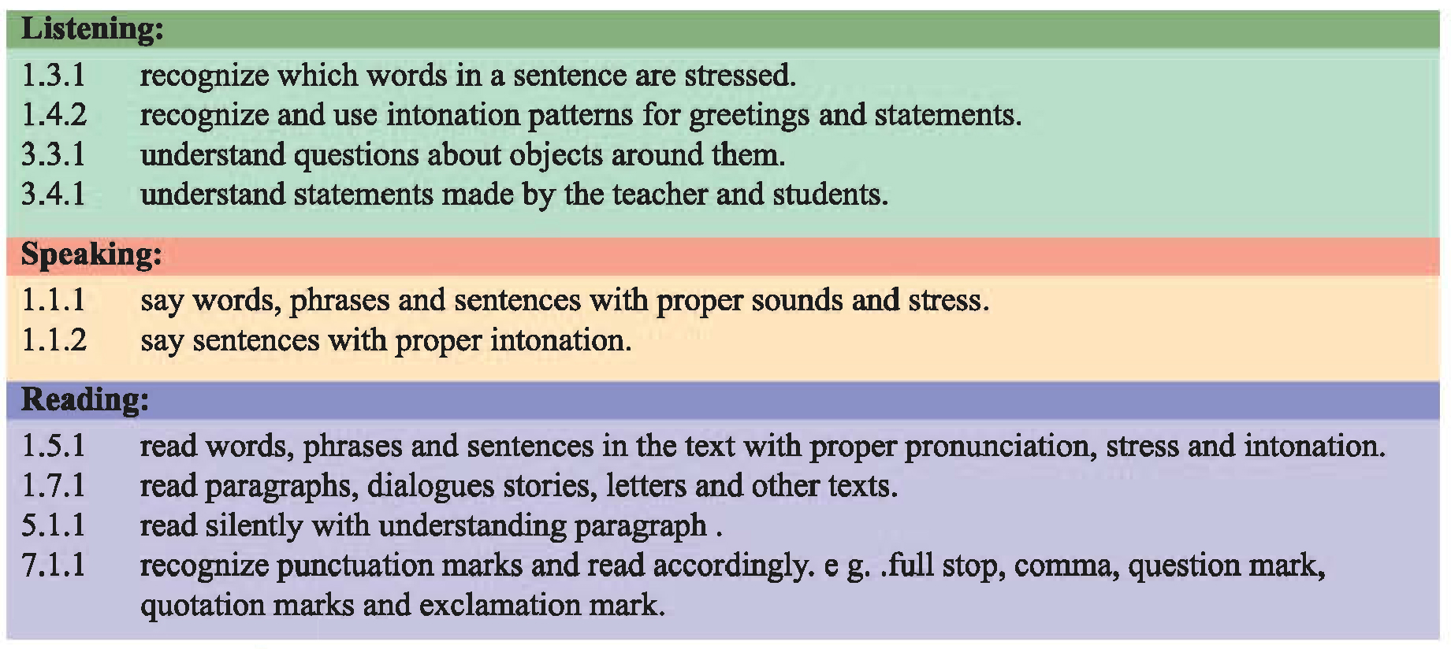
Learning outcomes

Slide 6
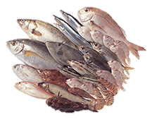
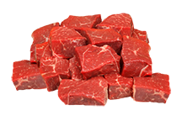
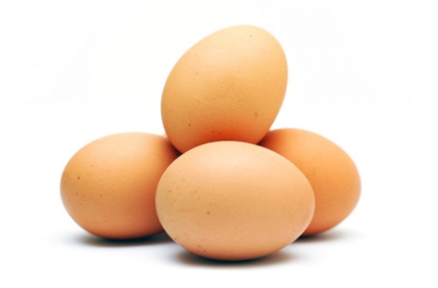
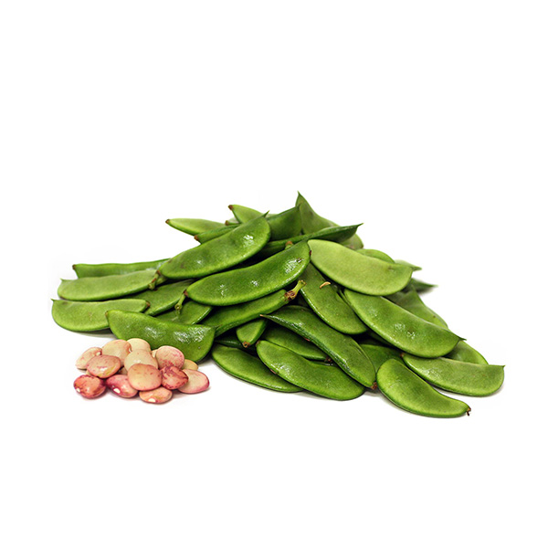
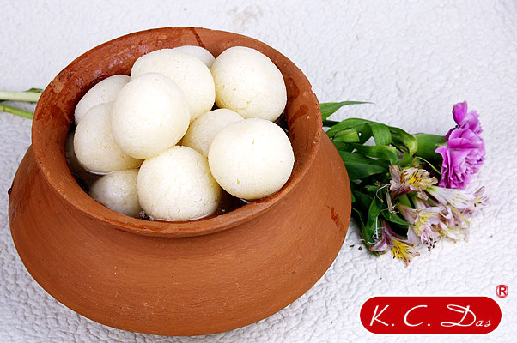
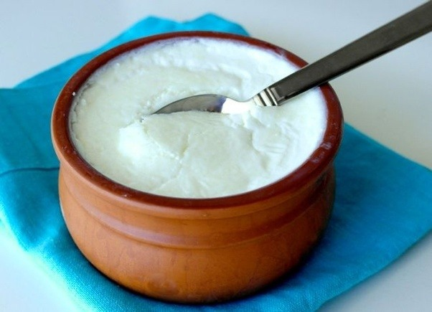
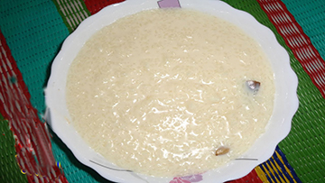
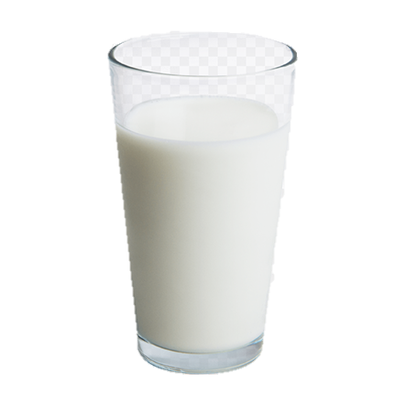
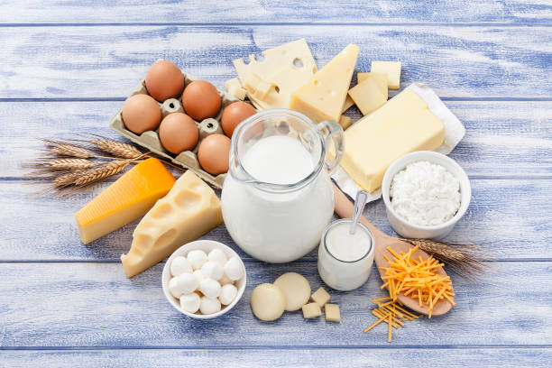
Meat
Egg
Bean
Fishes
Sweet
Curd
Payes
Milk
Fish, meat and dairy products.
Chicken
Dairy Products

Slide 7
This type of foods have protein. Protein help our teeth and bones. Protein and dairy make us strong

Slide 8
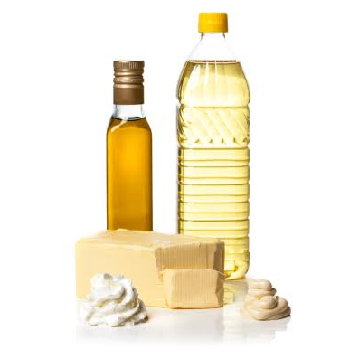
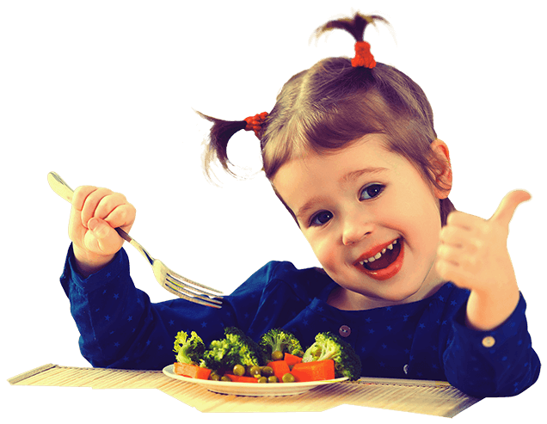
Fat and oil make food delicious.

Slide 9
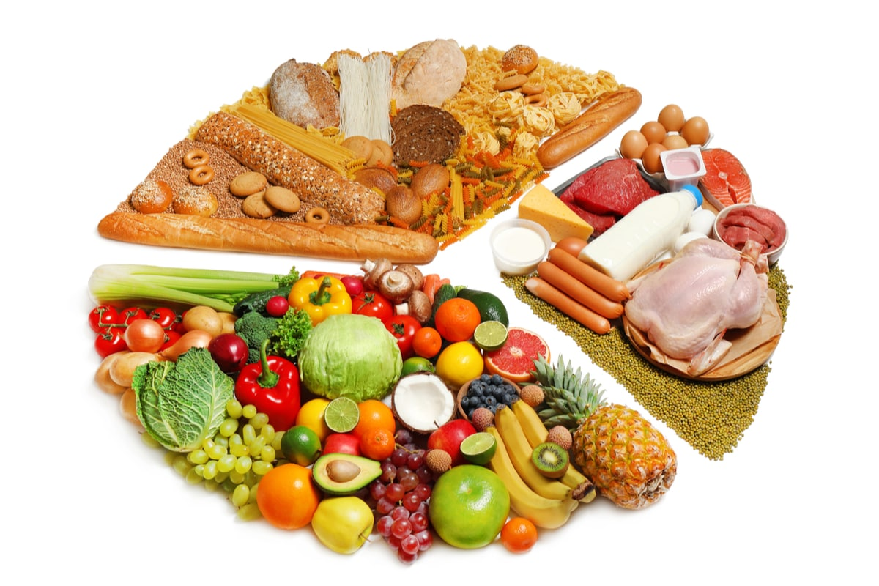
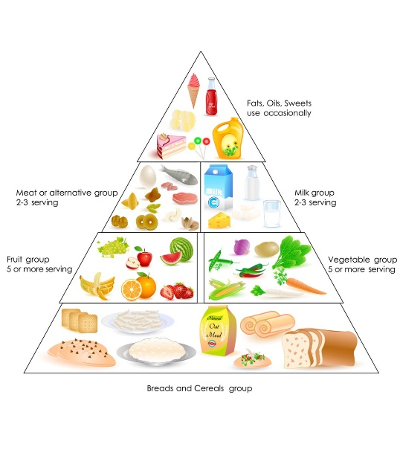
When we have choices about food, we need to make good choices.

Slide 10
New words
Product
Commodity, Vendible
Protein
Marrow
Dairy
Food made from milk
Delicious
Testy
Choice
Option

Slide 11
Teacher’s Model Reading
Dear students, open your English book at page 24. I am reading the text loudly. Please put your fingers on the text..

Slide 12
Silent Reading
Dear students, now read the text silently.

Slide 13
Individual work
Choose your best five foods from the following chart.
Sandwich
Chocolate
Ice-cream
Pop-corn
Banana
Mango
Burger
Milk
Rice
Egg
Fishes
Orange
Chips
Meat
Carrot

Slide 14
Pair work
Ask and answer in pair.
1. What is protein?
2. Why should we eat Protein?
3.What makes food delicious?

Slide 15
Group work
Fishes
Peanut
Orange
Chips
Sandwich
Chocolate
Ice-cream
Pop-corn
Banana
Egg
Mango
Burger
Milk
Rice
Carrot
Meat
Protein Group
Write five dairy product.
Dairy Group
What makes us strong.
Delicious work
Write five healthy food.

Slide 16
Evaluation
Put tick mark on the correct answer:
1. Sweet is a ----------food.
a. Healthy
Wrong answer
b. Unhealthy
Wrong answer
c. Dairy
Correct answer
d. Dirty
Wrong answer

Slide 17
2. How many levels are there in the Food Pyramid?
a. 3
Wrong answer
b.4
Wrong answer
c. 5
Correct answer
d. 6
Wrong answer

Slide 18
3. What does make us strong?
a. Grain
Wrong answer
b. Protein
Correct answer
c. Fat
Wrong answer
d. Fruits
Wrong answer

Slide 19
Task
Home work
Write five sentences about your food habit at your home.

Slide 20
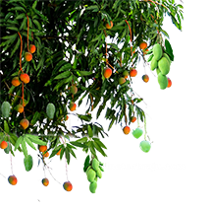
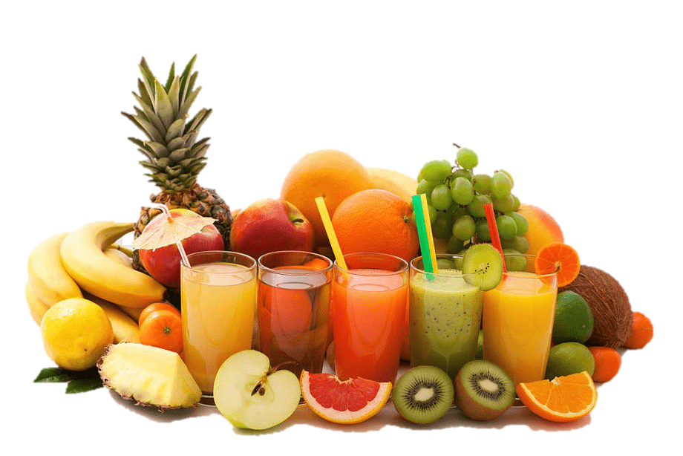
Dear student, plstay safe and use musk. ease
See you later, bye………

