Slide 1
Welcome To my Student

Slide 2
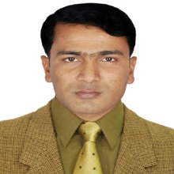
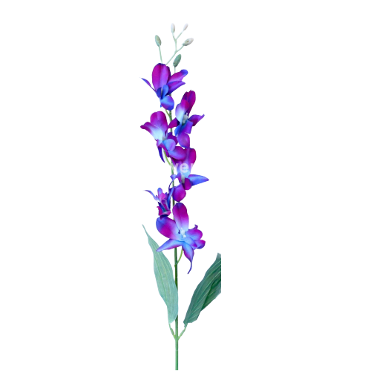
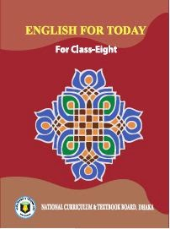
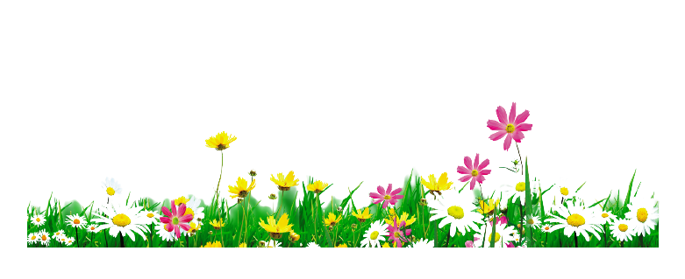
Identity
Muhammad Rehan Uddin
Assistant Teacher
Pakshail Ideal High School
Barlekha, Moulvibazar.
Mobile: 01742823363
ICT4E District Ambassador, Moulvibazar.
English 1st paper
Class- Eight
Unite: One, Lesson: One
Time: 50 Minute

Slide 3
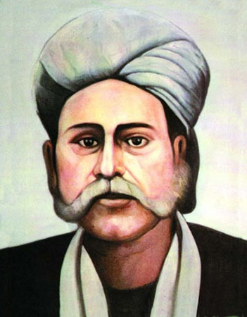
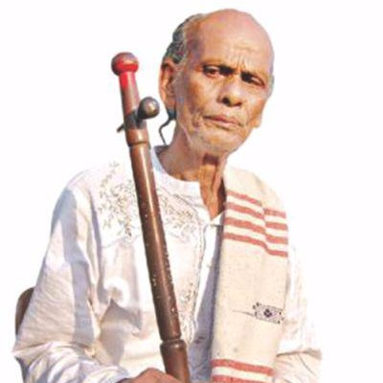
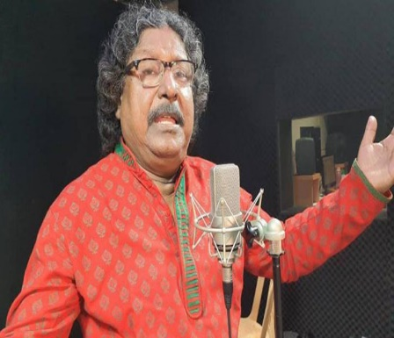
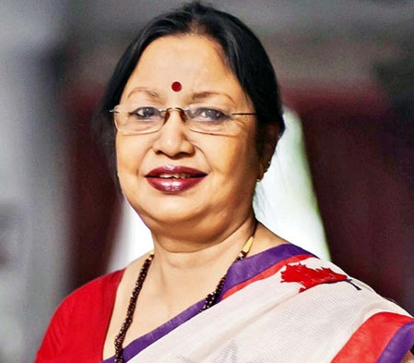
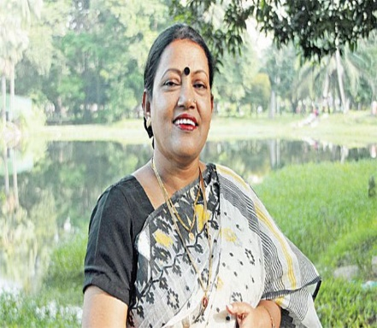
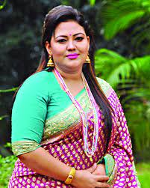
Let’s watch few picture’s………
What types of singer
are they?
They are folk singer.

Slide 4
So today’s our lesson is…….
Our Folk Songs

Slide 5
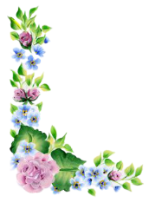
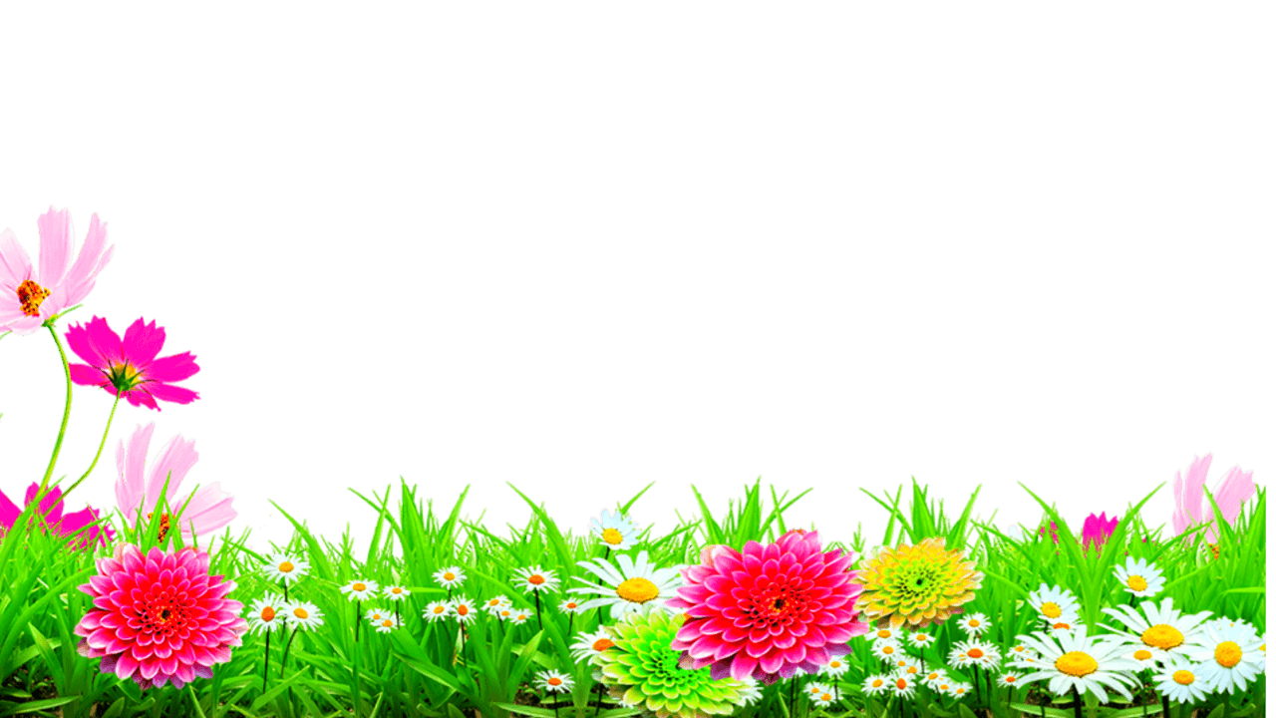
Learning Outcome
After studied the lesson, students will be able to…
Read and understand texts through silent reading.
Infer meaning from the text.
Ask and answer the questions
write answer to questions.
Write a short Paragraph.

Slide 6
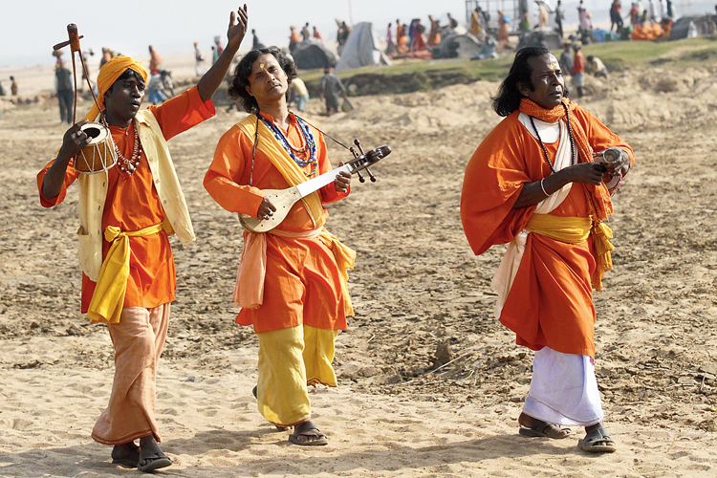
Let’s we know some new words.
Folk
লোকসঙ্গীত
Relating to the traditional art or culture of a community or nation.

Slide 7
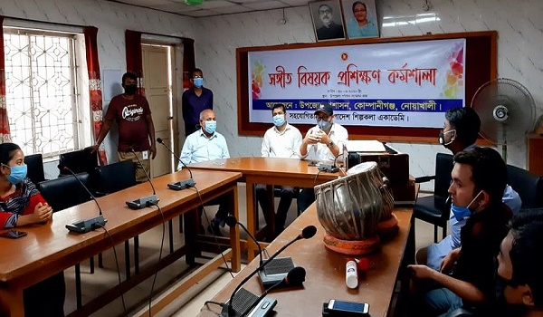
Musical
সঙ্গীত বিষয়ক
A song is not enjoyable without musical instrument.

Slide 8
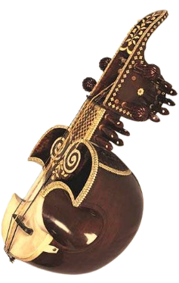
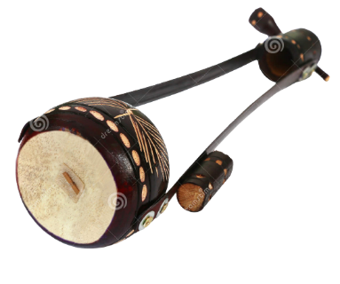
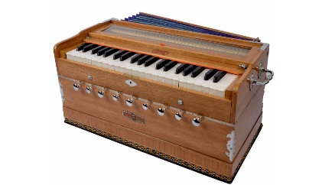
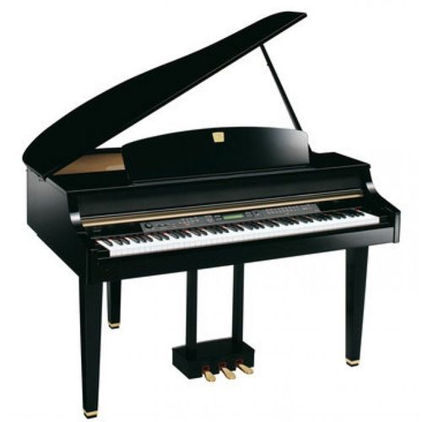
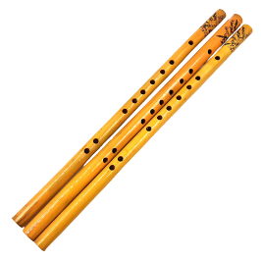
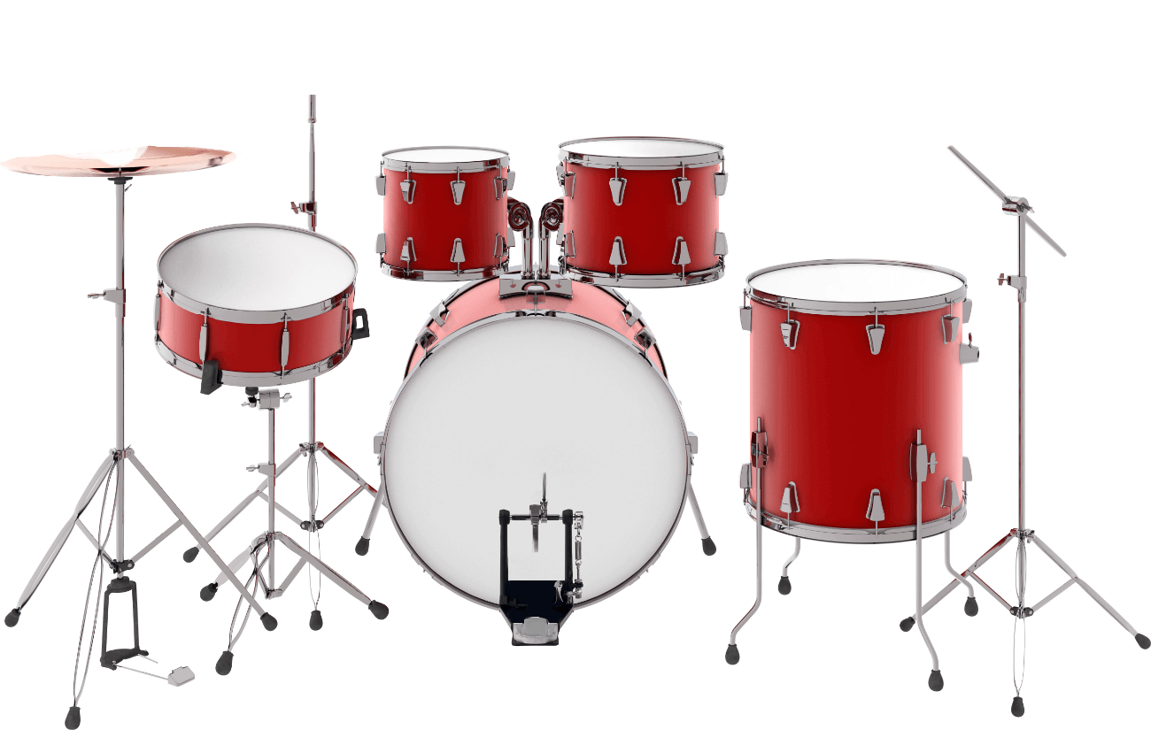
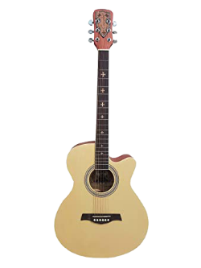
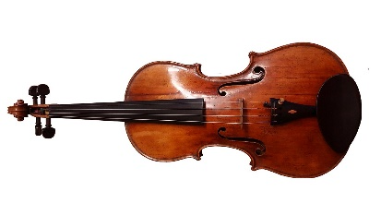
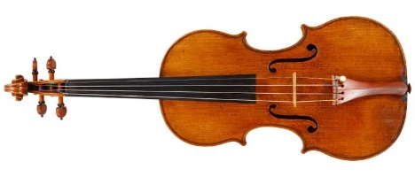
Instrument
যন্ত্রপাতি
The instruments which are used in singing.

Slide 9
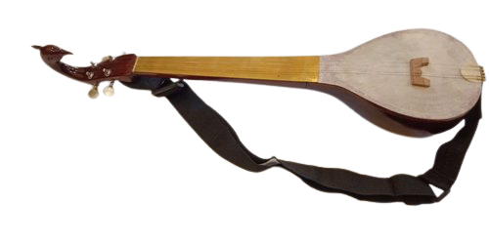
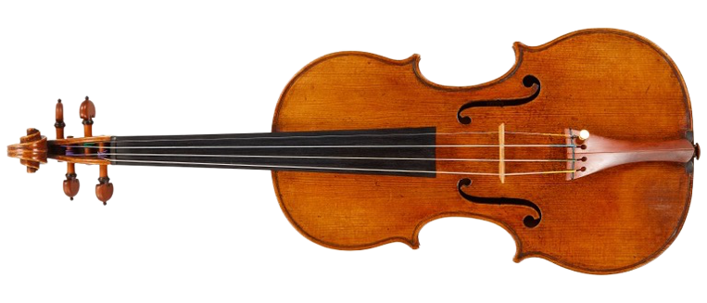
Let’s introduce some musical instruments and answer the following questions.
Dotara
Sarinda
Guitar

Slide 10
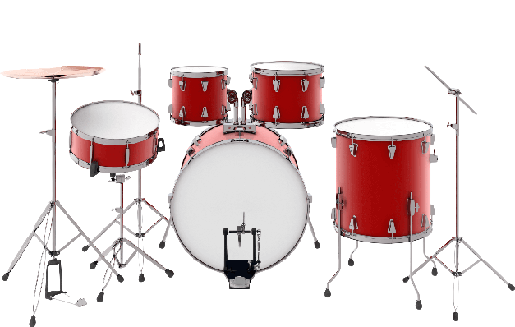
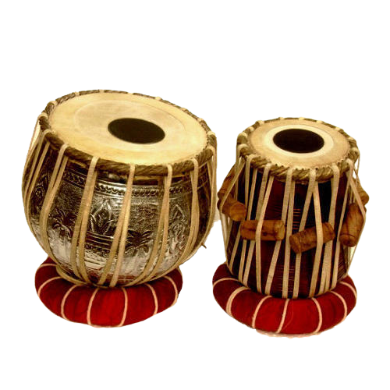
Bamboo Flute
Drum
Tabla

Slide 11
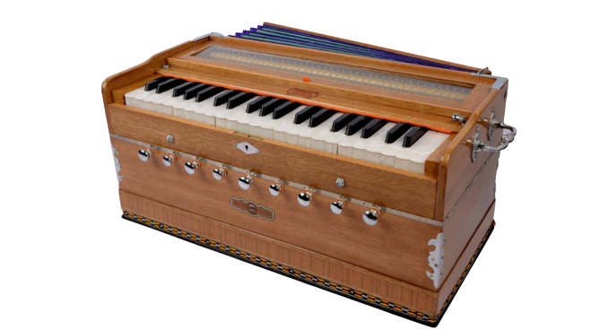
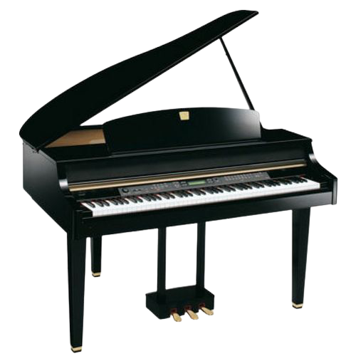
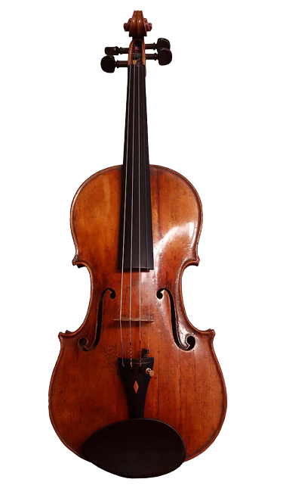
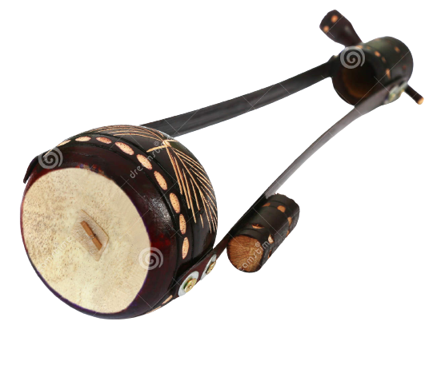
Piano
Harmonium
Ek-Tara
Violin

Slide 12
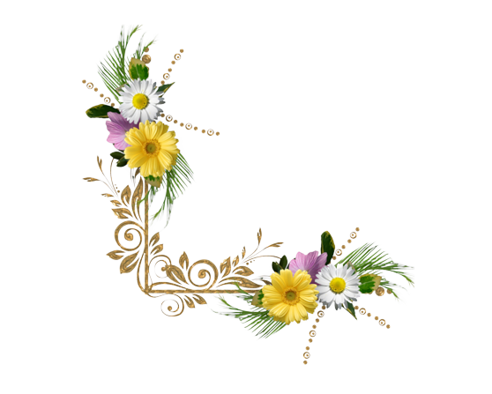
Pair work
Now Answer the following questions…….
1. Can you sing a song?
Ans: Yes, I can sing a song.
2. Can you play any of these musical instrument?
Ans: Yes, I can play Harmonium of these musical
instruments.
3. Do you know anybody who can play any of these
instruments? Tell what you know about her/him.
Ans: Yes, I know a person who is my favorite teacher.
He can play harmonium any occasion.

Slide 13
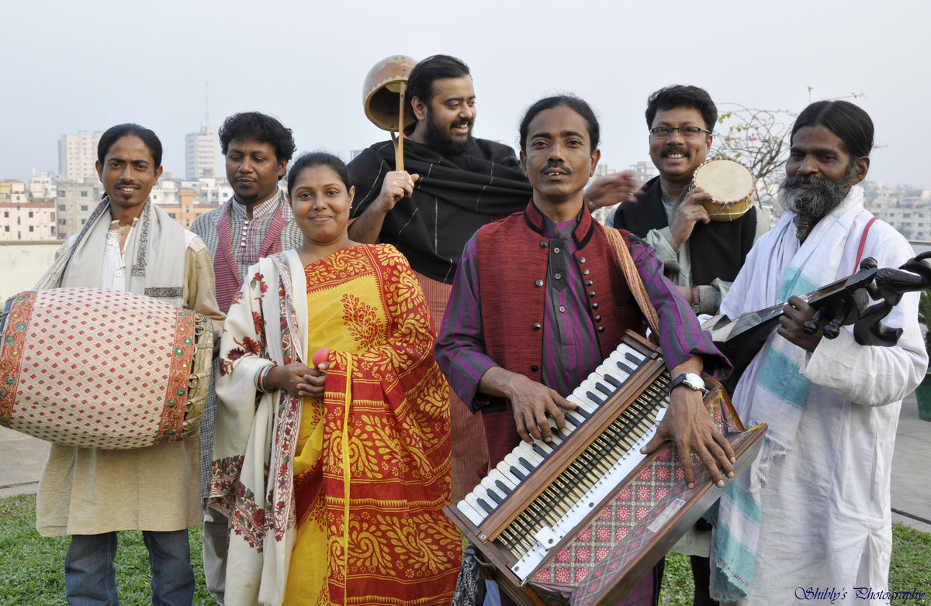
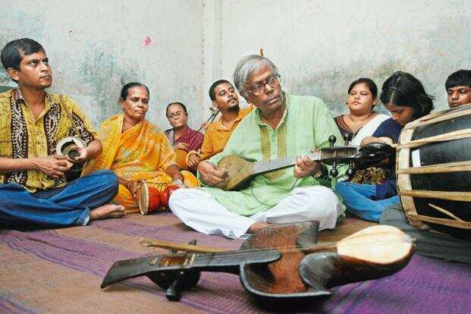
Read the text silently & carefully……
Folk songs are songs sung in the traditional style of a community or country. Here the traditional style includes the themes, words and tunes of the songs that have existed for a long time among the common people.

Slide 14
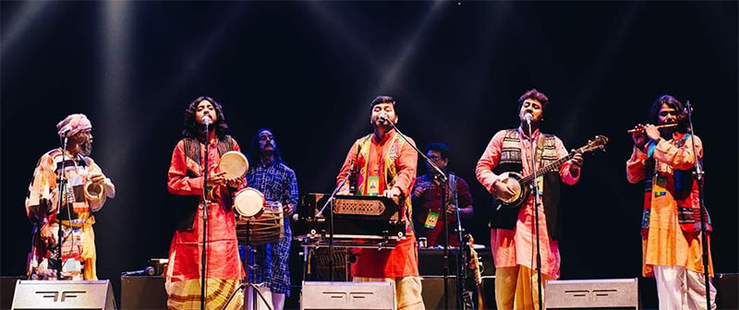
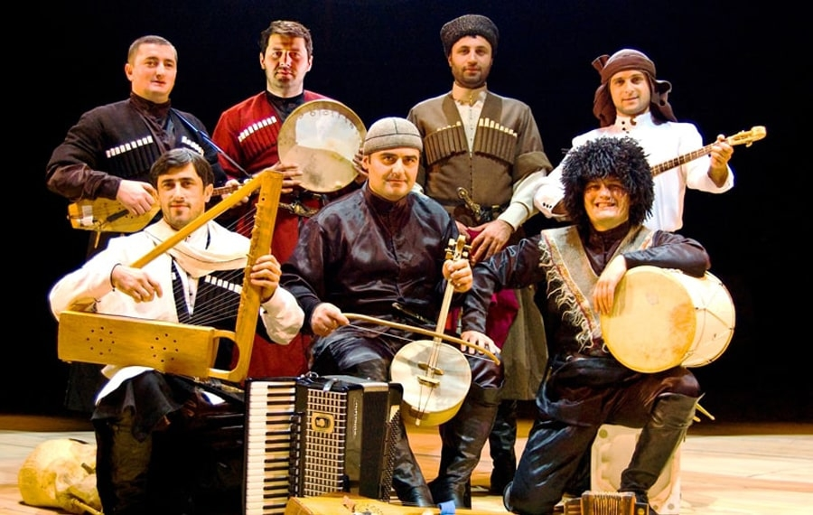
We have a rich history and collection of folk songs in Bangladesh. Of them Palligiti, Bhatiali, Bhawaiya, Jari, Sari, Gambhira, Lalongiti, Palagaan and songs of Hason Raja are very popular. The traditional Musical instruments are usually played with these songs.

Slide 15
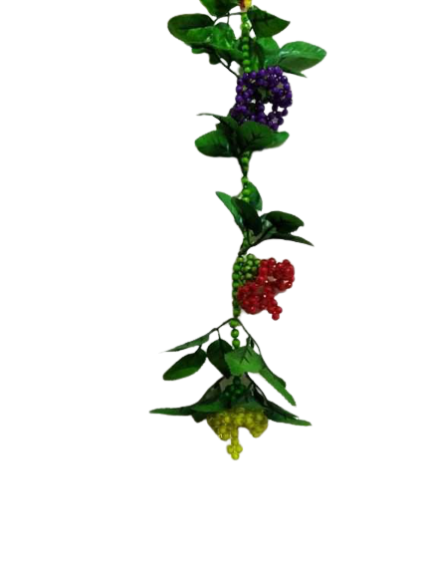
Let’s we know some folk songs name.
Songs of Hason Raja
Gambhira
Bhawaiya
Palagaan
Lalongiti
Bhatiali
Palligiti
Jari
Sari

Slide 16
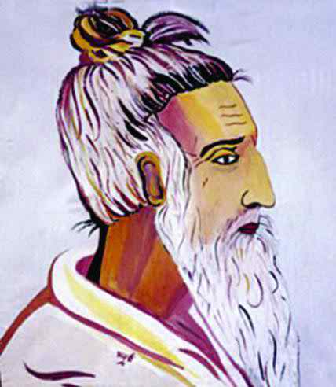
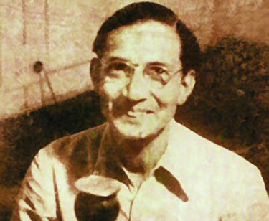
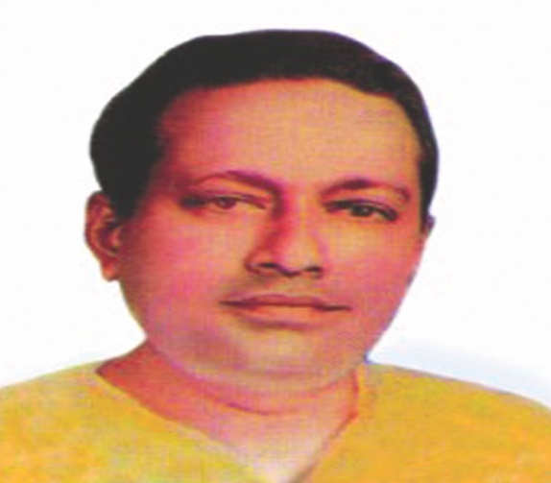
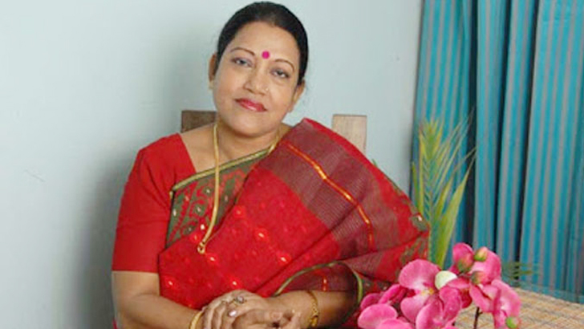
Let’s we introduce some folk singer
Lalon Fakir
Abbas Uddin
Abdul Alim
Hason Raja
Abdul Karim
Ferdousi Rahaman
Forida Parvin
Fakir Alomgir

Slide 17
Groups Work
1. Who usually like our folk songs?
Ans: The rural people and the elderly people usually like
our folk songs.
2. Can you name some well known folk singers?
Ans: Yes, I can some well known folk singers in our country
are Shah Abdul Karim, Momataj, Forida Parvin, Kuddus
Bayati, Bari Siddiki and so on.
3. Do you like folk songs? If you do, who is your favourite
folk singer? Which song or songs do you like most?
Ans: Yes, I like folk songs. My favourite folk singer is Shah Abdul Karim.
I have many favourite folk songs. Among them “Tumi amar ami tumar
ai asha kore tumare pushilam koto adore”

Slide 18
4. Discuss in groups whether the modern instruments like the guitar
and piano could be played with with the folk songs.
Fardhin: Do you like folk songs, friend?
Farhan: Yes, I do. I like them very much. These songs are an integral part of
our cultural heritage.
Ayash: Certainly, But have you noticed that these songs are nowadays frequently
sung with modern instrument like the guitar and the piano. My question is that
is this trend right or wrong.
Fardhin: well, it cannot be answered in a word. It is arguable. But I think the use
of modern instrument is not always bad at all. Change is the law of life. So
We should be ready to accept new trend if it does really good to us.
Farhan: Right you’re! Besides, in some cases the use of modern instrument is making
these song more appealing. And, also there have been significant changes in
the type of choice over time.
Fardhin & Ayash: Obviously, thank you very much.
Farhan: Thank you all too.

Slide 19
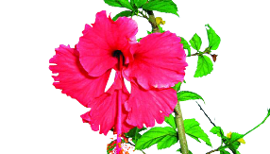
Evaluation
1. Why do you like folk songs?
2. Do you enjoy any folk songs concert?
3. Who is your favourite folk singer?
4. Which song do you like most?
5. Do you play any instrument mention of this text?

Slide 20
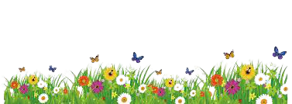
Home work
Write a paragraph about “our folk songs”

Slide 21
Thanks To All

