Slide 1
Welcome to my dear
all Student

Slide 2
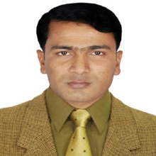
Muhammad Rehan Uddin
B.A, B.ED, M.A
Assistant Teacher
Pakshail Ideal High School
Barlekha, Moulvibazar.
Email: mdrehanuddin17@gmail.com
ICT4E District Ambassador, Moulvibazar.
Subject: English 1st Paper
Class: Nine & Ten
Unite: One, Lesson: Two
Time: 50 Minute
Lesson Identity
Teacher’s identity

Slide 3
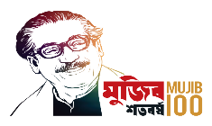
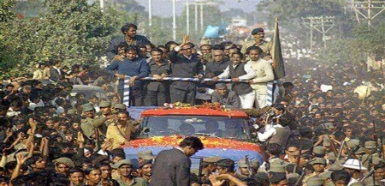
Look at the picture and give answer the following questions.
Ans-1: We see the father of the nation Bangabandhu Sheikh Mujibur Rahman standing on a truck surrounding with many people around him.
Ans-3: Yes, we find a connection between the picture and title of the lesson. The title of the lesson “The tale of Homecoming” and the picture shows Bangabandhu homecoming 10 January 1972.
Ques-3: Do you find any connection between the picture and the title of the lesson? How?
Ans-2: I can identify Bangabandhu Sheikh Mujibur Rahman on the open truck in the middle of the picture.
Ques-1: What do you see in the picture?
Ques-2: What do you identify in the picture?

Slide 4
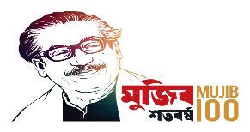
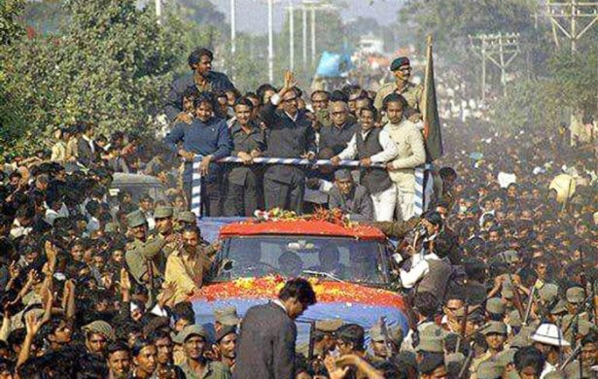
So, Today’s our lesson is……….
The Tale of Homecoming

Slide 5
Learning outcomes
After this lesson the students will be able to…..
Read and understand the text.
Talk about the Question and give the Answer.
Match the words/phrases Column A with Column B.
Describe different times and situations of Bangabandhu’s homecoming.
Make a timeline of the incident.

Slide 6
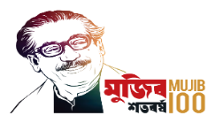
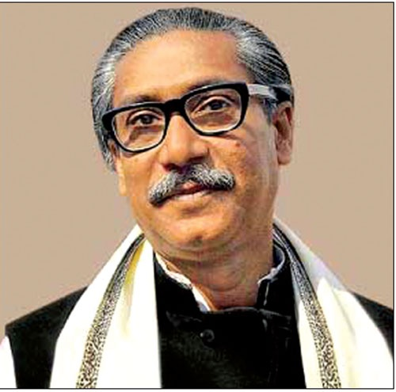
Bangabandhu
A Name
A History
A Flag
Independent

Slide 7
Let’s introduce some new words.
Word | Meaning | Bengali Meanings
Imprison | confine, detain | বন্দি করে রাখা, কারারুদ্ধ করা
Eminent | prominent, renowned | মহান, বিশিষ্ট
Opposition | competitor, rival | প্রতিপক্ষ, বিপক্ষ
Immense | huge, vast, massive | অপরিমেয়, বিশাল
Genocide | holocaust, mass slaughter | গনহত্যা
Prisoner | Captive, Jailbird, Convict | বন্দী, কয়েদী
wholeheartedly | Heartfelt, sincere | আন্তরিকভাবে, মনেপ্রাণে

Slide 8
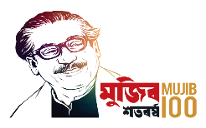
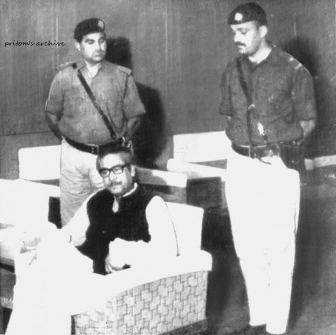
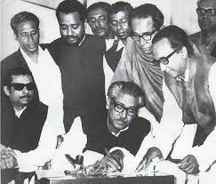
Read the text silently and carefully.
Bangabandhu Sheikh Mujibur Rahman was arrested by the Pakistani army immediately after his declaration of independence at the first hour of the 26 March 1971. He was taken to Pakistan as a captive and imprisoned there in a small cell for capital punishment until 7th January, 1972. Even a grave was dug in front of his cell but Mujib was fearless. Ile knew nothing would stop the Bangalees to gain independence.

Slide 9
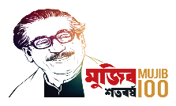
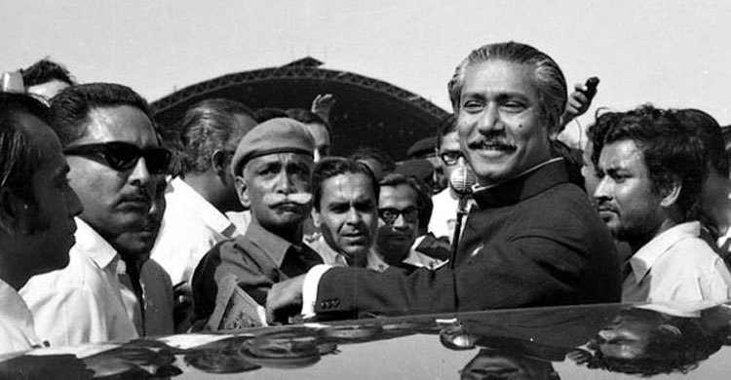
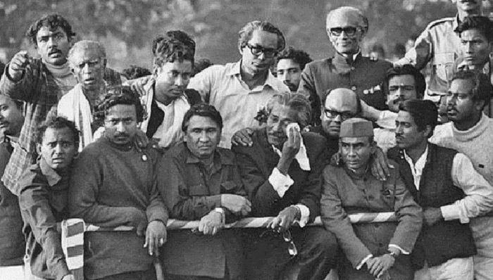
In fact, his name and independence became synonymous. So the whole world was awaiting breathlessly to witness his homecoming. And he had a grand homecoming indeed narrated by eminent columnist and writer Syed Badrul Ahsan.

Slide 10
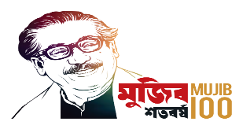
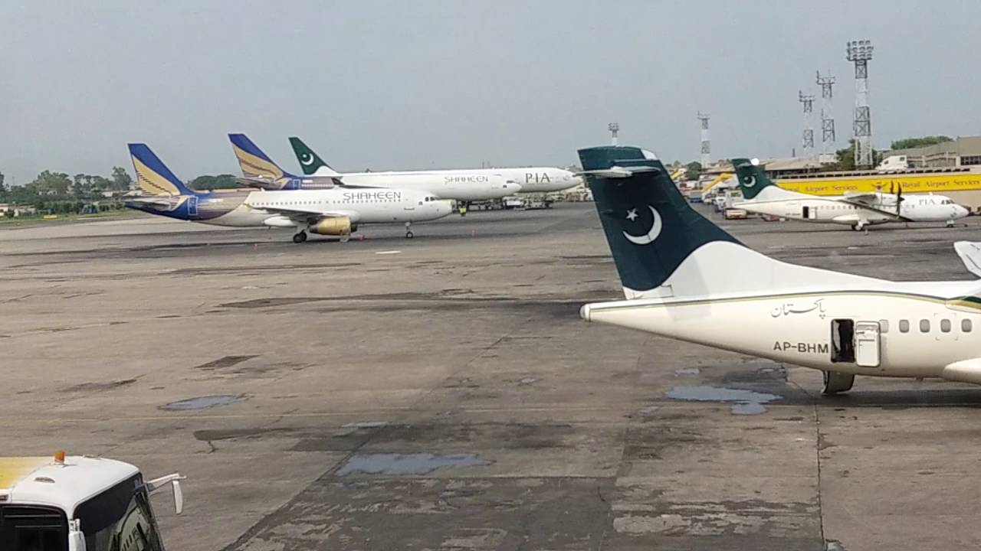
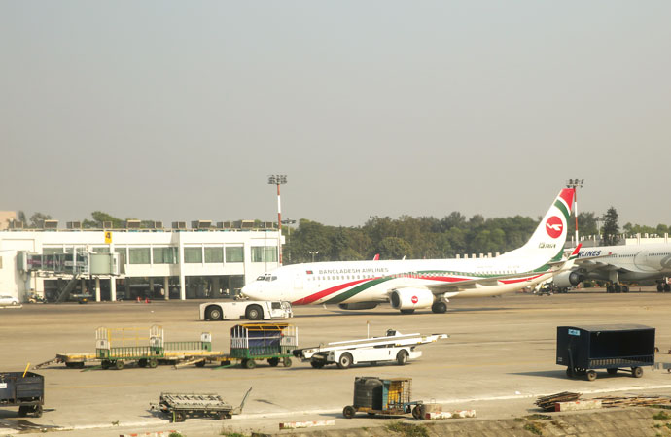
Early in the morning on 8 January 1972, Bangabandhu arrived at Heathrow Airport. News of Bangabandhu's arrival in London spread quickly. Journalists, the general public, British officials and politicians and Bangalee residents in the city made their way to Hotel Claridges. News bulletins on the BBC and other media organizations made note of the Bangabandhu's arrival in their headlines. By early afternoon, the Father of the Nation had met the British Prime Minister Edward Heath and Leader of the opposition Harold Wilson.

Slide 11
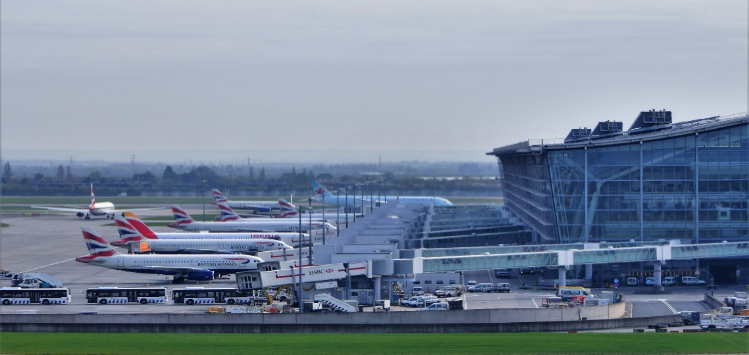
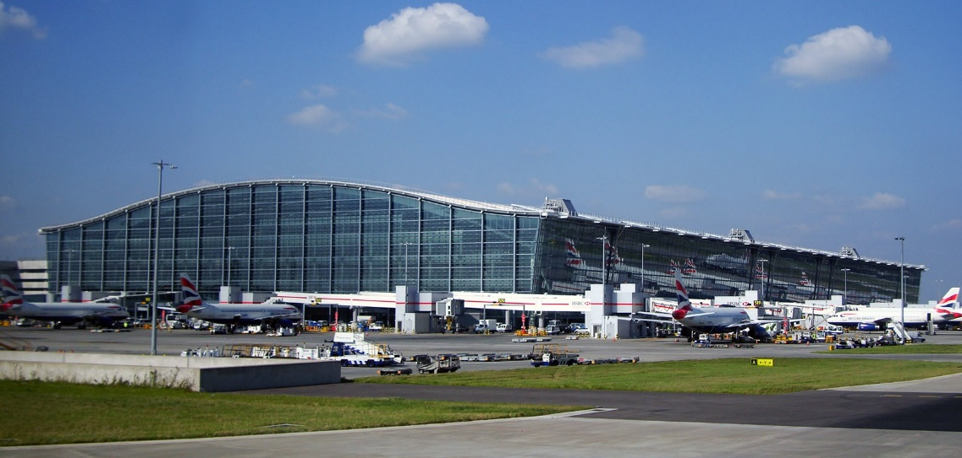
Early in the morning on 8 January 1972, Bangabandhu arrived at Heathrow Airport. News of Bangabandhu's arrival in London spread quickly. Journalists, the general public, British officials and politicians and Bangalee residents in the city made their way to Hotel Claridges. News bulletins on the BBC and other media organizations made note of the Bangabandhu's arrival in their headlines. By early afternoon, the Father of the Nation had met the British Prime Minister Edward Heath and Leader of the opposition Harold Wilson.

Slide 12
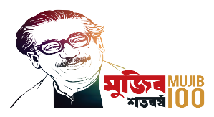
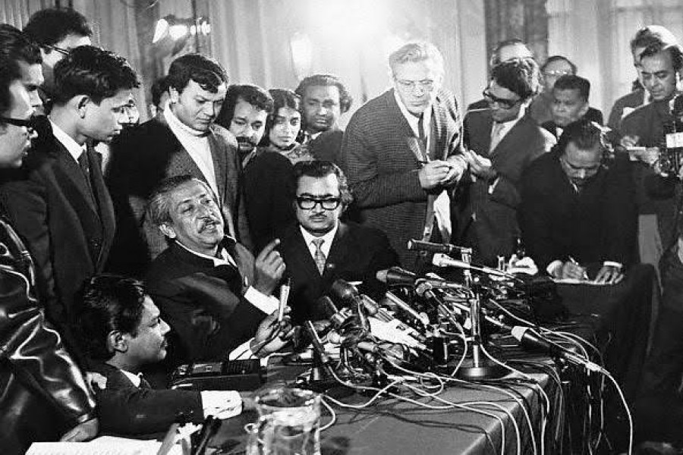
Bangabandhu's opening words at a crowded news conference that evening at Claridges was a touch poetic. He expressed the unbounded joy of freedom achieved by his people in an epic liberation struggle. Bangladesh, he told the crowd was a reality and would fulfill its obligations as part of the international community. I made it clear that those who were involved in different types of crimes including genocide would be trialled by his government.

Slide 13
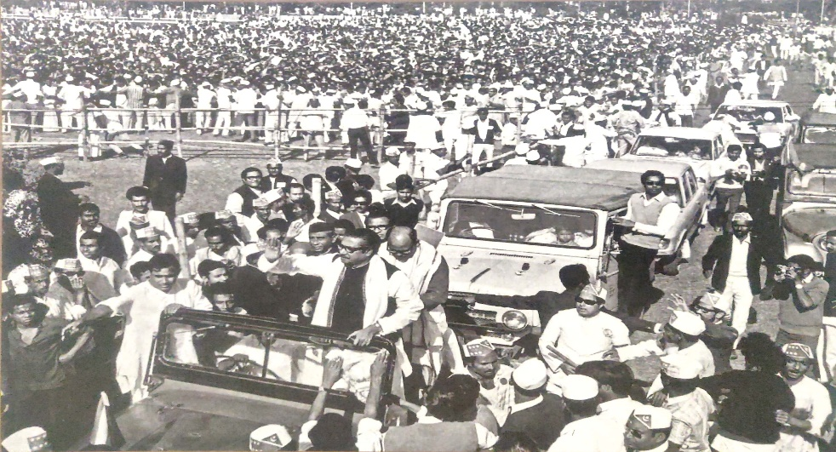
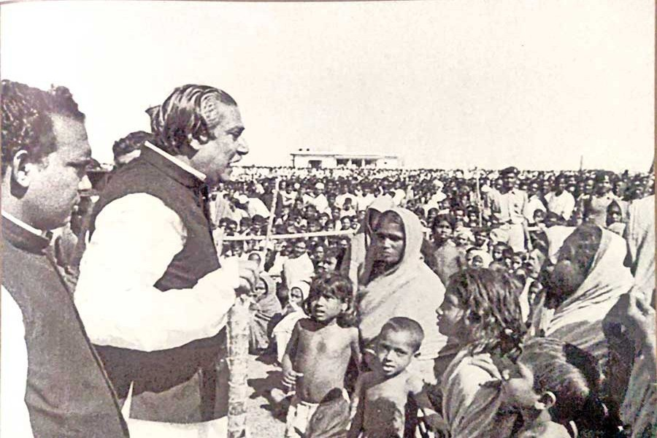
Then he called Dhaka and for the first time since his arrest by the Pakistan Army in March, spoke to his family. A long conversation then followed with Prime Minister Tajuddin Ahmad. The conversations with his family and with Tajuddin were emotional affairs, but he now had a clear picture of all that had happened in his absence in Bangladesh. It gave him immense pleasure knowing that he had truly, liberated his people.

Slide 14
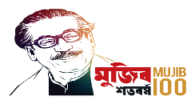
C. Work in pairs. Write on the blank spaces how you would express these words/phrases in your own language and then make sentences with them.
Word | Meanings | Sentence
Declaration of
Independent
Announcement
of Laverty
At that time the declaration of independence was essential for the Nation.
Captive
Punishment
Death
Punishment
Bangabandhu Sheikh Mujibur Rahman was imprisoned in a small cell in Pakistan for capital punishment.
Waiting with
more Interest
After the independence the whole world was awaiting breathlessly to witness Bangabandhu’s homecoming.
Await breathlessly

Slide 15
Word | Meaning | Sentence
Make their way
Move towards
a place
They made their way to the front gate of the college.
Emotional affairs
Feelings of
intimacy
Close friends have emotional affairs with one another.
Immense
The repairing cost of the bridge has been immense.
in extremely

Slide 16
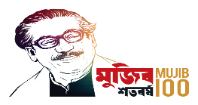
Word | Meaning | Sentence
Bangabandhu’s opening words at crowded news conference at Claridges was a touch poetic.
Touch poetic
Sensitive feeling
The freedom of Bangladesh gave Bangabandhu an unbounded joy.
Unbounded joy
great pleasure
The Pakistan Army is responsible for brutal genocide in the liberation war of Bangladesh
Genocide
Mass killing

Slide 17
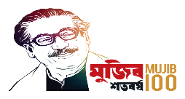
Talk about the following question and Answer to them.
01. What made Bangabandhu so bold while in the prison?
02. How did time change in Bangabandhu’s life within the nine months in a Pakistani prison?
03. How did London welcome Bangabandhu?
04. Do you agree with the statement that Bangabandhu was excited as well as relieved from long anxiety in London? Why/Why not?

Slide 18
Match Your Answer with them…..
1. Bangabandhu was so bold while in the prison because he knew nothing would stop the Bangalees to gain independence.
2. Bangabandhu was brought in Pakistan as a prisoner nine months earlier with little or no hope to return to his home/homeland. However, when Bangladesh finally got independence, Bangabandhu was released and he was free to come back home.
3. Bangabandhu was welcomed in London with proper honour by the British prime minister and the leader of the opposition along with journalists, the general public, British officials and politicians and Bangalee residents.
4. Yes, I agree with the statement that Bangabandhu was excited as well as relieved from long anxiety in London. Because he called Dhaka and spoke to his family and Taj uddin Ahmed for the first time after his arrest by the Pakistan Army in March 1971.

Slide 19
Match the word/phrase in column with the means in Column B.
Column A | Column B
On the way | A group of army personnel who rules a country
Stop over | To fill eyes with tears
Mesmerized | Uttered
Wholeheartedly | In course of a journey
Tar mark | Area from which planes take off at an airport
Horde of newsman | A group of journalists or newspaper reporters
To moist eyes | Mist or fog that covers winter evening
Military junta | hypnotized
Intoned | From the heart
Winter haze | Rest for some time

Slide 20
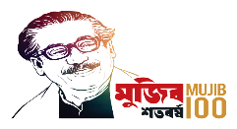
Pair work
Phrases | Section | Sentence
Dream comes true | Section B | So the whole world was awaiting breathlessly to witness his homecoming.
Home, sweet home | Section B | Nine months earlier he was brought to Pakistan as a prisoner with little hope to return. And now he was free to go home.
Days behind the bars | Section B | He was taken to Pakistan as a captive and imprisoned there in a small cell for capital punishment until 7th January 1972.
Goodbye Pakistan | Section B | Pakistan, as soon as the PIA aircraft took off, was finally behind him.
The hero before the world press | Section B | News bulletins on the BBC and other media organizations made note of the Bangabandhu’s arrival in their headlines.
Tribute to genuine friends | Section E | There he wholeheartedly thanked Mrs. Gandhi, the people and the politicians of India for the tremendous help they had provided to Bangladesh and its ten million refugees.
We’ve been worthy | Section E | Mujib told the jubilant crowd that the poet had been proved wrong. “Come back, O poet’’, he intoned dramatically, “and see how your Bangalees are today transformed into worthy men.”
End of a long waiting | Section E | As soon as the door of the aircraft opened, Bangabandhu appeared.
Tears of joy | Section E | Their tears soon led to moist eyes in nearly everyone else present around them.

Slide 21
Group work
Make a timeline of the incidents mentioned in the texts on Bangabandhu's homecoming.
Timeline | Incident
26 March 1971 | Bangabandhu was arrested and taken to Pakistan as a captive until 7th January 1972.
7 January 1972 | Bangabandhu became free from prison and left Pakistan in the evening
8 January 1972 | Bangabandhu arrived at Heathrow Airport, London of England in the early morning
9 January 1972 | Bangabandhu left London for Dhaka in the evening.
10 January 1972 | Bangabandhu reached Delhi in the morning.
10 January 1972 | Sometimes after 1.30pm he landed with British Aircraft in Dhaka at the Tejgaon airport
10 January 1972 | There was three hours procession on an open truck on the way from the airport to Race course.
10 January 1972 | Finally, Bangabandhu made his way back to his family in the hazy winter evening.

Slide 22
Evaluation
When did Bangabandhu arrest by the Pakistan Army?
Why did they dug a grave in front his cell?
What happened in the evening of 7th January, 1972?
How did Bangabandhu honour by the British people and
Their Government?
When did Bangabandhu come back in his Mother land?

Slide 23
Home work
Write a paragraph about Bangabandhu’s
homecoming in 150 words.

Slide 24
Thank’s To All

