Slide 1
Welcome to you all

Slide 2
Teacher’s Information
Md. Shamsul Alam
BA(Hons.)MA in English.
Assistant Teacher( English)
Nabodoy Girl’s High School
Shailkupa Jenaidah.
Phone:01917-452052,01722-922691
Email:shamsul101085@gmail.com

Slide 3
Introduction of the Topic
Class: 9-10
Subject: English 1st Paper
Unit: One

Slide 4
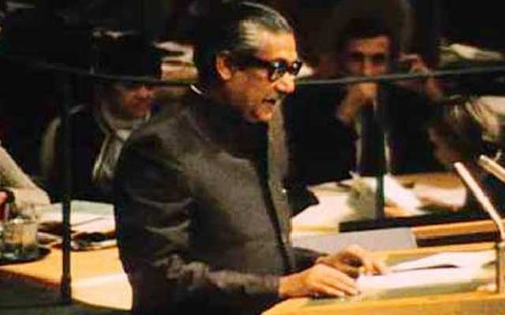
What do you see in the picture?
What do you know about it?
United Nations
Bangabandhu at the UN.

Slide 5
Our Today’s Class:
Lesson:3
(Bangabandhu at the UN)

Slide 6
Learning outcomes
After studying the lesson, the students will be able to;
narrate incidents and events
learn new word meaning
ask and answer the questions.

Slide 7
Vocabulary presentation
Wage-----carry out
Gratitude----gratefulness
Relocation----replacement
Denounce----criticize
Unprecedented----uncommon

Slide 8
English For Today
During a general strike on 21 February, 1952 the protesting students tried to defy Section 144 imposed by the government. The police opened fire and killed a number of students including Abdus Salam, Rafiq Uddin Ahmed, Abul Barkat, Abdul Jabbar and others. In his autobiography, Sheikh Mujibur Rahman says, “...We decided in the meeting in my room to observe 21 February as State Language Day and to form a committee that day to conduct the movement to establish Bengali as the state language.“
(adapted from Centre for Research and Information (CRI), August 2020

Slide 9
Read the text.
Mujibur Rahman was one of the few student leaders who played a significant role in turning the language movement into a mass movement. As a student leader, he was the central figure in organizing mass gatherings, rallies and strikes for raising awareness against the discriminatory language policy of Pakistan. The language movement started when the Governer General of Pakistan, Muhammad Ali Jinnah, declared "Urdu and only Urdu shall be the state language of Pakistan" on 19 March 1948 at the course Maidan while addressing a public gathering. He again uttered the same on 24 March 1948 at the University of Dhaka during his convocation speech. The students instantly protested against this announcement vehemently.
It was the time when young Mujib started organizing the student front of Muslim League in East Pakistan. He was proud of his Bengali identity and very active to initiate strikes and protests against the language policy of Pakistan government. Later, the then Prime Minister of Pakistan Khwaja Nazimuddin echoed the statement of Mr. Jinnah on 26 January, 1952. Mujib was in prison during this time due to his political activism and was admitted to the Dhaka Medical College under police custody. However, he stayed in constant touch with other leaders directly engaged in the movement to make Bangla the state language. His directions from prison led the movement to a success. On 14 February, he started a hunger strike there.

Slide 10
Read the text and answer the following questions.
a) Where was Bangabandhu during Language Movement?
b)Why do you think Bangabandhu struggled for establishing Bangla as a state language?
c)Who declared Urdu would be a state language ?
d) What happened on 21 February?

Slide 11
Thank you All

