Slide 1
Welcome to you all

Slide 2
INTRODUCTION
Md. Shamsul Alam
BA(Hons.)MA in English.
Assistant Teacher( English)
Nabodoy Girl’s High School
Shailkupa Jenaidah.
Phone:01917-452052,01722-922691
Email:shamsul101085@gmail.com
ENGLISH FOR TODAY
CLASS: NINE

Slide 3
Look at the picture and try to tell what our today’s topic is

Slide 4
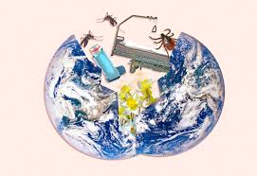
Yes, you are right, Our today’s lesson is
Man and climate
Unit-5 Lesson-3

Slide 5
After finishing this lesson students will be able to-
say how the climate is changing
describe where the fossil fuels are being used
write true or false
choose the best answers from the alternatives
Answer the following questions
LEARNING OUTCOMES

Slide 6
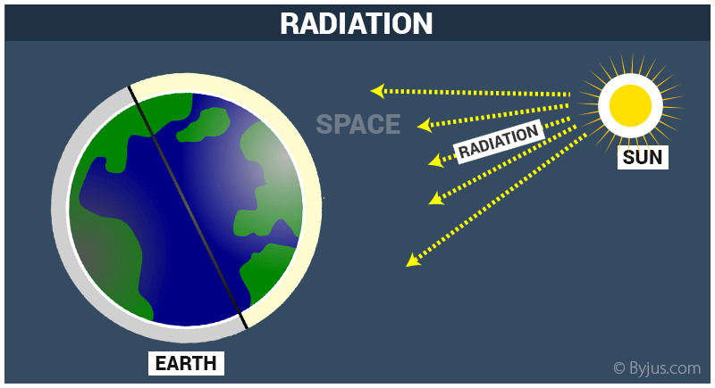
Let’s learn some unknown words
Word
Synonym
Radiation
Divergence
Diffusion
Dispersion
Divergency
The emission of energy as electromagnetic waves or as moving subatomic particles, especially high-energy particles which cause ionization.
They got a dose of radiation poisoning.

Slide 7
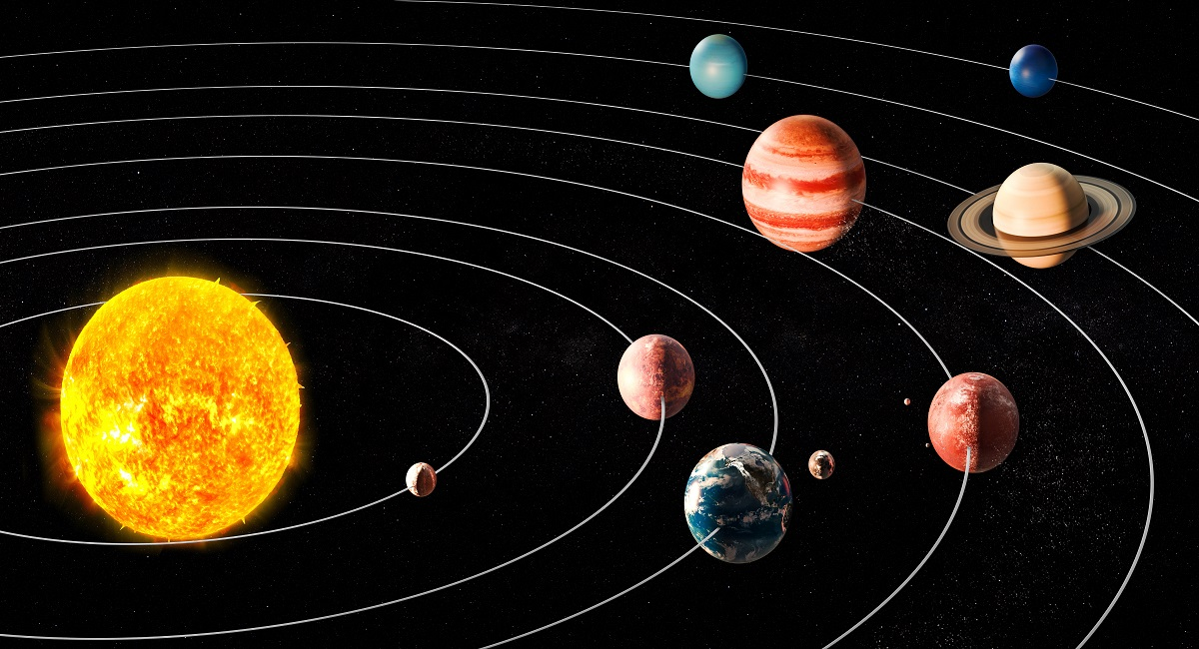
Let’s learn some unknown words
Word
Synonym
Orbit
Path
Track
Trajectory
Circuit
The Earth's orbit around the sun.
The curved path of a celestial object or spacecraft around a star, planet, or moon, especially a periodic elliptical revolution.

Slide 8
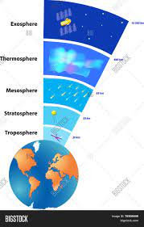
Let’s learn some unknown words
Word
Synonym
Atmosphere
Environment
Troposphere
Mesosphere
Airspace
The hotel is famous for its friendly, welcoming atmosphere
The envelope of gases surrounding the earth or another planet

Slide 9
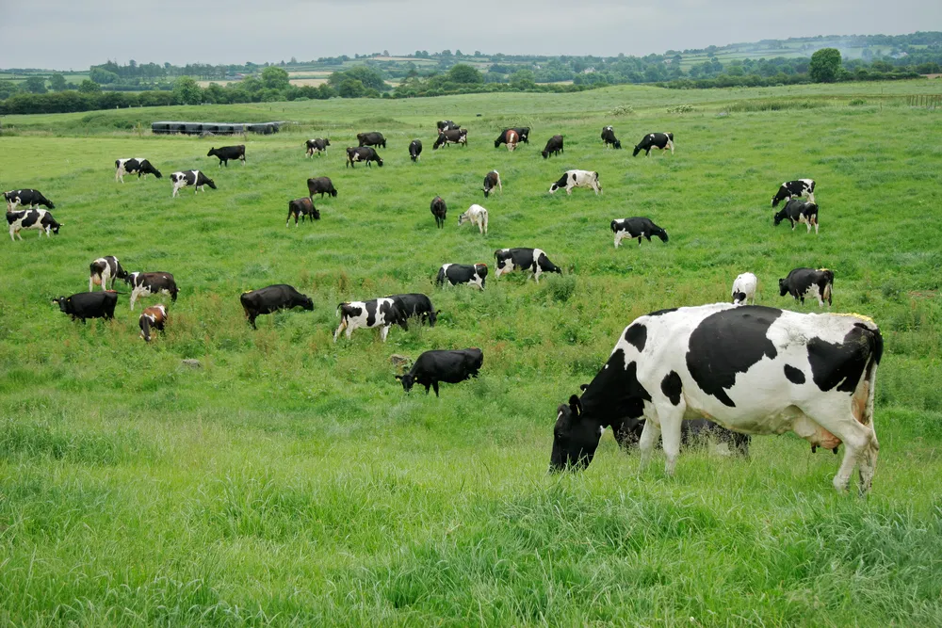
Let’s learn some unknown words
Word
Synonym
Pasture
Agist
Meadow
Grass field
Herbage
To pasture is to put livestock into a field to graze, or to retire an old horse.
The cows came home from the pasture.

Slide 10
Humans can neither change the sun's radiation nor the earth's orbit around the sun. But they can control the increase in the amount of greenhouse gases and its effect on the atmosphere. Only during the last hundred years the carbon dioxide concentration has been raised alarmingly in the atmosphere and we humans can be held responsible for this.
The main cause of the increase in carbon dioxide level in the atmosphere is the burning of fossil fuels. Since the end of the I9,. century, industrial activities increased rapidly giving rise to many factories. These factories required energy, which was produced through the combustion of coal. Besides coal, other sources of energy such as mineral oil and natural gas were also burned to heat our houses, run cars and airplanes or to produce electricity. Nowadays, about 85 million barrels of crude oil are burned daily. Every time a fossil raw material is burned, it releases carbon dioxide into the air.

Slide 11
Therefore, it is clear that more and more greenhouse gases like carbon dioxide are being generated worldwide by humans. Moreover, we are also strengthening the greenhouse effect by deforestation, which means cutting down trees. Every year enormous areas of forests are destroyed by people to obtain wood and to clear regions for mining and to create pasture. This loss of the forest causes dual problems. Trees that are burned up release large volumes of carbon dioxide gas into the air. On the other hand, as forests absorb a lot of carbon dioxide from the air and deliver oxygen instead, we also destroy an important storehouse of carbon dioxide when we clear forests.

Slide 12
A. Discus the questions in pairs.

Slide 13
Can man influence the climate ? If the answer is yes, explain how?
Ans: Yes, man can influence the climate.
Increase of carbon di oxide can change the climate and man help increasing carbon di oxide in atmosphere by burning coal, oil, fossil fuels.
2. Which human activities are responsible for increasing carbon di oxide in the atmosphere?
Ans: People are cutting down trees to obtain wood, to create pasture and for mining, they are also using coal, oil, fossil fuels . These all are responsible for increasing carbon di oxide in the atmosphere.
3. How can trees help save our environment?
Ans: Trees help save our environment because they absorb a lot of carbon di oxide from the air and release oxygen instead.

Slide 14
B. Read the statements below and say if they are true or false. If false give the correct information.

Slide 15
Fossil fuels are burned at an alarming rate due to industrialization.
2.Coal is the only fuel used for generating energy.
3.At present, nearly 85 million barrels of crude oil are used weekly.
4.Deforestation is caused by nature.
5.Forests help consume carbon di oxide gases from the air.
True
False. C/I: Besides Coal, other sources of energy such as mineral oil and natural gas are also used for generating energy.
False. C/I: At present, nearly 85 million barrels of crude oil are used daily.
False. C/I: Deforestation is caused by people to obtain wood and to clear regions for mining and to create pasture.
True

Slide 16
C. Match the meaning in column B and the words /phrases in column A.

Slide 17
A | B
1. Sun’s radiation | a. Energy that is transmitted from the sun in the form of rays or waves or particles
2. Fossil fuels | b. The process used by plants to convert light energy captured from the sun to chemical energy.
3. Combustion of coals | c. A basic material or substance used in the production or manufacturing of goods.
4.Crude oil | d. Non-renewable sources of energy that come from remains of plants and animals.
5. Raw materials | e. Intentional destruction or removal of trees and other vegetations for agricultural, housing or firewood use.
6. Deforestation | f. A naturally occurring, unrefined petroleum product that can be refined to produce usable products such as diesel, gasoline, heating oil, jet fuel, kerosene, etc.
7. Photosynthesis | g. Burning of coal usually in industrial plants.

Slide 18
D Write a letter to the editor of a newspaper expressing your concern about growing deforestation in your area. Describe how deforestation is changing your environment. Also suggest what action could be taken to stop cutting down trees. Follow the clues below.
danger cause by deforestation
increase of carbon dioxide in the atmosphere
the green house effect
making people aware of the adverse effect of deforestation
making an action plan to stop deforestation

Slide 19
5/7/2021
The Editor
The Daily Star
Karwan Bazar, Dhaka.
Subject: Request for publishing an article on ‘growing deforestation’.
Dear Sir,
With due respect and honour I would like to let you know that I am an inhabitant of Bogura. I have come to know that you are much interested to publish national and international articles on recent affairs in your daily. So, I have written an article on growing deforestation in my area. I would be grateful if you kindly publish it in your renowned daily newspaper.
Yours faithfully
Md. Shamsul Alam

Slide 20
1. What does ‘fossil’ mean?
a. ruins b. havocs
c. debris d. impression of plant or animal hardened in rock
2. What does ‘rapidly’ mean?
a. suddenly b. swiftly
c. drastically d. steadily
3. Which of the period describes the beginning of rapid industrialization?
a. The start of the 19th century b. The start of the 18th century
b. The end of the 18th century d. The end of the 19th century

Slide 21
4. Greenhouse is caused by-------
a. indiscriminate felling down of trees b. planting of more trees
c. forestation d. reforestation
5. What is the figure related to barrels of crude oil burnt everyday?
a. 85 million b. 8.5 million
c. 850 million d. 0.85 million
6. -------- is one of the greenhouse gases.
a. Oxygen b. Carbon dioxide
c. Oxygen and Carbon dioxide d. Hydrogen
7. Who/what caused deforestation?
a. Human being b. Nature
c. Automatically d. Wild animals

Slide 22
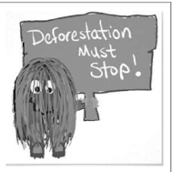
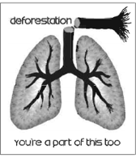
E. Look at these poters below. They are made to make people aware of the dangers of deforestation. In group design a poster to show the dangers caused by deforestation. Then write a slogan for the poster.

Slide 23
Home Work
Write a summary of the above passage.

Slide 24
Thank You all!

