Slide 1
Welcome To All Student

Slide 2
Muhammad Rehan Uddin
B.A, B.Ed, M.A
Assistant Teacher
Pakshail Ideal High School
Barlekha, Moulvibazar.
Email: mdrehanuddin17@gmail.com
ICT4E District Ambassador,
Moulvibazar.
Subject: English 1st paper
Class: Nine & Ten
Unite: One, Lesson: One
Time: 50 Munities
Lesson Identity
Teacher’s Identity

Slide 3
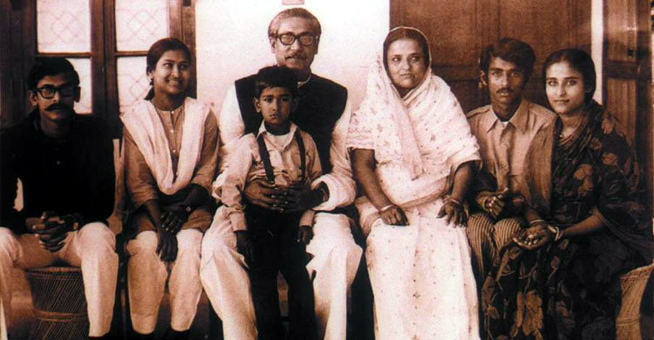
What do you see in the picture?
I can see the family of Bangabandhu in the picture

Slide 4
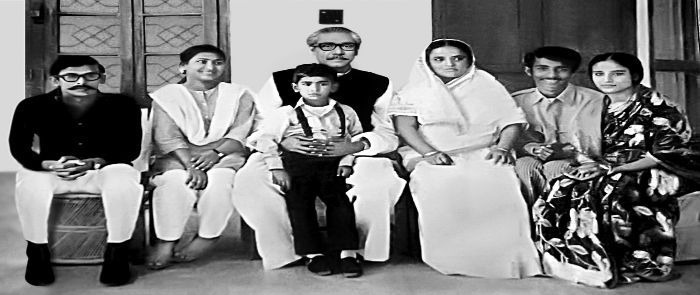
What do you know about them?
Bangabhandhu is one of the greatest leaders of all time. Being family members they played a great role to raise him as father of the nation.

Slide 5
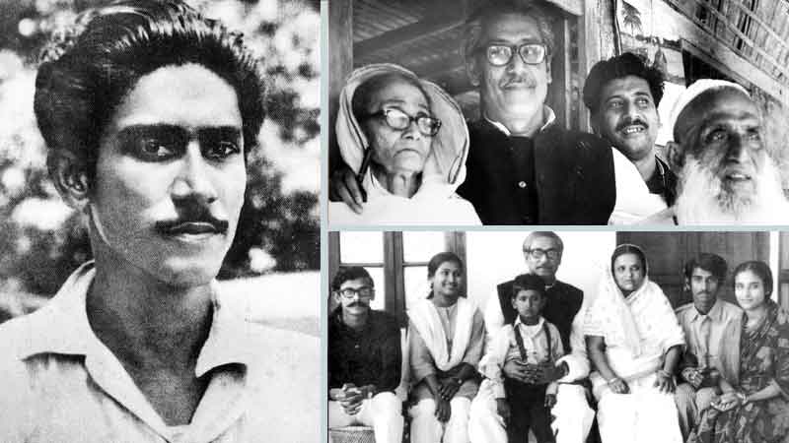
Where were those people during the Liberation war?
Those people had to suffer a lot during the liberation war. They had to move one place to another regularly for a safer shelter to stay alive.

Slide 6
So, to day’s our lesson is…………
Bangabandhu’s Family in 1971

Slide 7
Learning outcome
After the end of the lesson, The student will be able to……..
Read and understand the texts
Narrate incident and events in logical sequence
You can Solve true or false.
Ask and answer the questions.

Slide 8
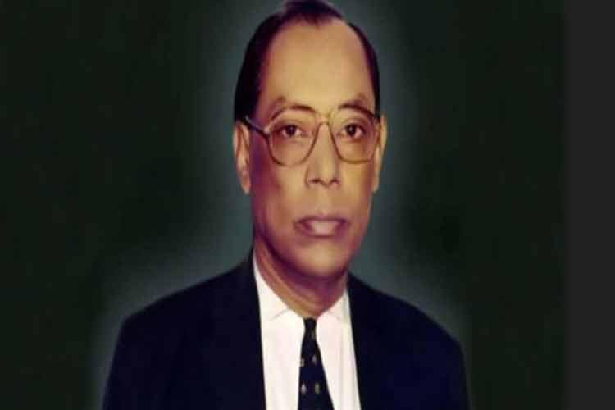
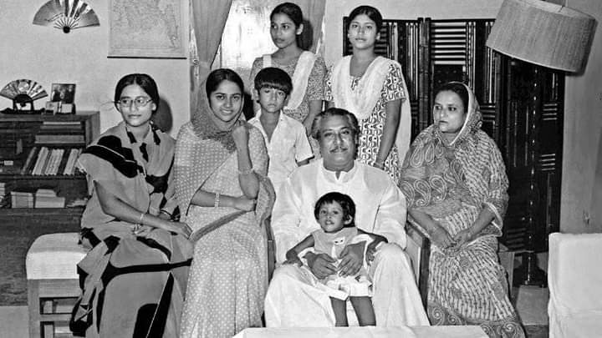
Read the text silently & carefully
It was the night of 25th March 1971. There was a full of quietness at Bangabandhu’s home at Dhanmondi Road No 32 throughout the day. Bangabhandhu Sheikh Mujibur Rahaman and his family members Could apprehend that some thing tragic was going to happen. Gunshots were heard around the city. Bangabandhu’s eldest son Sheikh Kamal was out of home for forming barricaders against the Pakistan army who had been killing people indiscriminately that night. Bangabandhu decided to send the girls of the family to a safer place for the night and he gave their responsibility to his son in law Mr. Wazed Miah.

Slide 9
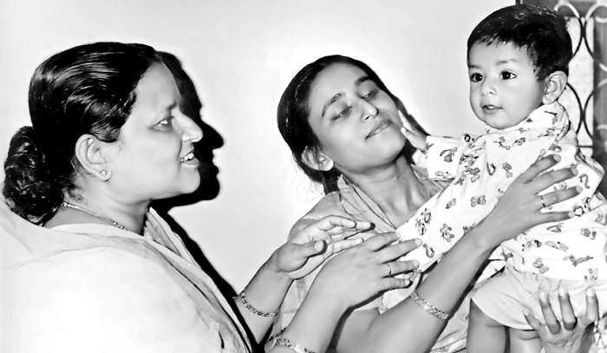
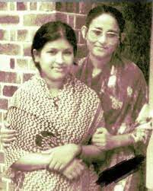
Bangabandhu’s Daughter Sheikh Hasina, who was expecting a baby soon along with her sister Sheikh Rehana and her cousin Farida were sent to a house at Road No 15, Dhanmondi for that Night. Bangabandhu’s wife Begum Fazilatunnesa Mujib, stayed with him.

Slide 10
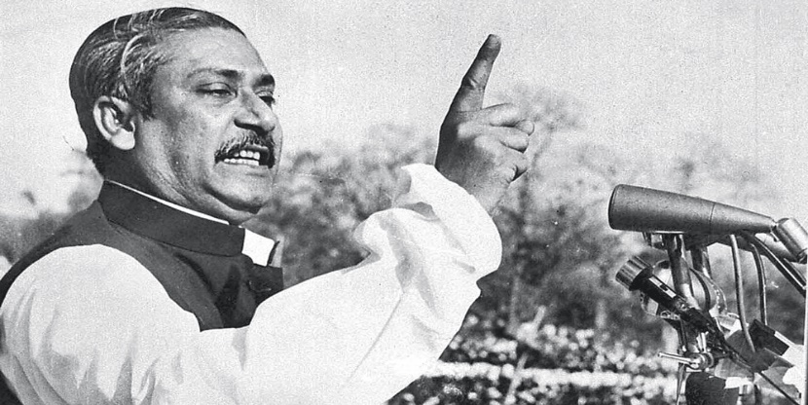
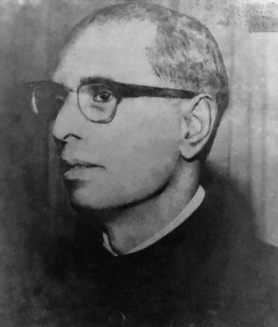
Just before midnight, Bangabandhu send the declaration of Independence to Mr. Zohur Ahmed Chowdhury at Chittagong via wireless. At the darkest part of that night, the Pakistan Army surrounded his home and started firing at random. The situation agitated Bangabandhu much and he asked them to stop. But soon he instructed to get ready to Go with them. Begum Mujib packed his necessary belongings. After Bangabandhu left She was at a loss what to do and where to go with her children. However, being a Supportive wife of the great leader all through her life, she soon pulled up her mental strength. But her anxiety continued till the end of the war.

Slide 11
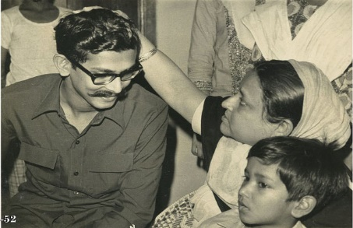
The next day Begum Mujib had to leave House No-32 children and other members of her home. During the next couple of months, they moved From one shelter to another in search of a safer place. During their stay In those places, some people came forward to helping them while some Refused to give them shelter for fear of their own safely. When their Provision ran short, Sheikh Kamal, who had already joined the Liberation War, came to them in disguise and delivered some money. Some closed People also supported the family with money and food stuff.

Slide 12
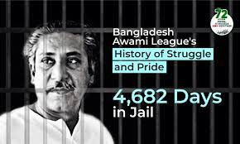
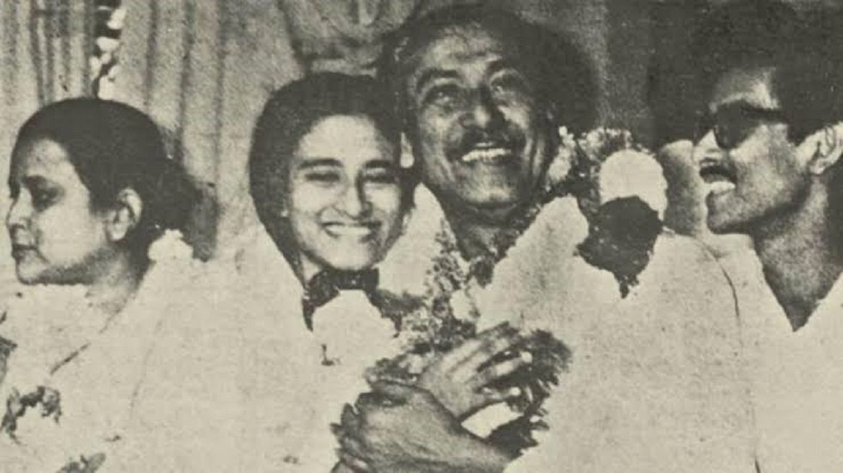
So far the family members were ignorant about Bangabandhu’s condition. Suddenly They came to know that he was alive and had been taken to Pakistan. Begum Mujib Started to keep contact with Awami League leaders. But soon the family was taken the family to Dhanmondi, House No-18 by the Pakistan Army and kept under house Arrest. However, people would come to their home with valuable information in Disguise of vendors also some would throw pieces of waste paper with important Information written on them.

Slide 13
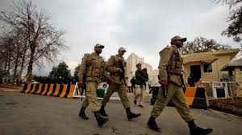
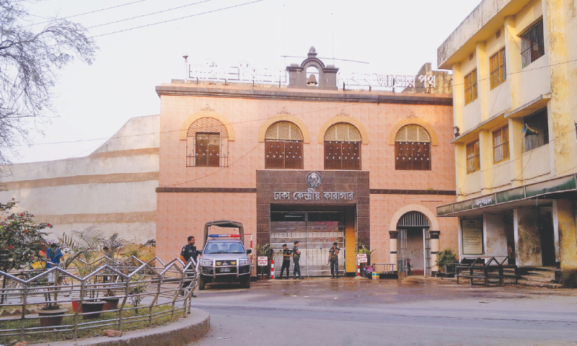
In the month of May, the same year, Pakistan Amy set fire to Bangabandhu’s Tungipara home in front of his parents. A young man from the village protested The evil deed and was shot dead. Both parents of Bangabandhu’s fell ill in October and were admitted to the PG Hospital. Begum Mujib and her family Were allowed to visit them two or three times a week for one hour. However, that created the opportunity for them to establish a better Communication with the freedom fighters.

Slide 14
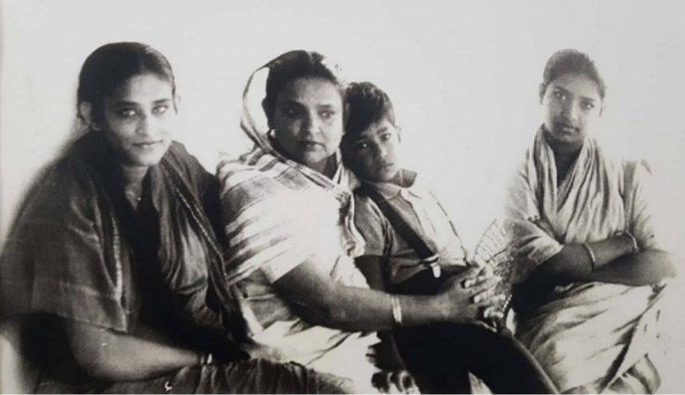
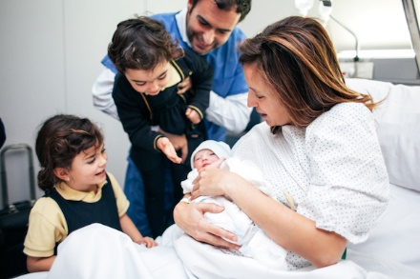
Begum Mujib was extremely worried about her children, especially her daughter Sheikh Hasina, because of her health condition. However, she was not allowed By the Pakistani rulers to be with her daughter Sheikh Hasina, when she was Admitted to Hospital. Mr. Wazed Miah and Bangabandhu’s second son Sheikh Jamal accompanied Sheikh Hasina to the hospital. Bangabandhu’s youngest Sister, pretending to be a hospital attendant, entered the hospital and looked After her niece. Sheikh Hasina was blessed with a baby boy on 27 July who Was later named Sajeeb Wazed Joy. As the Pakistan Army often used to threaten Sheikh Jamal that they would hang him upside down, he, finding an opportunity, Fled from hospital and joined the freedom fighters.

Slide 15
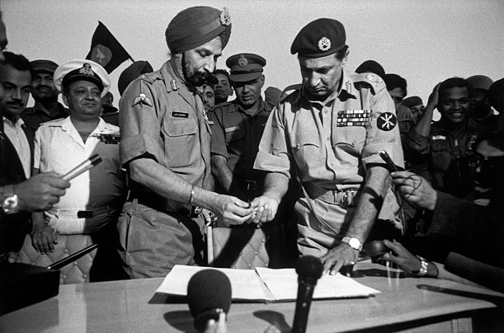
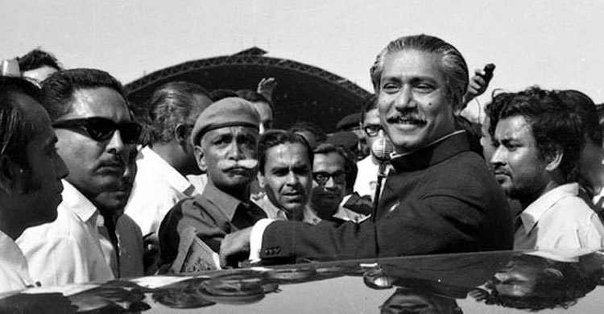
Finally the victory day arrived! There was joy everywhere! But, Bangabandhu’s Family was yet to be freed from captivity. The Pakistani occupational forces Were still cordoning Bangabandhu’s house and firing at people rushing over There chanting ‘Joy Bangla’ the invigorating slogan of the Bangalees. But they Fled the next morning when the Indian Army came to rescue the family. Sheikh Jamal returned home in the afternoon while Sheikh Kamal returned home the next day. Nevertheless, the biggest anxiety of the family persisted- Bangabandhu was yet to be released from Pakistan prison and they didn’t know When that great moment would arrive and how.

Slide 16
List the Five ways how the Pakistan army tortured Bangabandhu's family.
(Answers)
1. The Pakistani Army threatened the family members of Bangabandhu.
2. They also arrested Bangabandhu and put other family members under house arrest in their difficult times.
3. They set fire in Bangabandhu’s home in Tungipara where his parents used to live.
4. They had made Bangabandhu’s family homeless and the family members continuously had to look for a safer shelter.
5. They did not allow Begum Mujib to see her daughter Sheikh Hasina during her stay in the hospital.

Slide 17
Pair work
Tell the suffering of Bangabandhu’s family during Liberation war
in your own words.
The Pakistani Army threatened the family members of Bangabandhu. They also arrested Bangabandhu and put other family members under house arrest in their difficult times. Then they set fire for more tensions in Bangabandhu’s home in Tungipara where his parents used to live. They made Bangabandhu’s family homeless as a result- the family members continuously had to look for a safer shelter. They did not allow Begum Mujib to see her daughter Sheikh Hasina during her stay in the hospital. They continued to put troubles on Bangabandhu’s family till the victory of the liberation war.

Slide 18
Group work
Fist discuss in groups, Then answer the following questions.
1. Why was the family anxious on the 25th March night in 1971.
2. Where did Bangabandhu send the girls on that night.
3. How would the family communicate with people for freedom fighters
while they were under house arrest.
4. How did the Pakistan Army scare Sheikh Jamal? How did Sheikh Jamal
manage to flee from captivity?
5. How do you explain Bangabandhu’s family’s contribution
to Liberation war

Slide 19
Answers
1. The family was anxious as they realized that something horrific might occur as the Pakistani Army started firing randomly around the city and killing people indiscriminately on the night of 25th March in 1971.
2. Bangabandhu sent the girls to a safer place which was a house at Road no. 15, Dhanmondi with Dr. Wazed Miah on that night.
3. People or freedom fighters usually used to communicate with the family in the disguise of vendors and sometimes through a written waste paper with valuable information to the house during the house arrest

Slide 20
4. The Pakistani Army used to scare Sheikh Jamal by threatening to hang him upside down. He found a chance to escape and fled from captivity later joined the freedom fighters.
5. We cannot describe in words the contribution of the Bangabandhu family to the Liberation War. During the War of Liberation Bangabandhu’s family sacrificed a lot to liberate the country. His sons joined with the freedom fighters and fought against the Pakistani Army from the front line. His family communicated with freedom fighters with valuable information. They had to suffer a lot while Bangabandhu was in a Pakistan jail.

Slide 21
Evaluation
Tell me which is true & which is false under the following sentences
Begum Mujib went to a safer place at Dhanmondi at the night
on 25th March 1971.
1. False:
Correct Information:- Begum Mujib stayed with her husband Bangabandhu at the night on 25 March, 1971.
2. Bangabandhu had declared the independence of Bangladesh
Before he was arrested by Pakistan Army.
2. True:

Slide 22
3. Nobody stood beside the family of Bangabandhu during Liberation war.
3. False:
Correct Information:- Some close people stood beside the family of Bangabandhu during Liberation War.
4. Bangabandhu’s parents became very sick soon after the
Pakistan Army Had set fire to their home at Tungipara.
4. True:
5. After Liberation war was over, Sheikh Kamal and Sheikh
Jamal both returned on the same day.
5. False:
Correct Information:- After Liberation War was over, Sheikh Jamal returned home in the afternoon while Sheikh Kamal returned home the next day.

Slide 23
Home work
Write a short Paragraph “ the suffering of people during Liberation war”

