Slide 1
Welcome

Slide 2
INTRODUCTION
MARGAET ADHIKARI
ASSISTANT TEACHER
BALIGOAN GOVT. PRIMARY SCHOOL
KAMALGONJ,MOULVIBAZAR
ENGLISH FOR TODAY
CLASS – ONE
UNIT -- 14
LESSON – 4-6

Slide 3
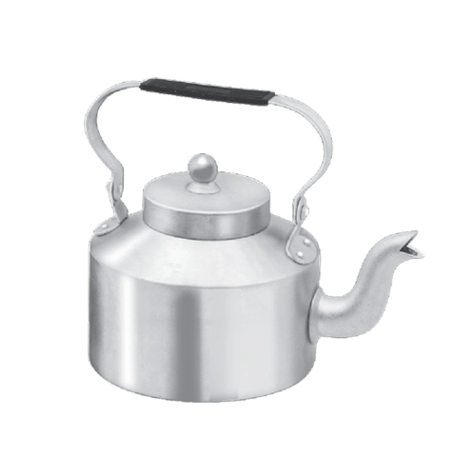
Dear students-
Let’s watch a picture and think about this:

Slide 4
Look, listen and say
K
k
Kite

Slide 5
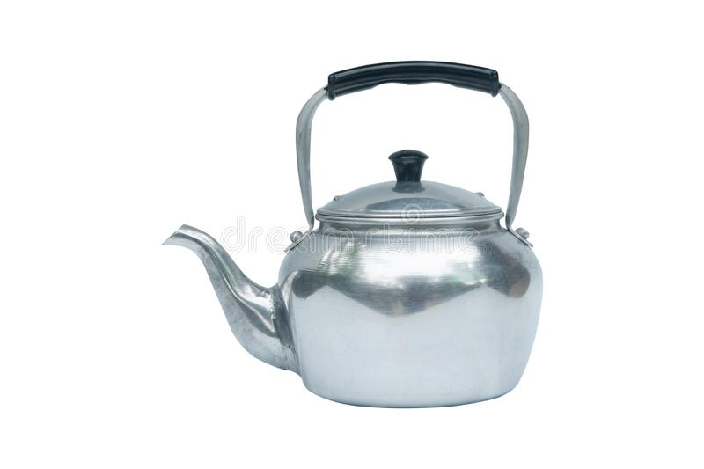
Look, listen and say
K
k
kettle

Slide 6
Today We are going to read
Alphabet (K, k).

Slide 7
Learning outcomes
By end of the lesson students will be able to-------
1.1.1 to become familiar with English sounds by listen to
common English word.
1.1.2 to say simple words.
1.2.1 to recognize and read the alphabet both small and
capital (non-cursive) letters.
3.1.2 write words using non-cursive small letters.

Slide 8
Look, listen and say
K
k
Kite

Slide 9
Look, listen and say
K
k
Kettle

Slide 10
Look, listen and say. Trace in the air.

Slide 11
Find out the Letter K’
D | K | D
K | C | K
A | K | B
K
K
K
K

Slide 12
Say and read. Trace and write.
K
K
K
k
k
k
Individual work

Slide 13
Say with me
Kite
Kettle

Slide 14
Say with me
Kite
Kettle

Slide 15
Dear students, open your English book at page 29.
I am reading the text loudly, please put your fingers say with me.

Slide 16
Say , Trace and write.
Evaluation
k
_ettle
_ite
k
ttl

Slide 17
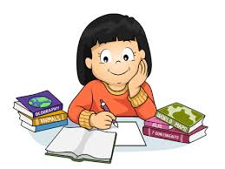
Task
Home work
Write your exercise book capital letter K and small letter k

Slide 18
Thank you everybody.
See you again.
Bye Bye

