Slide 1
1
Assalamualaikum
2
3
4
Md: Lutfor Rahman

Slide 2
To My Multimedia Class
Welcome
1

Slide 3
Teacher`s Identity
Lutfor Rahman (M,A, M-Ed)
Assistant Teacher,
SB Trainer English, Arts and Crafts and BGS.
Master Trainer in English TMTE Project British Council and DPE.
ICT4E District Ambassador, Dinajpur
Best content maker.
Kundarampur, Government Primary school School,
Ghoraghat, Dinajpur.
E-mail: mlutfor81@gmail.com

Slide 4
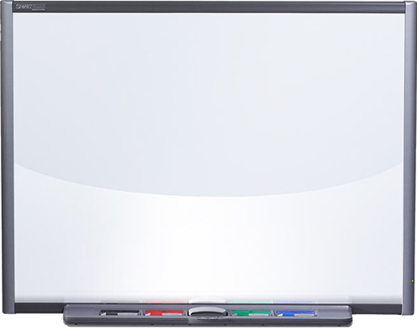
Click the play icon

Slide 5
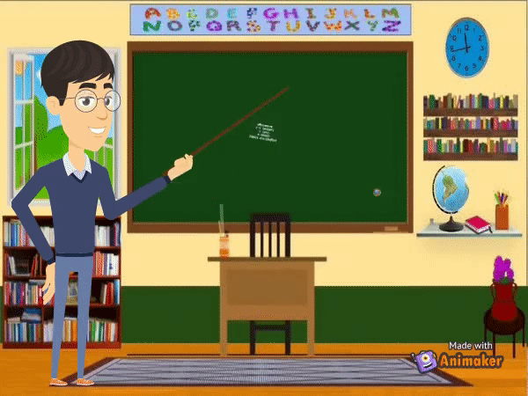
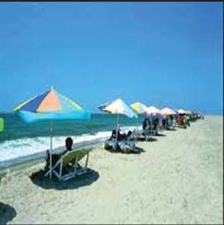

Slide 6
Learning outcomes (TMTE Way)
Students will be able to-
Exchange greetings
To each other
Say Good Morning .
To each other.

Slide 7
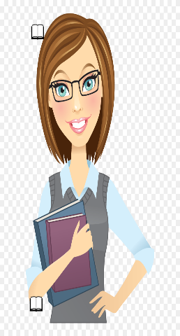
Good morning
Students.
Good morning
Teacher.
My name is Lutfor
I’m your English Teacher.

Slide 8
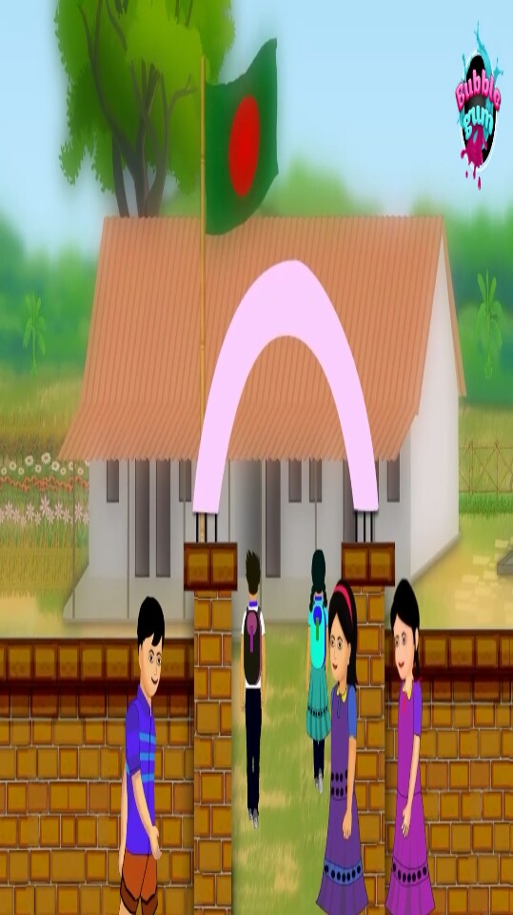
Good morning.
Good morning.
Teacher will discuss how to greet to each other.

Slide 9
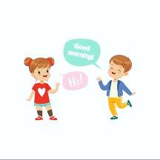
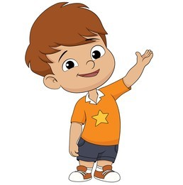
Practice in pair
Hello
Hi
Good morning
Good morning

Slide 10
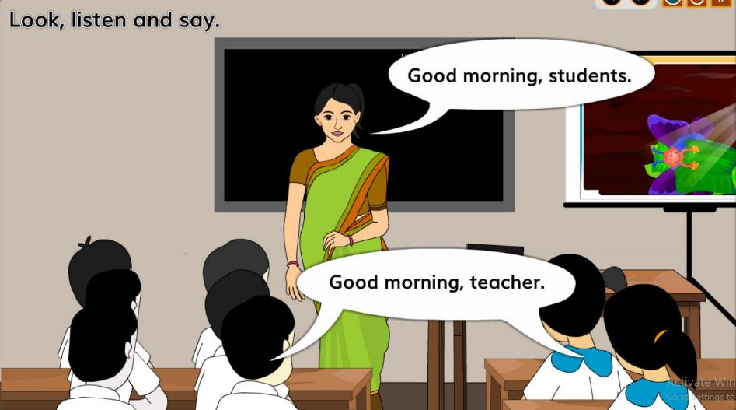
Look, listen and say

Slide 11
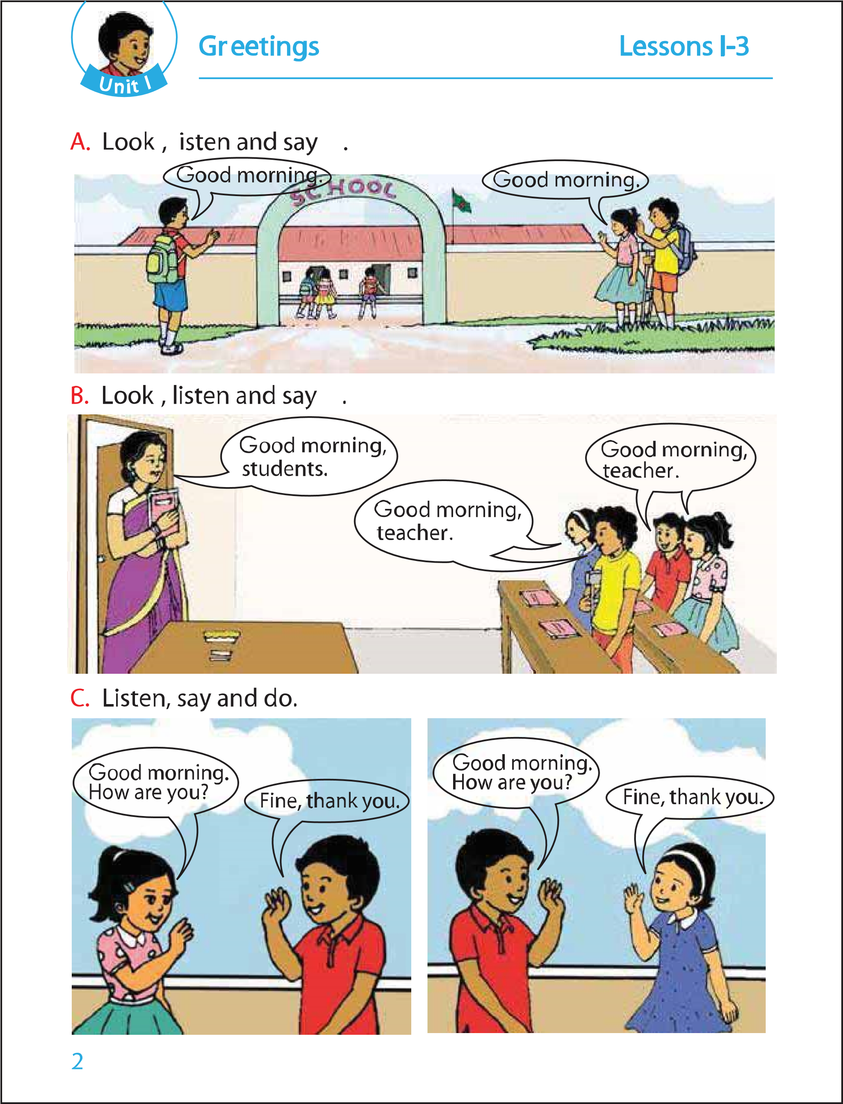
Open your English book page 2

Slide 12
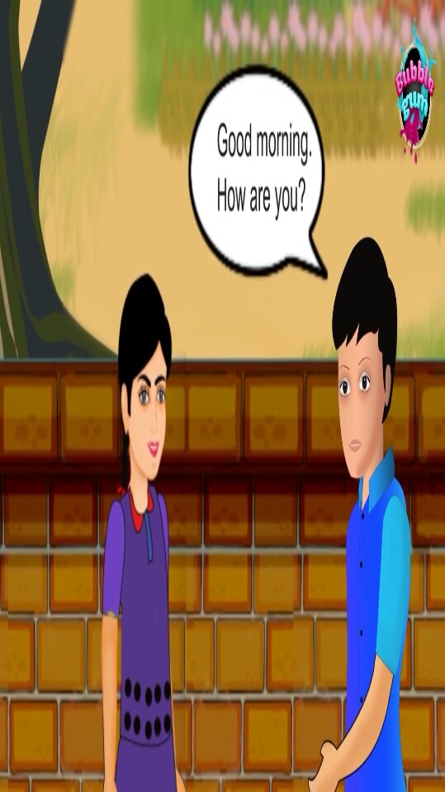
Listen, say and do (practice in pair girl and boy)
Good morning.
How are you?
Fine, thank you.

Slide 13
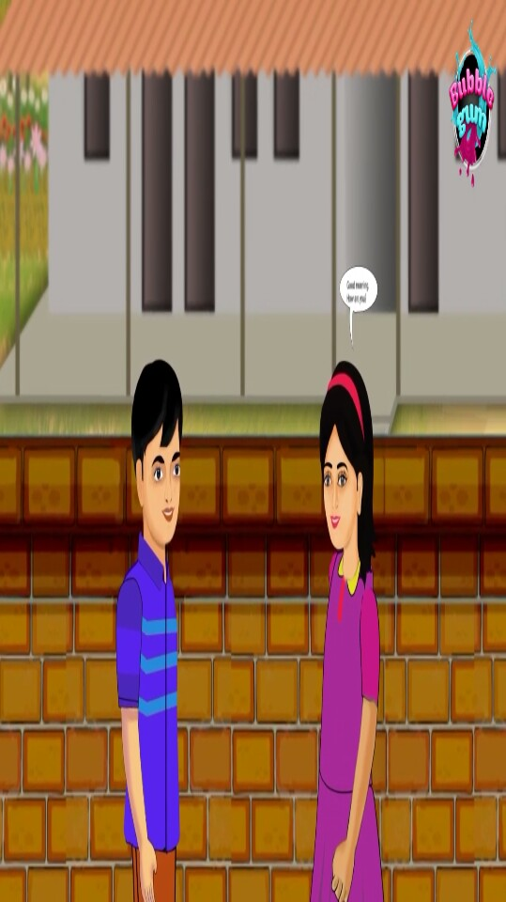
Listen, say and do (practice in pair boy and girl)
Good morning.
How are you?
Fine, thank you.

Slide 14
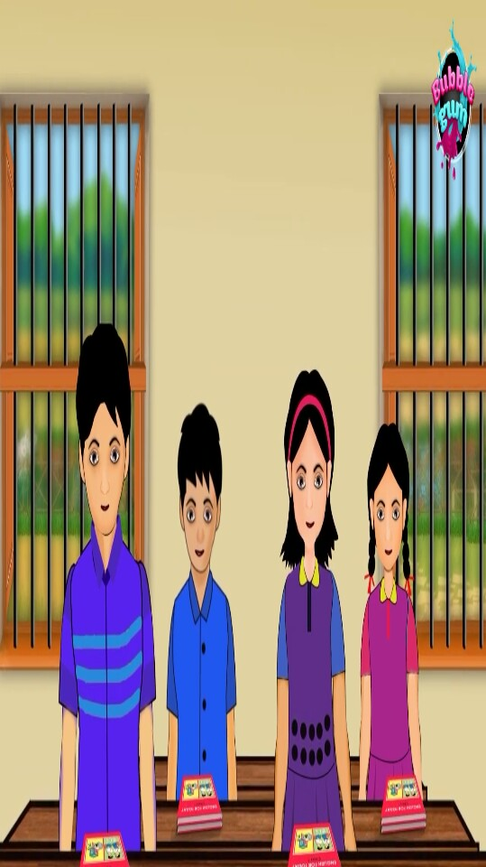
Group work.
Group 1 say Good morning. How are you?
Group 2 say Fine, thank you.

Slide 15
Home work
Try to say at home:
Good morning.
How are you?
Fine.
Thank you.

