Slide 1
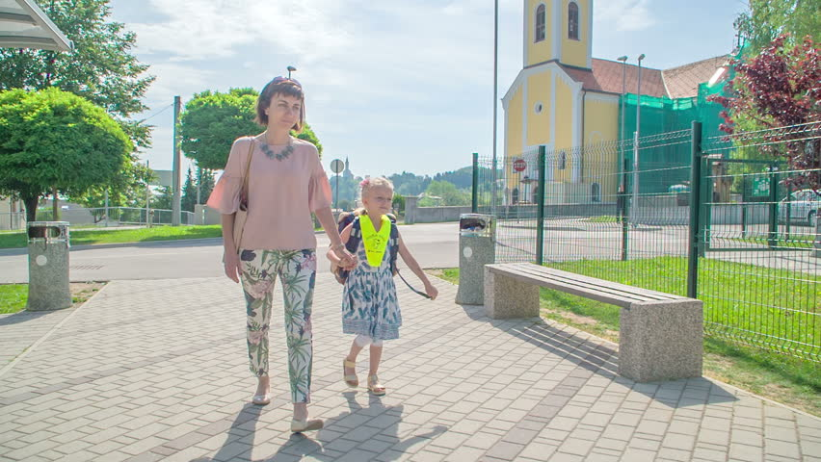
Flora’s first day at school (1)
Unit 3, Lesson 2 (B) by Umme Kulsum baby

Slide 2
Words | Meanings | Words | Meanings | Words | Meanings
Next | পরবর্তী | Hear | শুনা | Sleep | ঘুমানো
Week | সপ্তাহ | Say | বলা | Well | ভাল
Weak | দুর্বল | Start | শুরু করা | Night | রাত
Visit | পরিদর্শন | Tomorrow | আগামীকাল | Woke (wake) | জাগানো
Chat | খোশগল্প করা | Excited | উত্তেজিত | Early | ভোরের দিকে
Remember | মনে রাখা | Think | চিন্তা করা | Bath | গোসল করা
Recall | স্মরণ করা | Else | আর | Best | সেরা
Exactly | ঠিক | About | সম্পর্কিত | Far | দূরে
Happen | ঘটা | Even | এমন কি | walk | হাঁটা

Slide 3
Next week Farabi comes to visit Flora in her house. They are having a chat. “Can you remember your first day at school, Flora?” Farabi asks. “Oh, yes, I can,” Flora says. “I can recall exactly what happened. Would you like to hear it?” “I’d love to,” says Farabi. “Please tell me.” “Okay,” says Flora. “It was 2006. I was then 6 years old. One day my mother said, “Flora, you’re going to start your school tomorrow.” I was very excited. I couldn’t think of anything else. I was always thinking about the school, the teachers and the students of our school. I couldn’t even sleep well that night. The next morning my mother woke me up early in the morning. I had a bath and put on my best clothes. Then I had breakfast and started for the school with my mother. The school was not very far from our home. So we walked all the way.

Slide 4
B Say whether the following statements are true or false. If false, give the correct information. 1 Farabi and Flora are talking at school. 2 Flora is talking about her school. 3 Flora first went to school at the age of 6. 4 Her mother dressed her in her best clothes. 5 Flora walked to school.
Ans: False.
Correct Inf: They are talking at Flora’s house.

Slide 5
B Say whether the following statements are true or false. If false, give the correct information. 1 Farabi and Flora are talking at school. 2 Flora is talking about her school. 3 Flora first went to school at the age of 6. 4 Her mother dressed her in her best clothes. 5 Flora walked to school.
2. Ans: False. Correct inf: Flora is talking about her first day at school.

Slide 6
B Say whether the following statements are true or false. If false, give the correct information. 1 Farabi and Flora are talking at school. 2 Flora is talking about her school. 3 Flora first went to school at the age of 6. 4 Her mother dressed her in her best clothes. 5 Flora walked to school.
3. Ans: True.

Slide 7
B Say whether the following statements are true or false. If false, give the correct information. 1 Farabi and Flora are talking at school. 2 Flora is talking about her school. 3 Flora first went to school at the age of 6. 4 Her mother dressed her in her best clothes. 5 Flora walked to school.
4. Ans: False.
Correct Inf: Flora dressed herself in her best clothes.

Slide 8
B Say whether the following statements are true or false. If false, give the correct information. 1 Farabi and Flora are talking at school. 2 Flora is talking about her school. 3 Flora first went to school at the age of 6. 4 Her mother dressed her in her best clothes. 5 Flora walked to school.
5. Ans: True.

