Slide 1
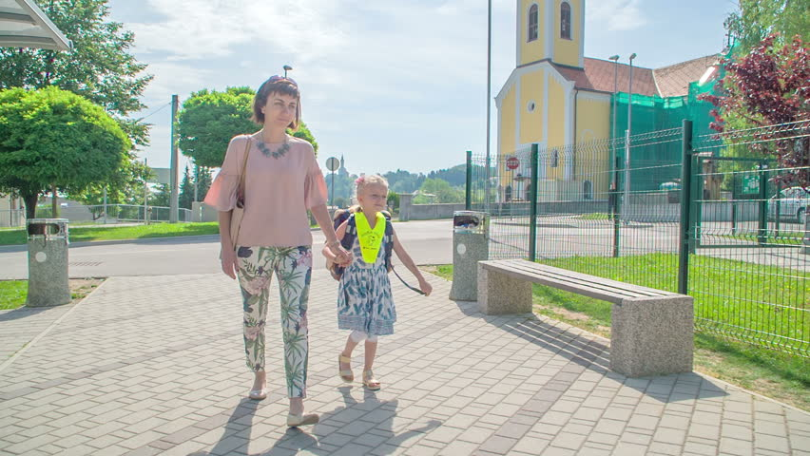
Flora’s first day at school (1)
Unit 3, Lesson 2 (C) by Umme Kulsum Baby

Slide 2
Words | Meanings | Words | Meanings | Words | Meanings
Next | পরবর্তী | Hear | শুনা | Sleep | ঘুমানো
Week | সপ্তাহ | Say | বলা | Well | ভাল
Weak | দুর্বল | Start | শুরু করা | Night | রাত
Visit | পরিদর্শন | Tomorrow | আগামীকাল | Woke (wake) | জাগানো
Chat | খোশগল্প করা | Excited | উত্তেজিত | Early | ভোরের দিকে
Remember | মনে রাখা | Think | চিন্তা করা | Bath | গোসল করা
Recall | স্মরণ করা | Else | আর | Best | সেরা
Exactly | ঠিক | About | সম্পর্কিত | Far | দূরে
Happen | ঘটা | Even | এমন কি | walk | হাঁটা

Slide 3
Next week Farabi comes to visit Flora in her house. They are having a chat. “Can you remember your first day at school, Flora?” Farabi asks. “Oh, yes, I can,” Flora says. “I can recall exactly what happened. Would you like to hear it?” “I’d love to,” says Farabi. “Please tell me.” “Okay,” says Flora. “It was 2006. I was then 6 years old. One day my mother said, “Flora, you’re going to start your school tomorrow.” I was very excited. I couldn’t think of anything else. I was always thinking about the school, the teachers and the students of our school. I couldn’t even sleep well that night. The next morning my mother woke me up early in the morning. I had a bath and put on my best clothes. Then I had breakfast and started for the school with my mother. The school was not very far from our home. So we walked all the way.

Slide 4
C Fill in the blanks with suitable words. Flora is a student. She is _______ class 7. She can remember her _______ day at school even today. She _______ to school in 2006. Her mother _______ her to school. The school was _______ a long way from their house. _____ Flora walked to school ______ her mother.
in
1st
went
took
not
So
with

