Slide 1
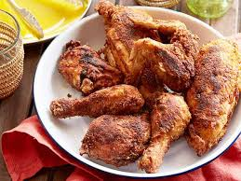
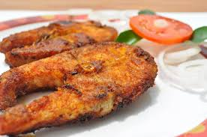
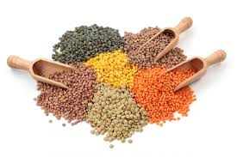
Unit 2 (Food and Nutrition) Lesson 1 (Good Food) C-Completing sentences
Umme Kulsum Baby
Asst. teacher
Nurul Amin Khan High School
Gouripur, Mymensingh

Slide 2
Words | Meaning | Words | Meaning
Nutrition | পুষ্টি | Grow | বৃদ্ধি পাত্তয়া
About | সম্পর্কিত | Properly | সঠিকভাবে
Important | গুরুত্বপূর্ণ | Stay | থাকা
Without | ছাড়া | Healthy | সুস্থ
Always | সর্বদা | Remember | মনে রাখা
Mean | বুঝানো | Though | যদিও
Kind | ধরন | Certain | নির্দিষ্ট
Health | স্বাস্থ্য | Amount | পরিমাণ
Must | অবশ্যই | Quantity | পরিমাণ
Contain | ধারণ করা | depend | নির্ভর করা
Natural | প্রাকৃতিক | Physical | শারীরিক
Substance | দ্রব্য | Structure | গঠন

Slide 3
Ms Rehana, the English teacher, is talking to the class about food. “Food is very important for our body,” she says. “We can’t live without it. So you must always have good food.” “What's good food, teacher?” asks a student. “Good food means the right kind of food for good health,'' says Ms Rehana. “It is nutritious. It must contain natural substances that our body needs to grow properly and stay healthy. But remember, you must not eat too much though the food is good. Eating too much is bad for health. You have to eat only a certain amount of food that your body needs. So we do not need the same kind of food in the same quantity. It depends on your growth and physical structure”.

Slide 4
C. Complete these sentences. 1 We should eat good food to________________________. 2 We should not eat more than______________________. 3 Eating too much food is not_______________________. 4 Good food means_______________________________.
the right kind of food for good health
our body needs
good for health
keep our body fit and healthy

