Slide 1
E
W
M
O
E
L
C
Shamima Nasrin Sonia

Slide 2
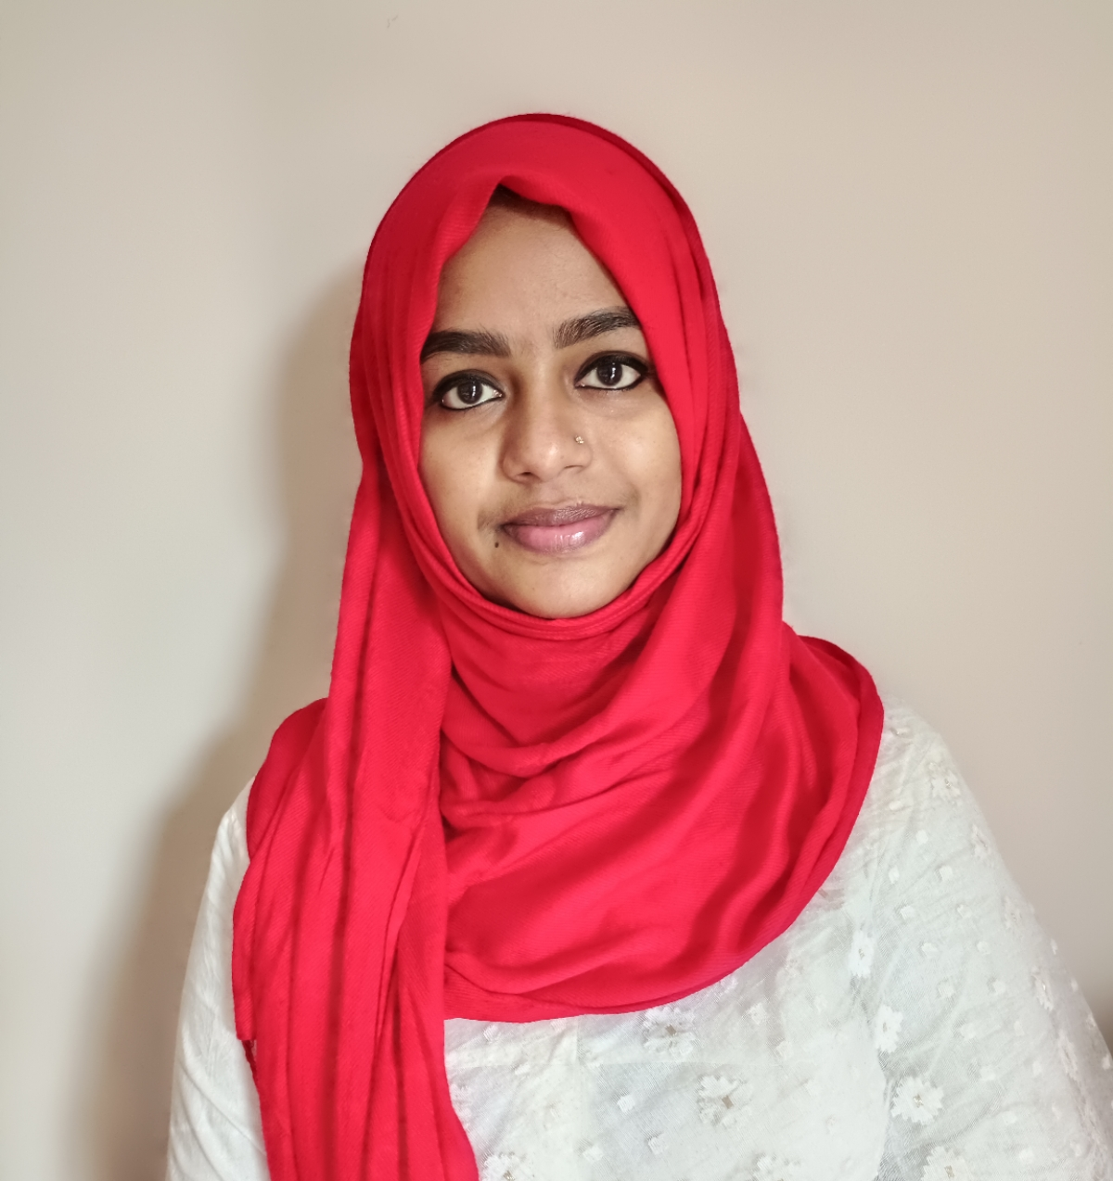
Presented by
Shamima Nasrin Sonia
Assistant Teacher
Dokkin Gasua Govt. Primary School
Muladi, Barishal.
Class- One
Subject- English For Today
Unit- 29
Lessons: 4-6
Part- A

Slide 3
Greetings
Good morning, students.
Good morning, teacher.
How are you, my dear little students?
Fine, thank you, teacher.

Slide 4
Let’s see a video song
Shamima Nasrin Sonia

Slide 5
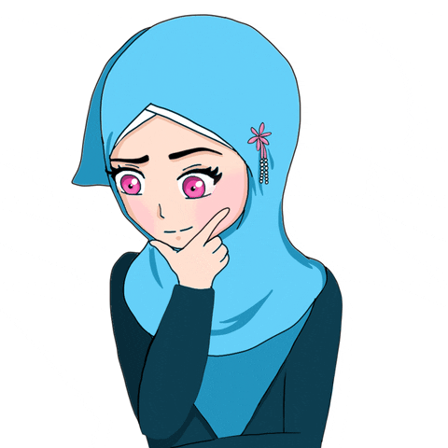
What do you see in the video?
Alphabet

Slide 6
Today’s lesson
is
“Alphabet”
Shamima Nasrin Sonia

Slide 7
Learning outcomes
Students will be able to
Reading
1.2.1
Recognize and read the alphabet both small and capital. (non-cursive)
Writing
1.2.1
Write non- cursive capital and small letters.

Slide 8
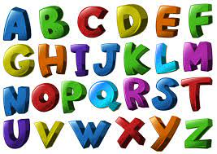
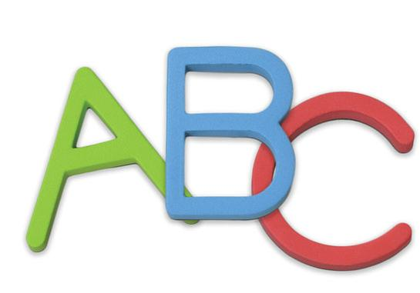
Let’s know the meaning of new words.
Alphabet
বর্ণমালা
Letter
অক্ষর

Slide 9
Alphabet chart
What are you see in the picture?
Aa
Bb
Cc
Dd
Ee
Ff
Gg
Hh
Ii
Jj
Kk
Ll
Mm
Nn
Oo
Pp
Qq
Rr
Ss
Tt
Uu
Vv
Ww
Xx
Yy
Zz

Slide 10
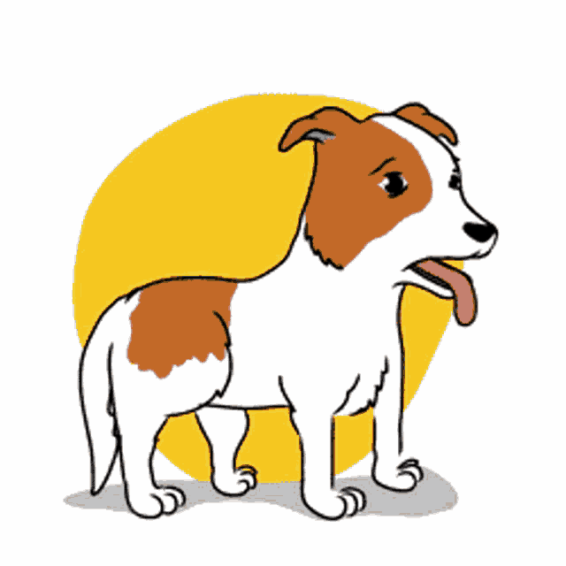
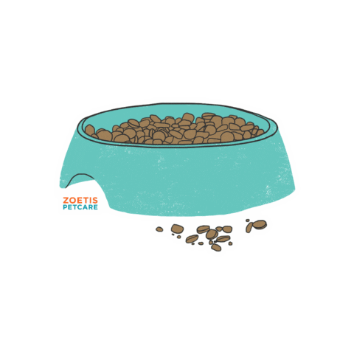
Read the alphabet and help the dog to eat her food
A dog, dog’s food and capital letters
What are you see in the picture?
A
B
C
D
E
F
G
H
I
J
K
L
M
N
O
P
Q
R
S
T
U
V
W
X
Y
Z

Slide 11
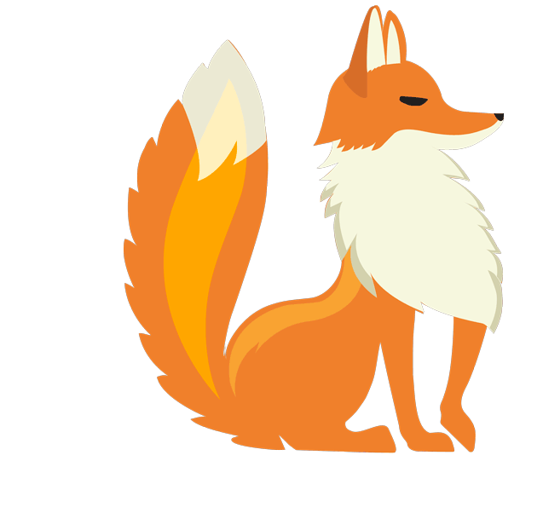
Individual work
Trace all the letters

Slide 12
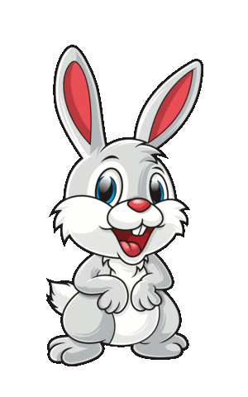
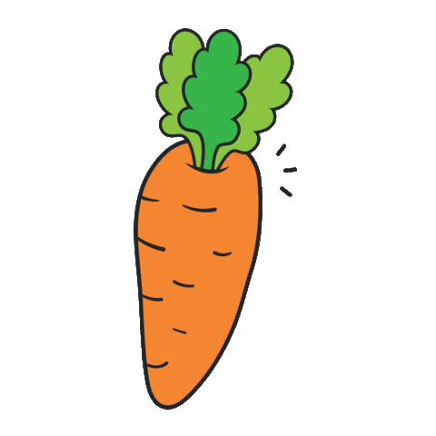
Read the alphabet and help the rabbit to eat the carrot
Rabbit, carrot and small letters
What are you see in the picture?
a
b
c
d
e
f
g
h
i
j
k
l
m
n
o
p
q
r
s
t
u
v
w
x
y
z

Slide 13
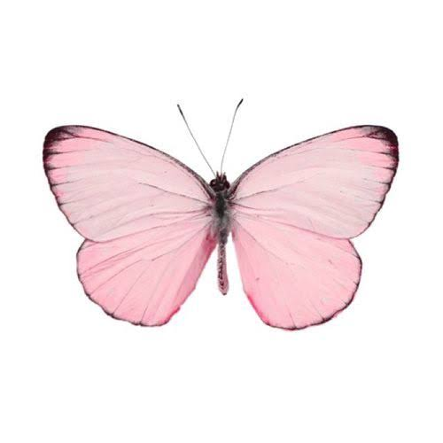
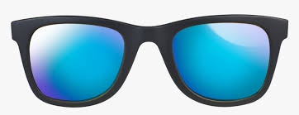
Pair work
Write the small letters
F
_
f
B
_
b
Q
_
q
P
_
G
g
p
_
I
_
i

Slide 14
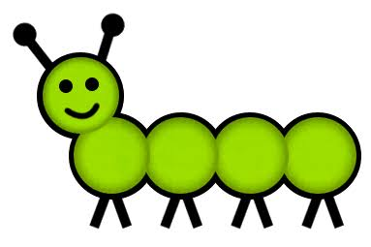
Let’s write the next letters
B
_
_
_
_
_
_
_
_
_
C
D
E
H
I
J
K
R
S
T
U

Slide 15
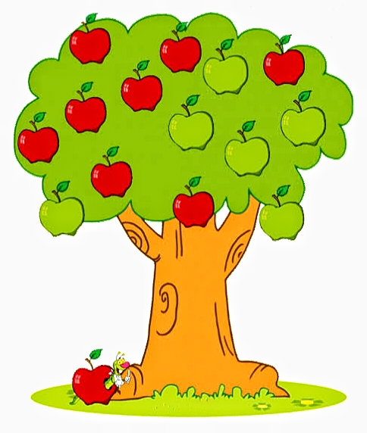
Let’s circle all the capital letter ‘ F ‘ s of a tree
a
h
A
F
F
G
t
S
z
F
p
F
L
F

Slide 16
Find the same capital letter lock and match the same small letter key
G
f
k
A
g
K
a
F

Slide 17
Today it’s raining small letter ‘m’
m
m
f
m
m
a
e
m
m
m
k
m
s
m
m
m
m
m
m
h

Slide 18
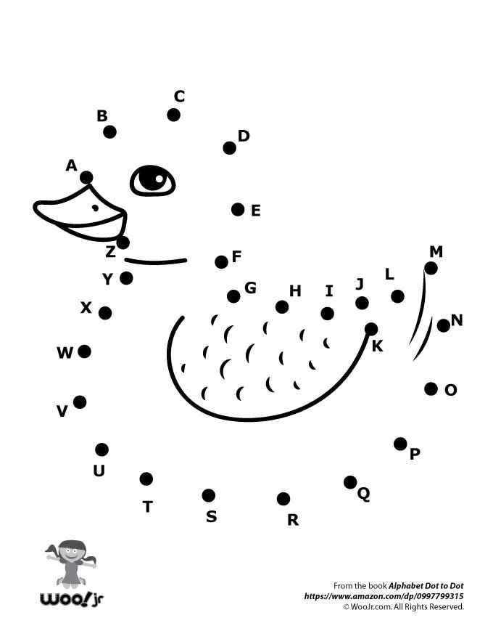
Connect the dots from A to Z to complete the picture

Slide 19
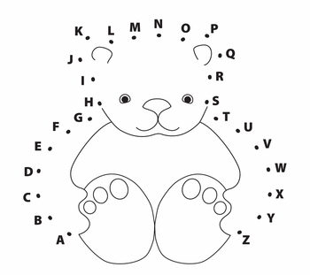
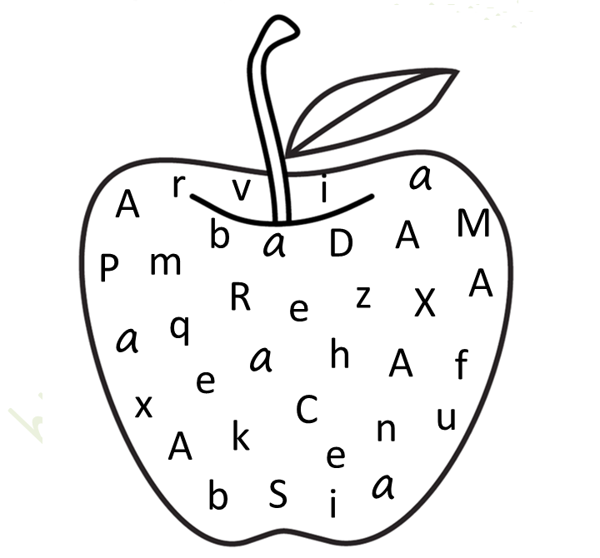
Group work
Join the dots
Circle the alphabet Aa

Slide 20
Open your English textbook
Page no- 59

Slide 21
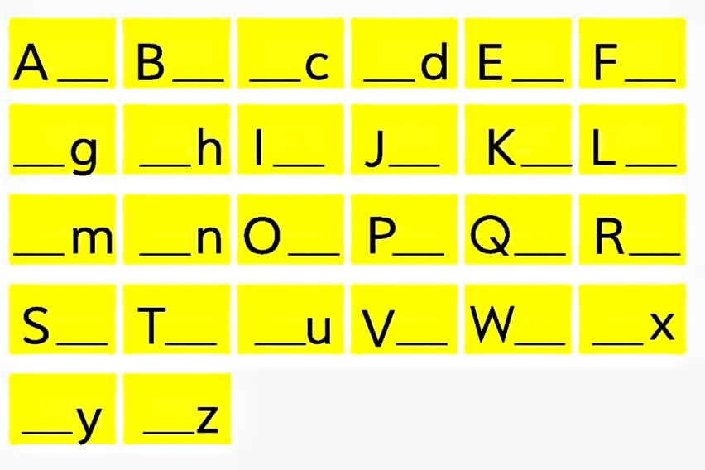
Write the capital and small letter
a
b
C
D
e
f
G
H
i
j
k
l
M
N
o
p
q
r
s
t
U
v
w
X
Y
Z

Slide 22
Evaluation
Finish the popcorn alphabet chart
A
B
C
D
E
F
G
H
I
J
K
L
M
N
O
P
Q
R
S
T
U
V
W
X
Y
Z

Slide 23
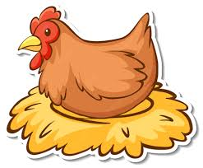
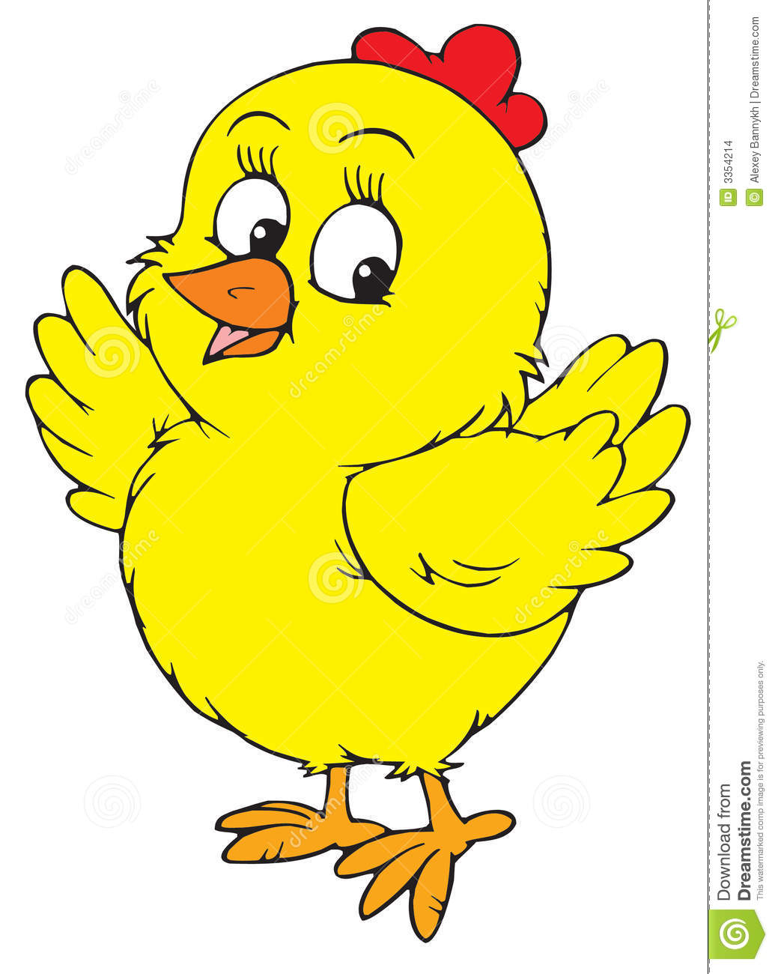
Evaluation
Match capital letter with its small letter
D
g
A
d
G
a

Slide 24
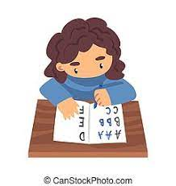
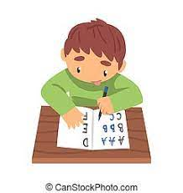
Task
Write the alphabet both small and capital from your home.

Slide 25
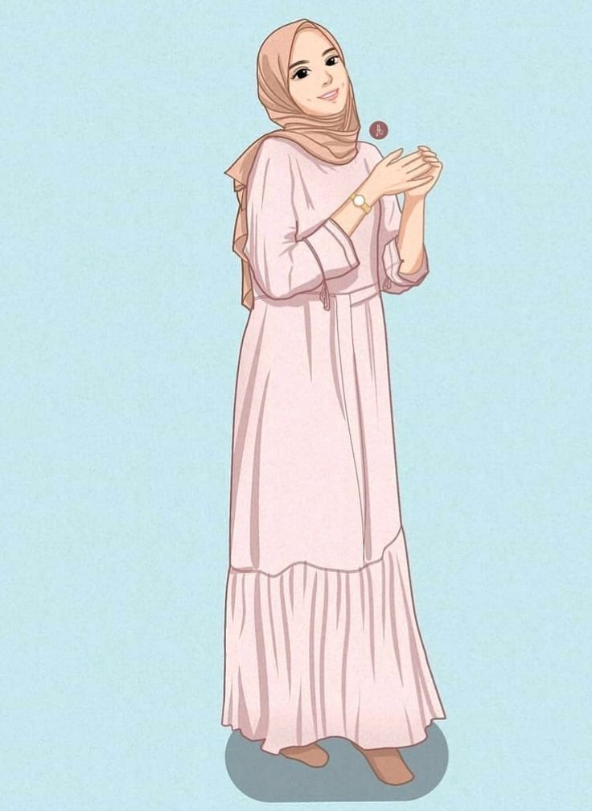
Goodbye, teacher.
Goodbye, students. See you next class.

