Slide 2
Teacher’s identity
Kohinoor Akter
SeniorTeacher
Gojmohal Tannery High School
Dhaka
Mobile Number: 01917598118
E-mail ID: kohinoorakter04@gmail.com

Slide 3
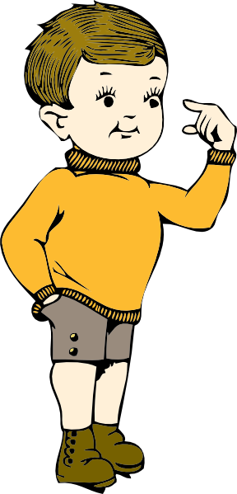
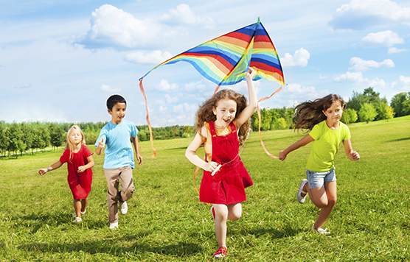
The children are enjoying their time, aren’t they?

Slide 4
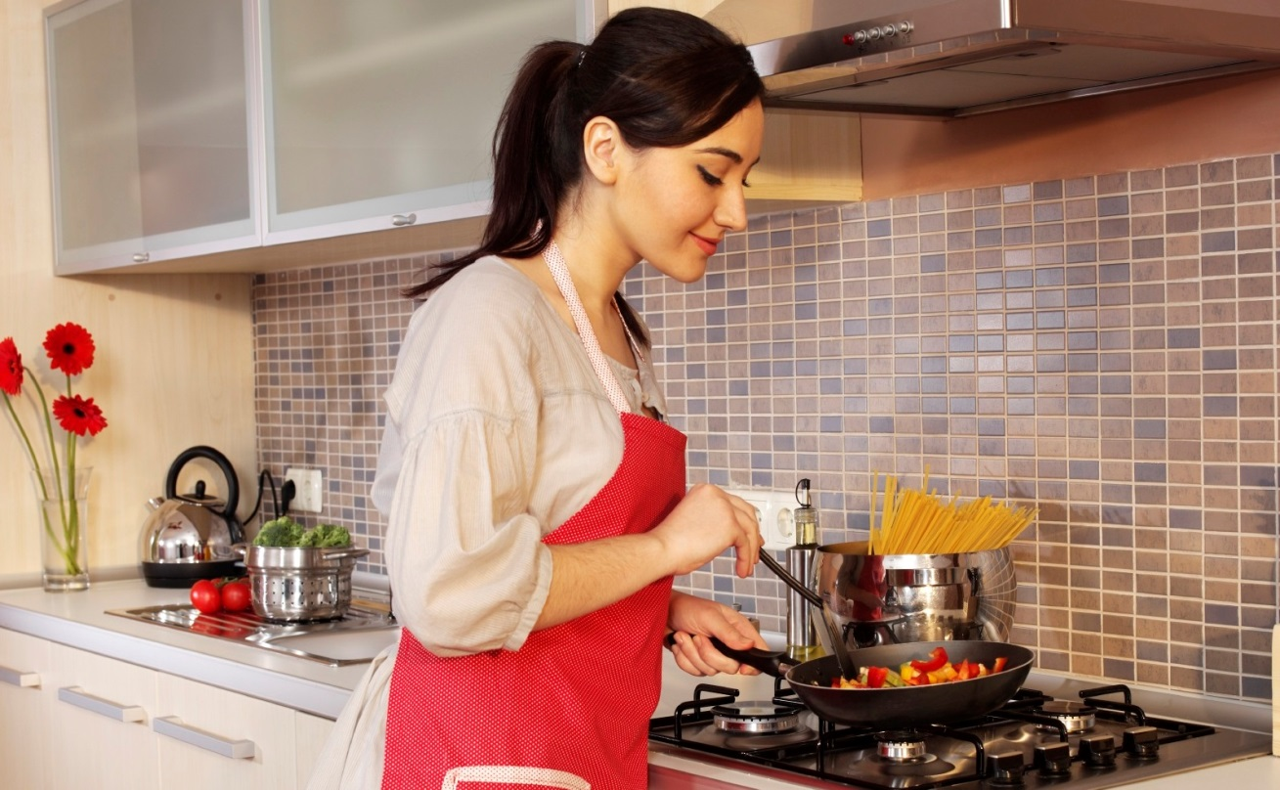
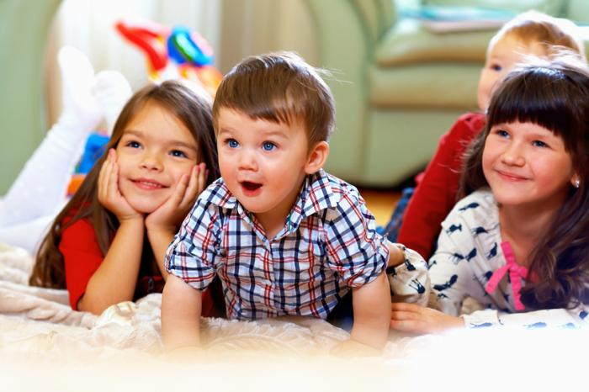
She can cook delicious dishes, can’t she?

Slide 5
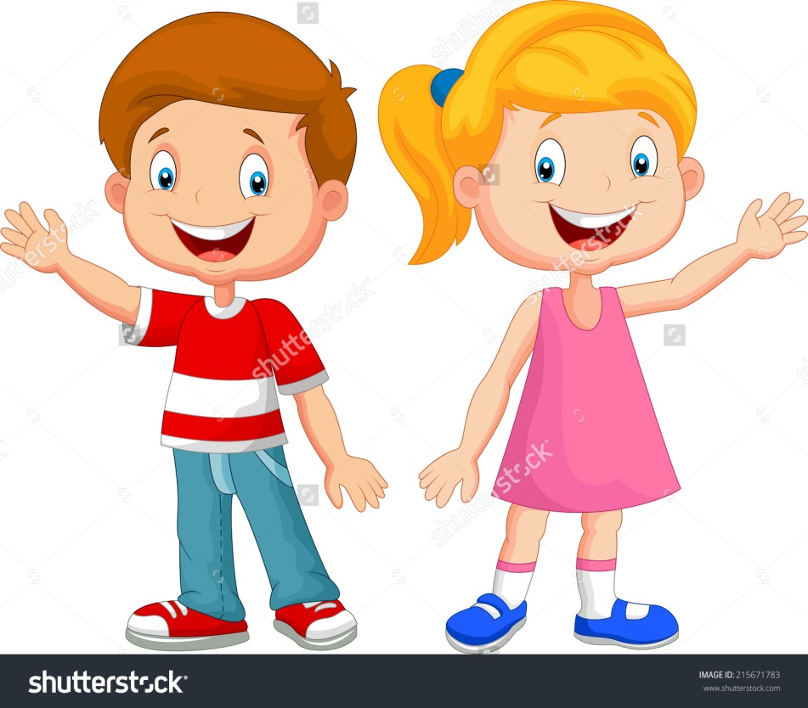
He works very hard, doesn’t he?

Slide 6
Today’s lesson
Tag-question

Slide 7
Objectives
By the end of this lesson,
1. SS will be able to tell the definition of tag-question.
2. SS will be able to tell the use of tag-questions.
3. SS will be able to make different tag-questions.

Slide 8
What is a tag-question?
What
Nasima is intelligent, isn’t she?
A tag-question is a question made by adding a short question/question-tag at the end of an assertive sentence or of an imperative sentence.
Statement
Question-tag
Tag-question
Notes:
Click on the word ‘What’ to get the definition.

Slide 9
QUESTION TAG
A positive statement
A negative question tag
He is a good boy
, isn’t he?

Slide 10
QUESTION TAG
A negative statement
A positive question tag
He was not late
, was he?

Slide 11
Look at the sentences given below and follow the rules of making tag-questions.
rules
Jamal is from Chittagong, isn't he?
Morjina can speak English, can't she?
A positive statement is followed by a negative question tag.
They aren't funny, are they?
He shouldn't say things like that, should he?
A negative statement is followed by a positive question tag.
Notes:
Click on the word ‘rules’ to get the explanation.

Slide 12
QUESTION TAG
If the main part of the sentence is positive (affirmative), the question tag is negative….
 | affirmative | negative
be | I’m late, They are waiting, We were late, | aren’t I? aren’t they? weren’t we?
have | I’ve finished, He’s left, | haven’t I? hasn’t he?
do does did | You like it, It works, You painted it, | don’t you? doesn’t it? didn’t you?
modals | I can see him, | can’t I?

Slide 13
QUESTION TAG
If the main part of the sentence is negative , the question tag is positive (affirmative)….
 | negative | affirmative
be | I’m not late, They aren’t waiting, We weren’t late, | am I? are they? were we?
have | I haven’t finished, He hasn’t left, | have I? has he?
do does did | You don’t like it, It doesn’t work, You didn’t break it, | do you? does it? did you?
modals | I can’t see him, | can I?

Slide 15
Look at the sentences given below and follow the rules of making tag-questions.
rules
You play the guitar, don't you?
Aleya likes tennis, doesn't she?
When the verb in the main sentence is in the present simple we form the question tag with do / does.
They went to the cinema, didn't they?
She studied in Dhaka University, didn't she?
If the verb is in the past simple we use did.
Notes:
Click on the word ‘rules’ to get the explanation.

Slide 16
Uses of tag-questions
Uses
1. Tag-question are mainly used for asking for a confirmation/approval.
2. Sometimes tag-questions made from imperative sentences are used for making a ‘request’ or a ‘proposal’.
Now try to guess the uses of tag-questions
Notes:
Click on the word ‘uses’ to get the explanation.

Slide 17
Rules of tag-questions
Remember that 's = is or has, and ‘d = had or would Peter’s got a cat,_________? She’s in the office,_______?
He’d gone to visit his village,_______?
I’d prefer die to take this,_________?
hasn't he
isn't she
hadn’t he
wouldn’t I

Slide 18
Rules of tag-questions
Question tags with "HAVE" and "DO" are often both possible after the noun–auxiliary "have". Note: "do" is preferred in American English. Mr. Farmer has two cars, hasn't he? Or doesn't he? She has a nice kitten, hasn't she? Or doesn't she? You haven’t a house, have you? Do you? They have a garden, haven’t they? Or don’t they?

Slide 19
Rules of tag-questions
If the statement contains words such as no, no one, nothing, rare, no sooner, few, little, nobody, scarcely, hardly, hardly ever, never, neither, seldom, under no circumstances… etc, it is considered a negative statement and followed by an affirmative tag. Julia hardly ever drinks coke, does she? Nothing will cure his illness, will it? He never acts like a gentleman, does he? She is hardly the right person for the job, is she? It is no good, is it?

Slide 20
Rules of tag-questions
If the subject of the statement is somebody, anybody, nobody, everybody, no one, and neither …. We use the pronoun “they” in question tag. Somebody entered the garden, didn't they? Everybody was upset, weren't they? Nobody objects to the plan, do they?

Slide 21
Rules of tag-questions
When the subject of the statement is that or this, the pronoun in the tag is "it". The pronoun is "they" for their plural forms these and those. This is an expensive necklace, isn't it? Those are very naughty children, aren't they? That wasn't a big surprise, was it? These weren't yours, were they?

Slide 22
Rules of tag-questions
When we use a there + be combination in a sentence the pronoun in the tag is again "there". There isn't a hotel next to the museum, is there? There won’t be any trouble, will there? There is a bus to Atlantic City every hour, isn't there? There weren't any children at school, were there?

Slide 23
Rules of tag-questions
Let’s has the tag "shall we?" Let’s go to the movie theater, shall we? Let us drink tea, shall we? Let’s go out for a walk, shall we?
but,
Let me /Let him /Let them do the work, will you? [Request]

Slide 24
Rules of tag-questions
“Have to” is considered Simple Present and “had to” is considered Simple Past. Your father has to wear glasses, doesn't he? They don’t have to come early, do they? We had to borrow some money to buy a new house, didn't we? They didn't have to read the story book, did they?

Slide 25
Rules of tag-questions
When main verb is Have, Has, Need, you should use do/does as auxiliary verb in present tense and did in Past Tense.
He has some books, doesn’t he? (Has is the main verb in present tense)
but, He has finished the task, hasn’t he? (Has is the auxiliary verb in present perfect tense)
He had some books, didn’t he? (Had is the main verb in past tense)
but, He had finished the task, hadn’t he? (Had is the auxiliary verb in past perfect tense)
I need a pencil to write with, don’t I? (Need is the main verb)
You need to wait for an hour, needn’t you? (Need is auxiliary verb)

Slide 26
Rules of tag-questions
Some introductory phrases such as “I am afraid, I think, I believe, I am sure, I suspect, I suppose , it appears that , it seems that , it looks as if , as far as I remember , as far as I can see … so on “ don’t affect question tags except for the transfer of negation . I suppose you are not serious, are you? I think my mom returned home, didn't she? I don’t suppose you are serious, are you? I don’t believe you have paid for it yet, have you? I don’t think anyone will volunteer, will they? I hope he won’t object to our plan, will he? It appears that she is enjoying herself, isn't she? As far as I can see, Hasan is the best, isn't he?

Slide 27
Rules of tag-questions
If the subject of the sentence is everything, nothing, something, anything the pronoun in the tag is "it". Everything is ready, isn't it? Nothing has the end, has it? Anything is possible, isn't it?

Slide 28
Group work
Group
(a) Nothing is impossible, ——–?
(b) The idle always lag behind, ——–?
(c) Motivation seldom goes in vain, ——–?
(d) You studied hard, ——–?
(e) Let us start our journey, ——–?
(f) There is nothing for her to eat, ——–?
(g) Bangladesh is our motherland, ——–?
(h) Everybody loves flower, ——–?
(i) He has few reasons for waiting, ——–?
(j) We ought to love our motherland, ——–?
(a) Nothing is impossible, is it?
(b) The idle always lag behind, don’t they?
(c) Motivation seldom goes in vain, does it?
(d) You studied hard, didn’t you?
(e) Let us start our journey, shall we?
(f) There is nothing for her to eat, is there?
(g) Bangladesh is our motherland, isn’t she?
(h) Everybody loves flower, don’t they?
(i) He has few reasons for waiting, hasn’t he?
(j) We ought to love our motherland, oughtn’t we?
Notes:
Click on the word ‘Group’ to get the correct answers.

Slide 29
Evaluating questions
(i) When do we use ‘do/does’ for making question-tags?
(ii) When do we use ‘did’ for making question-tags?

Slide 30
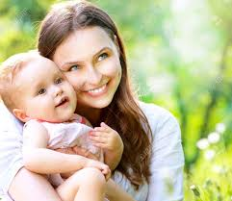
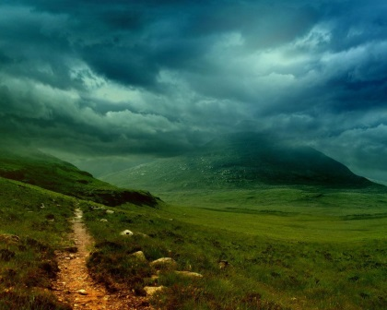
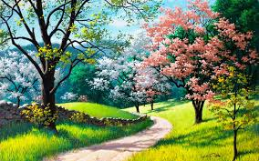
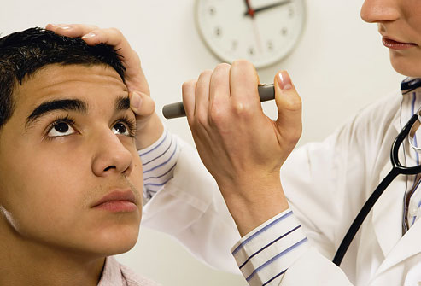
Every mother loves her child._________?
Nobody is so fast as she,_________?
It may rain now,_________?
aren't they
are they
mayn’t it
The doctor helps the patient,__________?
doesn’t he
Let’s solve the problem,________?
shall we
How nice the scenery is ,_________?
Let me examine your eyes ,_________?
isn’t it
will you
Moni didn’t play well,_________?
did she

Slide 31
Homework
Make a list of the verbs which are used in making question-tags.

Slide 32
See you again.

