Slide 1
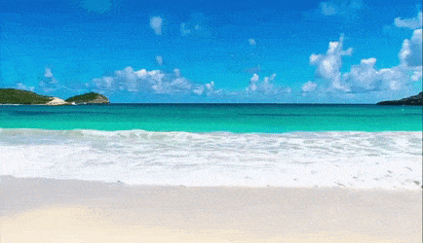
Welcome

Slide 2
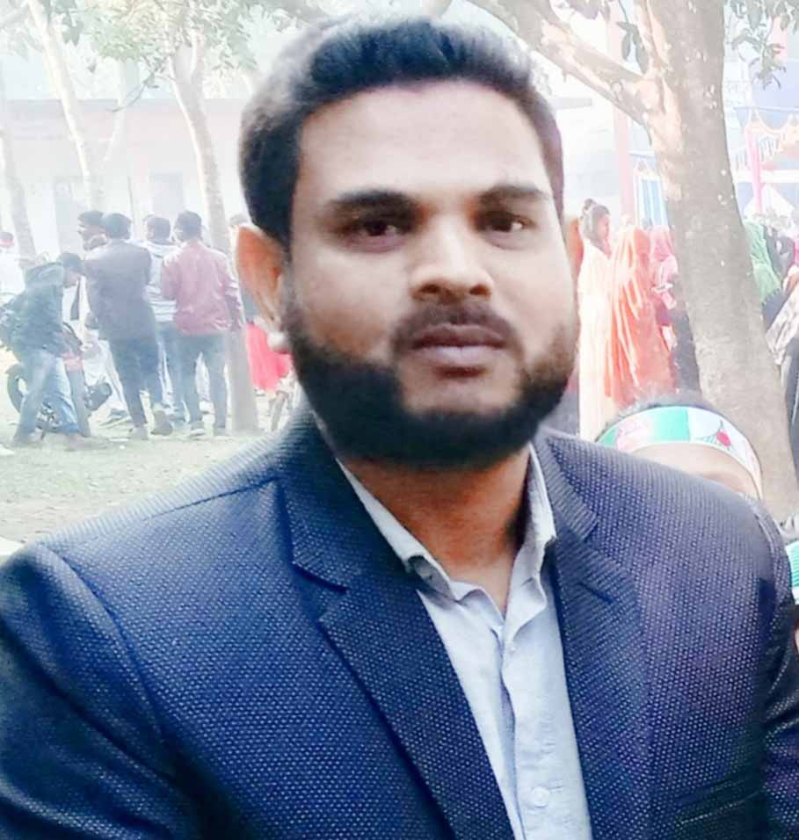
Presented By
Md.Hafizur Rahman
Assistant Teacher
Haripur Government Primary School
Haripur , Thakurgaon .
Phone: 01716437086
Email:hafizict5@gmail.com

Slide 3
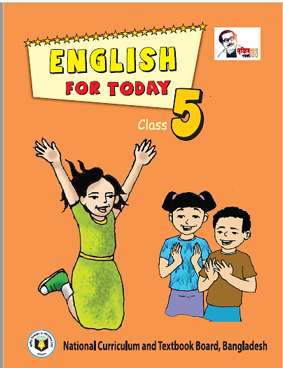
Lesson Identity
Subject : English
Class: Five
Time: 40 minutes
Date: 24-06-2022

Slide 4
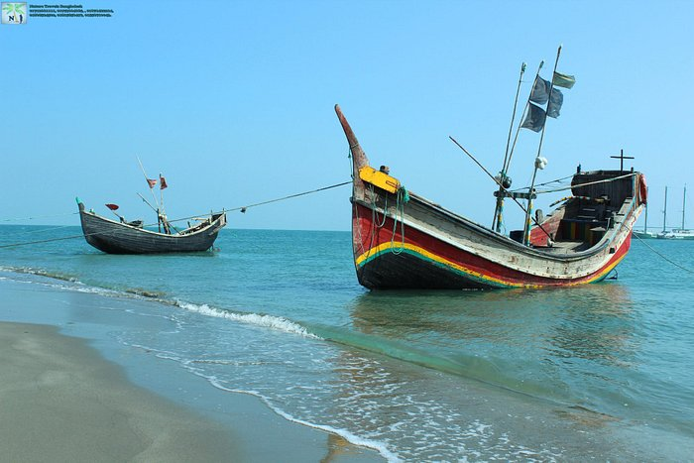
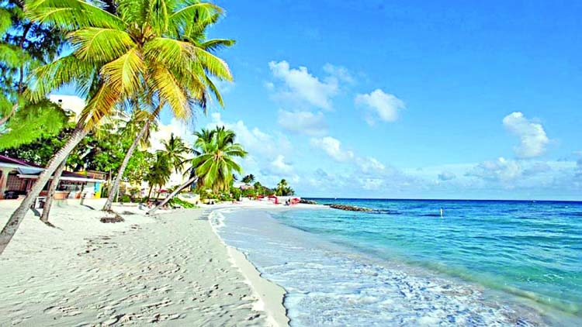
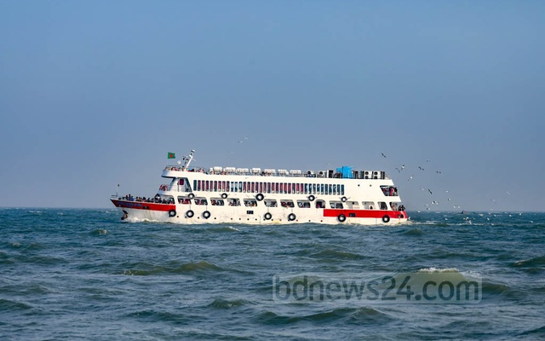
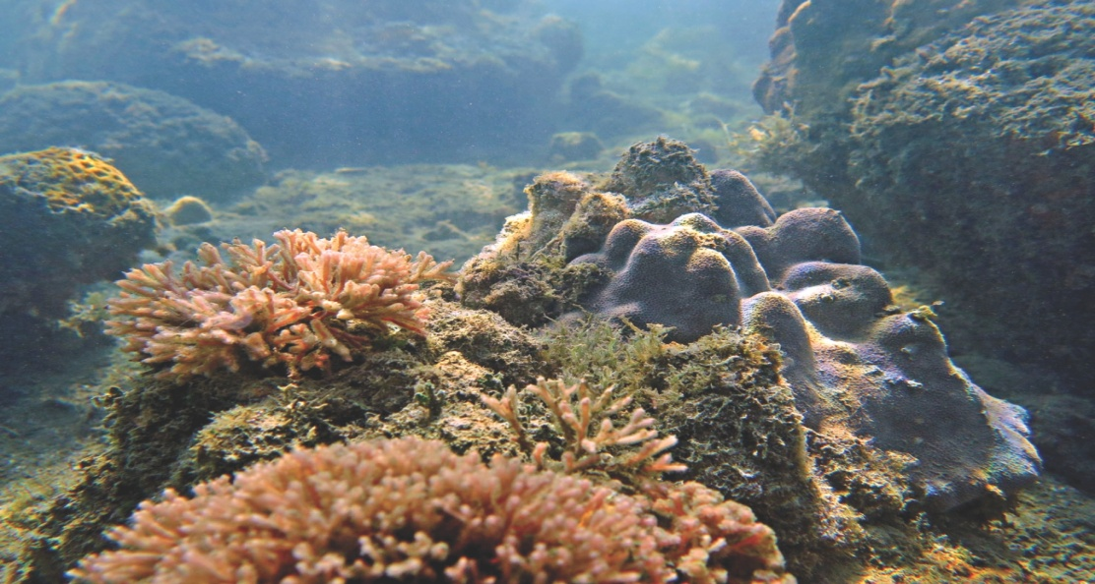
Dear Student , Let’s see some picture?
What can you see in the picture?
Sea boat
Sea beach
Sea truck
coral

Slide 5
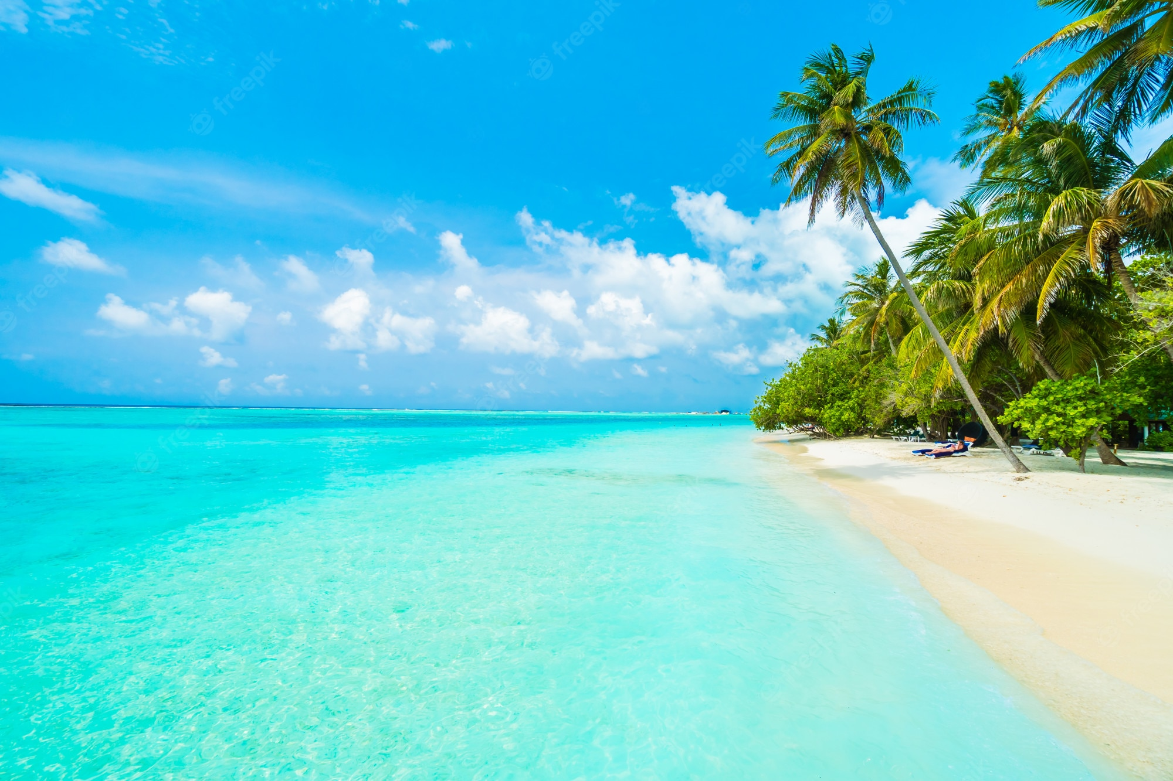
Today lesson
How Far is Saint Martin’s
Unit: 12
Lesson: 1( Andy : Hi-----special place)
Page No. 46

Slide 6
Learning Outcomes
By end of the lesson student will be able to
Listening:
1.3.1- recognize which words in a sentence are stressed
3.4.1- understand statements made by the teacher and student.
Speaking
1.1.1: Say words, phrases and sentences with proper sound and stress.
3.2.1- understand questions about family and friends of students.
Reading
1.6.1- recognize and read statements, commands, greetings, questions and answers.
I .5.1- read silently with understanding text

Slide 7
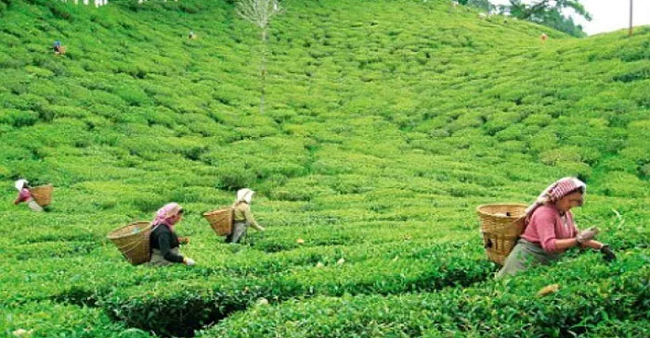
Some new word’s of the lesson.
Tea garden
Plot of tea ground.
.
চা বাগান
last month , I have visited a tea garden .

Slide 8
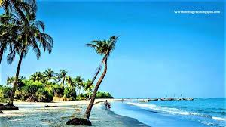
Some new word’s of the lesson.
Saint Martin
Name of an Island in Bangladesh.
সেন্ট মার্টিন দ্বীপ
Saint martin island is only coral island in Bangladesh.

Slide 9
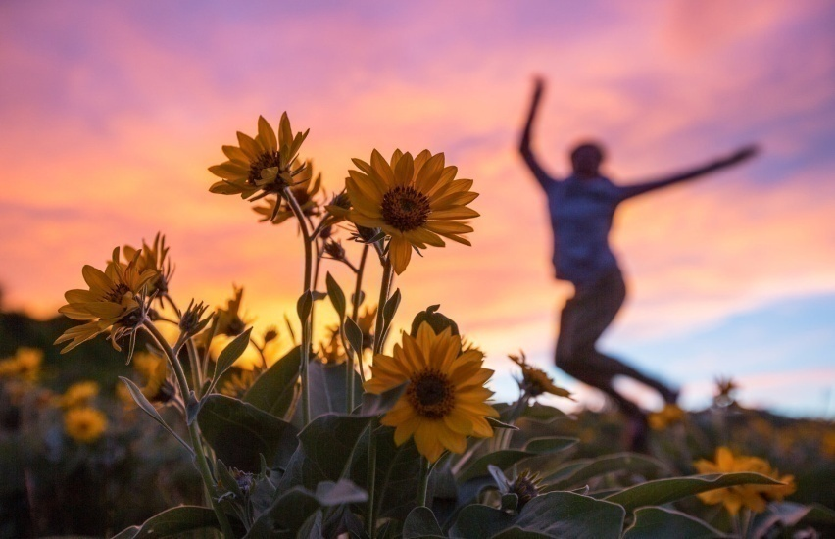
Some new word’s of the lesson.
Wonderful
marvelous
চমৎকার
There are many wonderful places in Bangladesh

Slide 10
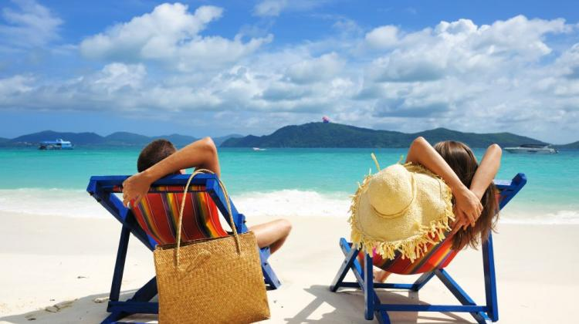
Some new word’s of the lesson.
Tourist
traveler
পর্যটক
Saint martin Island is a nice tourist spot in Bangladesh.

Slide 11
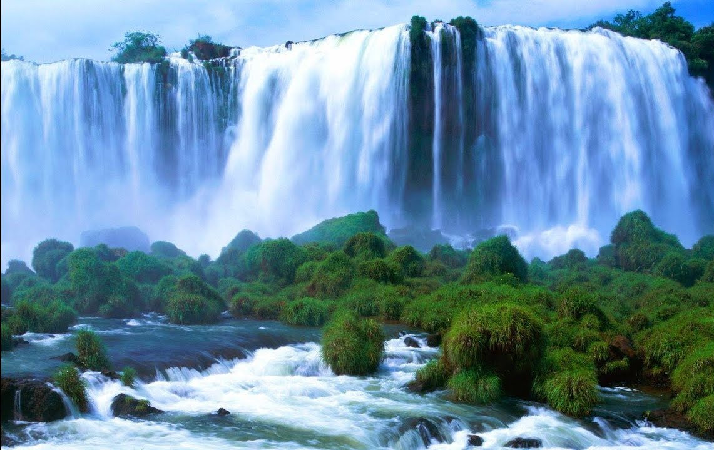
Some new word’s of the lesson.
a cascade of water falling from a height
Waterfall
ঝরনা
There are some wonderful waterfalls in Madhabkundu

Slide 12
Some new word’s of the lesson.
Spot
A place
জায়গা
Cox’s Bazar is a tourist spot.

Slide 13
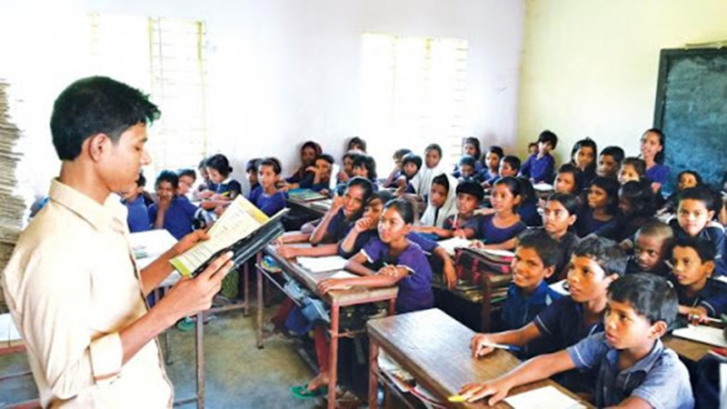
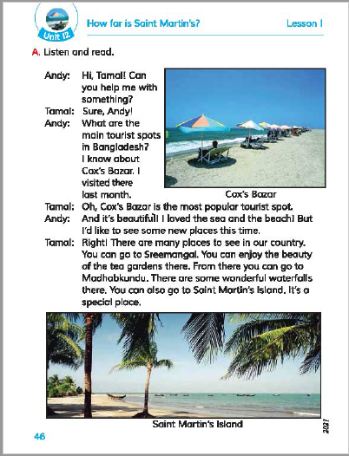
Teacher speaking loudly
Open your book and turn to page 46

Slide 14
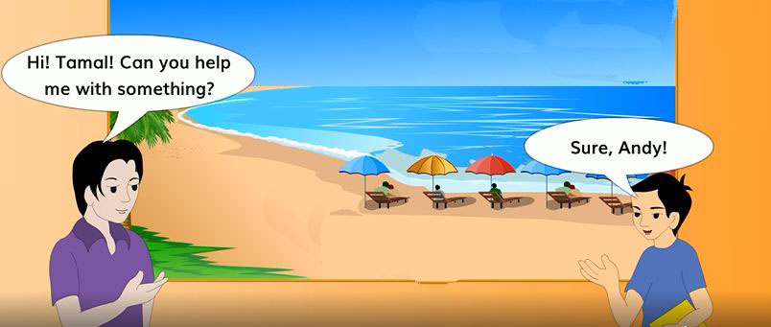

Slide 17
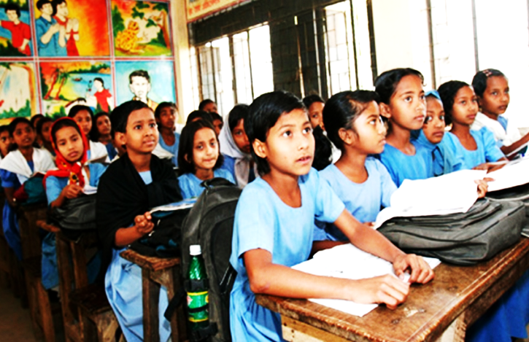
Students reading loudly

Slide 18
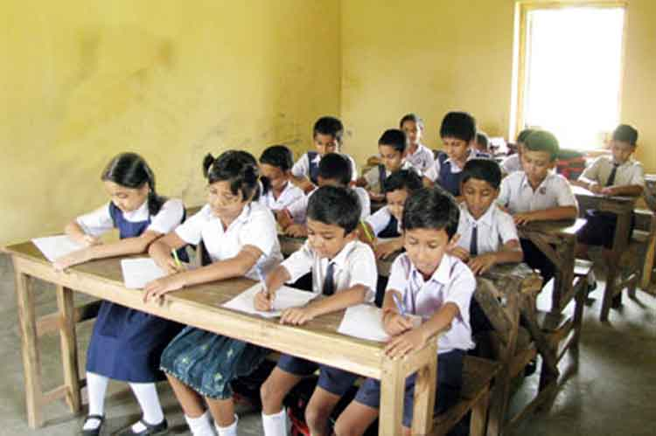
Students silent reading

Slide 19
Individual work
True or False
True
a) Saint Martin is an island.
True
b) You can see coral in different shape and color in Saint Martin .
True
c) This island is in the Bay of Bengal.
False
d) Andy visited Cox’s Bazar 2 years ago.
False
e) There are some waterfalls in Cox’s bazar.

Slide 20
Pair work
Fill in the blanks.
special
special
tourist
wonderful
like
tourist
wonderful
like
visited
visited
a. I’d ---------- to see some new places .
B. There are some ------------ waterfalls there.
c. I----------- there last month.
d. Cox’s Bazar is the most popular ----------- spot.
e. It’s a -------------- place.

Slide 21
Group work
Match the words of the column A with their meanings in column B
Column-A | Column-B
Exciting | i). a person who is travelling or visiting a place for pleasure
b. Tourist | iv) a tea plantation
c. Coral | V ) Sea beach
d. Wonderful | vi) a beach lying along the sea.
e. Tea Garden | vii) marvelous
 | ii) causing great enthusiasm
 | Iii) a hard stony substance on the sea

Slide 22
Evaluation
Ques:1. What tourist places does Tamal tell Andy about?
Ans: Tamal tells Andy about Cox’s Bazar, Sreemangal, Madhabkundu and Saint Martin’s Island..
Ques:2.What is the name of the Island Tamal tells Andy about?
Ans: The name of the island Tamal tells Andy about is Saint Martin’s Island.
Ques:3.Where is this island?
Ans: This island is in the Bay of Bengal.
Ques:4.What can you see on this island?
Ans: I can see coral in different shape and color .

Slide 23
One day one word
exciting
উত্তেজনাপূর্ণ
sentence making
one of the most exciting matches I've ever seen.

Slide 24
Home Task
Write five sentence about “main tourist spot of Bangladesh ”

Slide 25
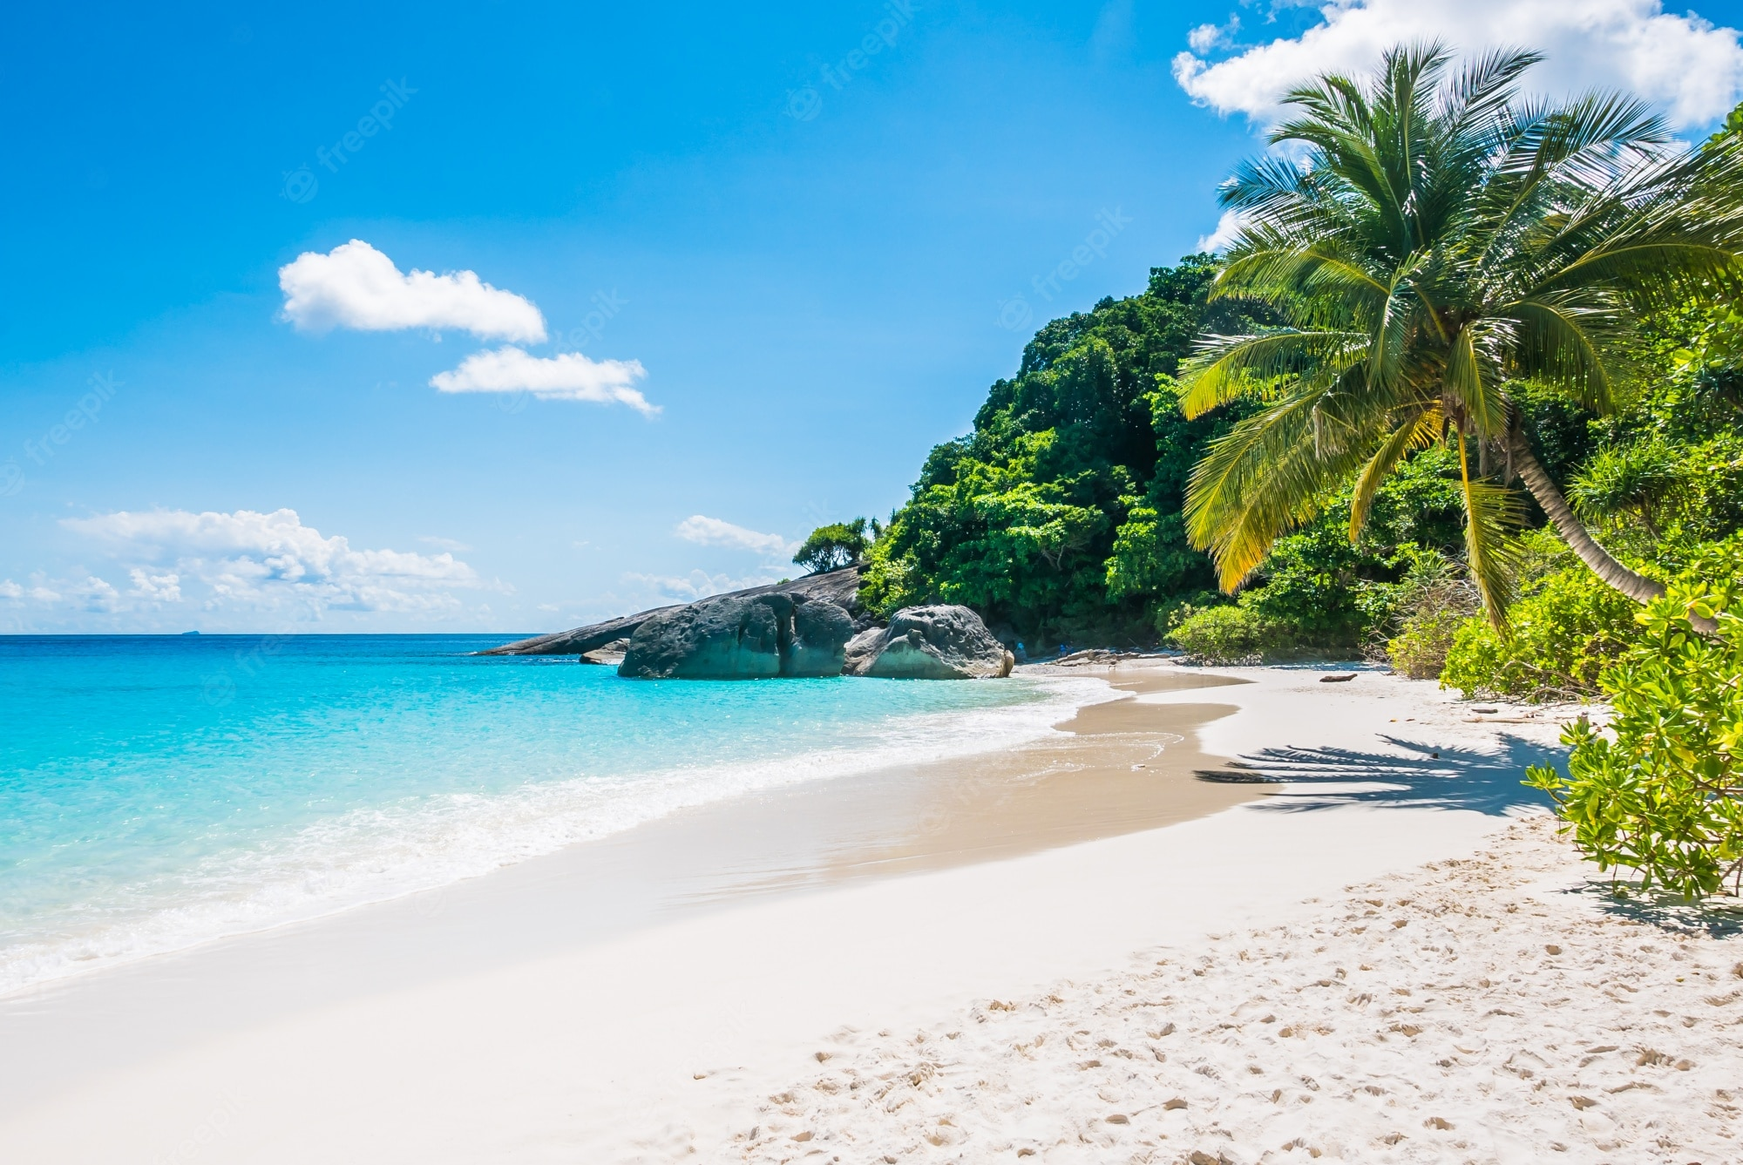
Good Bye
See you….

