Slide 1
W
E
L
C
O
M
E

Slide 2
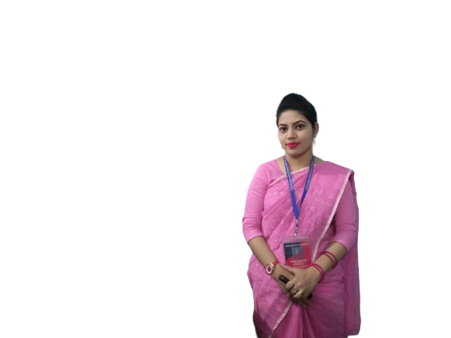
Teacher’s Identity
ASMA KHANOM
ASSISTANT TEACHER
KALACHANDPUR GPS SADAR,NOAKHALI

Slide 3
LESSON
INTRODUCTION
Class-Four
Subject-English
Unit-20
Lesson:1-2

Slide 4
Let’s sing a food song

Slide 5
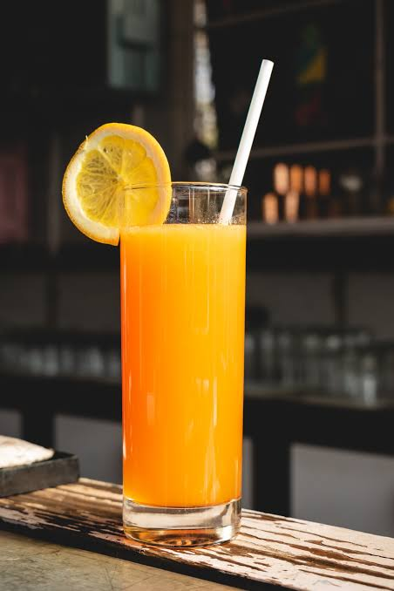
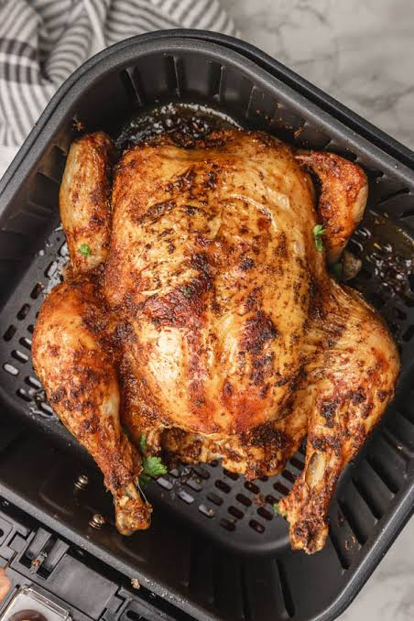
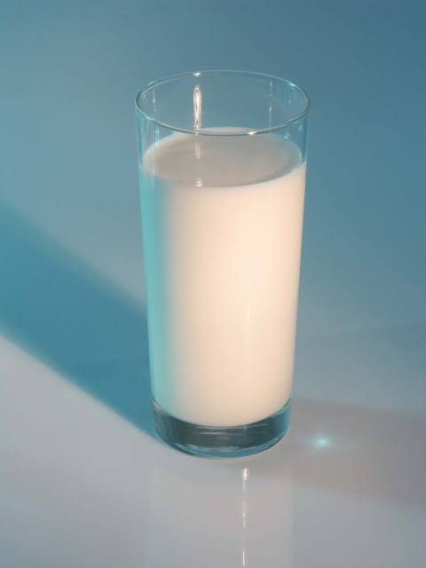
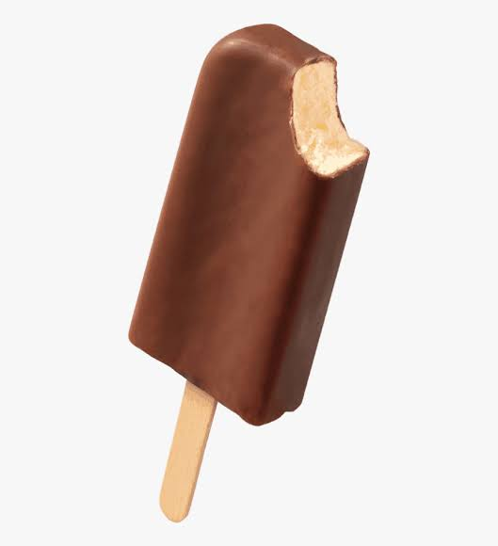
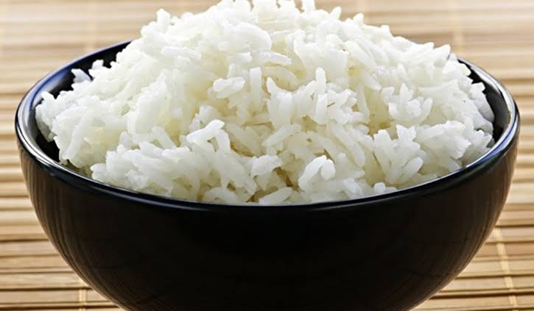
What do you see in the pictures?
Ice cream
Juice
Chicken
Milk
These are food and meals
Rice

Slide 6
The name of our lesson is
Food and Meals

Slide 7
Learning outcomes:
Listening
3.3.1 understand questions about objects around them.
Speaking
8.1.1 take part in conversations on simple topics(likes/dislikes,hobbies,holidays,family,friends,etc)
Reading
1.7.1 read short paragraphs,dialogues and simple letters.

Slide 8
Look,listen and say

Slide 9
Look,listen and say

Slide 10
Look,listen and say

Slide 11
Look,listen and say

Slide 12
Look,listen and say

Slide 13
Look,listen and say

Slide 14
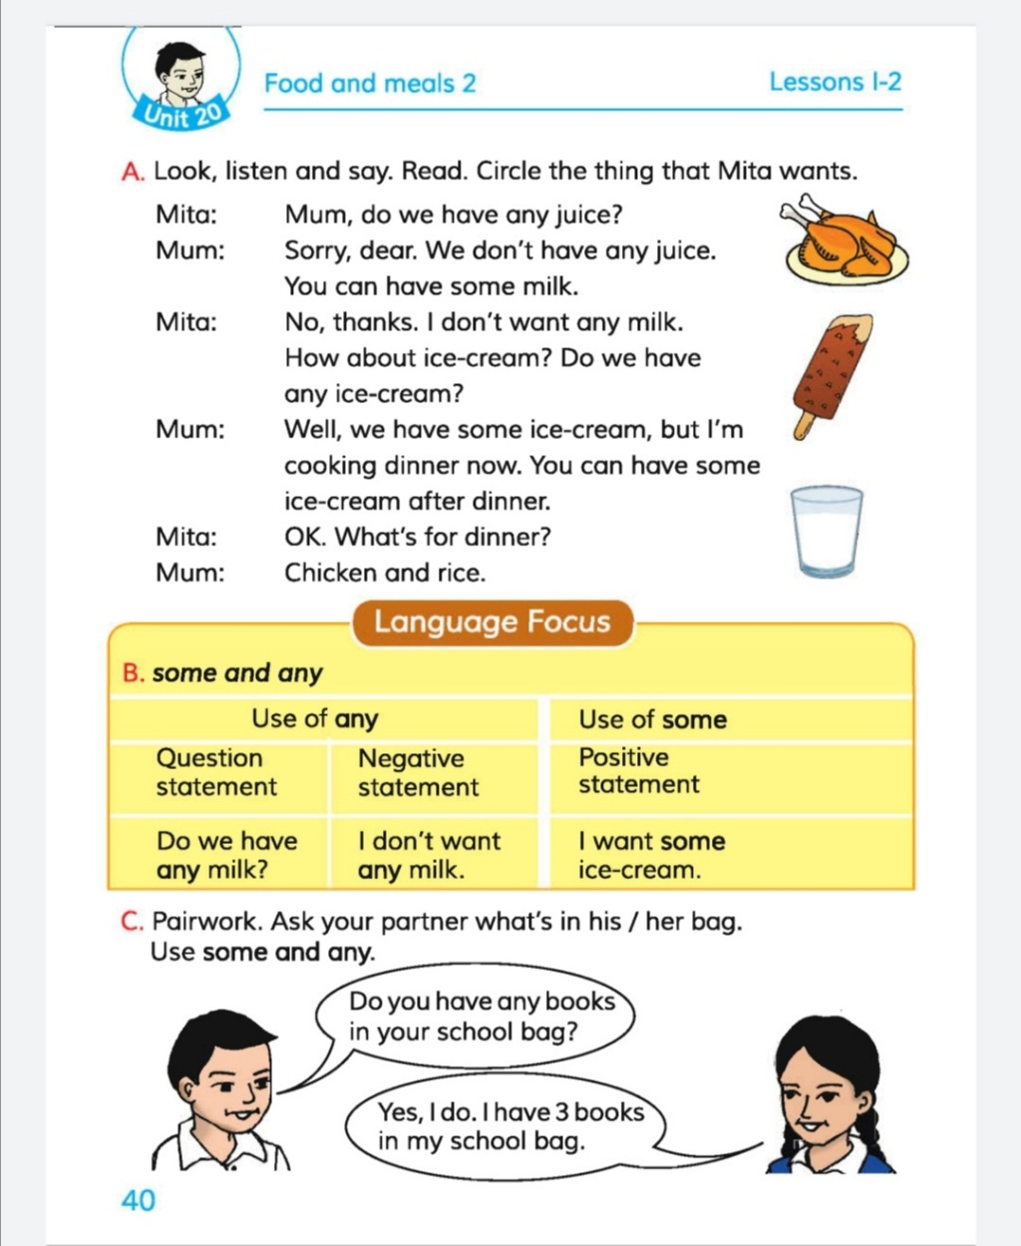
Open your book
Page no-40

Slide 15
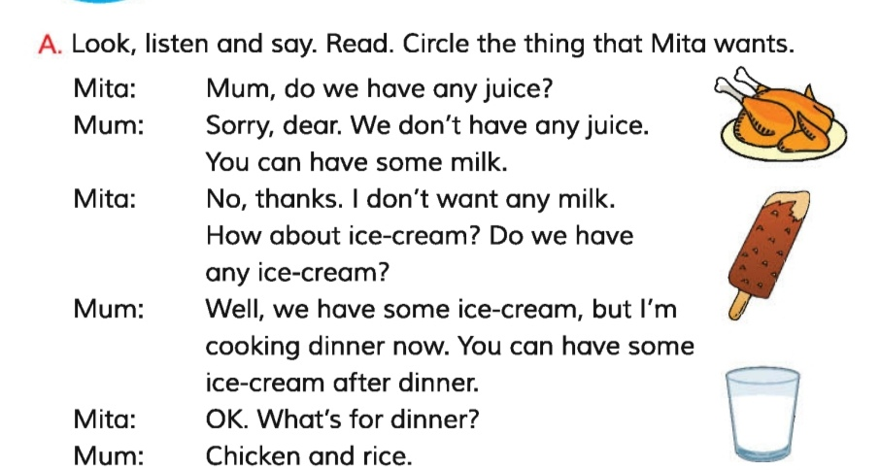

Slide 16
Group Work
Group A
Group B
Act the dialogue in groups.

Slide 17
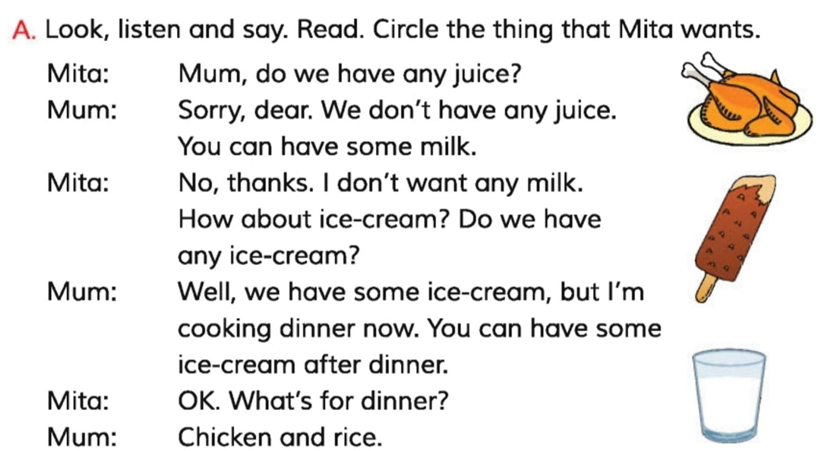
Circle the thing that mita wants
Pair Work

Slide 18
Evaluation
Answer the questions.
1.What does Mita want to her mother?
2.What does Mita get from her mother?
3.What’s for dinner?

Slide 19
Let’s check the answer
1. What does Mita want to her mother?
Ans: Mita wants some juice and ice-cream to her mother.
2. What does Mita get from her mum?
Ans: Mita gets ice-cream from her mum.
3. What’s for dinner?
Ans: Chicken and rice.

Slide 20
Homework
Write some foods that are mentioned in the dialogue.

