Slide 1
Welcome to my
English Class

Slide 2
Presented By:
Md. Shafiul Alam
Asst. Teacher Bazitkhila Govt. Primary School
SHERPUR SADAR, SHERPUR.

Slide 3
Subject: English
Class: Four
Unit: 3
Lesson: 1-3 ,Activity-B

Slide 4
Learning outcomes:
Reading:
1.5.1 read words, phrases and sentences in the text with proper pronunciation, stress and intonation.
1.7.1 read short paragraphs, dialogues and simple letters.
Writing:
Write short paragraphs about familly.

Slide 5
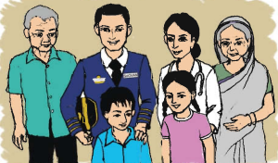
Let’s see the pictures-

Slide 6
What are these pictures?
Family
Father, mother, sister and brother usually make a family. Grandmother and grandfather also live with us. They are also a part of the family.
Whom do you live with us?

Slide 7
Todays lessons is –
Family
Lesson- 1-3

Slide 8
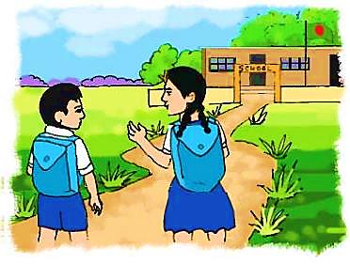
What can you see in the picture?
A boy and a girl are going to school.

Slide 9
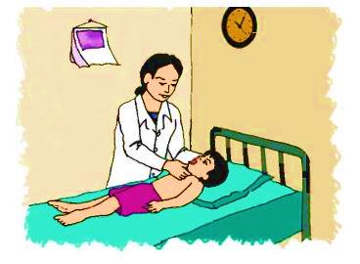
What can you see in the picture?
A doctor is taking care of a patient.

Slide 10
Physician
Doctor
My father is a doctor.
Take care
Look after
She takes care of my health.

Slide 11
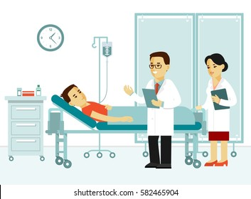
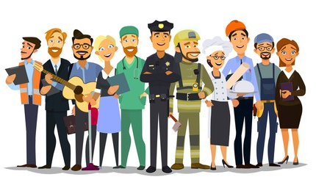
Patient
A sick person.
She takes care of many patients everyday .
Job
Employ
She likes her job very much.

Slide 12
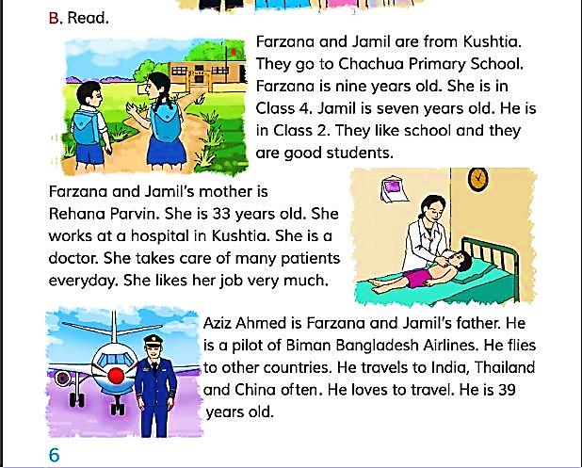
Let’s read the text

Slide 13
Look and say
Farzana and Jamil are from Kushtia. They go to Chachua Government Primary School. Farzana is nine years old. She is in class 4. Jamil is seven years old. He is in class 2. They like school and they are good students.

Slide 14
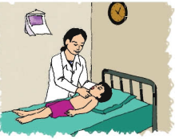
Look and say
Farzana and Jamil’s mother is Rehana Parvin. She is 33 years old. She works at a hospital in Kushtia. She is a doctor. She takes care of many patients everyday. She likes her job very much.

Slide 15
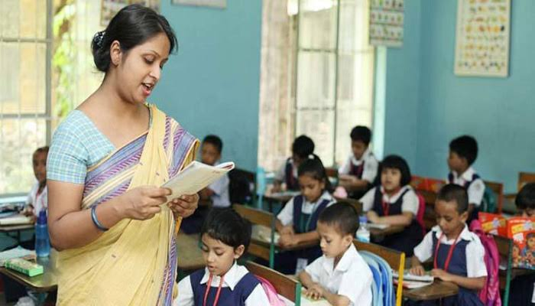
Teacher’s Reading

Slide 16
Group / pair Reading
Individual reading

Slide 17
Evaluation
Answer the following questions
Where are Farzana and Jamil from?
How old is Jamil?
Why does she work at a hospital in Kushtia?
d.What is the passage about?

Slide 18
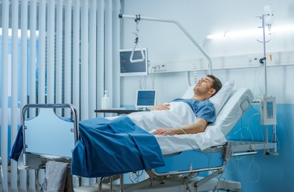
One day one word
Patient
রোগী

Slide 19
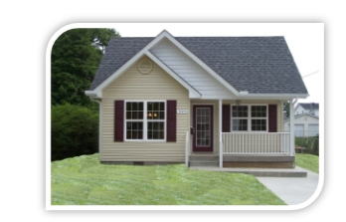
Home work
Write 5 sentences about your family.

Slide 20
Goodbye

